Slide 1
Estimating the Undiagnosed Fraction:
The “Testing History” Method of Backcalculation
Martina, Jeanette & Deven
Notes:
Update on this project about …
Notes: just 4 slides on backcalculation

Slide 2
How we are using backcalculation

Slide 3
Backcalculation: basic idea
10 diagnoses observed
New diagnoses in 2014…
2014
2013
2012
2011
2010
Time
3 infections
3 infections
2 infections
1 infection
1 infection
…are based on infections that occurred in the past

Slide 4
Time from Infection to Diagnosis (TID)
10 diagnoses observed
Each case has a time from infection to diagnosis
2014
2013
2012
2011
2010
Time
3 infection
3 infection
2 infections
1 infections
1 infections
TID = 0 yrs
TID = 1 yrs
TID = 2 yrs
TID = 3 yr
TID = 4 yrs

Slide 5
TID probability distribution
This gives the probability of diagnosis by year
Percent of cases
Years from infection to diagnosis
30% 30% 20% 10% 10%
3 infections
3 infections
2 infections
1 infection
1 infection
TID = 0 yrs
TID = 1 yrs
TID = 2 yrs
TID = 3 yrs
TID = 4 yrs

Slide 6
Backcalculation’s 3 Components
OBSERVE
BACKCALCULATE
ESTIMATE
Sum ( * )
Cases diagnosed at T
Incidence X yrs ago
TID
probability for X yrs ago
=

Slide 7
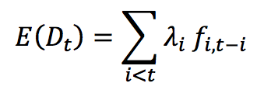

i.e., Convolution

Slide 8
Estimating TID (f_{i,t-i})

Slide 9
TID from Testing History
Infection window = [Start date, Date of diagnosis]
1) Get date of last negative test
“When was your last negative HIV test?”
Previous test exists
No previous test
Missing
Start date = date provided
Start date = age 16 or age-18 yrs
2 data inclusion options
First key assumption
Second key assumption
Third key assumption
2) Assign time of infection within the infection window

Slide 10
1st key assumption: If no previous test
We set the start date of the possible infection window to a maximum value
Either:
18 years ago OR
Age 16, as the earliest age of infection
IMPACT: This gives a conservative (longer) estimate of the time spent undiagnosed

Slide 11
2nd key assumption: If missing test data
Two options:
Exclude these when estimating the TID distribution
They are still included in the backcalculation
IMPACT: Assumes these cases are “missing at random”
Include these when estimating the TID distribution
Assuming the maximum possible infection window of age-18 or 16 yrs old.
IMPACT: Assumes “worst case”, so a conservative (longer) estimate of the time spent undiagnosed.

Slide 12
3rd key assumption: Time of infection
Uniform:
Distributes the probability of infection uniformly across the possible interval
UNIFORM
Pr(infection)
Last neg test
Diagnosis
At last neg test (ALNT):
Probability=1 that infection occurred on the day after the last negative test
AT LAST NEG TEST
Pr(infection)
Last neg test
Diagnosis

Slide 13
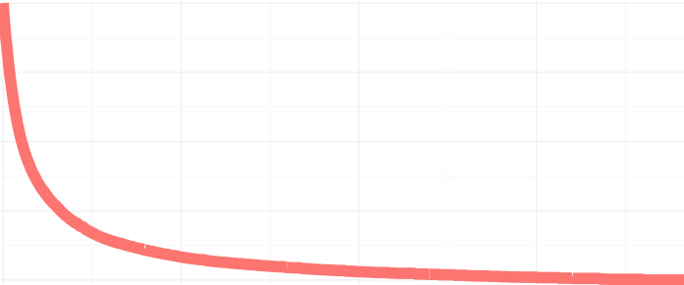
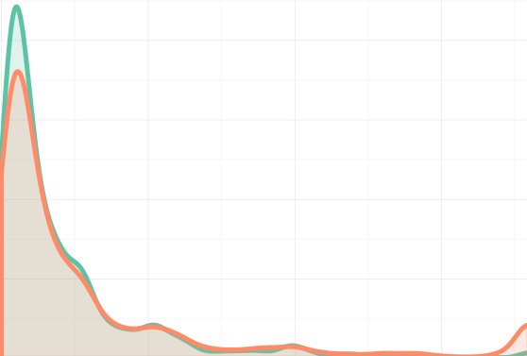

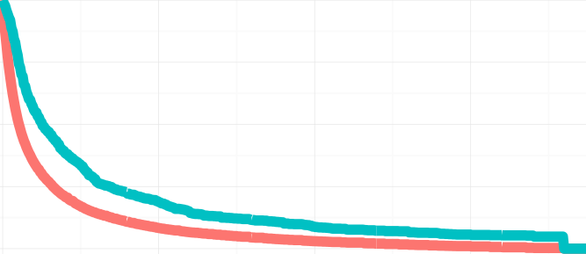
Impact of TID Assumptions on TID
OBSERVED ONLY
UNIFORM
“BASE CASE”
Pr(infection)
% undiagnosed
Density of last negative tests
Last neg test
Diagnosis
18 years
AT LAST NEG TEST
“WORST CASE (OBS)”
0 years
18 years
Pr(infection)
% undiagnosed
We use this for the KC analysis
Last neg test
Diagnosis
18 years

Slide 14
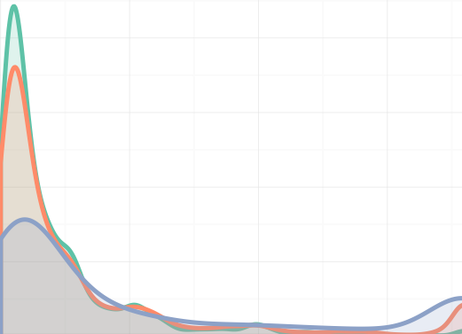

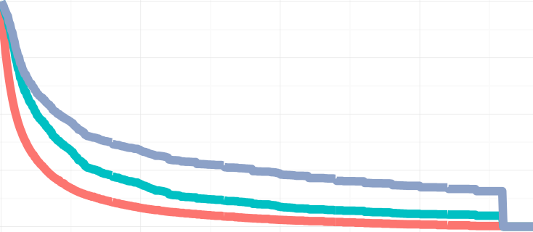
OBSERVED ONLY
UNIFORM
“BASE CASE”
Pr(infection)
% undiagnosed
Density of last negative tests
Last neg test
Diagnosis
18 years
AT LAST NEG TEST
“WORST CASE (OBS)”
Pr(infection)
% undiagnosed
0 years
18 years
We use this for the WA state analysis
Last neg test
DIagnosis
18 years
INCLUDING MISSING
AT LAST NEG TEST
“WORST CASE (MISS)”
Density of last negative tests
Pr(infection)
% undiagnosed
Last neg test
Diagnosis
18 years
0 years
18 years

Slide 15
Suggestions

Slide 16
Rshiny portal
Technical issues
Risk-based testing scenario

Slide 17
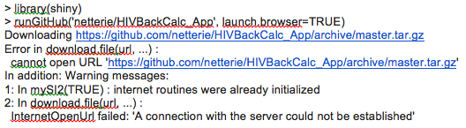
Technical Issues
Simply storing files – don’t do on GitHub?
Browser vs in-RStudio launches give different errors
If there’s a Shiny package update, code stops working (progress bar)
Availability of shiny package versions is occasionally different for Mac and Windows
R-internet access on an older Windows laptop (32bit)

Slide 18
Risk-Based Testing
Goal: Find a more optimistic assumption than the base case that is data-driven
UNIFORM ASSUMPTION
“BASE CASE” TID
% undiagnosed
Pr(infection)
Last neg test
Diagnosis
18 years

Slide 19
Requirements
1. Data-driven input is simple
% of HIV+ diagnoses that are a result of risk-based testing
“Risk-based testing” = infection occurs in same quarter as diagnosis

Slide 20
Requirements
2. Translation to TID function makes sense regardless of the infection window length
It is just important to keep in mind that the data will have a range of infection windows, so if we want a hard rule like, 50% probability of infection in 1st quarter, what about infection windows that are <1 quarter long?

Slide 21
Requirements
3. Translation to TID function is defensible but requires few additional assumptions
What assumptions does the approach make about the mix of risk-based testers and regular testers?

Slide 22
Example: exponential infection
Pr(infection)
Last neg test
Diagnosis
(Map window length to exponential probability using inverse transform sampling)

Slide 23
Example: exponential infection
Legend | Infection probability | % infected in qtr of diagnosis
Black | At last negative test | 9%
Blue | Uniform (Exponential, lambda=1) | 31%
Orange | Exponential, lambda=5 | 59%

Slide 24
Applications: 1. MSM in Seattle/King County 2006-12 2. WA state, 2005-13

Slide 25
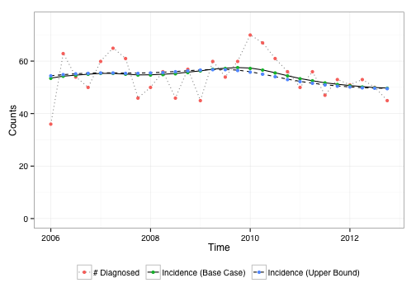
KC MSM: Incidence ~ Constant
15% missing testing history
Uniform TID
ALNT TID
Notes:
Fairly constant incidence…precede by % missing by race

Slide 26


KC MSM: Undiagnosed % Varies by Race
ALNT TID
Uniform TID

Slide 27
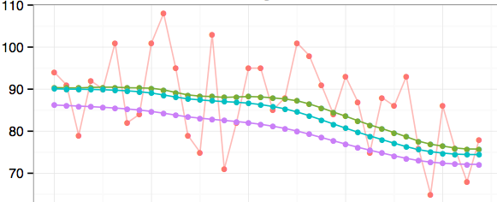



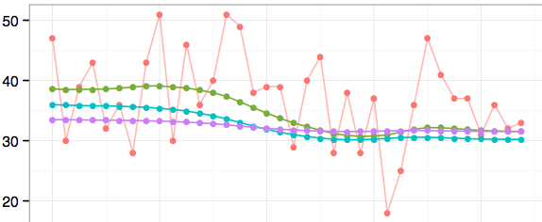

WA: Incidence is declining, esp. for MSM
MSM
35% missing
Number of cases
Uniform TID
ALNT TID, excl miss
Hetero
ALNT TID, inc miss
60% missing

Slide 28
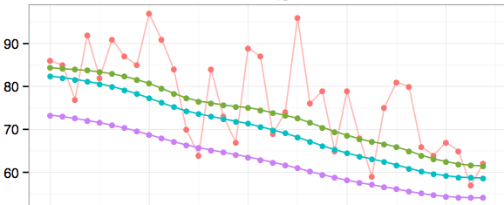
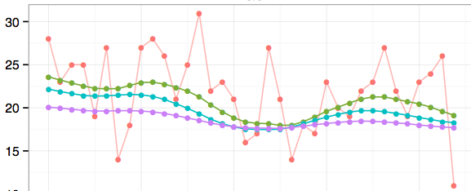
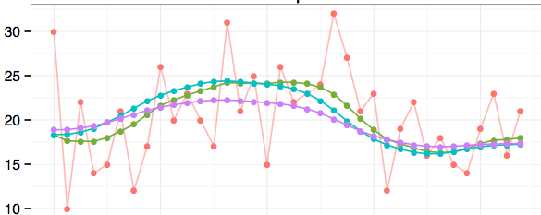

White
40% missing
Black
49% missing
Uniform TID
ALNT TID, excl miss
ALNT TID, inc miss
Hispanic
48% missing

Slide 29
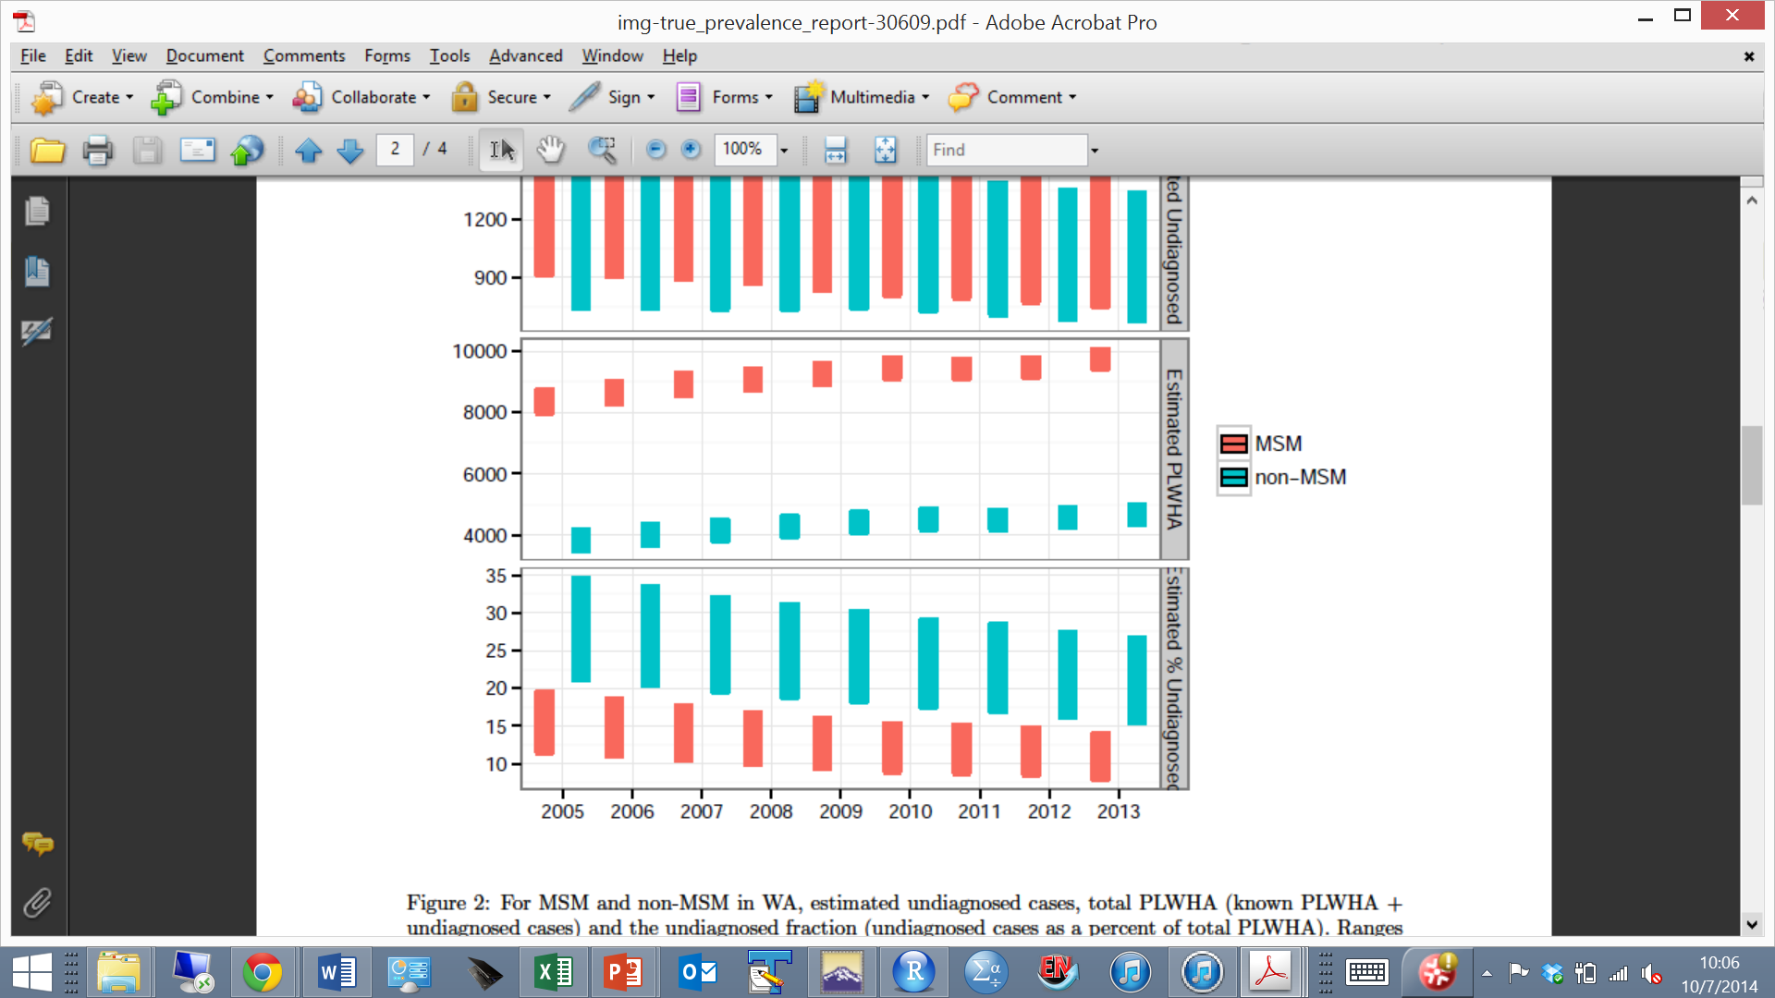
WA state undiagnosed fraction
ALNT TID
Uniform TID
2013: MSM: 8 - 14%
Non-MSM: 16 - 27%

