Slide 1

Modeling for global breast cancer screening and treatment planning
Ruth Etzioni, Catherine Duggan, Jeanette Birnbaum, Christina Fitzmaurice, Benjamin Anderson

Slide 2
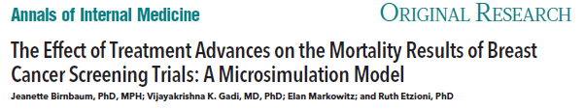
Motivation
Breast cancer in LMICs – presents in advanced stages with generally poor survival
Limited resources – need to identify feasible combination of early detection and treatment that will make most impact
We recently developed a model of breast cancer screening and treatment and used it to update mammography screening trials
Objective – adapt the model to project outcomes of different early detection and treatment efforts in LMICs

Slide 3
Three steps
A. Decouple effect of screening from effect of treatment
Effect of screening
Reduce frequency of advanced disease
(Additionally) May improve survival of localized disease
Effect of treatment
Improve stage-specific survival
B. Project benefits:
Quantify impact of early detection on disease stage
Impute treatment benefit from trials and meta-analyses
C. Compute outcomes
Project relative and absolute mortality reductions due to combination of screening and treatment efforts

Slide 4
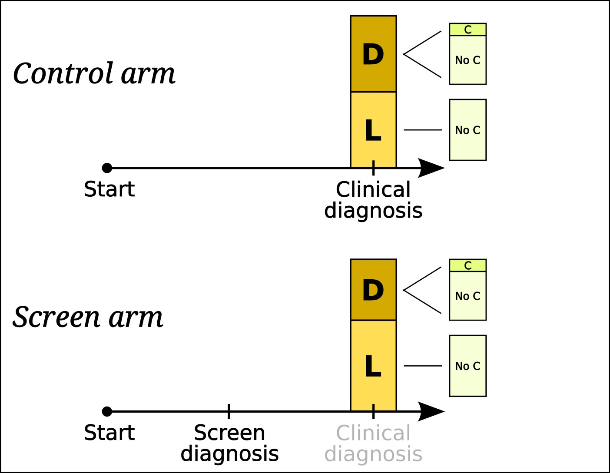
Model schematic
Stage shift
Treatment allocation/benefit
No early detection efforts
Some early detection efforts

Slide 5
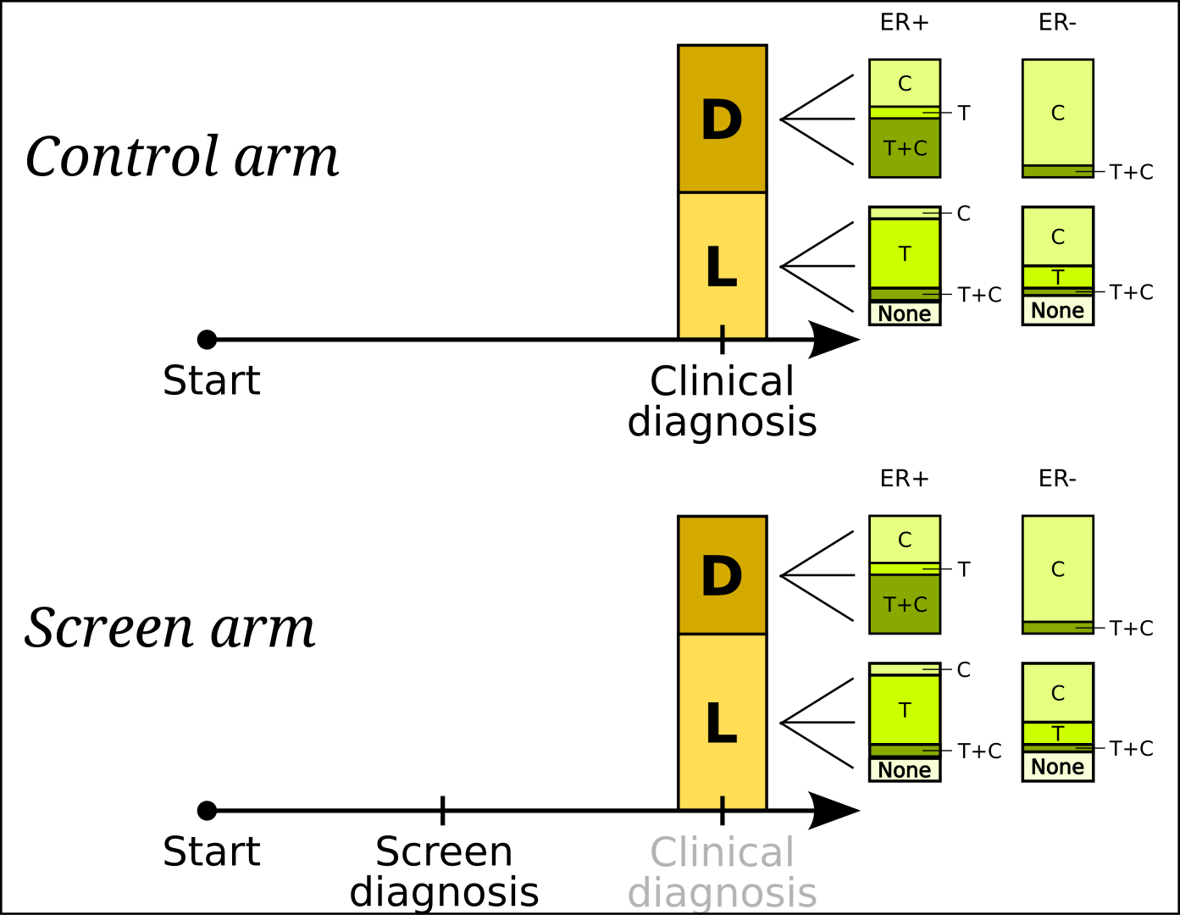
More treatment options
Stage shift
Treatment allocation/benefit
No early detection efforts
Some early detection efforts

Slide 6
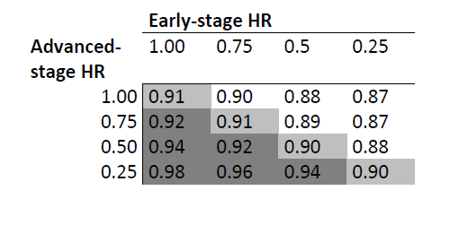
Model results under different treatment benefits for early and advanced stage disease
Mortality rate ratios (MRR) over 10 years
Assumes screening reduces advanced stage by 15%
Assumes all detected cancers are treated
Considers different treatment effects for early/advanced stage
Greatest benefit of screening when early-stage treatment works
Early stage treatment benefit (hazard ratio)
Advanced stage treatment benefit (hazard ratio)
Screening is optimal when
early stage treatment works

Slide 7
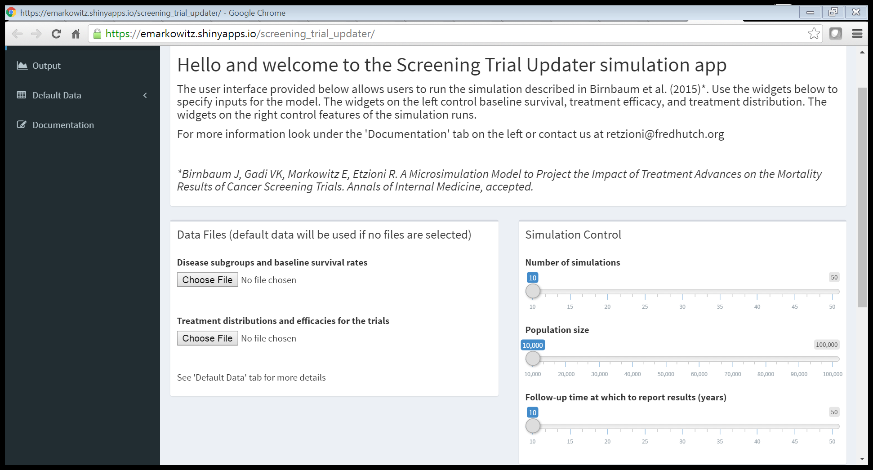
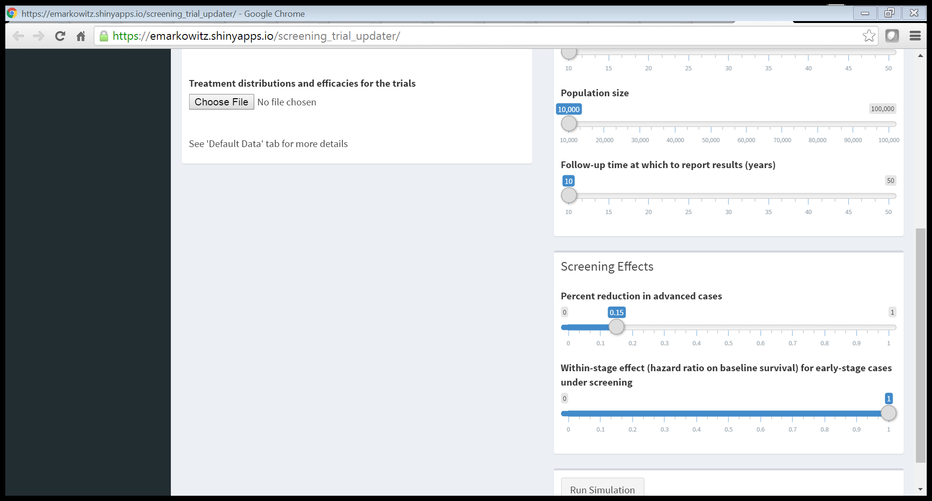
Model interface
Model Interface

Slide 8
Model inputs: US women
Age-specific incidence without screening Receptor status by stage | SEER 1975-1979 SEER 2010 | Ranges from 109-382 per 100,000 82% ER+
Percent advanced - no early detection - with early detection | SEER 1975-1979 | 50% 42.5% (15% reduction)
Baseline survival (no systemic rx) Early stage Advanced stage | SEER 1975-1979 | 90% survive 5 years 58% survive 5 years
Early detection Treatment options (besides surgery) | Mammography Radiation, chemo, Tamoxifen, Trastuzumab | Reduces advanced stage by 15% Benefits extracted from trials

Slide 9
Model inputs: Uganda
Age-specific incidence without screening Receptor status by stage | GLOBOCAN 2012 Galukande 2013 | Ranges from 55-136 per 100,000 47% ER+
Percent advanced - no early detection - with early detection | Galukande 2015 | 89% ∆ %
Baseline survival (no systemic rx) Early stage Advanced stage | Galukande 2015 | 35% survive 5 years
Early detection Treatment options (besides surgery) | Education, CBE, ultrasound, mammogram Some chemo? tamoxifen | Reduces advanced stage by ?% Benefits extracted from trials?

Slide 10
Modeling for global planning: challenges
Key inputs e.g. stage distribution and stage-specific survival are typically not available from population-representative registries
Use case series and individual facility publications
Intervention options for LMICs are more limited than in the US and not all have an established evidence base for benefit
Education, clinical breast exam, ultrasound rather than mammograms for early detection
Surgery, generic therapies for treatment
Develop estimates of change in stage under these interventions
If we can reduce delay in care seeking and diagnosis by up to 12 months how will this translate into down-staging?
Potentially leverage external natural history models (e.g. CISNET)
Need to translate treatment efficacy from trials to these settings
Compliance may be lower; use efficacy from trials as an upper bound for benefit

