Slide 1
eBPF

Slide 2
Background: eBPF

Slide 3
Learn the benefits of eBPF for observability, networking, and security without kernel modification
Understand the overall eBPF program architecture
Background and Motivation Behind eBPF
Key Advantages of eBPF
eBPF Architecture Overview
eBPF Use Cases

Slide 4

What is eBPF?
eBPF: Like extensions in chrome browser, you can add features via approved APIs, without rewrite the kernel
  No need to reboot or rebuild the kernel
  Attach at critical points to capture detailed data for networking, security, and performance
  Filter/transform early, enforce policies, and modify packet or system behavior with low overhead

Slide 5
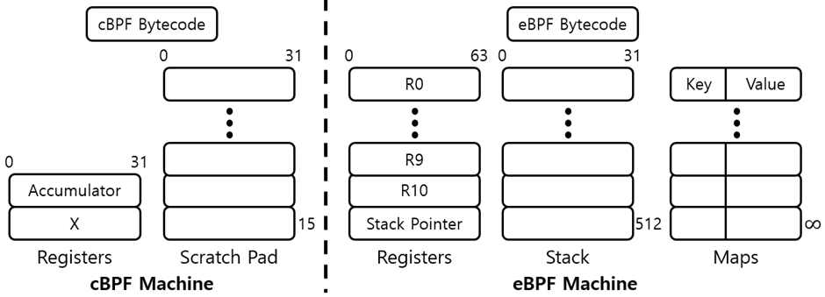
Classic BPF(Berkeley Packet Filter)
BPF: A in-kernel virtual machine for packet filtering
  How it works: A small bytecode program runs on each packet and returns either drop(0) or pass(N) N bytes to the socket
  Advantages: Super fast, safe by construction (no backward jumps, bounded size), no kernel patch needed; great for capture-only use cases.
  Limitations:
    Focused on packets only
    Limited ISA(Instruction Set Architecture)(32 bit, only 2 registers, tiny scratch pad)
    Actions limited to accept/drop for that socket; cannot modify/redirect
    Executes late (at socket), so you can’t drop packet early
Notes:
Limitations of BPF
only two registers
A (Accumulator): the main work register. Almost every ALU op uses A.
X (Index): mostly used as an offset for indirect loads, also a spare temp value.
No stack, only tiny scratch pad 32bit * 16 slots.
scratch pad is temporary per packet
No functions, No recursion, No calls, No loops, No persistent state
So suitable for simple packet filter, only determine drop/pass
eBPF is 64 bit, has 10 registers, 512 byte stack per call, BPF maps for persistent/shared state, Helpers(for safe kernel APIs), bounded loops

Slide 6
eBPF: Design goals
General: support in packets, syscalls, kprobes/tracepoints, uprobes, tc/XDP, LSM
Safe: strong verifier (bounds, pointer checks, control-flow, bounded loops)
Fast: JIT-compiled, runs close to the event source (low overhead/latency)
Practical: small programs in C, reusable maps (shared/persistent state), helpers (safe kernel APIs)
Dynamic: load/unload at runtime, no kernel rebuild/reboot
Notes:
Terminology Descriptions
Kernel API: The internal functions that the Linux kernel exposes to kernel code.
They are powerful but unstable for apps: only kernel modules or the kernel itself can call them directly.
eBPF cannot call arbitrary kernel APIs; it must use BPF helpers (a safe subset the kernel exposes to BPF programs).
(BPF) Helper: Whitelisted, stable system calls for eBPF programs.
They perform safe operations on behalf of your BPF code-
e.g., get PID/UID (bpf_get_current_pid_tgid), read task name (bpf_get_current_comm), read packet bytes (bpf_skb_load_bytes), or access maps (bpf_map_update_elem).
Think “kernel-approved utility functions.”
kprobe: Dynamic hocks on kernel functions. kprobe runs when a kernel function is entered
Use them to observe kernel behavior without patching. e.g.attach to __x64_sys_openat to see file opens.
uprobe: like kprobes, but for user space functions. great for tracing a specific process or library e.g. tracing libc function calls
tc: Linux’s framework to classify/shape/filter packets on ingress/egress of a NIC.
eBPF programs can attach at tc to inspect/mark/redirect packets in the networking stack (later than XDP, earlier than sockets).
Good for policy enforcement, shaping, or advanced filtering.
XDP(eXpress Data Path): A very early, very fast hook in the NIC driver receive path.
eBPF at XDP can decide drop / pass / transmit back / redirect before most of the network stack runs.
Best for high-performance use cases (DDoS mitigation, fast filtering, load-balancing).
LSM(Linux Security Module): LSM is the kernel’s security hook framework.
eBPF LSM lets BPF programs observe or enforce decisions on security-relevant events (like file open, socket connect) within LSM hooks-useful for auditing or lightweight policy.
JIT(Just In Time) compiler: After verification, the kernel translates BPF bytecode into native CPU instructions so it runs fast.
JIT is why eBPF has low overhead even though it’s sandboxed.

Slide 7
eBPF: What has Improved

Slide 8
eBPF: What has Improved
64-bit ISA: eBPF instructions operate on 64-bit values. That makes pointer math and counters natural on 64-bit kernels.
Registers
  R0 = return value register (what your program returns to the hook).
  R1-R5 = arguments when you call a helper (e.g., map update needs key/value pointers).
  R6-R9 = callee-saved temporaries (can keep values across helper calls).
  R10 = frame pointer for the stack (address the stack as R10 - offset).
Stack: 512Byte stack per call

Slide 9
eBPF: What has Improved
Maps: kernel-resident key/value stores that both BPF programs and user space can access(like shared whiteboard!)
  Give us persistent/shared state(unlike cBPF’s tiny scratch pad)
Map types
  hash: general dictionary
  array: Fixed slots by index (0..N-1)
  per-CPU hash/array: one copy per CPU → no lock contention, sum later in user space.
  LRU hash: automatically removes least-recent entries
  ring buffer: one-way queue for events going to user space (high-throughput).
Basic operations: lookup, update, delete.
Notes:
Map is kernel-side key/value store that both BPF code and user space can access.
There are different map types implemented by the kernel (e.g., HASH, ARRAY, PERCPU_HASH, LRU_HASH, RINGBUF, …).
You pick one type when you declare the map.
That choice controls behavior (e.g., per-CPU storage, LRU eviction, streaming events).
You then use helpers (e.g., bpf_map_lookup_elem) to read/write.

Slide 10
eBPF: What has Improved
Various hook points: You can attach small, verified eBPF programs at different hook points to observe or act on events with low overhead
Hook types
  Tracepoints(syscalls): Stable kernel events like execve
  kprobes/kretprobes: Dynamic hooks on kernel functions
  uprobes/uretprobes: Dynamic hooks on user space functions in binaries/libs
  XDP(eXpress Data Path): Earliest hook in the NIC(Network Interface Card) driver RX(Receive) path
  tc(traffic control): Ingress/egress in the network stack
  Socket filter: per-socket capture/filtering(like classic BPF)
  LSM(Linux Security Module): Security hooks(open, connect, exec ...), lightweight auditing and allow/deny policies
Notes:
XDP(eXpress Data Path): A very early, very fast hook in the NIC driver receive path.
eBPF at XDP can decide drop / pass / transmit back / redirect before most of the network stack runs.
Best for high-performance use cases (DDoS mitigation, fast filtering, load-balancing).
LSM(Linux Security Module): LSM is the kernel’s security hook framework.
eBPF LSM lets BPF programs observe or enforce decisions on security-relevant events (like file open, socket connect) within LSM hooks-useful for auditing or lightweight policy.

Slide 11
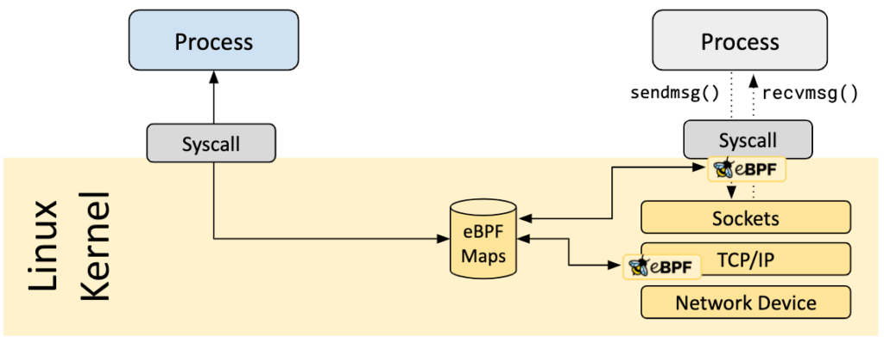
eBPF: What has Improved
Notes:
example of ebpf hook points

Slide 12
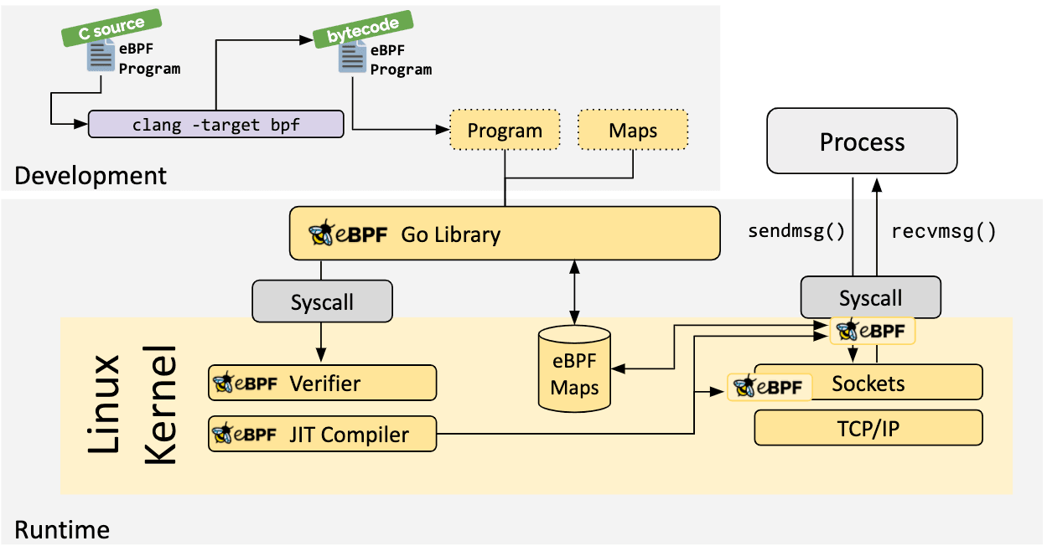
eBPF Architecture Overview

Slide 13
eBPF Architecture Overview
Development: You can write a C program and map definitions, compile to eBPF bytecode
Loading: A loader(BCC, libbpf, Go/Rust libs, bpftools etc...) calls the bpf() syscall to create maps and load programs from the ELF

Slide 14
eBPF Architecture Overview
Verifier: Like safety inspector, checks memory bounds, pointer usage, types, bounded loops, and overall control flow.
JIT(Just-In-Time) compiler: Like a live translator, JIT translates BPF bytecode into native CPU instructions

Slide 15
eBPF Architecture Overview
eBPF Maps: Keep persistent/shared state across events like counters & histograms, allow/deny lists, per-flow stats, last-seen timestamps, exporting events

Slide 16
eBPF Use Cases
Syscall tracing: capture filenames, PIDs, args and build rate counters or latency histograms.
Packet filtering: drop/redirect packet in NIC driver before the stack or per-socket filtering
Sensitive file watch: alert on /etc/shadow or keys directory access
Process execution auditing: log execve with first args, detect rate spikes or suspicious parents
CPU profiling: time in run queue, off-CPU time, stack traces for hot paths
Notes:
Although it’s called a packet filter, it’s actually used in a much wider range of applications. The name “packet filter” is kept mainly for tradition.

Slide 17
Lab Overview

Slide 18
Lab Overview
Learn to perform simple, rapid kernel event tracing using bpftrace.
Utilize different eBPF hook points: kprobes, tracepoints, and the XDP.
Understand how to develop and load advanced eBPF programs using C and Python.
Learn to pass custom data from the kernel to user-space using eBPF maps.
Apply eBPF for practical system monitoring/security (file access) and networking (packet modification).
Notes:
Although it’s called a packet filter, it’s actually used in a much wider range of applications. The name “packet filter” is kept mainly for tradition.

Slide 19
Lab Environment Setup

Slide 20
Lab Envrionment Setup
Let’s setup the development environment first.
We’ll conduct the lab assuming Ubuntu 22.04.5 LTS is installed..
First, update your package lists and upgrade all packages
  sudo apt update && sudo apt upgrade -y
Next, install the following packages
  sudo apt install -y clang llvm libelf-dev gcc make \
  iproute2 iputils-ping git curl build-essential \
  linux-headers-$(uname -r) cmake cmake-data pkg-config python3-distutils
  sudo apt install -y bpfcc-tools libbpfcc-dev python3-bpfcc bpftrace vim

Slide 21
Note: What each library does
clang, llvm: Compiler and toolchain used to compile eBPF programs into BPF bytecode (ELF objects).
libelf-dev: Development library for the ELF file format; required by tools (e.g., libbpf) to read ELF objects and load eBPF programs into the kernel.
iproute2, iputils-ping: Networking utilities for configuration, connectivity checks, and traffic experiments.
cmake, cmake-data, pkg-config: Build automation and dependency discovery for various source packages
linux-headers-$(uname -r): Header files for the currently running kernel; needed to build kernel modules and useful for some eBPF build workflows.
Notes:
just reference, no need to remember.

Slide 22
Note: What each library does
python3-distutils: Packaging/build utilities required by some Python-based tools (e.g., parts of BCC) for installation and execution.
bpfcc-tools: BCC/eBPF command line tools for quick tracing and performance troubleshooting without writing code.
libbpfcc-dev: Development headers and libraries for libccc used to build BCC-based applications; includes headers and pkg-config metadata
python3-bpfcc: Python 3 bindings for BCC (the bcc module), enabling you to write eBPF tools in Python.
bpftrace: A high-level tracing language and runtime for eBPF that supports one-liners and scripts over kprobes/uprobes/tracepoints

Slide 23
Useful commands
sudo bpftool prog list: List all eBPF programs currently loaded in the kernel
sudo bpftool map list: List all eBPF maps
sudo bpftool feature probe: Check which eBPF features your kernel and tooling support.
sudo bpftool prog show id <ID>: Show details (type, attach point, map refs) for a specific program

Slide 24
Basic Exercise1

Slide 25
Basic Exercise1: kprobe usage
Let’s monitor the execution of kernel functions!
You can find kernel functions available for use with kprobe using the command below.
  sudo cat /sys/kernel/debug/tracing/available_filter_functions
In this example, we use vfs_read, which is invoked whenever a file is read in the Linux file system.
The result of grep -Rnw /usr/src/linux-headers-$(uname -r) -e 'vfs_read'
※ vfs stands for “virtual file system”
※ You can find the source code here https://elixir.bootlin.com/linux/v6.16.4/source

Slide 26
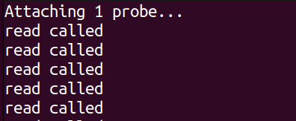
Basic Exercise1: kprobe usage
If you want to trace the execution of vfs_read, use the command below
  sudo bpftrace -e 'kprobe:vfs_read { printf("read called\n"); }’
  The -e option lets you run a one-liner bpftrace program for quick tracing
Running the command will produce numerous “read called” outputs, which is expected behavior.
Result of running sudo bpftrace -e 'kprobe:vfs_read { printf("read called\n"); }’

Slide 27
Basic Exercise2

Slide 28
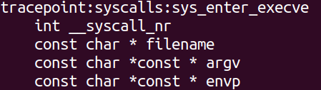
Basic Exercise2: tracepoint usage
Now, let’s take a look at monitoring system calls
You can list available syscall tracepoints by command below
  sudo bpftrace -l 'tracepoint:syscalls:*’
This time we use sys_enter_execve, which triggers on entry to the execve syscall
The result of sudo bpftrace -lv 'tracepoint:syscalls:sys_enter_execve'

Slide 29
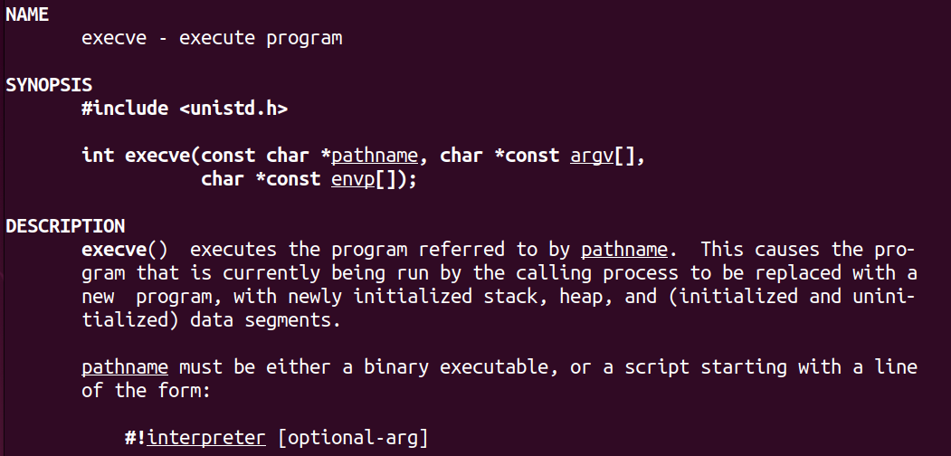
Basic Exercise2: tracepoint usage
You can find execve man page by command below
  man 2 execve
The result of man 2 execve

Slide 30
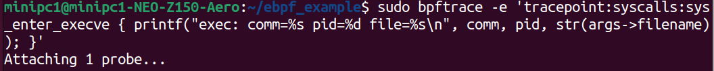
Basic Exercise2: tracepoint usage
To trace the execve system call, use the command below
  sudo bpftrace -e 'tracepoint:syscalls:sys_enter_execve { printf("exec: comm=%s pid=%d file=%s\n", comm, pid, str(args->filename)); }’
  comm and pid are built-in variables provided by bpftrace (please check man bpftrace)
  filename is taken from the sys_enter_execve arguments
After attaching the tracepoint, open another terminal to observe the output

Slide 31
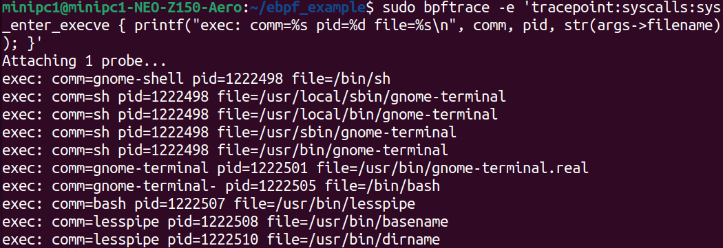
Basic Exercise2: tracepoint usage
The result after opening a terminal

Slide 32
Advanced Exercise1

Slide 33
Advanced Exercise: Alert on Sensitive File Access
Let’s build a program-using C and Python-that detects and alerts on access to sensitive files.
We’ll push event records into a per-CPU ring buffer (one of the eBPF map types mentioned on the previous slide)
The Python code will read those events, determine what happened, and perform follow-up actions such as generating alerts
You can find detailed information at the link below
  https://eunomia.dev/tutorials/bcc-documents/reference_guide_en/

Slide 34
Advanced Exercise: Alert on Sensitive File Access
First, we need to write c code to detect event!
We’ll use sys_enter_openat tracepoint which fires whenever a process calls the openat system call
You can find detailed information about openat with the command below
  man 2 openat
Note: Difference between openat and execve
  openat: Opens a file and returns a file descriptor (requires appropriate read/write permissions, depending on the flags)
  execve: Replaces the current process with a new program (requires execute permission on the target file)

Slide 35
Advanced Exercise: Alert on Sensitive File Access
#include <uapi/linux/ptrace.h>
#include <linux/sched.h>
/*
Event payload we define to send to user space.
- This is NOT a kernel-provided struct; it's our custom payload format.
- It will be delivered to user space as-is via a perf(per cpu) ring buffer (map).
*/
struct file_event_t {
u32 pid;
// using (bpf_get_current_pid_tgid() >> 32) yields TGID (process ID).
u32 uid;
// Caller’s UID. We use the lower 32 bits of bpf_get_current_uid_gid().
char comm[TASK_COMM_LEN];
// Current task's command name. Up to 16 bytes (including NUL).
char fname[256];
// File path passed to openat (read from user memory).
};
※ As a reminder, you can find detailed information about every function we used here:
https://eunomia.dev/tutorials/bcc-documents/reference_guide_en/

Slide 36
Advanced Exercise: Alert on Sensitive File Access
/*
BCC macro-BPF_PERF_OUTPUT: define a perf ring buffer map.
- Name: file_events(you can define on your own)
- The eBPF program pushes events into this buffer via perf_submit(),
- and user space (Python BCC) consumes them with open_perf_buffer().
*/
BPF_PERF_OUTPUT(file_events);
/*
TRACEPOINT_PROBE(syscalls, sys_enter_openat)
- eBPF function attached to the sys_enter_openat tracepoint.
- 'args' here is a pointer to an auto-generated struct provided by BCC,
exposing the tracepoint fields (dfd, filename, flags, mode, etc.) as 'args->field_name'.
!!! The exact shape of this struct is derived from the kernel's tracepoint !!!
to find format metadata:
sudo cat /sys/kernel/debug/tracing/events/syscalls/sys_enter_openat/format
or
sudo bpftrace -lv 'tracepoint:syscalls:sys_enter_openat'
*/
TRACEPOINT_PROBE(syscalls, sys_enter_openat) {

Slide 37
Advanced Exercise: Alert on Sensitive File Access
// Allocate one event record on the eBPF stack (~280B, below the 512B stack limit).
struct file_event_t evt = {};
/*
Fetch pid/tgid, uid/gid, and comm using eBPF helpers.
bpf_get_current_pid_tgid():
- returns 64 bits: upper 32 = TGID (thread group ID == process ID), lower 32 = PID (thread ID)
- Here we store TGID into evt.pid (>> 32).
If you need TID (thread ID), cast to (u32) to use the lower 32 bits.
*/
evt.pid = bpf_get_current_pid_tgid() >> 32;
/*
bpf_get_current_uid_gid():
- returns 64 bits: lower 32 = UID, upper 32 = GID
- evt.uid is u32, so only the lower 32 bits (UID) are stored.
*/
evt.uid = bpf_get_current_uid_gid();

Slide 38
Advanced Exercise: Alert on Sensitive File Access
// Copy current task's comm (process name) into evt.comm.
// - The helper guarantees NUL termination.
bpf_get_current_comm(&evt.comm, sizeof(evt.comm));
/*
Safely read the user pointer 'filename' passed to openat.
- bpf_probe_read_user_str(): reads a NUL-terminated string from user memory.
- Copies up to the given size and guarantees NUL termination.
- Returns a negative error code on failure; here we just attempt the read.
'args->filename' is a field from the tracepoint struct.
(With kprobes, you would fetch arguments from registers instead.)
(we can find the functions that can attach kprobes with command below.)
sudo cat /sys/kernel/debug/tracing/available_filter_functions | less
*/
bpf_probe_read_user_str(&evt.fname, sizeof(evt.fname), args->filename);

Slide 39
Advanced Exercise: Alert on Sensitive File Access
/*
Submit the collected event to the perf ring buffer.
- Passing 'args' as the first argument is a common BCC convention for ctx(context pointer).
- User space consumes it via b["file_events"].open_perf_buffer(...).
*/
file_events.perf_submit(args, &evt, sizeof(evt));
return 0;
}
It’s okay to just copy and paste, but make sure you read the comments in the code.
Next, let’s write the Python code that handles these events in user space.

Slide 40
Advanced Exercise: Alert on Sensitive File Access
from bcc import BPF
# --------------------------------------------------------------------
# 1) Load eBPF C source
# - Read file_detect.c from the same directory.
# - file_detect.c defines our struct file_event_t and
# TRACEPOINT_PROBE(syscalls, sys_enter_openat).
# - The kernel tracepoint provides the filename argument, and the
# eBPF program sends events to a perf ring buffer.
# --------------------------------------------------------------------
with open("file_detect.c") as f:
bpf_source = f.read()

Slide 41
Advanced Exercise: Alert on Sensitive File Access
# --------------------------------------------------------------------
# 2) Compile & load eBPF
# - BCC uses LLVM/Clang to compile the C code and then loads the
# resulting BPF program into the kernel.
# --------------------------------------------------------------------
b = BPF(text=bpf_source)
# --------------------------------------------------------------------
# 3) Attach the tracepoint
# - For TRACEPOINT_PROBE(syscalls, sys_enter_openat) in C, the
# function name in Python is "tracepoint__syscalls__sys_enter_openat".
# - Some environments autoload
# - In this example, we don’t need to attach explicitly
# --------------------------------------------------------------------

Slide 42
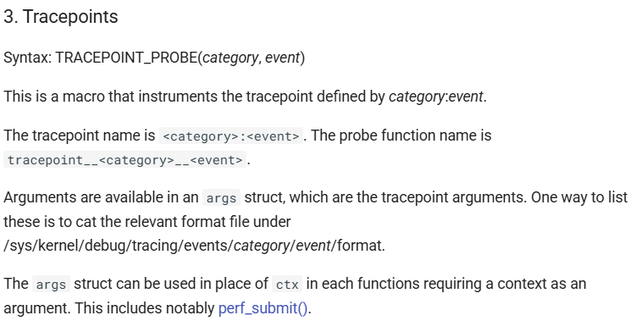
Advanced Exercise: Alert on Sensitive File Access
Note: Tracepoint macro naming rule

Slide 43
Advanced Exercise: Alert on Sensitive File Access
# --------------------------------------------------------------------
# 4) Event callback
# - The eBPF side defined BPF_PERF_OUTPUT(file_events), and pushes
# struct file_event_t via file_events.perf_submit().
# - b["file_events"].event(data) parses that C struct layout directly,
# so we can access event.pid / event.uid / event.comm / event.fname.
# --------------------------------------------------------------------
def on_file_event(cpu, data, size):
event = b["file_events"].event(data)
# Safely convert C char arrays to Python strings
comm = event.comm.decode(errors="ignore")
fname = event.fname.decode(errors="ignore").rstrip("\x00")
# Watch target: detect access to /etc/shadow
if fname == "/etc/shadow":
print(f"[*] ALERT: /etc/shadow accessed! "
f"(PID: {event.pid}, Proc: {comm}, UID: {event.uid})")
else:
# Informational log (remove if too noisy)
print(f"[i] Skipped: {fname} "
f"(PID: {event.pid}, Proc: {comm}, UID: {event.uid})")

Slide 44
Advanced Exercise: Alert on Sensitive File Access
# --------------------------------------------------------------------
# 5) Open perf buffer & polling loop
# - Register the callback with open_perf_buffer().
# - perf_buffer_poll() blocks and dispatches events to the callback.
# - Keep looping so the program stays alive and processes events.
# --------------------------------------------------------------------
b["file_events"].open_perf_buffer(on_file_event)
print("[*] Monitoring for /etc/shadow access... (Press Ctrl+C to stop)")
try:
while True:
b.perf_buffer_poll()
except KeyboardInterrupt:
print("\n[!] Detaching BPF program and exiting...")
finally:
# Deleting 'b' lets BCC detach the tracepoint and clean up maps
del b
print("[*] BPF program detached successfully.")

Slide 45
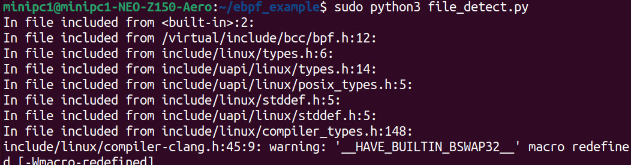
Advanced Exercise: Alert on Sensitive File Access
You must run the Python program with sudo

Slide 46
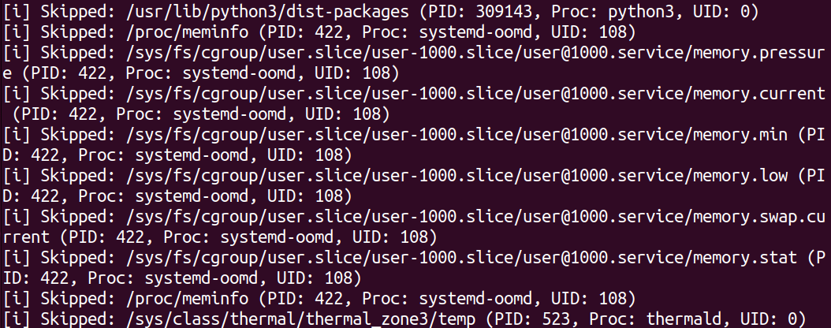
Advanced Exercise: Alert on Sensitive File Access
You will see numerous openat calls; most of them are skipped

Slide 47
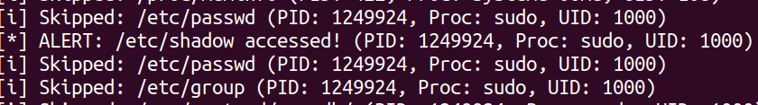
Advanced Exercise: Alert on Sensitive File Access
Open another terminal and run any command with sudo
You should see an alert, because sudo performs user authentication and reads /etc/shadow to check your stored password hash
If the output scrolls too fast, save the log to a file with sudo python3 your_program.py > log.txt then search for ‘ALERT’
※ If sudo doesn’t prompt for a password (due to its timestamp cache), it may not read /etc/shadow at that moment. Run sudo -k to force re-authentication. Also, if your sudoers has NOPASSWD for your user/command, there won’t be a read (so no alert).

Slide 48
Advanced Exercise2

Slide 49
Advanced Exercise: Source IP Modification
Now, let's do an exercise that is more related to networking
We will use XDP to change the source IP of all incoming packets to 1.1.1.1
To do this, we need to understand the structure of an incoming packet
The following explanation assumes you are familiar with the concepts of the OSI 7-layer model, as well as encapsulation and decapsulation

Slide 50
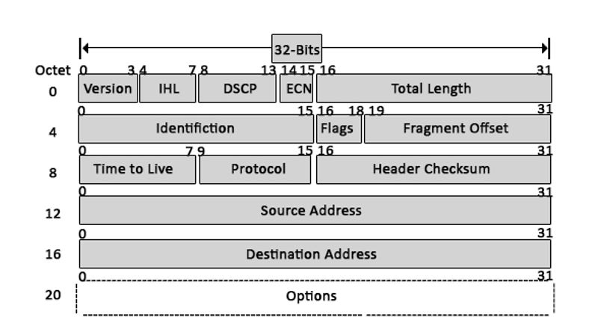
Advanced Exercise: Source IP Modification
We need to understand the structure of the IP header at the L3 layer
You might think that only the source IP needs to be changed, but in fact, the checksum field must be updated as well
We don't need to know the details of how the checksum is generated. That's because it's already handled by the BPF library

Slide 51
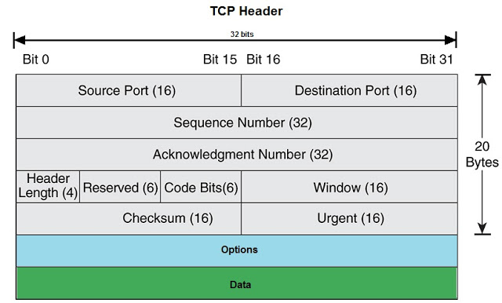
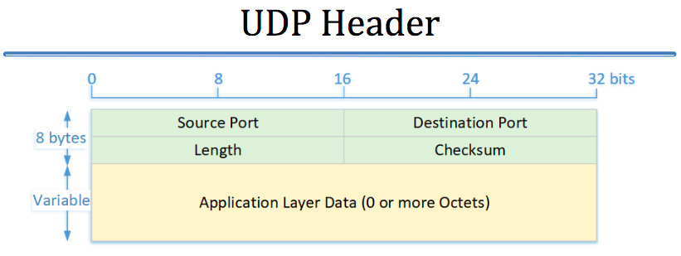
Advanced Exercise: Source IP Modification
Additionally, we need to understand the TCP/UDP header structure because changing the IP address also affects the TCP/UDP checksum.
In the case of UDP, the checksum is optional and is set to zero if not used, so we need to check for this.
Since the checksum calculation method is the same, we can process it with the same function used for the IP header.

Slide 52
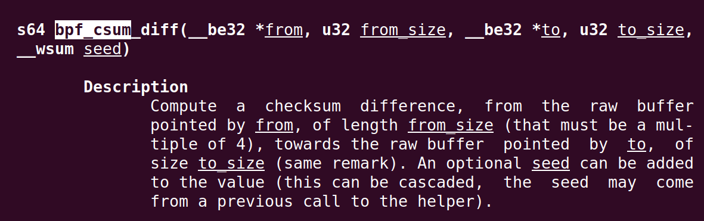
Advanced Exercise: Source IP Modification
You can check the checksum-related functions with the man bpf-helpers command, and in this example, we will be using the bpf_csum_diff function.

Slide 53
Advanced Exercise: Source IP Modification
Let's start by building a C program that can modify packet headers!
// The best way to find which header a specific struct (e.g. struct iphdr)
// belongs to is to search for the struct name on a Linux Kernel source code search
// website like Elixir Bootlin (https://elixir.bootlin.com).
#include <uapi/linux/bpf.h> // Contains core BPF definitions(e.g. struct xdp_md, XDP_PASS)
#include <uapi/linux/if_ether.h> // For the Ethernet header (struct ethhdr) and constants(ETH_P_IP)
#include <uapi/linux/ip.h> // For the IPv4 header (struct iphdr)
#include <uapi/linux/tcp.h> // For the TCP header (struct tcphdr)
#include <uapi/linux/udp.h> // For the UDP header (struct udphdr)
#include <uapi/linux/in.h> // For protocol number constants (IPPROTO_TCP, IPPROTO_UDP)

Slide 54
Advanced Exercise: Source IP Modification
// Network communication uses big-endian as its standard, but most PC CPUs use little-endian.
// Therefore, a conversion is necessary when sending data over the network or interpreting packet data
// The most accurate information on this concept can be found in the Linux man pages
// Run the `man byteorder` command in your terminal
// https://gcc.gnu.org/onlinedocs/gcc/Byte-Swapping-Builtins.htm
// hton -> host to network
#ifndef bpf_hton_32
#define bpf_hton_32(x) __builtin_bswap32(x)
#endif
#ifndef bpf_hton_16
#define bpf_hton_16(x) __builtin_bswap16(x)
#endif
// Defines the new source IP address (1.1.1.1) as a constant.
#define NEW_SADDR bpf_hton_32(0x01010101)

Slide 55
Advanced Exercise: Source IP Modification
// static: Restricts the scope of this function to the current file, preventing name collisions.
// inline: Suggests to the compiler that it should copy-paste the function code at the
// call site instead of making a function call, optimizing performance and
// bypassing the BPF Verifier's constraints on function calls.
// __sum16: A type representing a 16-bit checksum field.
// __be32: A type representing a 32-bit big-endian (network byte order) integer.
// __s64: A type representing a 64-bit signed integer.
static inline void csum_replace4(__sum16 *csum, __be32 from, __be32 to) {
//Use bpf_csum_diff to calculate the checksum difference between the old value (from) and the new value (to)
__s64 diff = bpf_csum_diff(&from, sizeof(from), &to, sizeof(to), 0);
if (diff != 0) {
// Add the difference to the actual checksum field (*csum).
bpf_csum_diff(NULL, 0, csum, sizeof(__sum16), diff);
}
}

Slide 56
Advanced Exercise: Source IP Modification
int xdp_ip_changer(struct xdp_md *ctx) {
// ctx is metadata passed by the kernel to the XDP program
// Get the start address (data) and end address (data_end) of the packet data
void *data_end = (void *)(long)ctx->data_end;
void *data = (void *)(long)ctx->data;
// The outermost header of the packet is the Ethernet header
struct ethhdr *eth = data;
// BPF Boundary Check: We must prevent the BPF program from accessing memory
// beyond the end of the packet. The BPF Verifier will not load the program without such checks
// https://docs.cilium.io/en/stable/reference-guides/bpf/index.html
// More details are in the document above, but for now, we just accept it as a requirement
// We must always check if "current pointer + size to read > end of data".
if ((void *)eth + sizeof(*eth) > data_end) {
return XDP_PASS;
// If the packet is shorter than an Ethernet header, don't process it and pass it to the kernel
// It could be an unknown protocol or a test packet, so let the upper layers handle it.
}

Slide 57
Advanced Exercise: Source IP Modification
// If the Ethernet frame's protocol type is not IPv4 (0x0800), do not process it.
// Use `bpf_hton_16` to compare with the network byte order value.
if (eth->h_proto != bpf_hton_16(ETH_P_IP)) {
return XDP_PASS;
}
// The IP header is located immediately after the Ethernet header.
struct iphdr *ip = data + sizeof(*eth);
if ((void *)ip + sizeof(*ip) > data_end) { // Check if there's enough space for a minimal IP header (20 bytes).
return XDP_PASS;
}
// The IHL(Internet Header Length) field in the IP header specifies the header length in 4-byte words.
// If IP options are included, the header can be longer than 20 bytes, so we must calculate the exact length.
__u32 ip_header_len = ip->ihl * 4;
if ((void *)ip + ip_header_len > data_end) {// If the packet is shorter than an IP header, don't process it and pass it to the kernel
return XDP_PASS;
}

Slide 58
Advanced Exercise: Source IP Modification
__be32 old_saddr = ip->saddr; // Store the original IP address to use later for checksum calculation.
__be32 new_saddr = NEW_SADDR;
// Overwrite the source IP address with the new address.
ip->saddr = new_saddr;
// Update the L3 (IP) checksum. Since the IP address has changed, the checksum must also be changed.
csum_replace4(&ip->check, old_saddr, new_saddr);
// The L4 (TCP/UDP) checksum is calculated based on a Pseudo-header,
// which includes the source/destination IP addresses.
// Therefore, if the IP address changes, the L4 checksum must also be recalculated.

Slide 59
Advanced Exercise: Source IP Modification
if (ip->protocol == IPPROTO_TCP) {
struct tcphdr *tcp = (void *)ip + ip_header_len; // The TCP header is right after the IP header.
if ((void *)tcp + sizeof(*tcp) <= data_end)
csum_replace4(&tcp->check, old_saddr, new_saddr); // Update TCP checksum.
}
} else if (ip->protocol == IPPROTO_UDP) {
struct udphdr *udp = (void *)ip + ip_header_len; // The UDP header is right after the IP header.
if ((void *)udp + sizeof(*udp) <= data_end) {
// The UDP checksum is optional and can be zero. Only update it if it's not zero.
if (udp->check != 0) {
csum_replace4(&udp->check, old_saddr, new_saddr); // Update UDP checksum.
}
}
}
return XDP_PASS;
}
char LICENSE[] = "GPL";

Slide 60
Advanced Exercise: Source IP Modification
Now, let's write the Python code to run the C program we just wrote. It's very simple!
import time
import argparse
import sys
from bcc import BPF # Correctly importing the BCC library
parser = argparse.ArgumentParser(description="Load an eBPF XDP program to change IP addresses.")
parser.add_argument("-i", "--interface", required=True, help="Network interface to attach the XDP program to (e.g., eth0)")
args = parser.parse_args()
device = args.interface
c_file = "xdp_ip_changer_kern.c"
# This variable will hold our BPF object. We define it here to access it in the finally block.
b = None

Slide 61
Advanced Exercise: Source IP Modification
try:
# Use src_file to load the C source. BCC compiles it automatically in the background.
b = BPF(src_file=c_file)
# Load the specific function 'xdp_ip_changer' from the compiled source as an XDP program.
fn = b.load_func("xdp_ip_changer", BPF.XDP)
print(f"[*] Attaching XDP program from source ({c_file}) to device ({device})...")
# Attach the loaded function to the XDP hook of the actual network device.
# Once this function executes successfully, from this point on, every packet
# coming into the device will pass through our eBPF program.
b.attach_xdp(device, fn, 0)
print(f"[*] Successfully attached!")
print("[*] Press Ctrl+C to detach and exit.")
# When the Python script exits, the eBPF program is automatically detached from the interface.
# Therefore, we put the script into an infinite loop to keep the eBPF program running.
while True:
time.sleep(1)

Slide 62
Advanced Exercise: Source IP Modification
except KeyboardInterrupt:
# This block is executed when the user presses Ctrl+C.
print(f"\n[*] Detaching XDP program from device ({device})...")
except Exception as e:
# This block is executed for any other unexpected errors.
print(f"An error occurred: {e}", file=sys.stderr)
finally:
# The `finally` block always executes to ensure the program is detached.
# We call remove_xdp to clean up the attachment from the network device.
if b:
b.remove_xdp(device, 0)
print("[*] Program detached. Exiting.")

Slide 63
Advanced Exercise: Source IP Modification
First, find your network interface using the ifconfig command.
Before the program running, launch Wireshark.
Then, run Chrome (to generate traffic) and the Python script we wrote.
You will see that the source IP for all packets has been changed to 1.1.1.1!

Slide 64
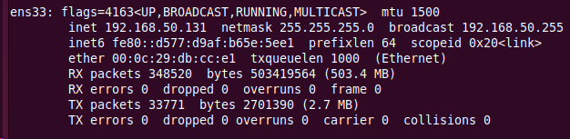
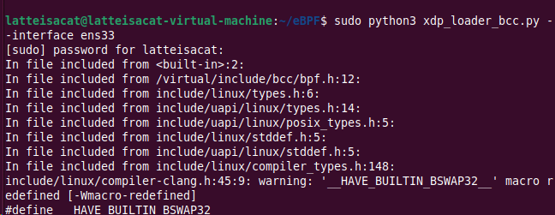
Advanced Exercise: Source IP Modification

Slide 65
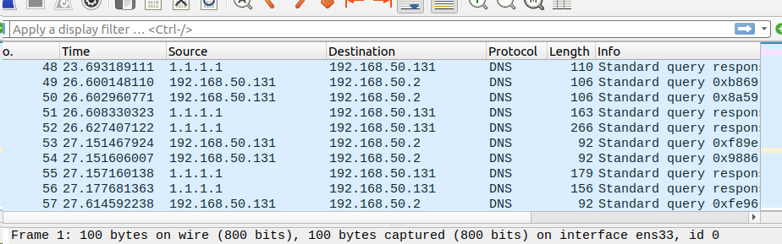
Advanced Exercise: Source IP Modification
Taking this technique a step further,
you could even build a backdoor to bypass a firewall!!

