Slide 1
Network Anomaly Detection Lifecycle and Semantics
draft-ietf-nmop-network-anomaly-lifecycle-02
draft-ietf-nmop-network-anomaly-semantics-02
NMOP WG, Monday 17th March 2025
IETF 122 - Bangkok
Vincenzo Riccobene (Huawei), Thomas Graf and Wanting Du (Swisscom), Alex Huang Feng (Insa Lyon)

Slide 2
Summary: “An Experiment: Network Anomaly Lifecycle” https://datatracker.ietf.org/doc/draft-ietf-nmop-network-anomaly-lifecycle/
This draft defines the lifecycle, generic data models and APIs to be used for Network Anomaly Detection Post-mortem analysis of network incidents
The lifecycle consists of three stages. Data is collected and revised across the three stages by using a label store, for which a data model and an API is defined in the draft
Adjustments to
detection system
Detection: The Network Anomaly Detection stage is about the continuous monitoring of the network through Network Telemetry [RFC9232] and the identification of symptoms.
Validation: Decides if the detected symptoms are signaling a real incident or if they are to be treated as false positives.
Refinement: Network operators perform postmortem analysis of incidents, analyze the telemetry data and detected anomalies with the objective to identify useful adjustments in the data collection and Anomaly Detection system.
Detection
Detected Symptoms
Refined Symptoms
Label Store
Labels
Refinement
Validation
Labels
Confirmed Symptoms
Anomaly
Symptom
Data Model Representation
Relevant State
Anomaly
Annotator
Anomaly
Service

Slide 3
Summary: “Semantic Metadata Annotation for Network Anomaly Detection” https://datatracker.ietf.org/doc/draft-ietf-nmop-network-anomaly-lifecycle/
This draft provides a detailed semantic to describe the output of Service Disruption Detection in a way that can be easy for Network Engineers to understand the underlying symptoms in a deterministic and semantically structured way.
The result is an augmentation of the Lifecycle data model, supporting the characterization of symptoms for connectivity services and the determinist mapping of operational and analytical data for those services
Define the symptom as a combination of:
Action: What action has the network node performed, in connection to the symptom (e.g. a packet was dropped)
Reason: Why the network node performed that action (e.g. the destination is unreachable)
Cause: What caused that reason to happen in the first place (e.g. Time To Live expired)
Augmented Data Model
Anomaly
Symptom
Relevant State
Anomaly
Annotator
Anomaly
Service
Define details related to the service, to enable the mapping to operational data

Slide 4


Main updates to the documents
Removed Antonio Roberto from the author list, as requested from him
Fixed most of the YANG errors from previous version
Yang Validation:
Made changes to the YANG models, as necessary, based on the work we did on the model validation (see next slides)
The remaining errors require some more drastic changes to the models. We want to validate those with code for the next iteration
Lifecycle
Semantics

Slide 5
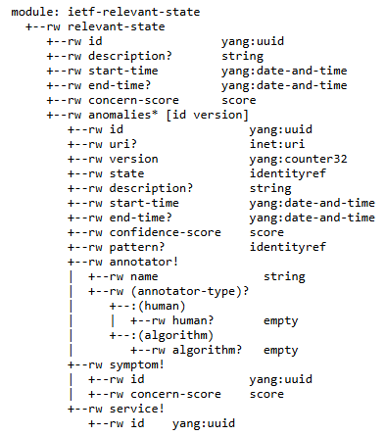
Lifecycle Data Model – Main updates
Having the concern score only at the symptom level is not enough. We also need a “global” concern score for the Relevant State
We need a link to the visualization of the symptom
Defining the pattern as an identity ref allows the user of the model to augment it easily, as needed.

Slide 6
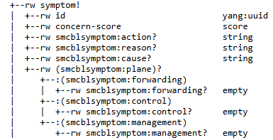
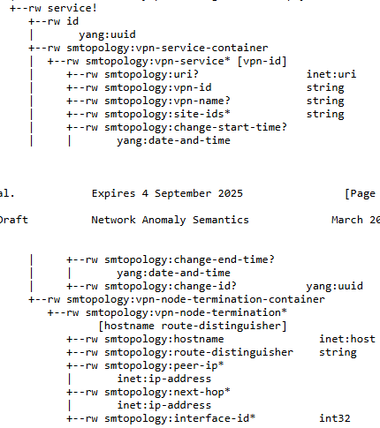
Semantics Data Model – Main updates
We need a link to the visualization of the symptom
In some cases, changes to the network inventory and maintenance windows can generate some false alarms.
These fields provide a reference to any change that needs to be tracked, to make the information available to the user and/or tag them during post-mortem analysis.

Slide 7
“hackathon” - Integration work Mapping data model on real data from Network Anomaly Detection
We are developing Antagonist (https://github.com/vriccobene/antagonist), an open source label store to persist and expose network anomaly detection labels, from the various actors involved in the lifecycle (both humans and algorithms).
Current stage: a detailed analysis of the mapping between the network incident data and the defined YANG data model is on going, to identify any further missing or misplaced fields
The changes proposed in this iteration are the result of the first part of this analysis, which will continue in the next few months
Next stage: test the Label Store with the actual data for network incidents from the network
We plan to provide more insights at the next IETF 123, and to get closer to the final version of the models

Slide 8

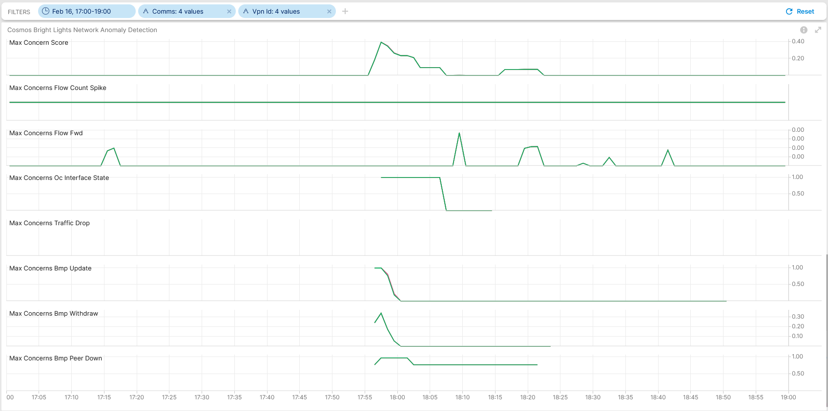
Mapping between network data and current Lifecycle model
Network Anomaly Lifecycle Management YANG Model
Relevant State
start-time
end-time
0.30

Slide 9
Mapping between network data and current Lifecycle model
Network Anomaly Lifecycle Management YANG Model
Anomalies & Symptoms
These are the symptoms

Slide 10
Next Steps
Finalize the mapping of the YANG model with data from other real network incidents
Update YANG models as needed, based on the analysis
Finalize open source implementation of Antagonist, based on findings from previous steps
Integrate and run Antagonist on the Swisscom Lab and validate the data models and the APIs
Finalize the YANG models, based on the evidence collected by the hackathon activities

Slide 11
Discussion Points
Any Feedback on the documents?
Would any other operator like to test any new Network Anomaly Detection use case with Antagonist?
Thanks!

