Slide 1
Swisscom: Network Incident Network Analytics Postmortem
Describes an incident in terms of what happened, which operational metrics where available, which analytical metrics described the symptoms and what improvements in the network anomaly detection system and network telemetry protocols are proposed.
thomas.graf@swisscom.com
06. March 2025

Slide 2

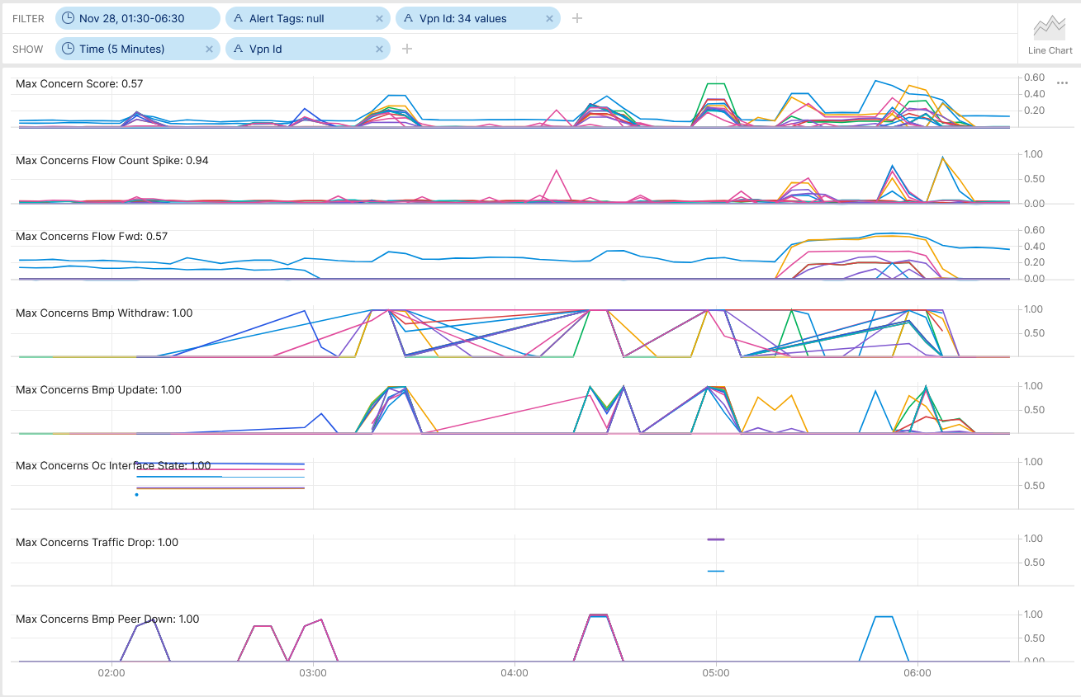
SRv6 Resilience Analysis & Tests in Production SRv6 Blackholing
Between 02:05-08 AM, use case 1, physical links on ipt-zhb790-a-des-01 Bundle-Ether10011 (CE facing interface to TC-GW Inter-AS Option A) had been disconnected. Interface and BGP peering state changes, BGP topology changes and interface traffic shift were observed and not alerted.
Between 02:56-59 AM, use case 2, physical links on ipt-zhb790-a-des-01 Bundle-Ether10031 (CE facing interface to MV-GW Inter-AS Option A) had been disconnected. Interface and BGP peering state changes, BGP topology changes and interface traffic shift were observed and not alerted.
Between 03.17-24 AM, use case 3, physical links on ipt-zhb790-a-des-02 Bundle-Ether2000 and Bundle-Ether2100 (P ABR facing) had been disconnected. Interface state changes, BGP topology changes and interface traffic shift were observed and alerted.
Between 04:22-30 AM, use case 4, BGP process was terminated and restarted at ipt-zhb790-a-des-02 (PE node Inter-AS Option A to SMEN) had been disconnected. BGP peering state changes, BGP topology changes and interface traffic shift were observed and alerted.
Between 04:53-57 AM, use case 5, IS-IS process was terminated and restarted at ipt-zhb790-a-des-02 (PE node Inter-AS Option A to SMEN) had been disconnected. BGP topology changes, traffic drop and interface traffic shift were observed and alerted.
Cosmos Bright Lights monitoring 34 L3 VPN's in real-time during maintenance window – Pivot Link

Slide 3


SRv6 Resilience Analysis & Tests in Production SRv6 Blackholing
At 05:17 AM, use case 6, RSP failover at ipt-zhb790-a-des-02 (PE node Inter-AS Option A to SMEN) was been performed. Missing traffic and NPU "IPv6 next-hop index invalid transmit adjacency" drops were observed and alerted.
At 05:43 and 05:47 AM, BGP peerings at pt-zhb790-a-des-02 (PE node Inter-AS Option A to SMEN) were being reset to update BGP routing tables. Along BGP peering state and topology changes, Missing traffic and NPU "IPv6 next-hop index invalid transmit adjacency" drops were still unchanged observed and alerted.
At 06:00 AM, ipt-zhb790-a-des-02 Bundle-Ether2000 and Bundle-Ether2100 (P ABR facing) were being shutdown. Missing traffic and NPU "IPv6 next-hop index invalid transmit adjacency" drops were no longer observed and traffic shifted to redundant ipt-zhh790-b-des-02.
At 06:54 AM, Cisco TAC SR 698355511 case has been opened to investigate traffic blackholing after RSP fail back.
Cosmos Bright Lights monitoring 34x L3 VPN's in real-time during maintenance window – Pivot Link

Slide 4
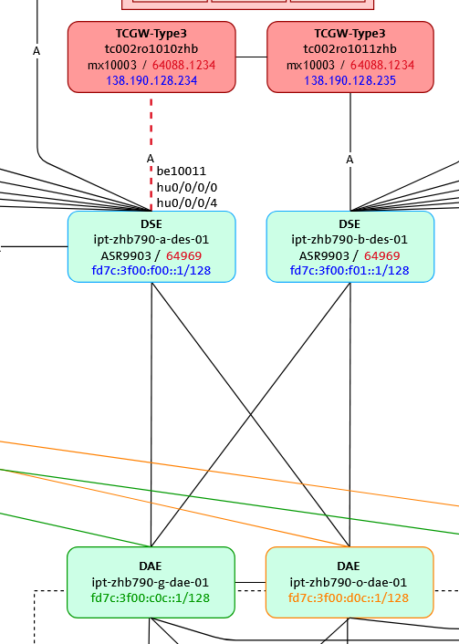
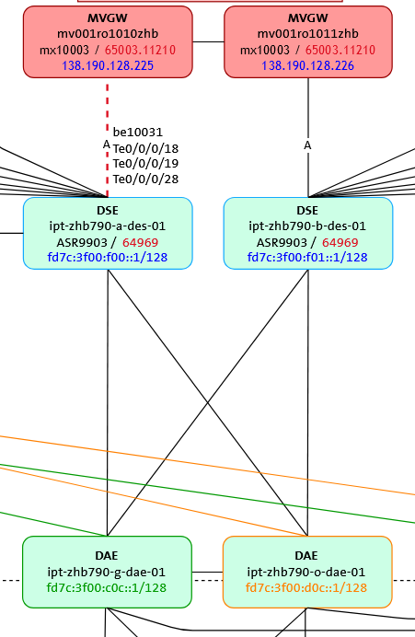
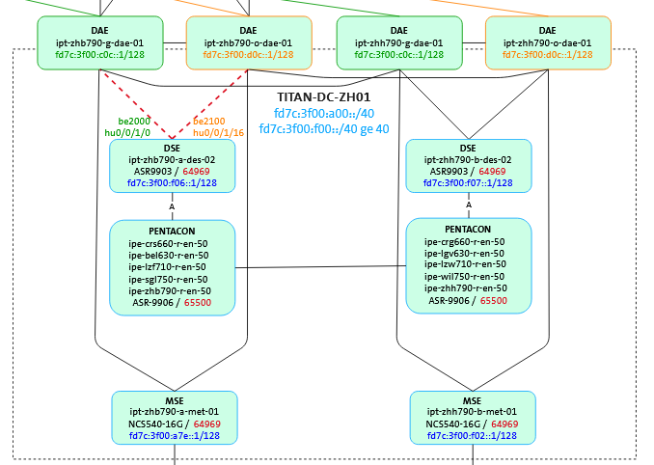
SRv6 Resilience Analysis & Tests in Production L1-3 Topology
1
2
3
4
6
5
Use Case 1, Edge Facing Link State Change
Use Case 2, Edge Facing Link State Change
Use Case 3, Core Facing Link State Change Use Case 4, BGP Process Restart Use Case 5, IS-IS Process Restart Use Case 6, RSP Failover

Slide 5
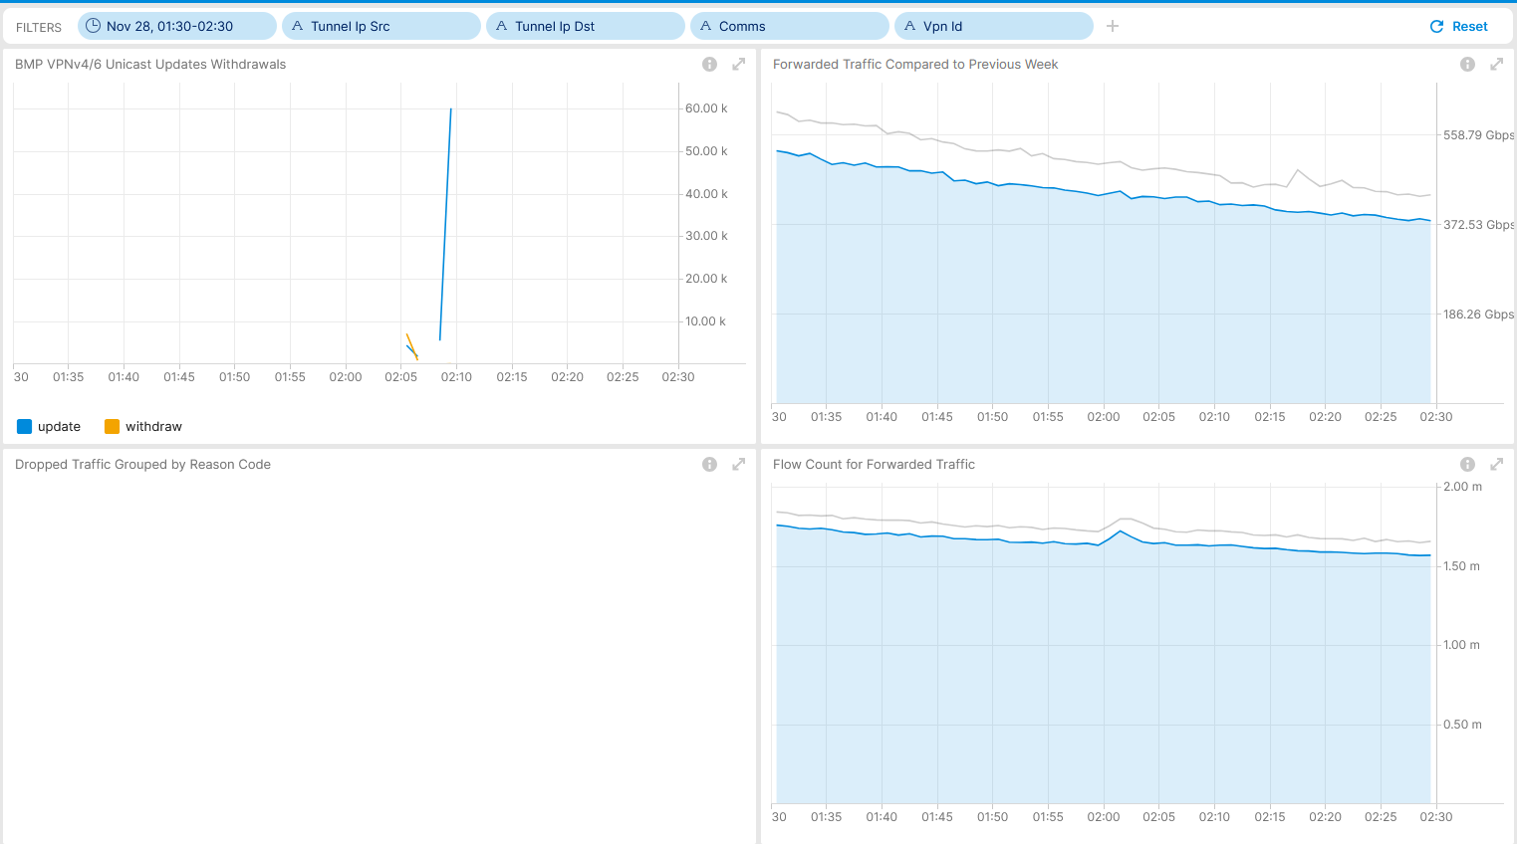
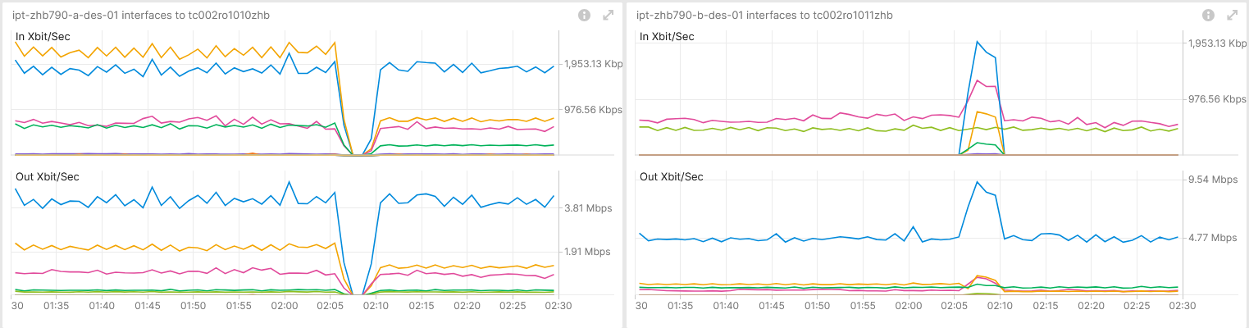
November 28th, SRv6 Resilience Analysis & Tests in Production Use Case 1 – Inter-AS Option A Interface State Change – Real-Time Maintenance Window Analysis
Shows BGP topology change and no traffic volume change. Measured with IPFIX and Correlated with BMP Local RIB.
Shows flow count spike due to BGP topology change. Measured with IPFIX and Correlated with BMP Local RIB.
Shows traffic shift among Inter-AS Option A ASBR's. Measured with YANG-Push openconfig-interface.yang.
Operational Network Telemetry forwarding plane, YANG-Push, IPFIX, BMP and BGP measured control plane metrics

Slide 6
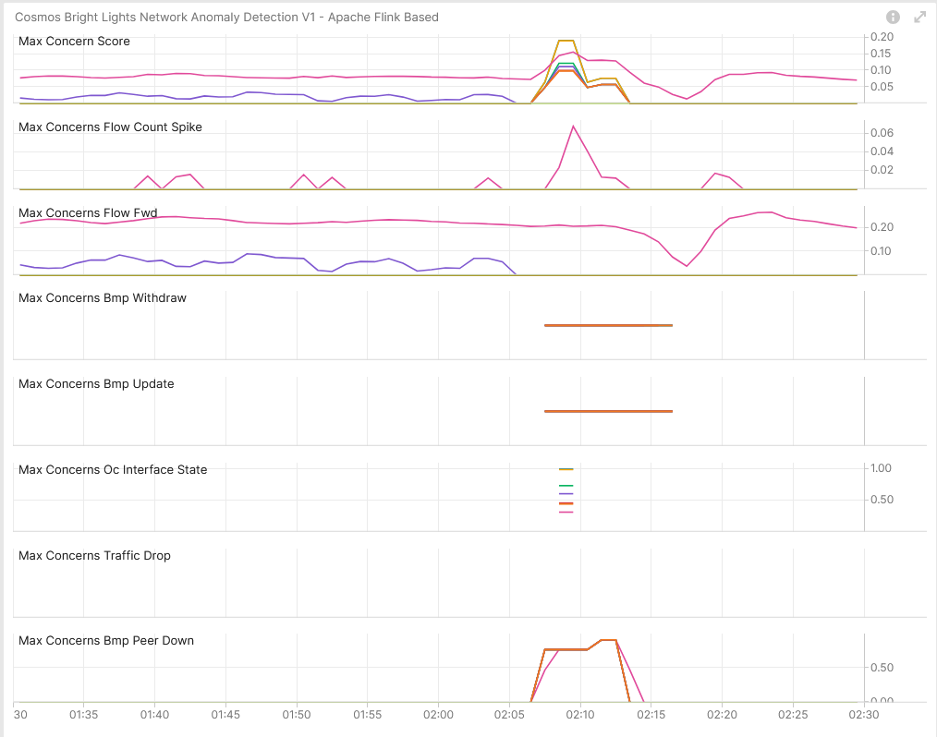

November 28th, SRv6 Resilience Analysis & Tests in Production Use Case 1 – Network Anomaly Detection – Live
Concern Score: 0.19
Flow Count Spike: 0.07
Missing Traffic: 0.26
Traffic Drop: 0.00
BMP Peer/Interface Down: 0.91/0.99 BMP Update/Withdrawal: 0.00/0.00
BMP route-monitoring Update/Withdraw check did not recognize topology change.
BMP peer Down/Up check recognized BGP peering state change.
Interface Down/Up check recognized Interface state change.
Traffic Drop spike recognized did not apply.
Missing Traffic check recognized long term traffic loss on 64498:2949.
Increased or decreased Flow Count check did recognize flow spike decrease.
Overall: 4 out of 6 checks have detected the Interface and BGP topology change and flow count spike. Why BGP topology changes were not identified needs to be investigated.
Cosmos Bright Lights Anomaly Detection – 8x L3 VPN's

Slide 7
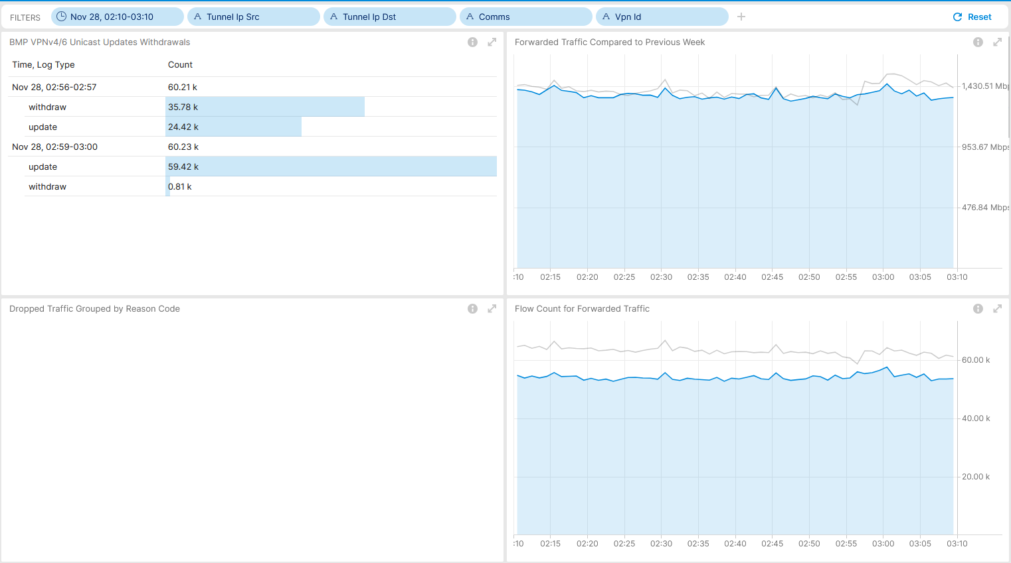
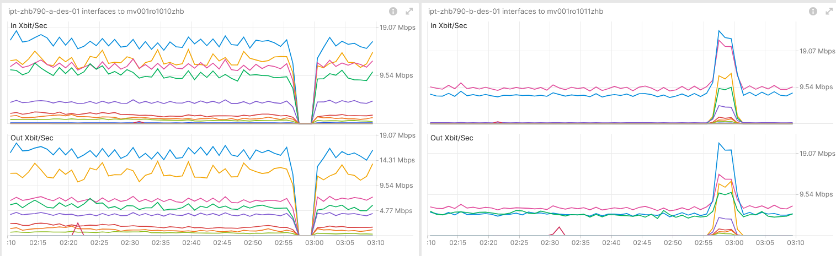
November 28th, SRv6 Resilience Analysis & Tests in Production Use Case 2 – Inter-AS Option A Interface State Change – Real-Time Maintenance Window Analysis
Shows BGP topology change and no traffic volume change. Measured with IPFIX and Correlated with BMP Local RIB.
Shows no flow count change. Measured with IPFIX and Correlated with BMP Local RIB.
Shows traffic shift among Inter-AS Option A ASBR's. Measured with YANG-Push openconfig-interface.yang.
Operational Network Telemetry forwarding plane, YANG-Push, IPFIX, BMP and BGP measured control plane metrics.

Slide 8
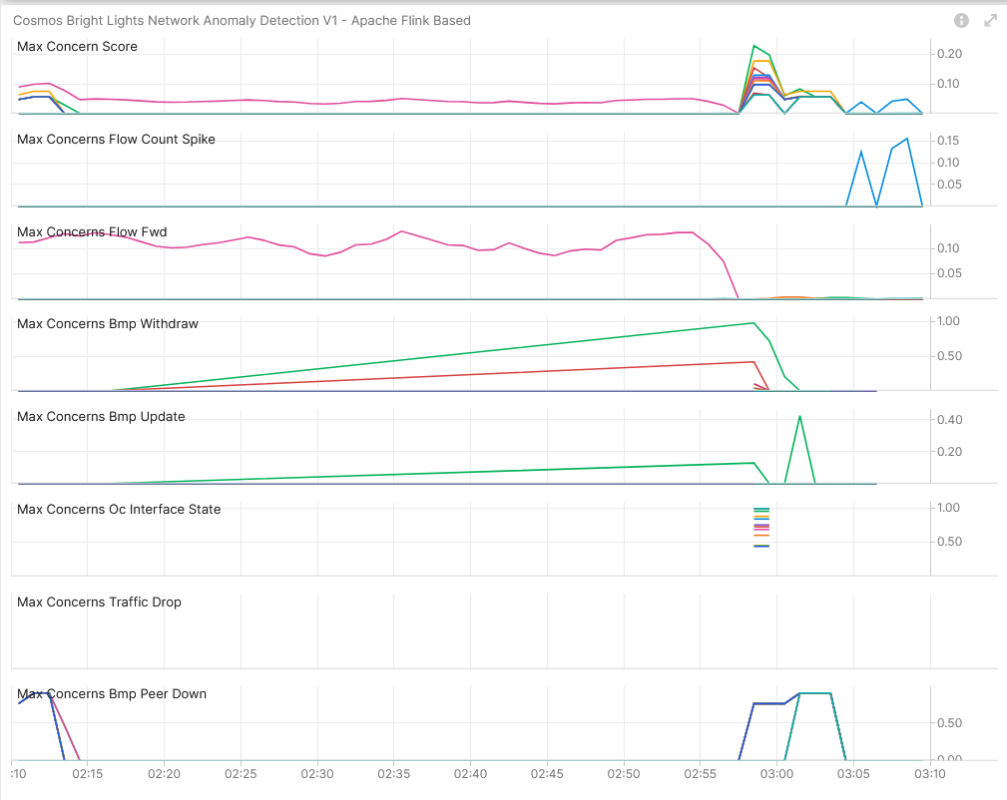
November 28th, SRv6 Resilience Analysis & Tests in Production Use Case 2 – Network Anomaly Detection – Live
Concern Score: 0.23
Flow Count Spike: 0.16
Missing Traffic: 0.00
Traffic Drop: 0.00
BMP Peer/Interface Down: 0.91/1.00 BMP Update/Withdrawal: 0.43/0.98
BMP route-monitoring Update/Withdraw check recognized topology change.
BMP peer Down/Up check recognized BGP peering state change.
Interface Down/Up check recognized Interface state change.
Traffic Drop spike recognized did not apply.
Missing Traffic check did not apply.
Increased or decreased Flow Count check did recognize flow spike increase.
Overall: 5 out of 6 checks have detected the interface and BGP topology change and flow count spike. Meets perfectly our expectations.
Cosmos Bright Lights Anomaly Detection – 12x L3 VPN's

Slide 9
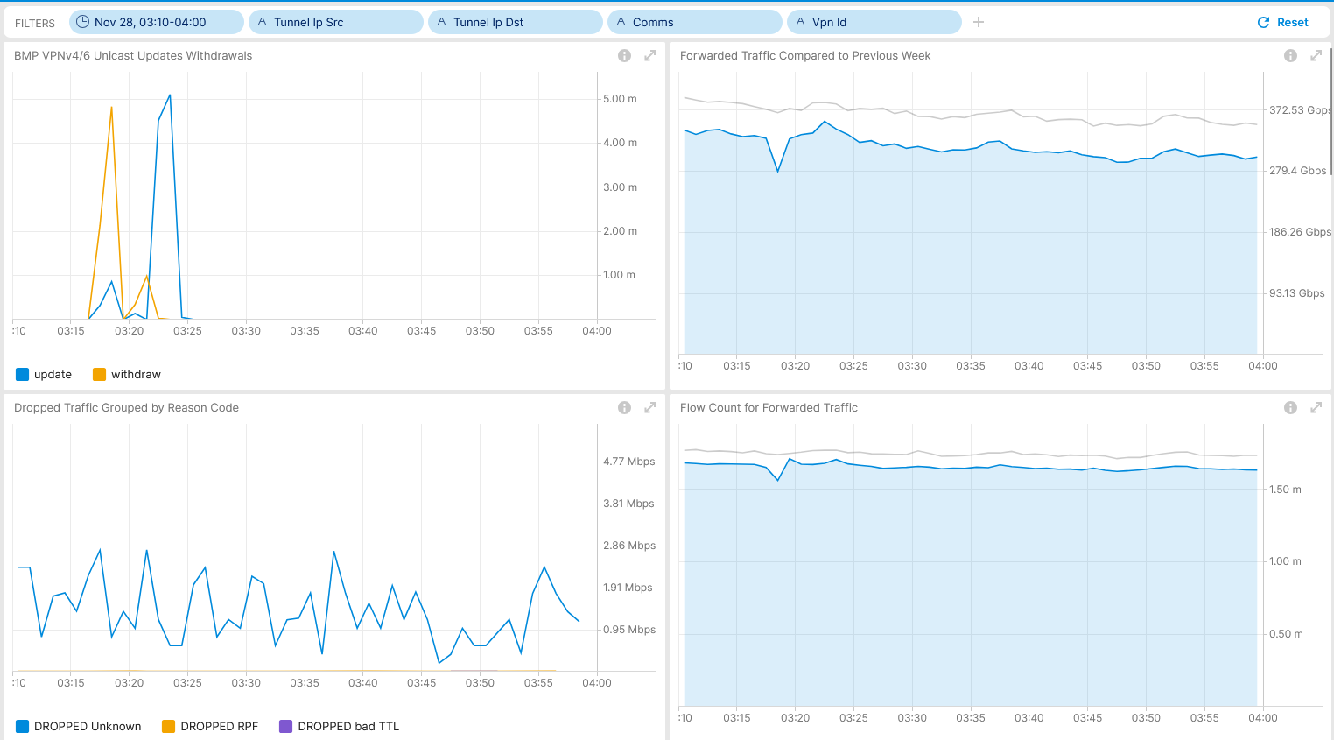
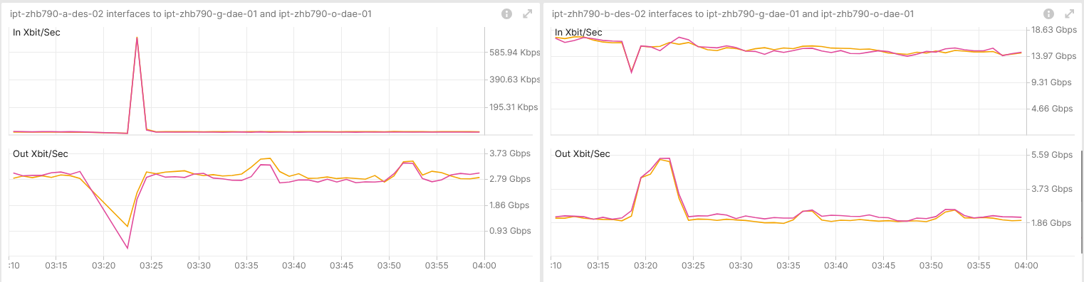
November 28th, SRv6 Resilience Analysis & Tests in Production Use Case 3 – SRv6 Provider Interface State Change – Real-Time Maintenance Window Analysis
Shows BGP topology change and brief missing traffic volume. Measured with IPFIX and Correlated with BMP Local RIB.
Shows brief flow count change. Measured with IPFIX and Correlated with BMP Local RIB.
Shows traffic shift among Inter-AS Option A ASBR's. Measured with YANG-Push openconfig-interface.yang.
Operational Network Telemetry forwarding plane, YANG-Push, IPFIX, BMP and BGP measured control plane metrics

Slide 10
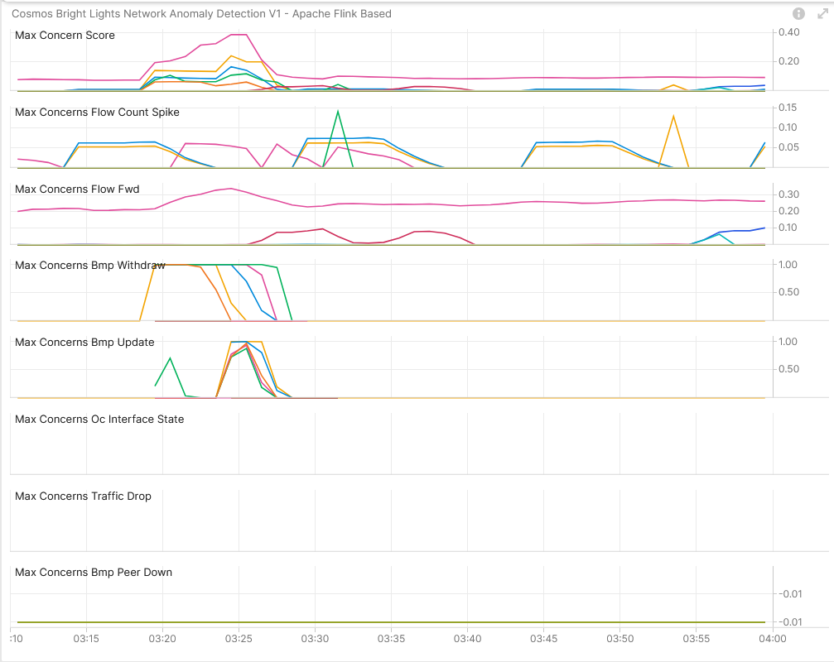
November 28th, SRv6 Resilience Analysis & Tests in Production Use Case 3 – Network Anomaly Detection – Live
Concern Score: 0.39
Flow Count Spike: 0.14
Missing Traffic: 0.34
Traffic Drop: 0.00
BMP Peer/Interface Down: 0.00/0.00 BMP Update/Withdrawal: 1.00/1.00
BMP route-monitoring Update/Withdraw check recognized topology change.
BMP peer Down/Up check did not apply.
Interface Down/Up did not apply.
Traffic Drop spike recognized did not apply.
Missing Traffic check did not recognize brief traffic loss.
Increased or decreased Flow Count check did not recognize decreased and increased flow count spike.
Overall: 1 out of 6 checks have detected the BGP topology change. Missing traffic and Flow Count changes are hard to recognize when many changes occur in short period of time. Nevertheless, lets investigate wherever we have a chance to improve.
Cosmos Bright Lights Anomaly Detection – 16x L3 VPN's

Slide 11
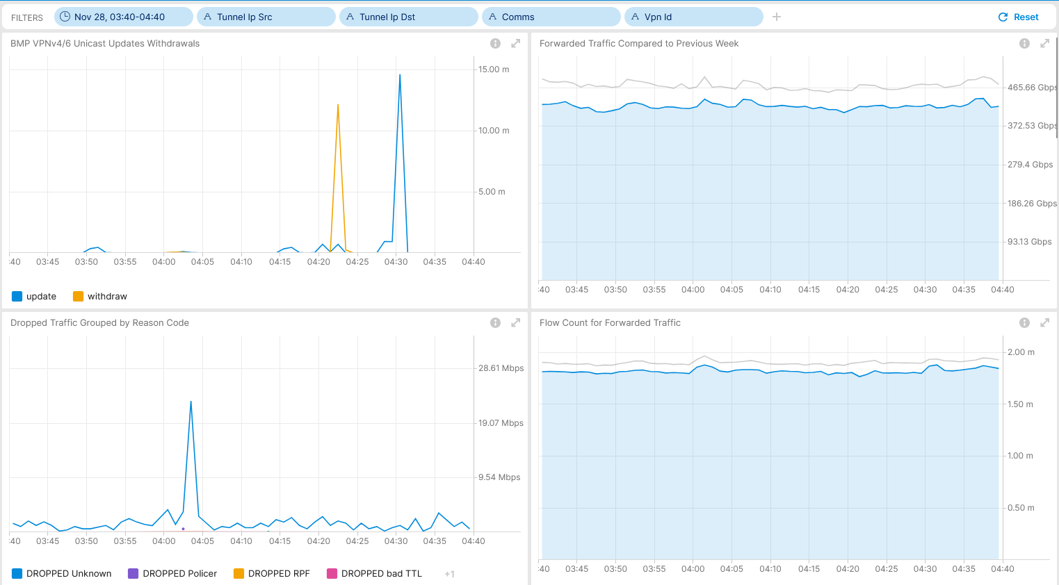
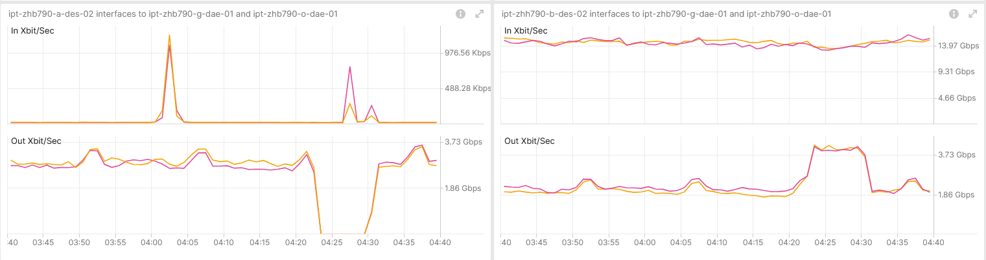
November 28th, SRv6 Resilience Analysis & Tests in Production Use Case 4 – BGP Process Restart – Real-Time Maintenance Window Analysis
Shows BGP topology change. Measured with IPFIX and Correlated with BMP Local RIB.
Shows no change in drops or flow count. Measured with IPFIX and Correlated with BMP Local RIB.
Shows traffic shift among Inter-AS Option A ASBR's. Measured with YANG-Push openconfig-interface.yang.
Operational Network Telemetry forwarding plane, YANG-Push, IPFIX, BMP and BGP measured control plane metrics

Slide 12
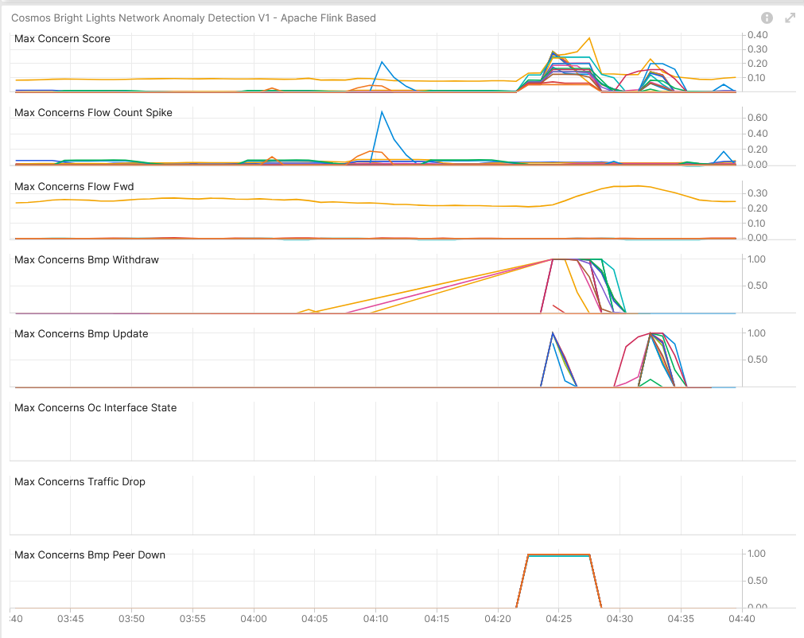
November 28th, SRv6 Resilience Analysis & Tests in Production Use Case 4 – Network Anomaly Detection – Live
Concern Score: 0.38
Flow Count Spike: 0.04
Missing Traffic: 0.35
Traffic Drop: 0.00
BMP Peer/Interface Down: 1.00/0.00 BMP Update/Withdrawal: 1.00/1.00
BMP route-monitoring Update/Withdraw check recognized topology change.
BMP peer Down/Up check recognize peering state changes.
Interface Down/Up did not apply.
Traffic Drop spike recognized did not apply.
Missing Traffic check recognized long term traffic loss on 64498:2949.
Increased or decreased Flow Count check did not apply.
Overall: 2 out of 6 checks have detected the BGP topology and peering state change. Meets perfectly our expectations.
Cosmos Bright Lights Anomaly Detection – 19x L3 VPN's

Slide 13
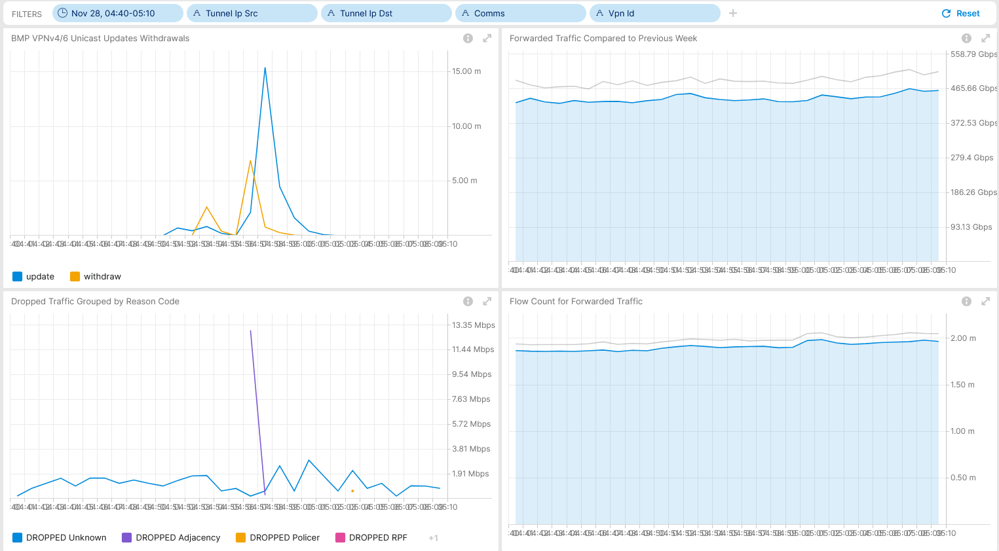
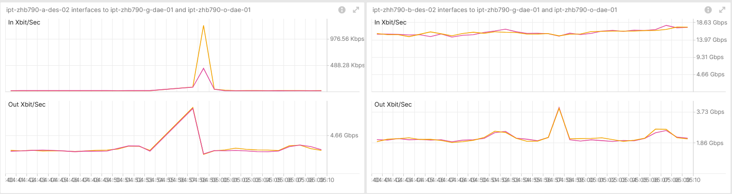
November 28th, SRv6 Resilience Analysis & Tests in Production Use Case 5– IS-IS Process Restart – Real-Time Maintenance Window Analysis
Shows BGP topology change. Measured with IPFIX and Correlated with BMP Local RIB.
Shows drop adjacency. Measured with IPFIX and Correlated with BMP Local RIB.
Shows brief traffic shift among Inter-AS Option A ASBR's. Measured with YANG-Push openconfig-interface.yang.
Operational Network Telemetry forwarding plane, YANG-Push, IPFIX, BMP and BGP measured control plane metrics

Slide 14
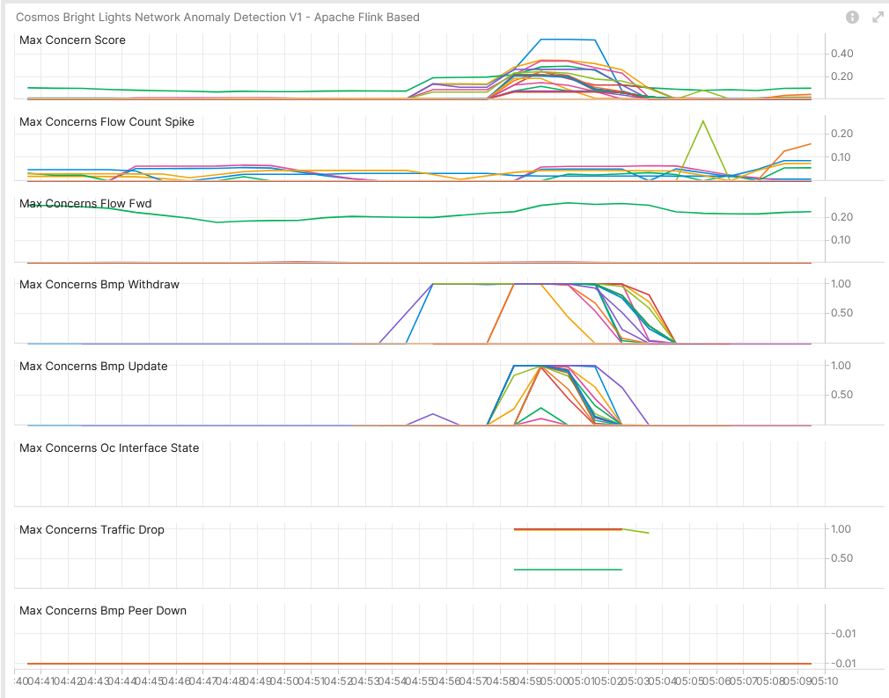
November 28th, SRv6 Resilience Analysis & Tests in Production Use Case 5 – Network Anomaly Detection – Live
Concern Score: 0.53
Flow Count Spike: 0.25
Missing Traffic: 0.27
Traffic Drop: 1.00
BMP Peer/Interface Down: 0.00/0.00 BMP Update/Withdrawal: 1.00/1.00
BMP route-monitoring Update/Withdraw check recognized topology change.
BMP peer Down/Up check did not apply.
Interface Down/Up did not apply.
Traffic Drop spike recognized topology change.
Missing Traffic check recognized long term traffic loss on 64498:2949.
Increased or decreased Flow Count check did not apply.
Overall: 2 out of 6 checks have detected the BGP topology change, and traffic drop spike. Meets perfectly our expectations.
Cosmos Bright Lights Anomaly Detection – 19x L3 VPN's

Slide 15
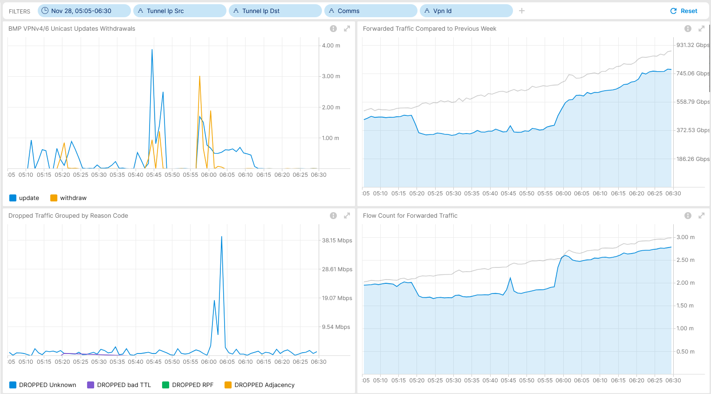
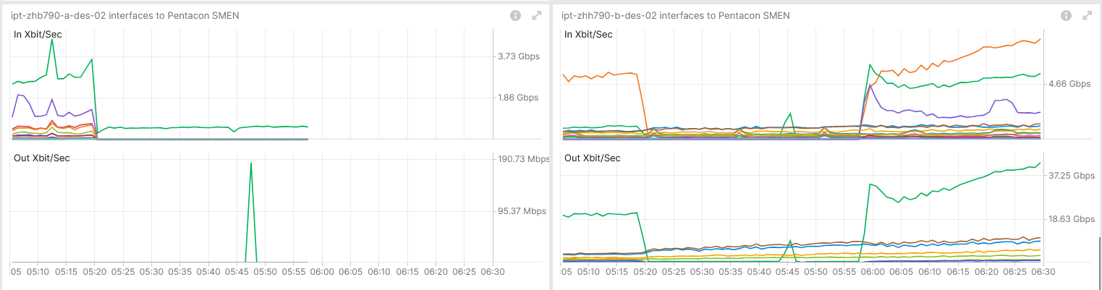
November 28th, SRv6 Resilience Analysis & Tests in Production Use Case 6– RSP Failover – Real-Time Maintenance Window Analysis
Shows BGP topology change and missing traffic during blackholing. Measured with IPFIX and Correlated with BMP Local RIB.
Shows drop unknown at recovery and reduced flow count during blackholing. Measured with IPFIX and Correlated with BMP Local RIB.
Shows traffic shift among Inter-AS Option A ASBR's. Measured with YANG-Push openconfig-interface.yang.
Operational Network Telemetry forwarding plane, YANG-Push, IPFIX, BMP and BGP measured control plane metrics

Slide 16
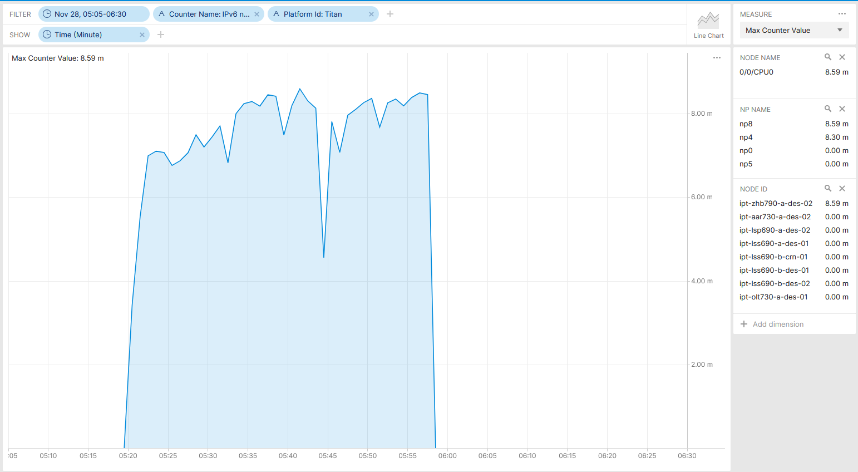
November 28th, SRv6 Resilience Analysis & Tests in Production IPv6 next-hop index invalid transmit adjacency drops - Real-Time Maintenance Window Analysis
Shows egress NPU drops on NPU 4 and 8 on line card 0/0/CPU0 at ipt-zhb790-a-des-02. Measured with YANG-Push.
Operational Network Telemetry YANG-Push collected NPU drop counter (IPv6 next-hop index invalid transmit adjacency) metrics.

Slide 17
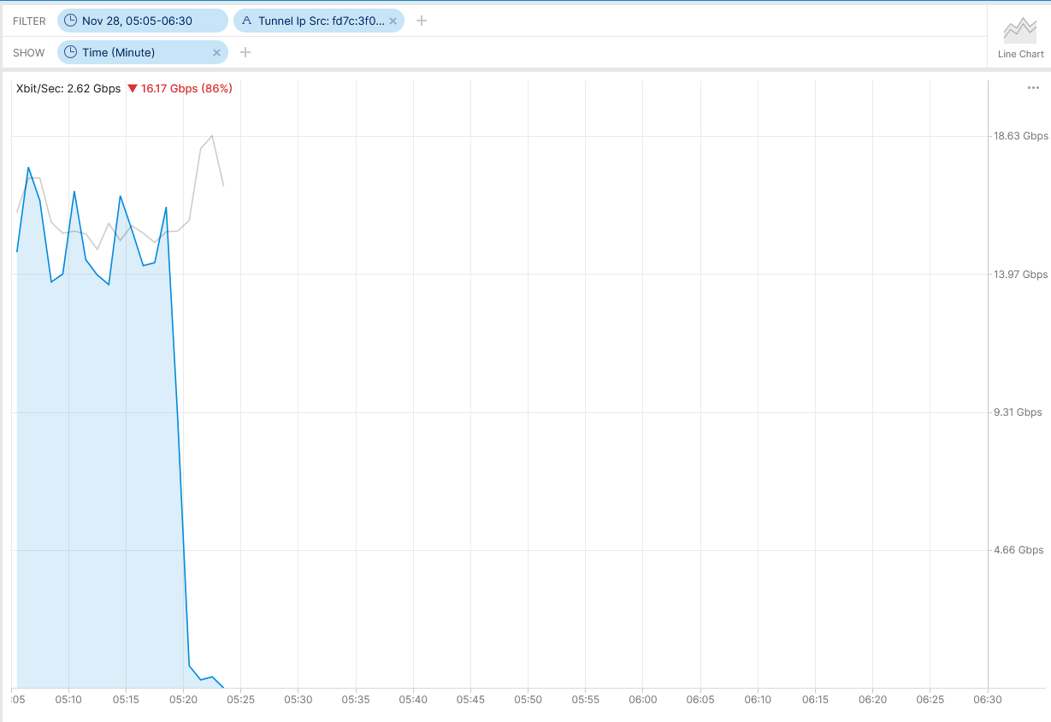
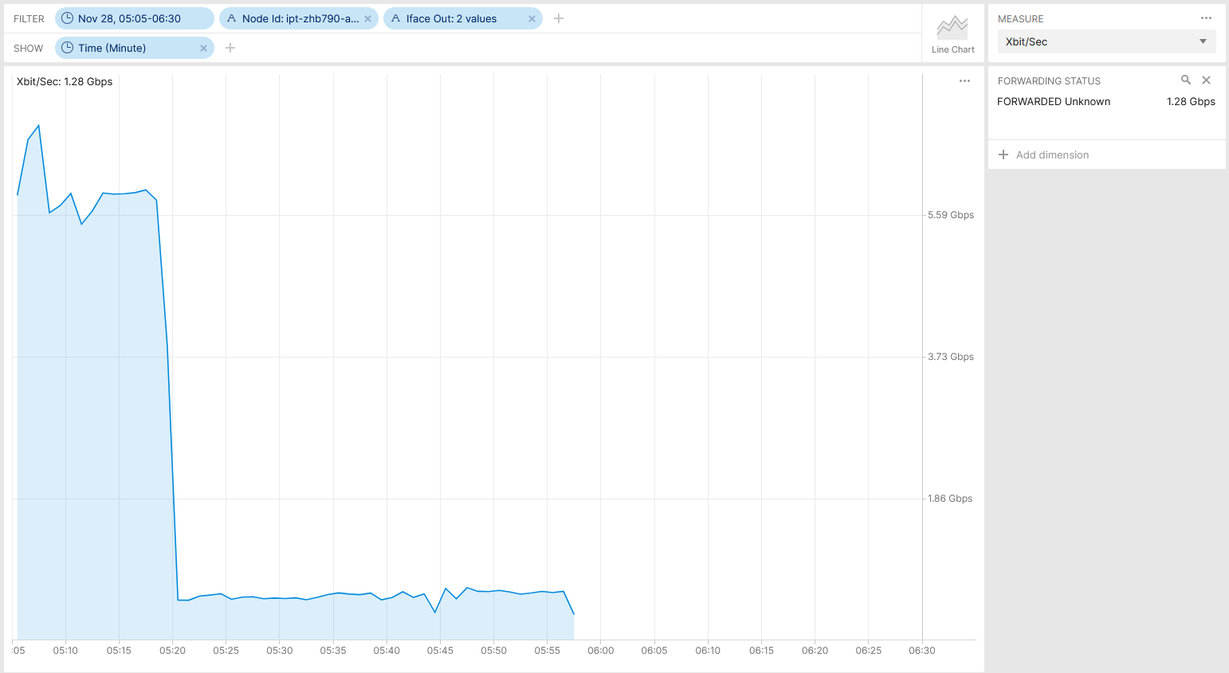
November 28th, SRv6 Resilience Analysis & Tests in Production IPFIX does not recognize at ingress the egress drop - Real-Time Maintenance Window Analysis
Shows that ingress captured traffic is measured forwarded mistakenly, however then dropped at egress on ipt-zhb790-a-des-02. Measured with IPFIX in different parts of the SRv6 domain.
Operational Network Telemetry IPFIX collected metrics showing traffic originated by IPv6 Tunnel source fd7c:3f00:f06::1 (ipt-zhb790-a-des-02).
Operational Network Telemetry IPFIX collected metrics showing traffic on Bundle-Ether2000 and Bundle-Ether2100 egress (SRv6 P) at ipt-zhb790-a-des-02 captured ingress.

Slide 18
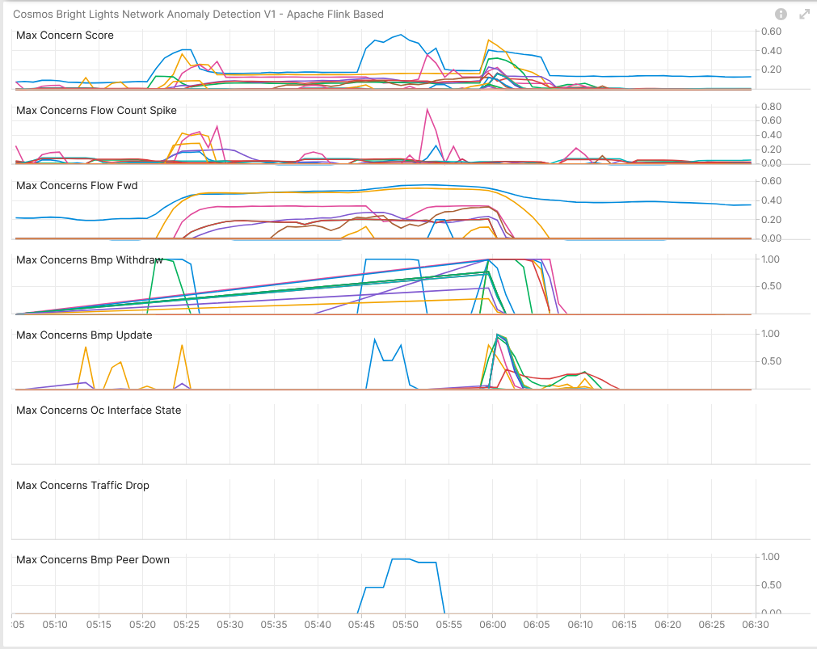
November 28th, SRv6 Resilience Analysis & Tests in Production Use Case 6 – Network Anomaly Detection – Live
Concern Score: 0.57
Flow Count Spike: 0.76
Missing Traffic: 0.57
Traffic Drop: 0.00
BMP Peer/Interface Down: 0.00/0.96 BMP Update/Withdrawal: 1.00/1.00
BMP route-monitoring Update/Withdraw check recognized topology change.
BMP peer Down/Up check recognized peering state changes.
Interface Down/Up did not apply.
Traffic Drop spike did not apply since IPFIX did not recognize egress drop.
Missing Traffic check recognized blackholing.
Increased or decreased Flow Count check recognize drop spike due to topology change.
Overall: 4 out of 6 checks have detected the BGP topology change, missing traffic and traffic drop spike. Meets perfectly our expectations.
Cosmos Bright Lights Anomaly Detection – 19x L3 VPN'

Slide 19
What went well?
IPFIX, BMP and YANG-Push delivered the almost perfect operational view on the impacted network.
Cosmos Bright Lights Network Anomaly Detection was battelled in a series of tests and showed that is more then just ready for production. It excels in most of the areas.
We are real-time. BGP topology changes within 3 seconds. Interface traffic within 60 seconds. IPFIX flow aggregation within 90 seconds. Network Anomaly Detection within 180 seconds.
What to do next?
Evaluate why in use case 1 BGP topology changes were not recognized. -> Ongoing.
Evaluate if in use case 3 Missing traffic and flow count changes could be detected. -> Ongoing.
Clarify wherever egress IPFIX could have identified drops. -> Done.
Persist operational data in TSDB for training purposes. -> Done.
What could be improved?
Detect egress drops on data plane serialization in IPFIX.
Include NPU drop verification in resilience analysis and add semantics in Cisco-IOS-XR-asr9k-np-oper.yang describing drop counter meaning.
Add "Cisco-IOS-XR-wdsysmon-fd-oper:system-monitoring/cpu-utilization" xpath in YANG-Push configuration.
Restart of IS-IS process would have no impact if Network Telemetry transport sessions would have been established outband.
Cisco TAC having access to operative Network Telemetry and network node software process, management plane, tracing data.

