Slide 1
An Architecture for YANG-Push to Message Broker Integration draft-ietf-nmop-yang-message-broker-integration-01
Motivation and architecture of a native
YANG-Push notifications and YANG Schema integration
into Message Broker and YANG Schema Registry
thomas.graf@swisscom.com ahmed.elhassany@swisscom.com
9. June 2024

Slide 2
From YANG-Push to Network Analytics Aiming for an automated processing pipeline
A network operator aims for:
An automated data processing pipeline which starts with YANG-Push, consolidates at Data Mesh and ends at Network Analytics.
Operational metrics where IETF defines the semantics.
Analytical metrics where network operators gain actionable insights.
We achieve this by integrating YANG-Push into Data Mesh to:
Produce metrics from networks with timestamps when network events were observed.
Hostname, publisher ID and sequence numbers help us to understand from where metrics were exported and measure its delay and loss.
Forward metrics unchanged from networks
Learn semantics from networks and validate messages.
Control semantic changes end to end.

Slide 3
An Architecture for YANG-Push to Apache Kafka Integration Status, Summary and Next steps
Status
Document adopted at NMOP.
Feedback from Dhruv, Andy, Fend and Qin addressed in -01. Thank you very much!
Changes in -01
Expanded last paragraph in introduction section to detail manual work currently needed in the end-to-end data processing chain due to missing YANG schema
Figure 1 in Section 3 and Section 3.1 now considers in step 1 to perform the YANG-Push notification capabilities described in Section 3 of RFC 9196
Added the message broker component in figure 1 in Section 3
Added section 3.8 describing that observation-time is used for times series metric indexing
Moved Section 4 and 5 to appendix
Used the boiler plate from RFC 7942 and moved section before Security Considerations
Applied RFC 8792 to handle long lines
Section 3.1 describes that in the described architecture both, dynamic and configured YANG-Push subscriptions are supported. To add clarity, an additional paragraph was added detailing on how being subscribed, messages are published in same or different transport session.
Next Steps
Looking forward for review and comments.

Slide 4
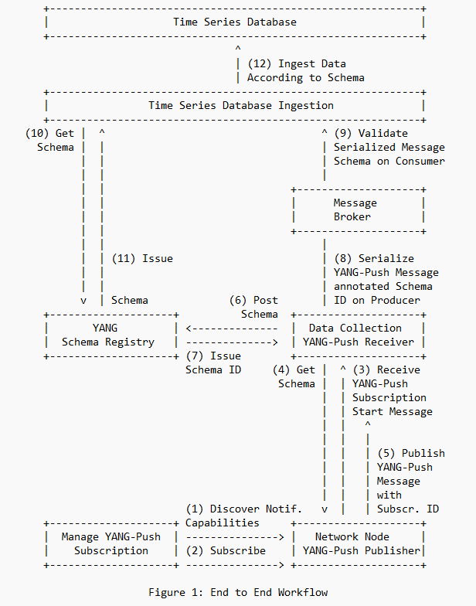
Elements of the Architecture Workflow Diagram
Network Orchestration subscribes to YANG datastore.
Network Node informs Data Collection on subscription state and publishes YANG metrics with YANG-Push.
Data Collection obtains for each subscription the YANG module dependencies and the YANG modules on the network node, registers it in the YANG Schema Registry and prefixes the forwarded YANG notifications with the obtained schema ID.
YANG Schema Registry issues for a Message Broker subject a schema ID for each new schema tree, compares a new schema tree with an existing and versions it.
Time Series Database Ingestion consumes YANG-Push notifications from Message Broker, obtains schema tree from YANG schema registry, validates YANG notifications against schema and uses schema to populate into database table.

Slide 5
Netconf Notifications Define YANG module
module: ietf-notification
structure notification:
+-- eventTime yang:date-and-time
YANG model for NETCONF Event Notifications, draft-ahuang-netconf-notif-yang, updates RFC 5277 by defining the schema as a YANG module.
This enables YANG-push to define semantics for the entire YANG push message and use other encodings than XML such as YANG-JSON RFC 7951 or YANG-CBOR RFC 9264.
Changes in -05: Updates and describes relationship to RFC 5277, RFC 8639, RFC 7951 and RFC 9254 in terms of notification structure.
<notification xmlns="urn:ietf:params:xml:ns:netconf:notification:1.0">
<eventTime>2023-02-04T16:30:11.22Z</eventTime>
<push-update xmlns="urn:ietf:params:xml:ns:yang:ietf-yang-push">
<id>1011</id>
<datastore-contents>
<interfaces xmlns="urn:ietf:params:xml:ns:yang:ietf-interfaces">
<interface>
<name>eth0</name>
<oper-status>up</oper-status>
</interface>
</interfaces>
</datastore-contents>
</push-update>
</notification>

Slide 6
Subscription State Change Notifications RFC 8641 Extensions
Support of Versioning in YANG Notifications Subscription, draft-ietf-netconf-yang-notifications-versioning, adds the ability to subscribe to a specific revision or latest-compatible-semversion. Extends the YANG-Push Subscription State Change Notifications so that the receiver learns on top of xpath and the sub-tree filter also the YANG module name, revision and revision-label.
Changes in -05: Changed ietf-yang-push.yang augmentation to resolve YANG issue that within a "case" statement identifiers need to be unique.
Support of Hostname and Sequencing in YANG Notifications, draft-tgraf-netconf-notif-sequencing, extends the NETCONF notification defined in RFC5277 with sysName, publisherId and sequenceNumber.
Changes in -05: Defined new NETCONF and YANG-Push notification capabilities and described how a systems discovers them.
{
"ietf-notification:notification": {
"eventTime": "2023-03-25T08:30:11.22Z",
"ietf-notification-sequencing:sysName": "example-router",
"ietf-notification-sequencing:sequenceNumber": 1,
"ietf-subscribed-notification:subscription-started": {
"id": 6666,
"ietf-yang-push:datastore": "ietf-datastores:operational",
"ietf-yang-push:datastore-xpath-filter": "/if:interfaces",
"ietf-yang-push-revision:revision": "2014-05-08",
"ietf-yang-push-revision:module-name": "ietf-interfaces",
"ietf-yang-push-revision:revision-label": "",
"ietf-distributed-notif:message-observation-domain-id": [1,2],
"transport": "ietf-udp-notif-transport:udp-notif",
"encoding": "encode-json",
"ietf-yang-push:periodic": {
"ietf-yang-push:period": 100
}
}
}
}
Figure 3: JSON YANG-Push Example for a subscription-started
notification message

Slide 7
Push-Update and Push-Change-Update Notifications RFC 8641 Extensions
Support of Hostname and Sequencing in YANG Notifications, draft-tgraf-netconf-notif-sequencing, , extends the NETCONF notification defined in RFC5277 with sysName, publisherId and sequenceNumber.
Changes in -05: Defined new NETCONF and YANG-Push notification capabilities and described how a systems discovers them.
Support of Network Observation Timestamping in YANG Notifications, draft-tgraf-netconf-yang-push-observation-time, extends YANG-Push push-update notifications with observation-time and state-changed-observation-time.
Changes in -01: Changed semantics; observation-time describes when and point-in-time at which point in time. Added new YANG-Push notification capabilities.
{
"ietf-notification:notification": {
"eventTime": "2023-03-25T08:30:11.22Z",
"ietf-notification-sequencing:sysName": "example-router",
"ietf-notification-sequencing:sequenceNumber": 1,
"ietf-yang-push:push-update": {
"id": 6666,
"ietf-yp-observation-time:observation-time": "2023-02-04T16:30:09.44Z",
"ietf-yp-observation-time:point-in-time": "current-accounting",
"datastore-contents": {
"ietf-interfaces:interfaces": [
{
"interface": {
"name": "eth0",
"type": "iana-if-type:ethernetCsmacd",
"oper-status": "up",
"mtu": 1500
}
}
]
}
}
}
}
Figure 4: JSON YANG-Push Example for a push-update notification message

Slide 8
Augmented-by Addition YANG Library Extension
module: ietf-yang-library
+--ro yang-library
| +--ro module-set* [name]
| | +--ro name string
| | +--ro module* [name]
| | | +--ro name yang:yang-identifier
| | | +--ro revision? revision-identifier
| | | +--ro namespace inet:uri
| | | +--ro location* inet:uri
| | | +--ro submodule* [name]
| | | | +--ro name yang:yang-identifier
| | | | +--ro revision? revision-identifier
| | | | +--ro location* inet:uri
| | | +--ro feature* yang:yang-identifier
| | | +--ro deviation* -> ../../module/name
| | | +--ro yanglib-aug:augmented-by*
-> ../../yanglib:module/name
Augmented-by Addition into the IETF-YANG-Library, draft-lincla-netconf-yang-library-augmentation, enables that augmented-by YANG modules can now be discovered in YANG Library RFC 8525.

Slide 9
Validate anydata schema subtree with YANG Library RFC 7950 Extension
notifications:
+---n push-update
| +--ro id? sn:subscription-id
| +--ro datastore-contents? <anydata>
{
"ietf-yang-push:push-update": {
"id": 89,
"datastore-contents": {
"ietf-interfaces:interfaces": {
"interface": [
{
"name": "eth0",
"oper-status": "down"
}]
}}
}
}
Validating anydata in YANG Library context, draft-aelhassany-anydata-validation, enables that anydata modeled nodes can be validated with YANG Library RFC 8525.
RFC 7950
7.10. The "anydata" Statement
The "anydata" statement defines an interior node in the schema tree.
It takes one argument, which is an identifier, followed by a block of
substatements that holds detailed anydata information.
The "anydata" statement is used to represent an unknown set of nodes
that can be modeled with YANG, except anyxml, but for which the data
model is not known at module design time. It is possible, though not
required, for the data model for anydata content to become known
through protocol signaling or other means that are outside the scope
of this document.

Slide 10
Open Points from IETF 119 Addressed at IETF 120
Open Point 1: datastore-contents in push-update or the value in push-change-update uses anydata as data type which contents does not have a schema defined. draft-aelhassany-anydata-validation addresses that anydata modeled nodes can be validated with YANG Library RFC 8525.
Open Point 2: Definitions how NOTIFICATIONS are encoded in NETCONF are defined in Section 4.2.10 of RFC 7950. However, specifications for encoding in JSON and CBOR are missing RFC 7951 Confirm finding and propose how this needs to be addressed.
Open Point 3: Test with running code wherever with draft-ietf-netconf-yang-notifications-versioning and draft-lincla-netconf-yang-library-augmentation all datastore-subtree-filter or datastore-xpath-filter referenced YANG modules and their dependencies can be fully identified.

Slide 11
Milestones IETF 115 - 120
IETF 115: Official Project Kickoff. Introduced draft-ietf-netconf-yang-notifications-versioning.
IETF 116: YANG module with augmentations can be registered in Confluent Schema Registry with YANG extension. draft-tgraf-netconf-notif-sequencing, draft-tgraf-netconf-yang-push-observation-time and draft-ahuang-netconf-notif-yang introduced.
IETF 118: All relevant YANG modules for a subscribed xpath can be determined through the YANG Library RFC 8525 and retrieved throug NETCONF <get-schema> rpc calls according to RFC 6022. Gap in YANG library addressed in draft-lincla-netconf-yang-library-augmentation.
IETF 119: draft-aelhassany-anydata-validation addresses that anydata modeled nodes can be validated with YANG Library RFC 8525. 6WIND VSR and Huawei VRP YANG-Push and open-source draft-lincla-netconf-yang-library-augmentation implementation validated at hackathon.
IETF 120: 6WIND VSR, Huawei VRP and Cisco IOS XR YANG-Push publisher and draft-aelhassany-anydata-validation implementation validated at hackathon. Running code proofed that with draft-ietf-netconf-yang-notifications-versioning and draft-lincla-netconf-yang-library-augmentation all datastore-subtree-filter or datastore-xpath-filter referenced YANG modules and their dependencies can be fully identified.

Slide 12

YANG-Push Implementation Status IETF 120
 | 6WIND VSR | Huawei VRP | Cisco IOS XR
RFC 8641 YANG-Push | x | x | x
draft-ietf-netconf-udp-notif | x | x
draft-ietf-netconf-distributed-notif | x | x
draft-ietf-netconf-yang-notifications-versioning | x | x
draft-tgraf-netconf-notif-sequencing | x
draft-tgraf-netconf-yang-push-observation-time | x
RFC 7895 YANG Module Library |  | x
RFC 8525 YANG Library | x |  | x
draft-lincla-netconf-yang-library-augmentation

Slide 13











Industry Colaboration On YANG Push to Apache Kafka integration
Text
Text
Text
Text
Text
INSA Lyon
University
Text
6WIND
Network Vendor
Imply
Imply Druid
Ciena
Blueplanet
Swisscom
Network Operator
Huawei
Network Vendor
NTT
Network Operator
Clickhouse
OLAP DBMS
Bell Canada
Network Operator
Cisco
Network Vendor
Confluent
Apache Kafka

Slide 14


