Slide 1
Extensible YANG Model for Network Telemetry Notifications
draft-ietf-nmop-message-broker-telemetry-message
ahmed.elhassany@swisscom.com
thomas.graf@swisscom.com
21. July 2025

Slide 2
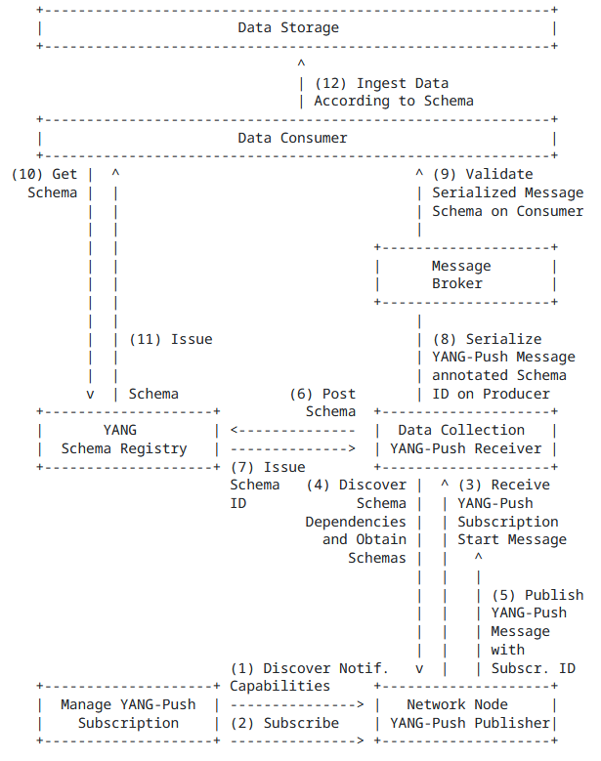
YANG-Push to Message Broker Architecture draft-ietf-nmop-message-broker-telemetry-message
The integration architecture is defined in draft-ietf-nmop-yang-message-broker-integration
The message produced by the Data Collection YANG-Push receiver towards the Message Broker is assumed to be the same as the one received from the router.
In production networks, operators often enrich collected data with additional information such as collection time and the YANG-Push subscription path.
This document aims to standardize the message format between Message Broker Producer and Consumer.

Slide 3
Feedback from NMOP
Document adopted at NMOP. Thanks a lot for the support and to Benoit and Reshad for their review.
Addressed all feedback from IETF 122, and on the NMOP mailing list from the adoption call.
ietf-platform-manifest is now being imported and platform-details reused
Clear naming for leafs and containers based on NMOP feedback
Thanks to Benoit, address and port now distinguishes between local and remote in container data-collection-metadata.
Added session-protocol identities.
Added feature flags for optional metadata: network-node-manifest and data-collection-manifest.
Updated both ietf-telemetry-message and ietf-yang-push-telemetry-message YANG modules based on feedback from Netgauze example implementation.
Added security section as per RFC 8407bis and IANA consideration section.
Added information about implementation status and examples from produced messages.

Slide 4
module: ietf-telemetry-message
+--ro message
+--ro network-node-manifest {network-node-manifest}?
| +--ro name? string
| +--ro vendor? string
| +--ro vendor-pen? uint32
| +--ro software-version? string
| +--ro software-flavor? string
| +--ro os-version? string
| +--ro os-type? string
+--ro telemetry-message-metadata
| +--ro node-export-timestamp? yang:date-and-time
| +--ro collection-timestamp yang:date-and-time
| +--ro session-protocol
| | telemetry-session-protocol-type
| +--ro export-address inet:host
| +--ro export-port? inet:port-number
| +--ro collection-address? inet:host
| +--ro collection-port? inet:port-number
+--ro data-collection-manifest {data-collection-manifest}?
| +--ro name? string
| +--ro vendor? string
| +--ro vendor-pen? uint32
| +--ro software-version? string
| +--ro software-flavor? string
| +--ro os-version? string
| +--ro os-type? string
+--ro network-operator-metadata
| +--ro labels* [name]
| +--ro name string
| +--ro (value)
| +--:(string-choice)
| | +--ro (string-choice)?
| | +--:(string-value)
| | +--ro string-value? string
| +--:(anydata-choice)
| +--ro (anydata-choice)?
| +--:(anydata-values)
| +--ro anydata-values? <anydata>
+--ro payload? <anydata>
ietf-telemetry-message YANG Schema Tree draft-ietf-nmop-message-broker-telemetry-message
1
2
Optional network node and collector data manifest reused from draft-ietf-opsawg-collected-data-manifest
Telemetry Protocol Metadata
Optional network operator metadata
YANG-Push message received from the router
1
3
4

Slide 5
ietf-telemetry-message YANG Schema Tree draft-ietf-nmop-message-broker-telemetry-message
module: ietf-yang-push-telemetry-message
augment /tm:message/tm:telemetry-message-metadata:
+--ro yang-push-subscription
+--ro id? sn:subscription-id
+--ro (filter-spec)?
| +--:(subtree-filter)
| | +--ro subtree-filter? <anydata>
| +--:(xpath-filter)
| +--ro xpath-filter? yang:xpath1.0
+--ro (target)?
| +--:(stream)
| | +--ro stream? string
| +--:(datastore)
| +--ro datastore? identityref
+--ro transport? sn:transport
+--ro encoding? sn:encoding
+--ro purpose? string
+--ro (update-trigger)?
| +--:(periodic)
| | +--ro periodic!
| | +--ro period? yp:centiseconds
| | +--ro anchor-time? yang:date-and-time
| +--:(on-change)
| +--ro on-change!
| +--ro dampening-period? yp:centiseconds
| +--ro sync-on-start? boolean
+--ro module-version* [module-name]
| +--ro module-name yang:yang-identifier
| +--ro revision? rev:revision-date
| +--ro revision-label? ysver:version
+--ro yang-library-content-id? string
Extends ietf-telemetry-message ietf-telemetry-message with YANG-Push subscription with information obtained from the YANG-Push subscription-started notification.
Previous implementation didn’t specify the correct filters (thanks Rob).
Unlike YANG-Push, we use one spec for datastore and notifications with a target leaf to specify the use of the filter.
Added additional metadata that are useful: transport, encoding, purpose, module-version, etc..

Slide 6
Questions and Next steps
Request more feedback from NMOP, BBF Broadband Network Data Collection (BNDC), network operators and network analytics software development colleagues wherever the proposed schema
The structure makes sense
Accommodates all needs or is missing elements
Validate consuming telemetry message with Ciena Blue Planet Unified Assurance and Analytics (UAA), Network Anomaly Detection and YANG transformation systems.
Propose second augmentation supporting IPFIX. Addressing WT-508 requirements from Broadband Forum.

Slide 7
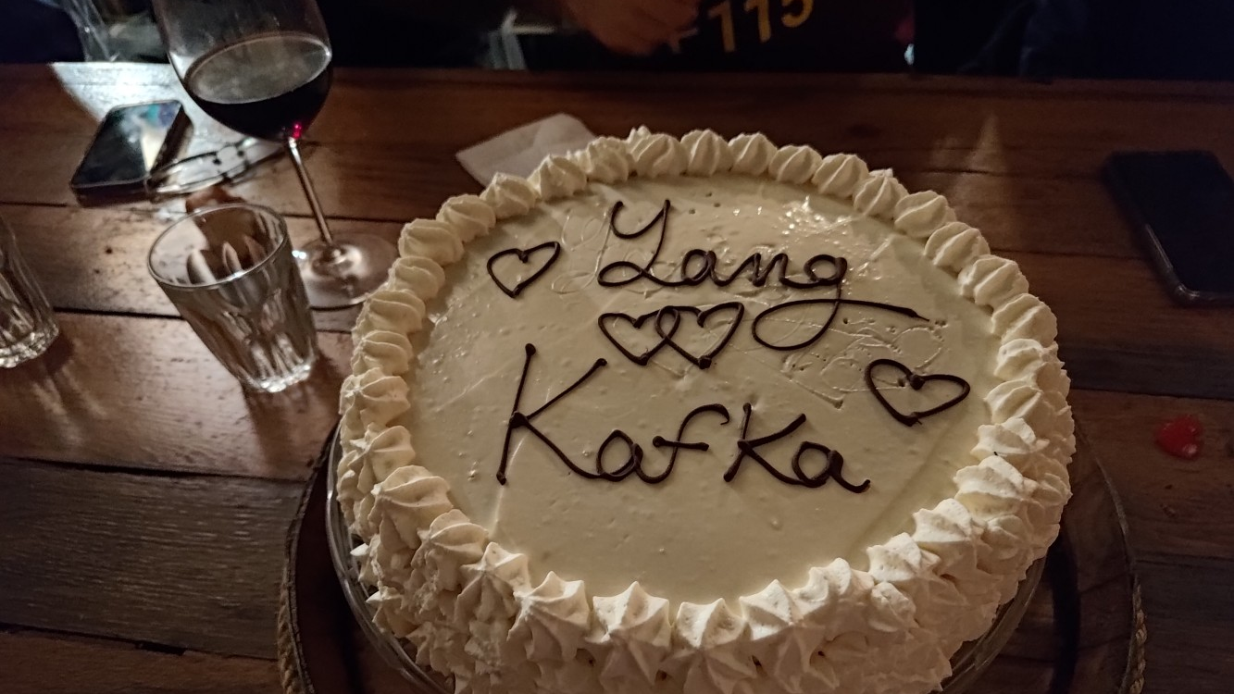
https://www.network-analytics.org/yp/

