Slide 1
YANG Notification Transport Capabilities draft-netana-netconf-yp-transport-capabilities-01
Augments "ietf-system-capabilities" to enable
a client to discover the transport protocol, encoding and security capabilities of a YANG-Push publisher
thomas.graf@swisscom.com
alex.huang-feng@insa-lyon.fr bill.wu@huawei.com
maqiufang1@huawei.com
6. February 2025

Slide 2
Agenda Items
How Transport Capabilities relates to YANG-Push to Message Broker Integration Architecture
Document Changes since -00
Current Document Status
Next Steps

Slide 3
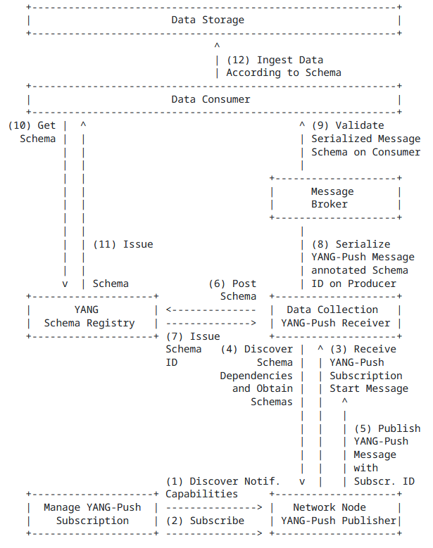
YANG Notification Transport Capabilities Integrates in the YANG-Push to Message Broker Integration Architecture
draft-ietf-nmop-yang-message-broker-integration describes an Architecture for YANG-Push to Message Broker Integration.
Section 4.1 of draft-ietf-nmop-yang-message-broker-integration describes the YANG-Push subscription workflow where before the subscription configuration the transport, notification and subscription capabilities are being discovered first.
draft-netana-netconf-yp-transport-capabilities extends "ietf-system-capabilities" for discovering transport, Section 3.2 of draft-netana-netconf-notif-envelope for notification metadata and Section 5.2 for observation timestamping.
This allows a client to discover all YANG-Push server capabilities to enable the automation of the YANG-Push subscription configuration workflow depending on the YANG-Push server capabilities .

Slide 4
YANG Notification Transport Capabilities Changes since -00, presented at IETF 121
identity tls12 {
base security-protocol;
description
"Indicates TLS Protocol Version 1.2. TLS 1.2 is obsolete,
and thus it is NOT RECOMMENDED to enable this feature.";
reference
"RFC 5246: The Transport Layer Security (TLS) Protocol Version 1.2";
}
identity tls13 {
base security-protocol;
description
"Indicates TLS Protocol Version 1.3.";
reference
"RFC 8446: The Transport Layer Security (TLS) Protocol Version 1.3";
}
identity dtls12 {
base security-protocol;
description
"Indicates DTLS Protocol Version 1.2. TLS 1.2 is obsolete,
and thus it is NOT RECOMMENDED to enable this feature.";
reference
"RFC 6347: The Datagram Transport Layer Security (TLS) Protocol Version 1.2";
}
identity dtls13 {
base security-protocol;
description
"Indicates DTLS Protocol Version 1.3.";
reference
"RFC 9147: The Datagram Transport Layer Security (TLS) Protocol Version 1.3";
}
Changes since -00, presented at IETF 121
Incorporated editorial changes from Med.
Thanks a lot Med!
Updated terminology section with:
The terms "subscriber", "publisher", and "receiver" are used as defined in [RFC8639]. The terms "client", and "server" are used as defined in [RFC8342].
Align TLS and DTLS entities with RFC 9645 (ietf-tls-server.yang). Supporting for both version 1.2 and 1.3.
Diff: https://author-tools.ietf.org/iddiff?doc_1=draft-netana-netconf-yp-transport-capabilities-01

Slide 5
YANG Notification Transport Capabilities draft-netana-netconf-yp-transport-capabilities-01 - Current Status
Current Status
Replaces draft-tao-netconf-data-export-capabilities. Presented at IETF 121 with the request of working group adoption.
The mandatory encoding question has been raised at the IETF 107. The choices in the poll did not include CBOR. The working group decided to let market decide in contrary to Section 7 of RFC 8639. which lead to eid6211 at "Held for Document Update" status.
Authors raised question at IETF 122 and on mailing list to NETCONF working group wherever document addresses the discoverability requirements defined in Section 7 of RFC 8639 and errata 6211 for draft-ietf-netconf-udp-notif and draft-ietf-netconf-https-notif. Kent and Andy confirmed yes.
Kent aligned with the authors opinions that Section 7 of RFC 8639 should be updated in draft-wilton-netconf-yp-observability to state that encoding and security properties MUST be discoverable in the System Capabilities model defined in RFC 9196.
Authors are aware of 4 implementations that are currently being developed and at IETF 122 hackathon validated. Targeting YANG-Push MVP 1 end of 2025 to be general available.

Slide 6
YANG Notification Transport Capabilities draft-netana-netconf-yp-transport-capabilities-01 - Current Status
Authors raised question at IETF 122 and on mailing list to NETCONF working group wherever document addresses the discoverability requirements defined in Section 7 of RFC 8639 and errata 6211 for draft-ietf-netconf-udp-notif and draft-ietf-netconf-https-notif. Kent and Andy confirmed yes.
To mandate default encoding for all YANG-Push transport protocols (https-notif and udp-notif) until a new document (possibly draft-wilton-netconf-yp-observability) updates RFC 8639 with errata eid6211 which gives the implementor the choice of implementing any discovery mechanism or a default encoding.
To mandate default encoding for all YANG-Push transport protocols (https-notif and udp-notif) until a new document (possibly draft-wilton-netconf-yp-observability) updates RFC 8639 with a requirement of draft-netana-netconf-yp-transport-capabilities based on RFC 9196.
To ignore default encoding requirements for all YANG-Push transport protocols (https-notif and udp-notif) until a new document (possibly draft-wilton-netconf-yp-observability) updates RFC 8639 with errata eid6211 which gives the implementor the choice of implementing any discovery mechanism or a default encoding.
To ignore default encoding requirements for all YANG-Push transport protocols (https-notif and udp-notif) until a new document (possibly draft-wilton-netconf-yp-observability) updates RFC 8639 with a requirement of draft-netana-netconf-yp-transport-capabilities based on RFC 9196.

Slide 7
YANG Notification Transport Capabilities draft-netana-netconf-yp-transport-capabilities-01 - Next Steps
Next Steps
Network operators require YANG-Push capabilities discovery mechanism to automate RFC 8639/8641 YANG-Push subscription process. This is one of the major pain points of todays legacy, non-standard YANG-Push implementations.
RFC 9196 does address network operators' needs, and this document complements the YANG-Push configured subscription transport capabilities aspect.
Considering that this is the 9th document iteration and stable, and that 4 major implementations are under way, the authors are concerned that if the NETCONF working group doesn’t adopt the document now then there is no sufficient time to discuss before implementations becoming general available.
Authors therefore request to raise a poll on February 10th interim to clarify wherever document addresses the discoverability requirements defined in Section 7 of RFC 8639 and errata 6211 for draft-ietf-netconf-udp-notif and draft-ietf-netconf-https-notif to receive additional feedback from the working group and initiate working group adoption call.
thomas.graf@swisscom.com
alex.huang-feng@insa-lyon.fr bill.wu@huawei.com
maqiufang1@huawei.com
6. February 2025

Slide 8
BACKUP

Slide 9
YANG Notification Transport Capabilities Capabilities for Systems and Datastore Update Notifications
Section 7 of RFC 8639 and errata 6211 describes that that supported YANG-Push transport encodings needs to be discoverable.
Section 2.5 of RFC 8639 describes configured YANG-Push subscriptions. draft-ietf-netconf-udp-notif and draft-ietf-netconf-https-notif are two transport protocols for configured YANG-Push subscriptions.
RFC 9196 defines two YANG modules, "ietf-system-capabilities" and "ietf-notification-capabilities".
The module "ietf-system-capabilities" provides a placeholder structure that can be used to discover YANG-related system capabilities for servers.
The module "ietf-notification-capabilities" augments "ietf-system-capabilities" to specify notification capabilities related to RFC 8641.
Section 3 of RFC 9196 defines the following transport agnostic notification capabilities
supported (reporting) periods for "periodic" subscriptions.
the maximum number of objects that can be sent in an update.
the set of datastores or data nodes for which "periodic" notification is supported.
supported dampening periods for "on-change" subscriptions.
the set of datastores or data nodes for which "on-change" notification is supported.

Slide 10
YANG Notification Transport Capabilities Extending System Capabilities for YANG-Push Configured Subscription Transport
module: ietf-notification-transport-capabilities
augment /sysc:system-capabilities/notc:subscription-capabilities:
+--ro transport-capabilities
+--ro transport-capability* [transport-protocol]
+--ro transport-protocol identityref
+--ro security-protocol? identityref
+--ro encoding-format* identityref
augment "/sysc:system-capabilities/notc:subscription-capabilities" {
description "Add system level capability.";
container transport-capabilities {
description "Capabilities related to YANG-Push transports.";
list transport-capability {
key "transport-protocol";
description "Capability list related to notification transport capabilities.";
leaf transport-protocol {
type identityref {
base sn:transport;
}
description "Supported transport protocol for YANG-Push.";
}
leaf security-protocol {
type identityref {
base security-protocol;
}
description "Type of secure transport.";
}
leaf-list encoding-format {
type identityref {
base sn:encoding;
}
description "Supported encoding formats.";
}
}
}
draft-netana-netconf-yp-transport-capabilities augments System Capabilities model and provides additional transport related attributes associated with system capabilities:
Specification of transport protocols the client can request to establish a draft-ietf-netconf-udp-notif or draft-ietf-netconf-https-notif configured transport connection;
Specification of transport encoding, such as JSON or XML as defined in RFC 8040 or CBOR as defined in RFC 9254 the client can request to encode YANG notifications;
Specification of secure transport mechanisms that are needed by the client to communicate with the server such as DTLS as defined in RFC 9147 TLS as defined in RFC 8446 or SSH as defined in RFC 4254;

