Slide 1
YANG Notification Transport Capabilities draft-ietf-netconf-yp-transport-capabilities-00
Augments "ietf-system-capabilities" to enable
a client to discover the transport protocol, encoding and security capabilities of a YANG-Push publisher
thomas.graf@swisscom.com
alex.huang-feng@insa-lyon.fr bill.wu@huawei.com
maqiufang1@huawei.com
16. March 2025

Slide 2
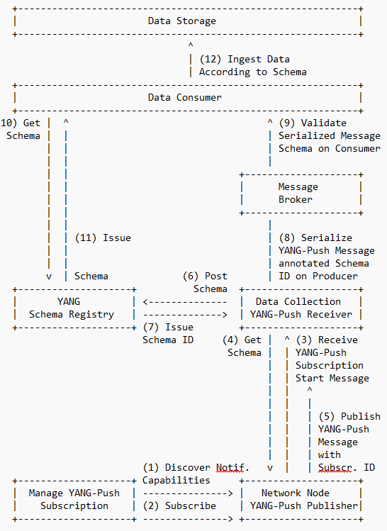
YANG Notification Transport Capabilities Integrates in the YANG-Push to Message Broker Integration Architecture
draft-ietf-nmop-yang-message-broker-integration describes an Architecture for YANG-Push to Message Broker Integration.
Section 4.1 of draft-ietf-nmop-yang-message-broker-integration describes the YANG-Push subscription workflow where before the subscription configuration the transport, notification and subscription capabilities are being discovered first.
draft-netana-netconf-yp-transport-capabilities extends "ietf-system-capabilities" for discovering transport, Section 3.2 of draft-netana-netconf-notif-envelope for notification metadata and Section 4 of draft-tgraf-netconf-yang-push-observation-time for observation timestamping.
This allows a client to discover all YANG-Push server capabilities to enable the automation of the YANG-Push subscription configuration workflow depending on the YANG-Push server capabilities .

Slide 3
YANG Notification Transport Capabilities Extending System Capabilities for YANG-Push Configured Subscription Transport
module: ietf-notification-transport-capabilities
augment /sysc:system-capabilities/notc:subscription-capabilities:
+--ro transport-capabilities
+--ro transport-capability* [transport-protocol]
+--ro transport-protocol identityref
+--ro security-protocol? identityref
+--ro encoding-format* identityref
augment "/sysc:system-capabilities/notc:subscription-capabilities" {
description "Add system level capability.";
container transport-capabilities {
description "Capabilities related to YANG-Push transports.";
list transport-capability {
key "transport-protocol";
description "Capability list related to notification transport capabilities.";
leaf transport-protocol {
type identityref {
base sn:transport;
}
description "Supported transport protocol for YANG-Push.";
}
leaf security-protocol {
type identityref {
base security-protocol;
}
description "Type of secure transport.";
}
leaf-list encoding-format {
type identityref {
base sn:encoding;
}
description "Supported encoding formats.";
}
}
}
draft-ietf-netconf-yp-transport-capabilities augments System Capabilities model and provides additional transport related attributes associated with system capabilities:
Specification of transport protocols the client can request to establish a draft-ietf-netconf-udp-notif or draft-ietf-netconf-https-notif configured transport connection;
Specification of transport encoding, such as JSON or XML as defined in RFC 8040 or CBOR as defined in RFC 9254 the client can request to encode YANG notifications;
Specification of secure transport mechanisms that are needed by the client to communicate with the server such as DTLS as defined in RFC 9147 TLS as defined in RFC 8446 or SSH as defined in RFC 4254;

Slide 4
YANG Notification Transport Capabilities draft-netana-netconf-yp-transport-capabilities-00 - Status and Next Steps
Current Status
Document is working group adopted.
Many thanks to Reshad, Med, Rob, Giuseppe, Nils and Benoit for the review and support.
Changes after IETF 121
We received a review from Med, thanks a lot!
Review was addressed in -01 as following:
Some editorial updates
TLS has now also two identities, same as DTLS for version 1.2 and 1.3, matching with what is defined in RFC 9645 (ietf-tls-server.yang)
Next Steps
Validate with implementations.
Working group last call.
thomas.graf@swisscom.com
alex.huang-feng@insa-lyon.fr bill.wu@huawei.com
maqiufang1@huawei.com
16. March 2025

Slide 5
YANG Notification Transport Capabilities draft-ietf-netconf-yp-transport-capabilities-00 - IETF 122 Hackathon
<?xml version="1.0"?>
<rpc-reply message-id="101" xmlns="urn:ietf:params:xml:ns:netconf:base:1.0">
<data>
<system-capabilities xmlns="urn:ietf:params:xml:ns:yang:ietf-system-capabilities">
<subscription-capabilities xmlns="urn:ietf:params:xml:ns:yang:ietf-notification-capabilities">
<max-nodes-per-update>4294967295</max-nodes-per-update>
<periodic-notifications-supported>state-changes</periodic-notifications-supported>
<minimum-update-period>3000</minimum-update-period>
<on-change-supported>state-changes</on-change-supported>
<notification-metadata xmlns="urn:ietf:params:xml:ns:yang:ietf-yp-notification">
<notification-envelope>true</notification-envelope>
<metadata>
<hostname-sequence-number>true</hostname-sequence-number>
</metadata>
</notification-metadata>
<transport-capabilities xmlns="urn:ietf:params:xml:ns:yang:ietf-notification-transport-capabilities">
<transport-capability>
<transport-protocol xmlns:idx="urn:ietf:params:xml:ns:yang:ietf-udp-notif-transport">idx:udp-notif </transport-protocol>
<encoding-format xmlns:idx="urn:ietf:params:xml:ns:yang:ietf-subscribed-notifications">idx:encode-json</encoding-format>
</transport-capability>
</transport-capabilities>
<yang-push-observation-supported xmlns="urn:ietf:params:xml:ns:yang:ietf-yp-observation">true</yang-push-observation-supported>
<yang-push-module-revision-supported xmlns="urn:ietf:params:xml:ns:yang:ietf-yang-push-revision">true</yang-push-module-revision-supported>
</subscription-capabilities>
</system-capabilities>
</data>
</rpc-reply>

