Slide 1
Extensible YANG Model for Network Telemetry Notifications
draft-ietf-nmop-message-broker-telemetry-message
ahmed.elhassany@swisscom.com
thomas.graf@swisscom.com
21. July 2025

Slide 2
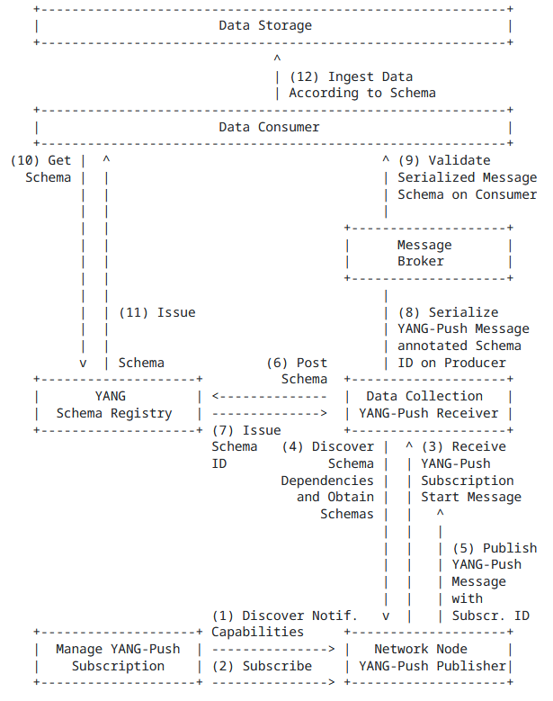
YANG-Push to Message Broker Architecture draft-ietf-nmop-message-broker-telemetry-message
The integration architecture is defined in draft-ietf-nmop-yang-message-broker-integration
The message produced by the Data Collection YANG-Push receiver towards the Message Broker is assumed to be the same as the one received from the router.
In production networks, operators often enrich collected data with additional information such as collection time and the YANG-Push subscription path.

Slide 3
Feedback from NMOP
Addressed all feedback from IETF 122 and on the NMOP mailing list.
Clear naming for leaves and containers.
Add feature flags for optional metadata: network-node-manifest and data-collection-manifest.
Add information about implementation status and example produced messages.

Slide 4
module: ietf-telemetry-message
+--ro message
+--ro network-node-manifest {network-node-manifest}?
| +--ro name? string
| +--ro vendor? string
| +--ro vendor-pen? uint32
| +--ro software-version? string
| +--ro software-flavor? string
| +--ro os-version? string
| +--ro os-type? string
+--ro telemetry-message-metadata
| +--ro node-export-timestamp? yang:date-and-time
| +--ro collection-timestamp yang:date-and-time
| +--ro session-protocol
| | telemetry-session-protocol-type
| +--ro export-address inet:host
| +--ro export-port? inet:port-number
| +--ro collection-address? inet:host
| +--ro collection-port? inet:port-number
+--ro data-collection-manifest {data-collection-manifest}?
| +--ro name? string
| +--ro vendor? string
| +--ro vendor-pen? uint32
| +--ro software-version? string
| +--ro software-flavor? string
| +--ro os-version? string
| +--ro os-type? string
+--ro network-operator-metadata
| +--ro labels* [name]
| +--ro name string
| +--ro (value)
| +--:(string-choice)
| | +--ro (string-choice)?
| | +--:(string-value)
| | +--ro string-value? string
| +--:(anydata-choice)
| +--ro (anydata-choice)?
| +--:(anydata-values)
| +--ro anydata-values? <anydata>
+--ro payload? <anydata>
ietf-telemetry-message YANG Schema Tree draft-ietf-nmop-message-broker-telemetry-message
1
2
Optional network node and collector data manifest according to draft-ietf-opsawg-collected-data-manifest
Telemetry Protocol Metadata
Optional network operator metadata
YANG-Push message received from the router
1
3
4

Slide 5
ietf-telemetry-message YANG Schema Tree draft-ietf-nmop-message-broker-telemetry-message
module: ietf-yang-push-telemetry-message
augment /tm:message/tm:telemetry-message-metadata:
+--ro yang-push-subscription
+--ro id? sn:subscription-id
+--ro (filter-spec)?
| +--:(subtree-filter)
| | +--ro subtree-filter? <anydata>
| +--:(xpath-filter)
| +--ro xpath-filter? yang:xpath1.0
+--ro (target)?
| +--:(stream)
| | +--ro stream? string
| +--:(datastore)
| +--ro datastore? identityref
+--ro transport? sn:transport
+--ro encoding? sn:encoding
+--ro purpose? string
+--ro (update-trigger)?
| +--:(periodic)
| | +--ro periodic!
| | +--ro period? yp:centiseconds
| | +--ro anchor-time? yang:date-and-time
| +--:(on-change)
| +--ro on-change!
| +--ro dampening-period? yp:centiseconds
| +--ro sync-on-start? boolean
+--ro module-version* [module-name]
| +--ro module-name yang:yang-identifier
| +--ro revision? rev:revision-date
| +--ro revision-label? ysver:version
+--ro yang-library-content-id? string
Extends ietf-telemetry-message ietf-telemetry-message with YANG-Push subscription with information obtained from the YANG-Push subscription-started notification.
Previous implementation didn’t specify the correct filters (thanks Rob).
Unlike YANG-Push, we use one spec for datastore and notifications with a target leaf to specify the use of the filter.
Added additional metadata that are useful: transport, encoding, purpose, module-version, etc..

Slide 6
Next steps
Validate consuming telemetry message with Blue Planet Unified Assurance and Analytics (UAA) and anomaly detection systems.

Slide 7
