Slide 1
UDP-based Transport for Configured Subscriptions draft-ietf-netconf-udp-notif-19/20
UDP-based protocol for YANG notifications
to collect YANG data from networking devices
G. Zheng, Huawei T. Zhou, Huawei
T. Graf, Swisscom
P. Francois, INSA-Lyon
A. Huang Feng, INSA-Lyon
Paolo Lucente, NTT
March 18th 2025

Slide 2
UDP-based Transport for Configured Subscriptions Status
WGLC ended February 13th (successfully)
Thanks Med, Andy, Giuseppe, Weiqiang, James, Dan, Camilo, Qiufang, Benoit, Ahmed, Yannick, Yufeng, Nils, Rob and Mahesh for the support and the (very detailed) reviews
Triggered lively discussions improving the I-D

Slide 3
UDP-based Transport for Configured Subscriptions Normative Changes
Core ideas of the draft have not changed
Normative changes (from discussions on the ML)
Private encoding options has been removed
Received feedback: Underspecified and main idea hard to parse
The order of the options is not mandated anymore
Received feedback: No reason to mandate such order
Remains: segmentation option MUST be first
DTLS 1.2 or later MUST be supported, DTLS 1.3 SHOULD be supported
Confirmed with SEC ADs (Thanks Rob for confirming this!)
Removed also DTLS1.2 limitations on the YANG module
Segmentation is mandatory for large messages

Slide 4
UDP-based Transport for Configured Subscriptions Editorial Changes
Added adherence to NMDA
New Terminology section
Terms from YANG-Push and Distributed-Notif
Text explaining how to reassemble a UDP-Notif message
Usage of Message Publisher ID + Message ID
Added discussion on DTLS Fragmentation with UDP-Notif Segmentation
Rather than mandating DTLS cipher suites → reference BCP195
Updated References
Security Considerations updated with template from I-D.ietf-netmod-rfc8407bis
Add statements on reasons for allocating a registry for I-D.ietf-netconf-udp-pub-channel (IANA Considerations)

Slide 5
UDP-based Transport for Configured Subscriptions What’s next?
The draft is ready for IESG reviews
Looking for a shepherd

Slide 6
Backup

Slide 7
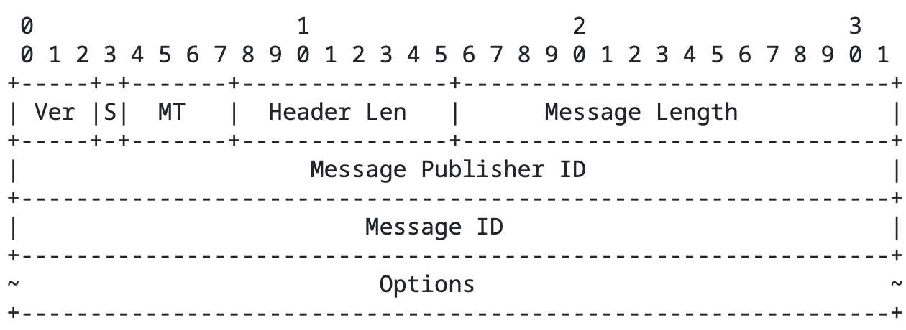
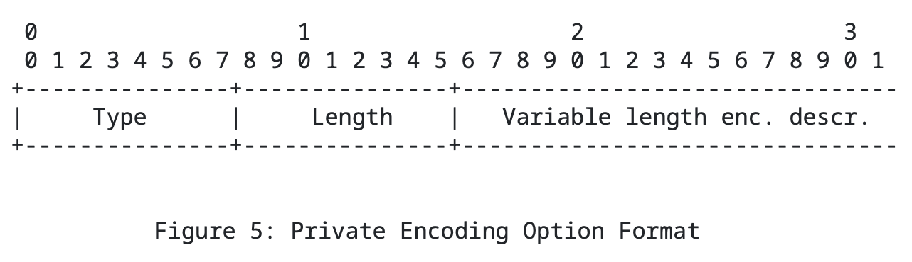
(Removed) Private Encoding Option
Generic TLV to define private encodings
Format defined by the user
To be used together with the MT value

