Slide 1
Semantic Metadata Annotation for Network Anomaly Detection draft-netana-nmop-network-anomaly-semantics-01
Experiment: Network Anomaly Postmortem Lifecycle draft-netana-nmop-network-anomaly-lifecycle-01
Helps to annotate operational data, refine outlier detection, supports supervised and semi-supervised machine learning development,
enables data exchange among network operators, vendors and academia, and make anomalies for humans apprehensible
thomas.graf@swisscom.com wanting.du@swisscom.com
alex.huang-feng@insa-lyon.fr
vincenzo.riccobene@huawei-partners.com
antonio.roberto@huawei.com
06. March 2024

Slide 2
What to monitor Which operational metrics are collected
« Network operators connect customers in routing tables called VPN's »
« Network Telemetry (RFC 9232) describes how to collect data from all 3 network planes efficiently »

Slide 3
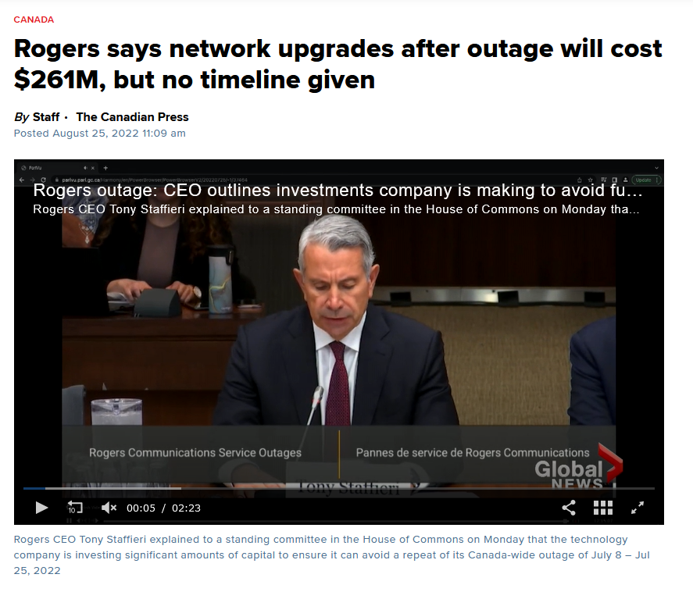
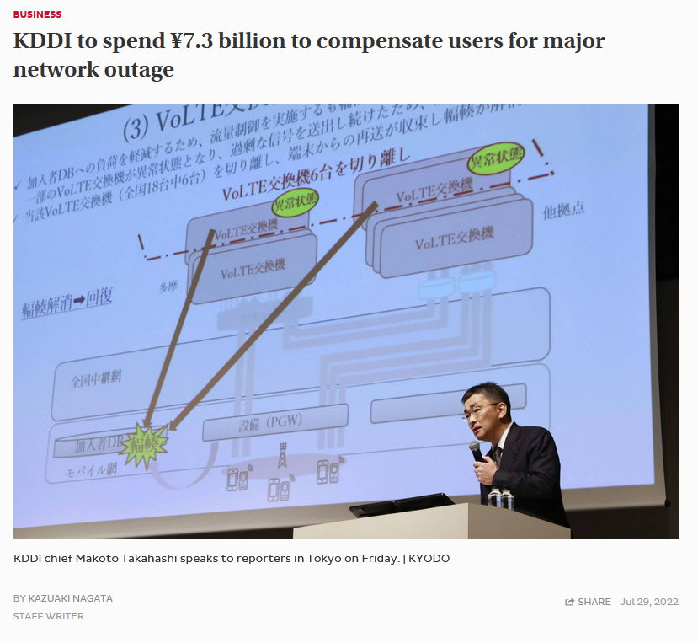

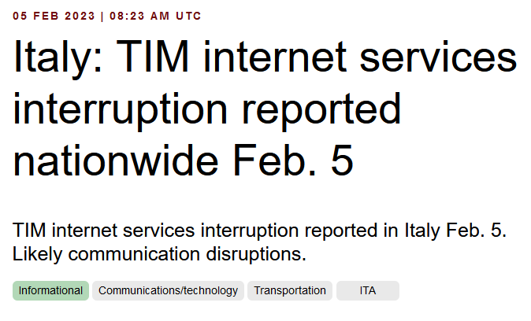

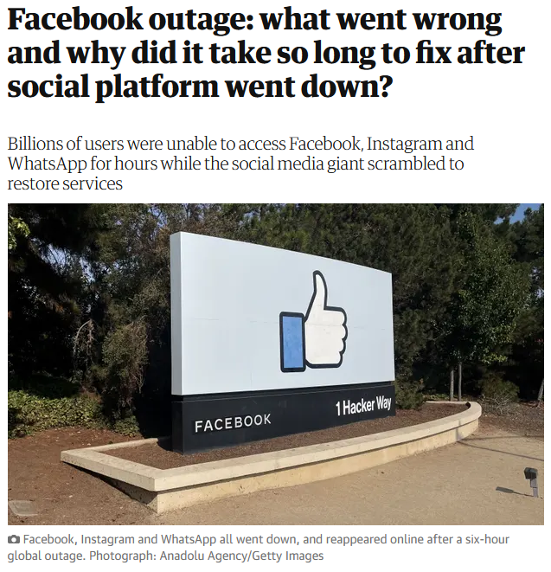
Why to automate monitoring Recognize network incidents faster than humans can
« Customers are always connected, when VPN's changing, regardless due to operational or configurational reasons, network operators are late to react due to missing visibility and automation »

Slide 4





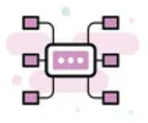

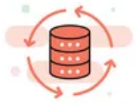


How to organize and collaborate with data The Data Mesh Architecture enables Network Analytics use
Service Owner
Platform Owner
Data Product Owner
Analytical Data Products Governed by Network Operator
Network Device Trend Detection
Verify, Troubleshoot and Notify
Network Anomaly Detection
Network Visualization
Network SLI and SLO
Closed Loop Operation
Data Product Owner
Operation Data Products Governed by Network Telemetry RFC 9232
Network Data Collection

Slide 5



What does Network Anomaly Detection mean Monitor changes
Answers
What changed and when, on which connectivity service, and how does it impact the customers?
Focuses
Provides meaningful connectivity service impact information before customer is aware of and support in root-cause analysis.
Data Mesh
Consumes operational real-time Forwarding Plane, Control Plane and Management Plane metrics and produces analytical alerts.
Direction
From connectivity service to network platform.
Network Anomaly Detection
For VPNs, Network Anomaly Detection constantly monitors and detects any network or device topology changes, along with their associated forwarding consequences for customers as outliers. Notifications are sent to the Network Operation Center before the customer is aware of service disruptions. It offers operational metrics for in-depth analysis, allowing to understand on which platform the problem originates and facilitates problem resolution.

Slide 6
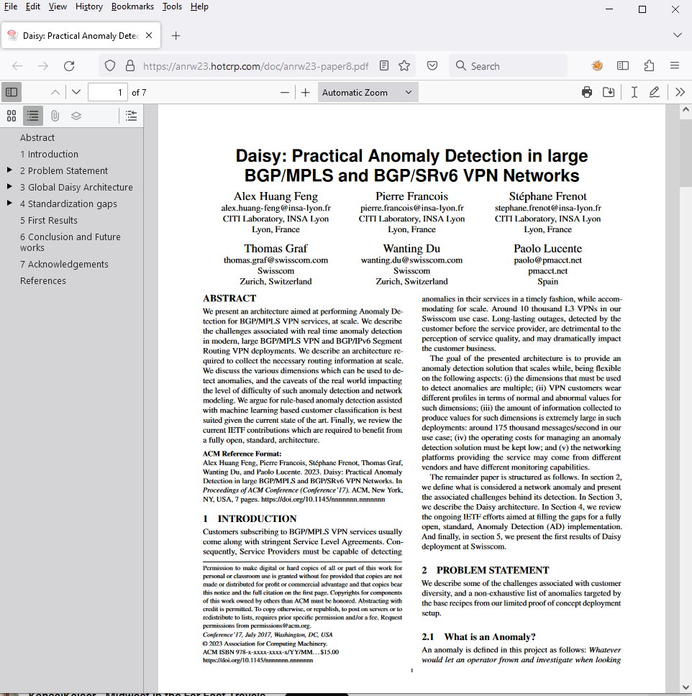
Presented in ANRW 2023 At IETF 117 San Francisco
« A more detailing paper will be submitted soon to IEEE Transactions on Network and Service Management»

Slide 7
What our motivation is Automate learn and improve
From network incidents postmortems we network operators learn and improve so does network anomaly detection and supervised and semi-supervised machine learning.
The more network incidents are observed, the more we can improve. With more incidents the postmortem process needs be automated, let's get organized first by defining human and machine-readable metadata semantics and annotate operational and analytical data.
Let's get further organized by exchanging standardized labeled network incident data among network operators, vendors and academia to collaborate on academic research.
« The community working on Network Anomaly Detection is probably the only group wishing for more network incidents »

Slide 8
What is a symptom and how to categorize them From action to reason to cause
Action: Which action the network node performed for a packet in the forwarding plane, a path or adjacency in the control plane or state or statistical changes in the management plane.
Reason: For each reason one or more actions describing why this action was used. From drop unreachable, administered, and corrupt in forwarding plane, to reachability withdraw and adjacency teared down in control plane, to Interface down, errors or discard in management plane.
Cause: For each reason one or more causes describes why the action was chosen. From missing next-hop and link-layer information in forwarding plane, to reachability withdrawn due to peer down or path no longer redistributed.
« Symptoms are categorized in which plane they have been observed, their action, reason and cause »

Slide 9
Questions to the audience Do you care?
Network Operators: Do you agree that today’s actions; traffic is dropped, path is withdrawn and interface down, are always exposed through Network Telemetry. But reasons and causes, dropped due to unreachable next-hop, withdrawn due to peer down, interface down due to missing signal, are rarely exposed to telemetry would be most interesting?
Network Vendors: Is the assumption correct that a when network service process, routing process and withdrawing a path occur, most of the time the vendor knows why it acts that way, and could potential make this reason and cause information available?
Academia: Would it help if network operators would provide well defined labeled operational and analytical data to enable and validate their research?
Everybody: Should these symptoms be clearly described and standardized for a common terminology so that operators, researchers and anomaly detection systems alike understand their meaning and learn and act accordingly?

Slide 10
Outliers in Anomaly Detection From global to contextual to collective
Global outliers: An outlier is considered "global" if its behavior is outside the entirety of the considered data set.
Contextual outliers: An outlier is considered "contextual" if its behavior is within a normal (expected) range, but it would not be expected based on some context. Context can be defined as a function of multiple parameters, such as time, location, etc.
Collective outliers: An outlier is considered "collective" if the behavior of each single data point that are part of the anomaly are within expected ranges (so they are not anomalous, it’s either a contextual or a global sense), but the group taking all the data points together, is.
« Collective outliers are important because networks are connected. Through different planes interconnected symptoms from various angles can be observed »

Slide 11
Annotate Operational Data YANG Module
module: ietf-symptom-semantic-metadata
+--rw symptom
+--rw id yang:uuid
+--rw event-id yang:uuid
+--rw description string
+--rw start-timeyang:date-and-time
+--rw end-time yang:date-and-time
+--rw confidence-score float
+--rw concern-score? float
+--rw tags* [key]
| +--rw key string
| +--rw value string
+--rw (pattern)?
| +--:(drop)
| | +--rw dropempty
| +--:(spike)
| | +--rw spike empty
| +--:(mean-shift)
| | +--rw mean-shift empty
| +--:(seasonality-shift)
| | +--rw seasonality-shift empty
| +--:(trend)
| | +--rw trend empty
| +--:(other)
| +--rw other string
+--rw source
+--rw (source-type)
| +--:(human)
| | +--rw human empty
| +--:(algorithm)
| +--rw algorithm empty
+--rw name? string
Symptoms describe what changed in the network for what reason and cause with which concern score from when to when.
Tags describes in which network plane, which action, reason and cause was observed.
Pattern describes the measurement pattern over time of the time series data.
Source describes which system observed the outlier. A human or a network anomaly detection system.

Slide 12
Semantic Metadata Annotation for Network Anomaly Detection Next steps
This work relates to the Network Anomaly Detection topic in the NMOP charter.
It bridges network and data engineering, operator, vendors and academia, domains by having the semantics and ontology of network symptoms for operational and analytical data defined.
This work will unveil what is missing in Network Telemetry data and provide input to other documents such as draft-davis-nmop-incident-terminology to enable a more detailed and holistic view for networks.
Do you realize the benefit of having standardized semantic metadata annotation for Network Anomaly Detection and how it helps network operators, vendor and academia to collaborate?
-> What are your thoughts and comments?
-> We request NMOP working group adoption.
thomas.graf@swisscom.com wanting.du@swisscom.com
alex.huang-feng@insa-lyon.fr
vincenzo.riccobene@huawei-partners.com
antonio.roberto@huawei.com
06. March 2024

Slide 13
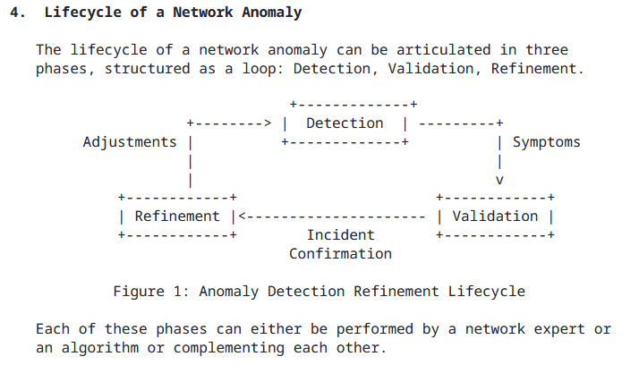
Network Anomaly Postmortem Lifecycle draft-netana-nmop-network-anomaly-lifecycle
Detection: The Network Anomaly Detection stage is about the continuous monitoring of the network through Network Telemetry [RFC9232] and the identification of symptoms.
Validation: Decides if the detected symptoms are signaling a real incident or if they are to be treated as false positives.
Refinement: Network operator performs detailed postmortem analysis of the network incident, collected Network Telemetry data and detected anomaly with the objective to identify useful adjustments in the Network Telemetry data collection and Anomaly Detection system.

Slide 14
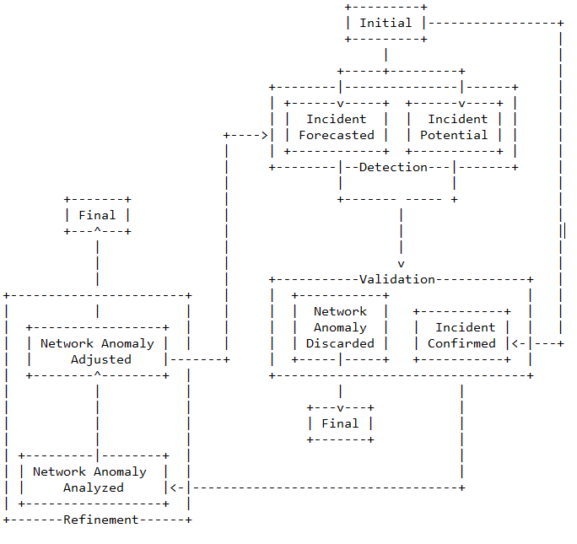
Network Anomaly State Machine Incident Relationships
Incident Forecasted: A potential network incident is predicted in the future by the Network Anomaly Detection system.
Incident Potential: A potential network incident has been detected by the Network Anomaly Detection system.
Incident Confirmed: A potential network incident has been confirmed in the postmortem validation.

Slide 15
Network Anomaly Metadata YANG Module
module: ietf-network-anomaly-metadata
+--rw network-anomalies
+--rw network-anomaly* [id author-name version state]
+--rw id yang:uuid
+--rw description? string
+--rw author-name string
+--rw author
| +--rw author-type? identityref
| +--rw algo-version? uint8
+--rw version uint8
+--rw state identityref
+--rw symptoms* [symptom_id]
+--rw symptom_id yang:uuid
ID and Description uniquely identifies the detected anomaly.
Author Name, Type, Version and Algo-Version describes wherever the anomaly was detected by a human or algorithm and uniquely identifies the system and version who/which detected.
State describes the state of the anomaly.
Symptoms describes the identified symptoms defined in ietf-symptom-semantic-metadata.

Slide 16
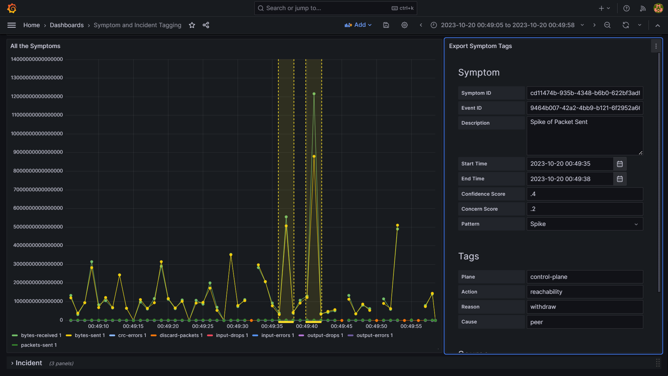
IETF 118 Hackathon – Antagonist Labelling a Symptom in Grafana
Vertical dotted lines are the tagged symptoms.
Once the symptom is selected, the user can add all the details.
Once the symptom is defined it gets submitted to Antagonist.
2
1

Slide 17



IETF 118 Hackathon - Antagonist Workflow
4
Ground Truth is exposed through the YANG format
2
Symptom and Incident Data is visually annotated
3
Symptoms and Incidents are processed
Telemetry Data is stored
REST
Antagonist (Anomaly tagging on historical data) https://github.com/vriccobene/antagonist
Incidents &
Symptoms
REST

Slide 18
Experiment: Network Anomaly Postmortem Lifecycle Next steps
This work relates to the Network Anomaly Detection topic in the NMOP charter.
It defines the Network Anomaly lifecycle by including the Network Incident Postmortem process.
This work will provide input to draft-davis-nmop-incident-terminology and complement other documents such as RFC 8632 and draft-feng-opsawg-incident-management where semantics for alerts and incidents are defined.
Do you realize the benefit of having a defined workflow and semantics to automate the Network Anomaly Postmortem Lifecycle?
-> What are your thoughts and comments?
thomas.graf@swisscom.com wanting.du@swisscom.com
alex.huang-feng@insa-lyon.fr
vincenzo.riccobene@huawei-partners.com
antonio.roberto@huawei.com
06. March 2024

