Slide 1
YANG Groupings for UDP Clients and UDP Servers draft-ietf-netconf-udp-client-server-03/04
Two YANG 1.1 modules
to support the configuration of UDP clients and UDP servers
A. Huang Feng, INSA-Lyon
P. Francois, INSA-Lyon
K. Watsen, Watsen Networks
July 25th 2024

Slide 2
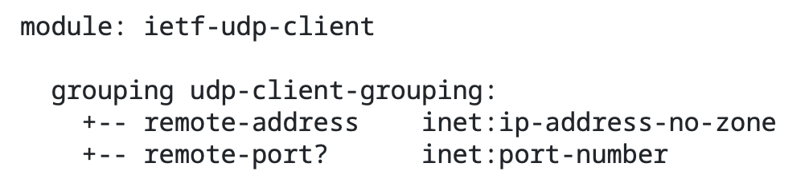
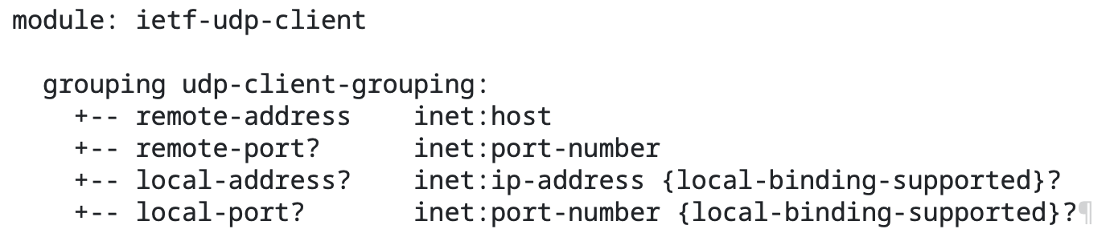
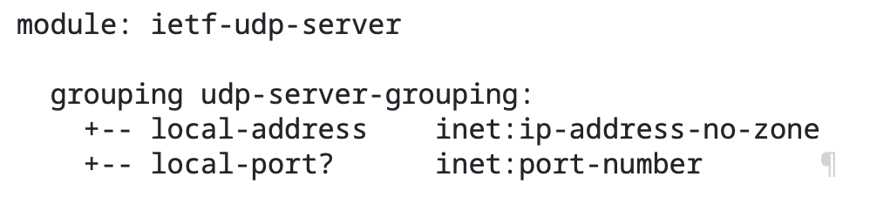
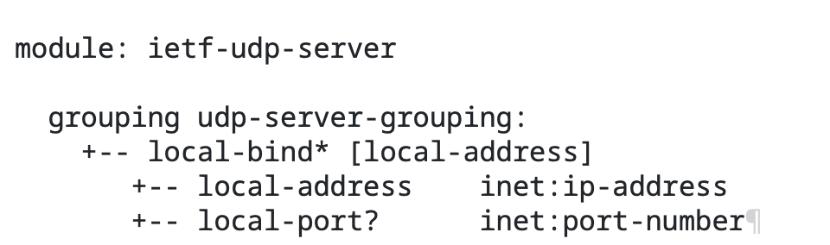
YANG Groupings for UDP Clients and UDP Servers Changes on -03 and -04
OLD
NEW

Slide 3
YANG Groupings for UDP Clients and UDP Servers Changes and Next steps
Changes in -03/-04
UDP groupings mimick the tcp client-server groupings defined in draft-ietf-netconf-tcp-client-server according to the WG feedback from IETF 119.
Added examples how the groupings can be applied.
Removed Default port “0” to allow more flexibility as requested from Med.
Many thanks for the review!
All comments are addressed
Next Steps
➢ Requesting working group last call.

Slide 4
UDP-based Transport for Configured Subscriptions draft-ietf-netconf-udp-notif-13
UDP-based protocol for YANG notifications
to collect YANG data from networking devices
G. Zheng, Huawei T. Zhou, Huawei
T. Graf, Swisscom
P. Francois, INSA-Lyon
A. Huang Feng, INSA-Lyon
Paolo Lucente, NTT
July 25th 2024

Slide 5
UDP-based Transport for Configured Subscriptions Changes in -13/-14 and next steps
ietf-udp-notif-transport.yang is using now the generic UDP client groupings from draft-ietf-netconf-udp-client-server.
A node is now capable of sending UDP-notif notifications to a inet:host rather than only to inet:ip-address-no-zone and is able to set its local address.
Since draft-ietf-netconf-udp-client-server specifies the Layer 4 port as default, Section 8.4 has been added to request IANA for a default port. → Rollbacked to mandatory port as requested by Med
Thanks Med for the feedback!
No pending items. All working group comments are addressed.
Next Steps
➢ Requesting working group last call.

Slide 6
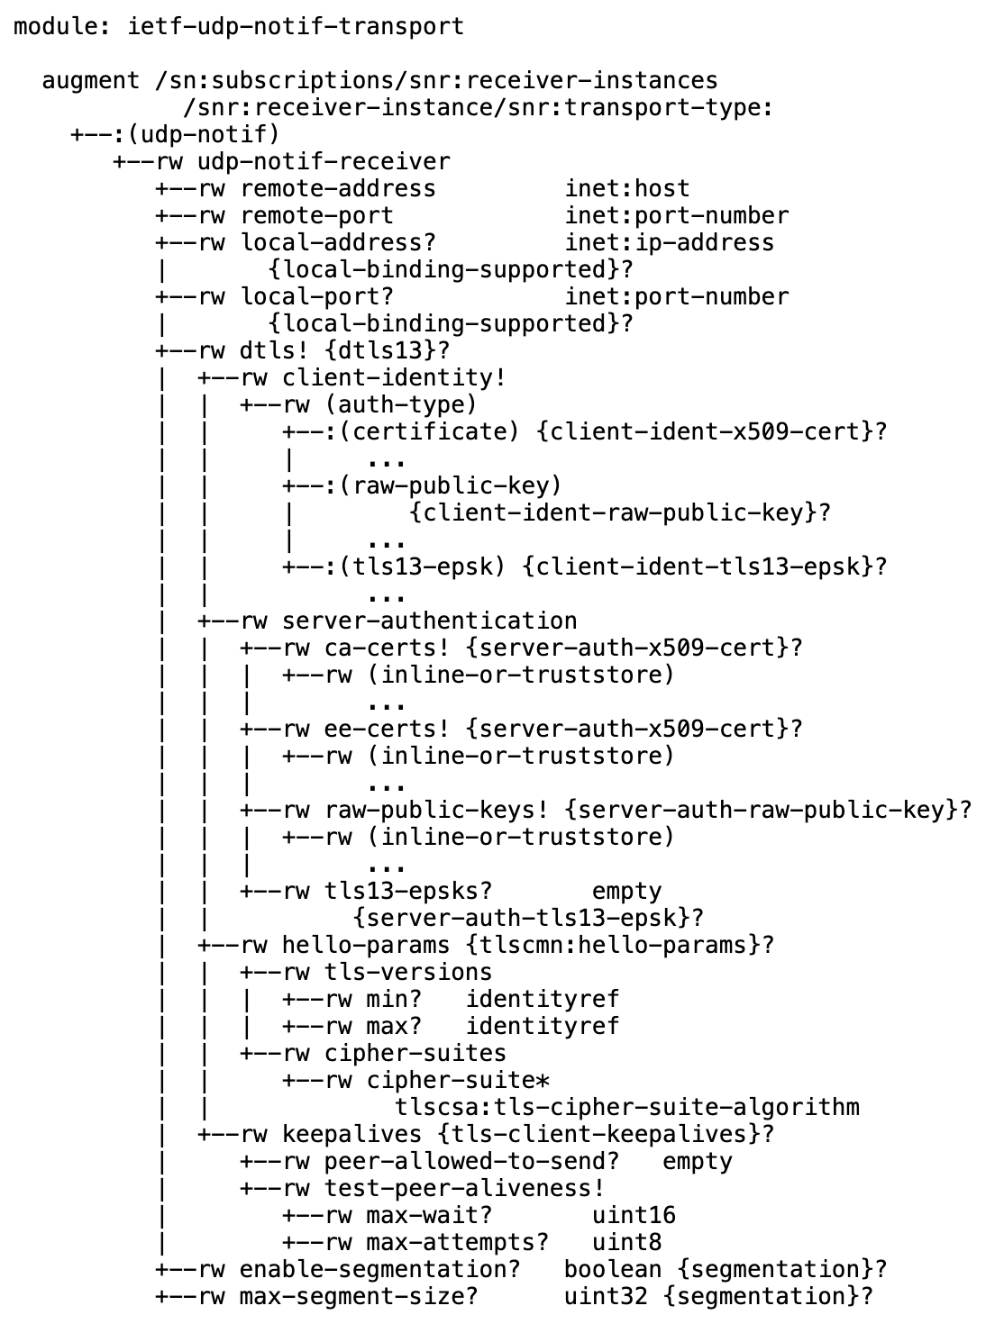
UDP-based Transport for Configured Subscriptions YANG module for UDP-notif configuration
Notes:
- Concerns about the segmentation design, given it is UDP, a loss of a packet makes the discard about the whole message (Hannes Tschofenig) --> defining segmentation here because of RFC8085: (An UDP application SHOULD NOT send UDP datagrams that result in IP packets that exceed the Maximum Transmission Unit (MTU) along the path to the destination)
- Jurgen Schonwalder --> Concerns about the probability of UDP packet loss
- Jurgen Schonwalder --> where is the performance impact? Can't 2023 linecards manage TCP?
- Andy --> narrow the scope of the draft to "small" messages
- Jurgen Schonwalder --> private encoding a bit overengineered?
- Jurgen Schonwalder --> 3-bit Ver field not pointing to the IANA [addressed]
- Hannes --> packet loss is negleactable, need to be explicit in the draft
- Jurgen --> which performance issues we are trying to tackle? not explicit
- Kent support the work for sending the telemetry data to the same rack
- Andy --> on-change notifications should be with TCP

Slide 7
Subscription to Distributed Notifications draft-ietf-netconf-distributed-notif-09
Extends YANG notification subscription to allow metrics being published directly from processors on line cards
zhoutianran@huawei.com
zhengguangying@huawei.com
evoit@cisco.com
thomas.graf@swisscom.com
pierre.francois@insa-lyon.fr
July 25th 2024

Slide 8
Subscription to Distributed Notifications Changes and Next steps
Changes in -09
Updated implementation status section.
Same as for subscription state change, push-update and push-change-update are now augmented with message-publisher-id as well.
Message-publisher-id augmentation is therefore removed in draft-tgraf-netconf-notif-sequencing-06.
Leads to one document describing the augments for message-publisher-id.
No pending items. All working group comments are addressed.
Next Steps
➢ Requesting working group last call.

Slide 9
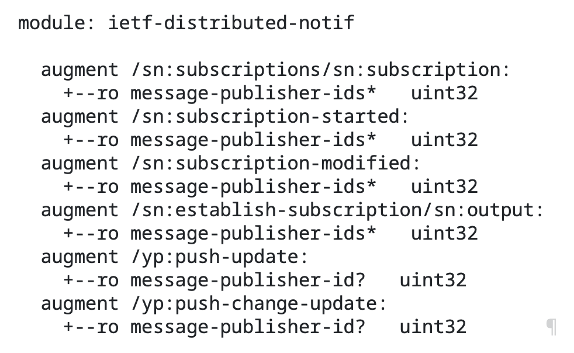
Subscription to Distributed Notifications YANG module

