Slide 1
An Architecture for a Network Anomaly Detection Framework draft-netana-nmop-network-anomaly-architecture-00
Motivation and architecture of a Network Anomaly Detection Framework
and the relationships to other documents describing
network symptom semantics and network incident lifecycle
wanting.du@swisscom.com pierre.francois@insa-lyon.fr
thomas.graf@swisscom.com vincenzo.riccobene@huawei-partners.com alex.huang-feng@insa-lyon.fr
25. July 2024

Slide 2






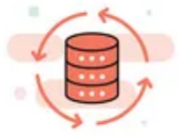

Data Mesh organizes Data in Organizations Enables Network Analytics use cases
Alert
Postmortem
RFC 8632
draft-netana-nmop-network-anomaly-semantics draft-netana-nmop-network-anomaly-lifecycle
Analytical Data draft-netana-nmop-yang-message-broker-integration
Network Device Trend Detection
Verify, Troubleshoot and Notify
Network Anomaly Detection
Network Visualization
Network SLI and SLO
Closed Loop Operation
draft-netana-nmop-network-anomaly-architecture
Operational Data draft-netana-nmop-yang-message-broker-integration
Network Data Collection
Network Telemetry (RFC 9232) IPFIX (RFC 7011, RFC 9487, RFC 9160, draft-ietf-opsawg-ipfix-on-path-telemetry)
BMP (RFC 7854, RFC 8671, RFC 9069, draft-ietf-grow-bmp-tlv, draft-ietf-grow-bmp-path-marking-tlv, draft-lucente-grow-bmp-rel)
YANG-Push (RFC 8639, RFC 8641, draft-ietf-netconf-udp-notif, draft-ietf-netconf-distributed-notif, draft-ahuang-netconf-notif-yang, draft-ietf-netconf-yang-notifications-versioning, draft-tgraf-netconf-notif-sequencing, draft-tgraf-netconf-yang-push-observation-time)

Slide 3
What to monitor Which metrics are collected
« Network operators connect customers in routing tables called Connectivity Services »
« Network Telemetry (RFC 9232) describes how to collect data from all 3 network planes efficiently »

Slide 4
Example: Monitoring L3 VPN's with IPFIX, BMP and YANG Push From Connectivity Service to Realtime Network Analytics
Connectivity Service perspective, Connection Points are connected through Logical Connections.
From a BGP control-plane perspective, IPv4/6 unicast prefixes in VRF's are tagged with BGP standard communities.
One BGP standard community to identify the Logical Connection. One BGP standard community to identify each Connection Point.
When IPv4/6 prefixes are exported from VRF's, a BGP route-distinguisher, BGP extended community route-targets and a SRv6 VPN SID for the IPv6 next-hop are allocated.
From a forwarding plane perspective, when IPv4/6 unicast traffic is received from the edge at the SRv6 PE, a lookup is performed, the SRv6 VPN SID is obtained and IPv6 next-hop is added when forwarded to the core.
Swisscom collects MPLS and SRv6 provider data plane, IPv4/6 unicast customer data-plane in IPFIX and at provider edge BGP VPNv4/6 unicast in production to perform real-time data correlation.

Slide 5



What does Network Anomaly Detection mean Monitor changes, called outliers, in networks
Answers
What changed and when, on which connectivity service, and how does it impact the customers?
Focuses
Provides meaningful connectivity service impact information before customer is aware of and support in root-cause analysis.
Data Mesh
Consumes operational real-time Forwarding Plane, Control Plane and Management Plane metrics and produces analytical alerts.
Direction
From connectivity service to network platform.
Network Anomaly Detection
For Connectivity Services, Network Anomaly Detection constantly monitors and detects any network or device topology change, along with their associated forwarding consequences for customers as outliers. Notifications are sent to the Network Operation Center before the customer is aware of service disruptions. It offers operational metrics for in-depth analysis, allowing to understand in which platform the problem originates and facilitates problem resolution.

Slide 6


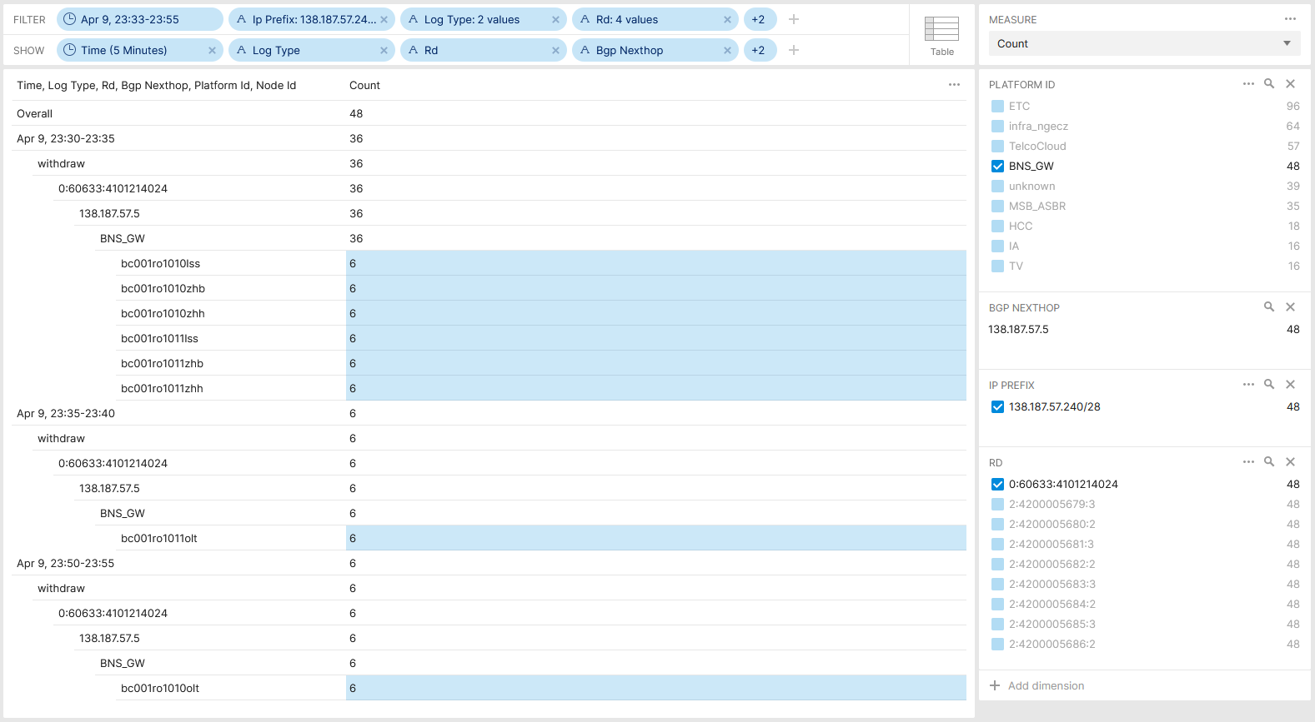

Postmortem, L3 VPN Pilot Migration - Voice Over IP Post Maintenance Window Analysis
Maintenance window was scheduled to start on April 9th 22:00 with a total of 4 migration steps.
At 12:45 CE facing interfaces on first PE node to be phased out was disabled. Triggering a VPNv4 withdrawal of 138.187.57.240/28 from 138.187.57.6 Lo0 towards route-reflectors and then to Inter-AS Option B ASBR. BMP route-monitoring and CLI show commands verified successful route propagation.
At 23:02 CE facing interfaces on first PE node to be migrated to was enabled. Triggering a VPNv4 update of 138.187.57.240/28 from 138.190.129.180 Lo0 towards route-reflectors and then to Inter-AS option B ASBR. BMP route-monitoring and CLI show commands verified successful route propagation.
At 23:34 CE facing interfaces on second PE node to be phased out was disabled. Triggering a VPNv4 withdrawal of 138.187.57.240/28 from 138.187.57.5 Lo0 towards route-reflectors and then to Inter-AS option B ASBR. BMP route-monitoring and CLI show commands verified successful route propagation to route-reflector and on two Option B ASBR, but on other six after 20 mins delay.
Overall BGP Update/withdrawals Across Swisscom MPLS/SRv6 Cores

Slide 7
Postmortem, L3 VPN Pilot Migration - Voice Over IP Show command drove to wrong conclusion
show route table bgp.l3vpn.0 protocol bgp 138.187.57.240/28 detail
60633:4101214024:138.187.57.240/28 (1 entry, 1 announced)
BGP Preference: 170/-101
Route Distinguisher: 60633:4101214024
Next hop type: Indirect, Next hop index: 0
Address: 0x1a963a3c
Next-hop reference count: 8
Source: 138.190.128.116
Protocol next hop: 138.187.57.5
Label operation: Push 83714
Label TTL action: prop-ttl
Load balance label: Label 83714: None;
Indirect next hop: 0x2 no-forward INH Session ID: 0x0
State: <Delete Int Ext ProtectionPath ProtectionCand>
Local AS: 64088.1116 Peer AS: 64088.1116
Age: 5:28 Metric: 805 Metric2: 4
Validation State: unverified
Resolving-AIGP: 4
Effective metric: 8 (IGP metric plus resolving AIGP)
Task: BGP_64088.1116.138.190.128.116
Announcement bits (1): 1-BMP
AS path: 60633 64088.5 ?
Communities: 60633:204 60633:208 60633:1002 64497:4965 64499:13338 target:60633:1100006314
Accepted
BMP: Pre: withdraw Station: DAISY_BMP_1
BMP: Pre: withdraw Station: DAISY_BMP_2
BMP: Station: <unassigned>
Color: VPN Label: 83714
Localpref: 100
Router ID: 138.190.128.116
Thread: junos-main
show route table bgp.l3vpn.0 protocol bgp 138.187.57.240/28 detail
60633:4103214024:138.187.57.240/28 (3 entries, 1 announced)
*BGP Preference: 170/-101
Route Distinguisher: 60633:4103214024
Next hop type: Indirect, Next hop index: 0
Address: 0x1526757c
Next-hop reference count: 4
Source: 138.187.57.3
Protocol next hop: 138.190.128.180
Label operation: Push 83118
Label TTL action: prop-ttl
Load balance label: Label 83118: None;
Indirect next hop: 0x2 no-forward INH Session ID: 0x0
State: <Active Ext ProtectionPath ProtectionCand>
Local AS: 64088.1116 Peer AS: 60633
Age: 14:29:45 Metric: 800 Metric2: 4
Validation State: unverified
Resolving-AIGP: 4
Effective metric: 8 (IGP metric plus resolving AIGP)
Task: BGP_60633.138.187.57.3
Announcement bits (2): 0-BGP_RT_Background 1-BMP
AS path: 60633 64088.1180 ?
Communities: 60633:204 60633:208 60633:1001 60633:1111 64497:4965 64499:13338 target:60633:1100006314
Accepted
BMP: Pre: advertise Station: DAISY_BMP_1
BMP: Pre: advertise Station: DAISY_BMP_2
Color: VPN Label: 83118
Localpref: 100
Router ID: 138.187.57.3
Thread: junos-main
Juniper JunOS CLI show command shows that path is for 20min no longer primary active but still as backup path inactive. Output mislead network engineer to believe that path is still installed.

Slide 8
Postmortem, L3 VPN Pilot Migration - Voice Over IP Data collection timestamp drove to wrong conclusion
"timestamp": "Tue Apr 09 2024 23:34:21",
"writer_id": "bew03bmp45c 20240220-1 (45ae4201)",
"peer_ip": "138.190.128.117",
"string": "Tue Apr 09 2024 23:52:34"
"timestamp": "Tue Apr 09 2024 23:34:21",
"writer_id": "bew03bmp45c 20240220-1 (45ae4201)",
"peer_ip": "138.187.57.4",
"string": "Tue Apr 09 2024 23:52:34"
"timestamp": "Tue Apr 09 2024 23:34:21",
"writer_id": "bew03bmp45c 20240220-1 (45ae4201)",
"peer_ip": "138.187.57.3",
"string": "Tue Apr 09 2024 23:52:34"
"timestamp": "Tue Apr 09 2024 23:34:21",
"writer_id": "bew03bmp45c 20240220-1 (45ae4201)",
"peer_ip": "138.190.128.117",
"string": "Wed Apr 10 2024 01:04:00"
"timestamp": "Tue Apr 09 2024 23:34:21",
"writer_id": "zoi03bmp45c 20240220-1 (45ae4201)",
"peer_ip": "138.187.57.3",
"string": "Tue Apr 09 2024 23:54:09"
"timestamp": "Tue Apr 09 2024 23:34:21",
"writer_id": "zoi03bmp45c 20240220-1 (45ae4201)",
"peer_ip": "138.187.57.4",
"string": "Tue Apr 09 2024 23:54:17"
"timestamp": "Tue Apr 09 2024 23:34:21",
"writer_id": "zoi03bmp45c 20240220-1 (45ae4201)",
"peer_ip": "138.190.128.117",
"string": "Tue Apr 09 2024 23:54:24"
"timestamp": "Tue Apr 09 2024 23:34:21",
"writer_id": "zoi03bmp45c 20240220-1 (45ae4201)",
"peer_ip": "138.190.128.117",
"string": "Wed Apr 10 2024 00:54:51"
The yellow marked timestamp shows the optional BMP per-peer header observation timestamp.
The blue marked timestamp shows the timestamp being augmented on the BMP data collection and being used for the time series database.
Because BMP per-peer timestamp is optional, in the time series database ingestion, the data collection augmentation timestamp is used instead. Leading to false conclusions when the state change was observed.

Slide 9
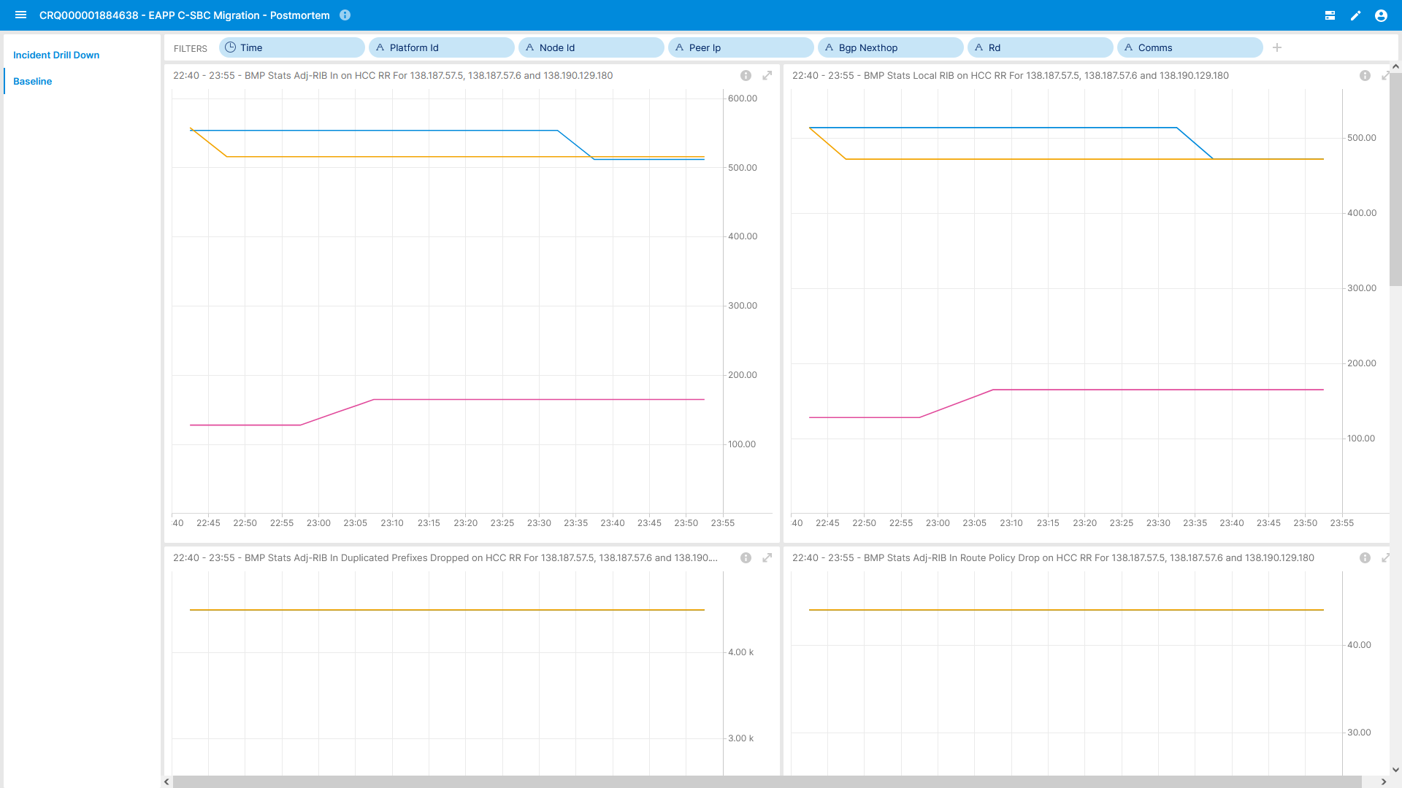
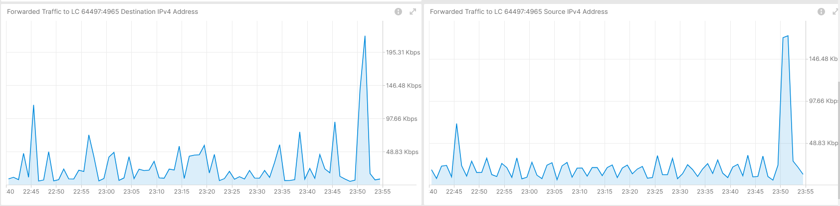

Postmortem, L3 VPN Pilot Migration - Voice Over IP Route-Reflector Peering and L3 VPN Traffic View
IPFIX configured on PE but not on involved MPLS Inter-AS option B ASBRs due to PR1567039.
BMP ADJ-RIB In pre-policy on BGP VPNv4 /6 on MPLS PE's. BMP ADJ-RIB In pre-policy on BGP VPNv4 /6 on Route Reflectors and BMP ADJ-RIB In pre-policy and ADJ-RIB Out post-policy on Inter-AS Option B ASBR.
YANG Push on most nodes but not relevant for this use case.
BMP Peering Statistics on Route Reflectors
Traffic to Voice over IP Service on affected L3 VPN

Slide 10
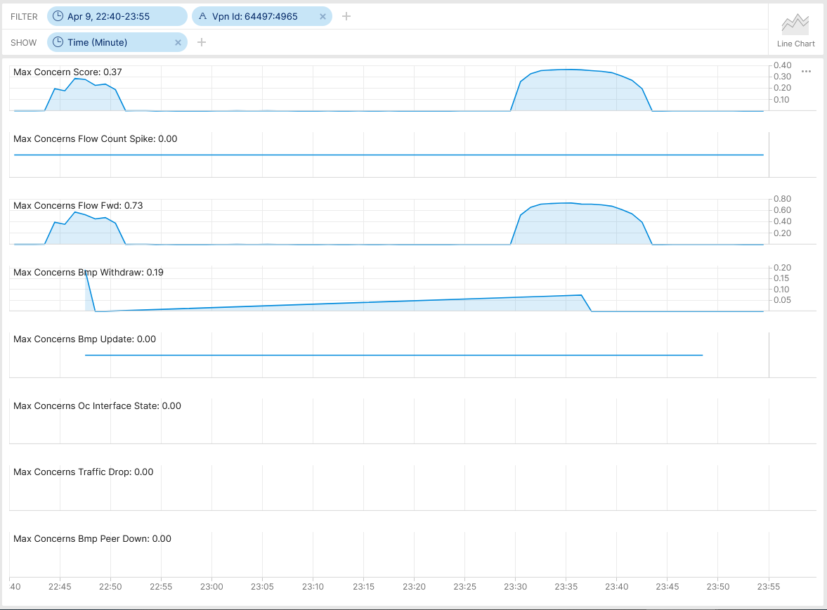

Postmortem, L3 VPN Pilot Migration - Voice Over IP 64497:4965 - Anomaly Detection - Live
Real-Time Streaming under Development
Max Concern Score: NA
BMP Withdrawal Score: 0.19
BMP route-monitoring Update/Withdraw check recognize withdrawal.
BMP peer Down/Up check did not apply.
Interface Down/Up check did not recognize.
Traffic Drop spike did not apply.
Missing Traffic check did not apply. (not fully implemented yet).
Increased or decreased Flow Count did not apply.
Overall: 1 out of 6 checks have detected the BGP topology change. Real-time streaming implementation work in progress as expected.
Cosmos Bright Lights Anomaly Detection – 64497:4965

Slide 11
What went well?
Work in progress Cosmos Bright Lights real-time streaming Anomaly Detection BMP route-monitoring withdrawal rule detected topology change.
BMP collected metrics are consistent across multiple vendors vs. CLI show output is vendor dependent.
Postmortem
What to do next?
Support on upcoming maintenance window with verification dashboard and active monitoring. -> Done
What could be improved?
BMP per-peer observation timestamp should be mandatory. See https://datatracker.ietf.org/doc/html/draft-boucadair-nmop-rfc3535-20years-later-02#section-4.7. -> To be addressed in GROW/NMOP.
BMP per-peer header should have an export timestamp. See https://datatracker.ietf.org/doc/html/draft-boucadair-nmop-rfc3535-20years-later-02#section-4.7. -> To be addressed in GROW/NMOP.
With RFC 8671 (Support for Adj-RIB-Out in BMP) path propagation could have been observed on route-reflectors.
With draft-lucente-grow-bmp-rel (Logging of routing events in BMP) path drops could been observed on Inter-AS option B ASBRs and route-reflectors.
With draft-ietf-grow-bmp-path-marking-tlv path status changed could have been observed on Inter-AS option B ASBRs.
Clarify why Juniper JunOS delayed BMP export for 20 resp. 80 minutes. Due to fact that the path was still passive in the BGP RIB?
With IPFIX (deconfigured due to PR1567039) and support of IE90 ForwardingStatus (not supported on Juniper JunOS) forwarding drops could have been observed on Inter-AS option B ASBRs.

Slide 12
Swisscom - Cosmos Bright Lights PoC Summary After 20 Incidents and 18 Months Time
Key Facts in V0 (2023-2024)
16 L3 VPNs proactively monitored.
Individual Service Disruption Detection rule accuracy is beyond 90%. Summed accuracy is beyond 95%.
Max Concern score ranged between 0.06 and 0.85. In average 0.46.
In 4 cases additional YANG, in 13 cases additional BMP, in 2 cases Netconf Transaction-ID and 1 case additional L2 IPFIX metrics would have helped to gain more visibility.
Key observability feature missing: BMP Local RIB with Path Marking.
5
In Replay Incident Detected
72 Alert Notifications
15
In Near Real-Time Incident Detected
46
Falls Positive due to Apache Druid delayed ingestion
6
Falls Positive due to previous week data not comparable

Slide 13
Swisscom - Cosmos Bright Lights PoC Detail Multiple Perspectives increases Accuracy
Key Improvements in V1 (2024)
>12000 L3 VPNs proactively monitored since June 2024.
Realtime Streaming eliminates delayed ingestion falls positives and scaling.
Improved profiling. Compares to multiple previous weeks and discard largest deviation eliminates falls positives. -> Work In progress
Key Improvements in V2 (2025)
Annotate operational and analytical Network Incident data for reproduction.
Enabling automated workflow. From PowerPoint slide decks to data driven actionable insights.
3
One out of Six checks
2
Four out of Six checks
20 Network Incidents
6
Three out of Six checks
8
Two out of Six checks

