Slide 1

Validate Configured Subscription YANG-Push Publisher Implementations NETCONF & NMOP WG
IETF 120
July 20-21th, 2024
Hackathon

Slide 2
Hackathon – Plan, Software, Repo
Plan
Validate work in progress vendor YANG-Push publisher implementations.
Configure RFC 8641 compliant YANG-Push configured subscription.
Verify output in packet capture before YANG-Push receiver and after transformation.
Software
YANG-Push Publisher - Cisco IOS XR
YANG-Push Publisher - 6WIND VSR
YANG-Push Publisher - Huawei VRP
YANG-Push Receiver - Pmacct
Test Repository
https://github.com/network-analytics/ietf-network-analytics-document-status/tree/main/120/Hackathon
Contains
Packet capture on the wire
Netconf RPCs and YANG-Push JSON messages
Python script which performed test cases

Slide 3
An Architecture for YANG-Push to Apache Kafka Integration draft-netana-nmop-yang-kafka-integration
+------------------------------------------------------------+
| Time Series Database |
+------------------------------------------------------------+
^
| (12) Ingest Data
| According to Schema
+------------------------------------------------------------+
| Time Series Database Ingestion |
+------------------------------------------------------------+
(10) Get | ^ ^ (9) Validate
Schema | | | Serialized Message
| | | Schema on Consumer
| | |
| | +--------------------+
| | | Message |
| | | Broker |
| | +--------------------+
| | |
| | (11) Issue | (8) Serialize
| | | YANG-Push Message
| | | annotated Schema
v | Schema (6) Post | ID on Producer
+--------------------+ Schema +--------------------+
| YANG | <-------------- | Data Collection |
| Schema Registry | --------------> | YANG-Push Receiver |
+--------------------+ (7) Issue +--------------------+
Schema ID (4) Get | ^ (3) Receive
Schema | | YANG-Push
| | Subscription
| | Start Message
| | ^
| | |
| | | (5) Publish
| | | YANG-Push
| | | Message
| | | with
(1) Discover Notif. v | | Subscr. ID
+--------------------+ Capabilities +--------------------+
| Manage YANG-Push | ---------------> | Network Node |
| Subscription | (2) Subscribe | YANG-Push Publisher|
+--------------------+ ---------------> +--------------------+
Figure 1: End to End Workflow
Subscription to YANG Notifications RFC 8639
Subscription to YANG Notifications for Datastore Updates RFC 8641
UDP-based Transport for Configured Subscriptions draft-ietf-netconf-udp-notif
Subscription to Distributed Notifications draft-ietf-netconf-distributed-notif
Support of Hostname and Sequencing in YANG Notifications draft-tgraf-netconf-notif-sequencing
Support of Versioning in YANG Notifications Subscription draft-ietf-netconf-yang-notifications-versioning
Support of Network Observation Timestamping in YANG Notifications draft-tgraf-netconf-yang-push-observation-time
YANG Library RFC 8525
Augmented-by Addition into the IETF-YANG-Library draft-lincla-netconf-yang-library-augmentation

Slide 4

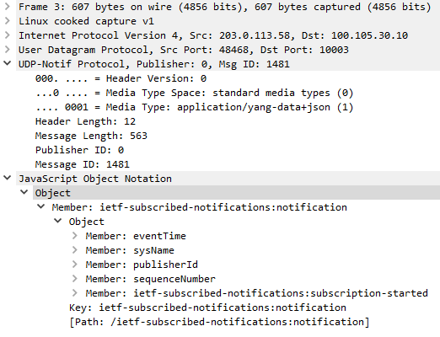
YANG-Push Data Processing Pipeline
Apache Kafka
{
"ietf-subscribed-notifications:notification": {
"eventTime": "2024-03-08T16:20:03.520570812+00:00",
"sysName": "daisy-ietf-ipf-zbl1843-r-daisy-58",
"publisherId": 0,
"sequenceNumber": 1502,
"ietf-subscribed-notifications:subscription-terminated": {
"id": 12345678,
"reason": "no-such-subscription"
}
}
}
YANG-Push Publisher
YANG-Push Receiver
YANG Push JSON
Apache Kafka
JSON Message

Slide 5
Cisco – YANG-Push Notifications
Push-Change-Update Notification
{
"ietf-notification:notification": {
"eventTime": "2024-07-19T15:01:30.175Z",
"ietf-yang-push:push-change-update": {
"id": 1,
"datastore-changes": {
"yang-patch": {
"patch-id": "TODO - insert patch-id here",
"edit": [
{
"edit-id": "1",
"operation": "replace",
"target": "/Cisco-IOS-XR-pfi-im-cmd-oper:interfaces/interface-xr/interface[interface-name='Loopback12']",
"value": {
"Cisco-IOS-XR-pfi-im-cmd-oper:interface": {
"interface-name": "Loopback12",
"interface-handle": "Loopback12",
"interface-type": "IFT_LOOPBACK",
"hardware-type-string": "Loopback interface(s)",
"state": "im-state-admin-down",
"line-state": "im-state-admin-down",
"encapsulation": "loopback",
"encapsulation-type-string": "Loopback",
"mtu": 1500,
"is-l2-transport-enabled": false,
"state-transition-count": 10,
"last-state-transition-time": "1721401289960121958",
"is-dampening-enabled": false,
"bandwidth": "0",
"max-bandwidth": "0",
"is-l2-looped": false,
"loopback-configuration": "no-loopback",
"ip-information": {
"ip-address": "192.0.2.90",
"subnet-mask-length": 32
},
"fast-shutdown": false,
"if-index": 154,
"is-intf-logical": true,
"is-intf-type-management": false,
"is-intf-type-cpu": false
Subscription-Started Notification
{
"ietf-notification:notification": {
"eventTime": "2024-07-19T15:01:00.300Z",
"ietf-subscribed-notifications:subscription-started": {
"id": 1,
"stream-xpath-filter": "Cisco-IOS-XR-pfi-im-cmd-oper:interfaces",
"transport": "transport",
"encoding": "encode-json"
}
}
}
Subscription-Terminated Notification
{
"ietf-notification:notification": {
"eventTime": "2024-07-19T15:03:58.590Z",
"ietf-subscribed-notifications:subscription-terminated": {
"id": 1,
"reason": "no-such-subscription"
}
}
}

Slide 6
6WIND - Subscription Started Notifications
{
"ietf-notifications:notification": {
"eventTime": "2024-07-09T13:26:53.295857916+00:00",
"sysName": "daisy-ietf-ipf-zbl1843-r-daisy-58",
"sequenceNumber": 855,
"ietf-subscribed-notifications:subscription-started": {
"id": 12345678,
"ietf-yang-push:datastore": "ietf-datastores:operational",
"ietf-yang-push:datastore-xpath-filter": "/state/vrf/interface/physical[name='ens192']/counters",
"transport": "ietf-udp-notif-transport:udp-notif",
"encoding": "encode-json",
"purpose": "send notifications",
"ietf-distributed-notif:message-publisher-ids": [
0
],
"ietf-yang-push:periodic": {
"period": 3000
},
"ietf-yang-push-revision:module-version": [
{
"module-name": "vrouter-interface",
"revision": "2024-04-22"
}
]
}
}
}
Support of Hostname and Sequencing in YANG Notifications, draft-tgraf-netconf-notif-sequencing, extends the NETCONF notification defined in RFC5277 with sysName, publisherId and sequenceNumber.
UDP-based Transport for Configured Subscriptions, draft-ietf-netconf-udp-notif, provides a UDP-based protocol for YANG notifications to collect data from network nodes.
Subscription to Distributed Notifications, draft-ietf-netconf-distributed-notif, extends YANG notifications subscription to allow metrics being published directly from processors on line cards.
Support of Versioning in YANG Notifications Subscription, draft-ietf-netconf-yang-notifications-versioning, adds the ability to subscribe to a specific revision or latest-compatible-semversion. Extends the YANG-Push Subscription State Change Notifications so that the receiver learns on top of xpath and the sub-tree filter also the YANG module name, revision and revision-label.

Slide 7
Huawei - Subscription Started Notifications
{
"ietf-notification:notification": {
"eventTime": "2024-03-12T23:20:24Z",
"ietf-subscribed-notification:subscription-started": {
"id": 1,
"ietf-yang-push:datastore": "ietf-datastores:operational",
"ietf-yang-push:datastore-xpath-filter": "/ifm:ifm/ifm:interfaces/ifm:interface",
"ietf-yang-push-revision:revision": "2024-01-23",
"ietf-yang-push-revision:module-name": "ifm",
"ietf-yang-push-revision:revision-label": "1.0.0",
"ietf-distributed-notif:message-observation-domain-id": [1,2],
"transport": "ietf-udp-notif-transport:udp-notif",
"encoding": "encode-json",
"ietf-yang-push:periodic": {
"ietf-yang-push:period": 60000
}
}
}
}
Support of Versioning in YANG Notifications Subscription, draft-ietf-netconf-yang-notifications-versioning, adds the ability to subscribe to a specific revision or latest-compatible-semversion. Extends the YANG-Push Subscription State Change Notifications so that the receiver learns on top of xpath and the sub-tree filter also the YANG module name, revision and revision-label.
UDP-based Transport for Configured Subscriptions, draft-ietf-netconf-udp-notif, provides a UDP-based protocol for YANG notifications to collect data from network nodes.
Subscription to Distributed Notifications, draft-ietf-netconf-distributed-notif, extends YANG notifications subscription to allow metrics being published directly from processors on line cards.

Slide 8
6WIND - Push Update Notifications
{
"ietf-notifications:notification": {
"eventTime": "2024-07-09T13:35:23.653892256+00:00",
"sysName": "daisy-ietf-ipf-zbl1843-r-daisy-58",
"sequenceNumber": 873,
"ietf-yang-push:push-update": {
"id": 68,
"datastore-contents": {
"vrouter:state": {
"vrf": [
{
"name": "main",
"vrouter-interface:interface": {
"physical": [
{
"name": "ens192",
"counters": {
"in-octets": "63771919981",
"in-unicast-pkts": "363662364",
"in-discards": "63590",
"in-errors": "0",
"out-octets": "59850316180",
"out-unicast-pkts": "307798704",
"out-discards": "0",
"out-errors": "0"
}
}
]
}
}
]
}
},
"ietf-distributed-notif:message-publisher-id": 0,
"ietf-yp-observation-time:observation-time": "2024-07-09T13:35:23.654432588+00:00",
"ietf-yp-observation-time:point-in-time": "current-state"
}
}
}
Support of Hostname and Sequencing in YANG Notifications, draft-tgraf-netconf-notif-sequencing, extends the NETCONF notification defined in RFC5277 with sysName, publisherId and sequenceNumber.
UDP-based Transport for Configured Subscriptions, draft-ietf-netconf-udp-notif, provides a UDP-based protocol for YANG notifications to collect data from network nodes.
Subscription to Distributed Notifications, draft-ietf-netconf-distributed-notif, extends YANG notifications subscription to allow metrics being published directly from processors on line cards.
Support of Network Observation Timestamping in YANG Notifications, draft-tgraf-netconf-yang-push-observation-time, extends YANG-Push push-update notifications with observation-time and state-changed-observation-time.

Slide 9
6WIND - Push Change Update Notifications
{
"ietf-notifications:notification": {
"eventTime": "2024-07-09T13:47:56.887480682+00:00",
"sysName": "daisy-ietf-ipf-zbl1843-r-daisy-58",
"sequenceNumber": 900,
"ietf-yang-push:push-change-update": {
"id": 69,
"datastore-changes": {
"yang-patch": {
"patch-id": "patch-1",
"edit": [
{
"edit-id": "edit-1",
"operation": "replace",
"target": "/vrouter:state/vrf[name='main']/l3vrf[name='A9']/vrouter-interface:interface/vrouter-loopback:loopback[name='Loopback-A9']/enabled",
"value": {
"vrouter-loopback:enabled": "false"
}
}
]
}
},
"ietf-distributed-notif:message-publisher-id": 0,
"ietf-yp-observation-time:observation-time": "2024-07-09T13:47:56.887798493+00:00",
"ietf-yp-observation-time:point-in-time": "current-state"
}
}
}
Support of Hostname and Sequencing in YANG Notifications, draft-tgraf-netconf-notif-sequencing, extends the NETCONF notification defined in RFC5277 with sysName, publisherId and sequenceNumber.
UDP-based Transport for Configured Subscriptions, draft-ietf-netconf-udp-notif, provides a UDP-based protocol for YANG notifications to collect data from network nodes.
Subscription to Distributed Notifications, draft-ietf-netconf-distributed-notif, extends YANG notifications subscription to allow metrics being published directly from processors on line cards.
Support of Network Observation Timestamping in YANG Notifications, draft-tgraf-netconf-yang-push-observation-time, extends YANG-Push push-update notifications with observation-time and state-changed-observation-time.

Slide 10

YANG-Push Implementation Status IETF 120
 | 6WIND VSR | Huawei VRP | Cisco IOS XR
RFC 8639 YANG-Push Subscription | x | x
RFC 8641 YANG-Push Notification | x | x | x
draft-ietf-netconf-udp-notif | x | x
draft-ietf-netconf-distributed-notif | x | x
draft-ietf-netconf-yang-notifications-versioning | x | x
draft-tgraf-netconf-notif-sequencing | x
draft-tgraf-netconf-yang-push-observation-time | x
RFC 7895 YANG Module Library |  | x
RFC 8525 YANG Library | x |  | x
draft-lincla-netconf-yang-library-augmentation
Red marked describes new capability at IETF 120

Slide 11
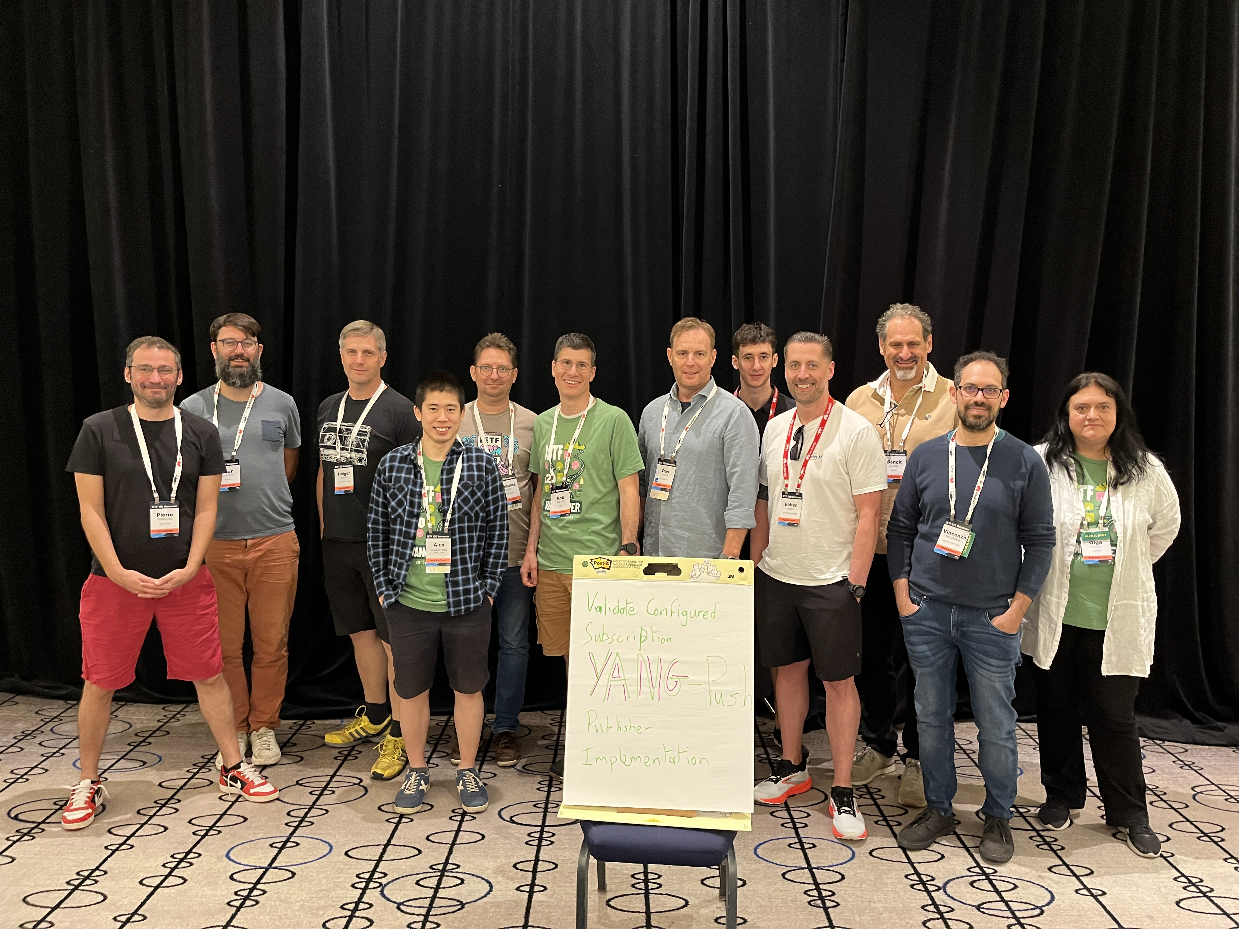
Thanks to…
Rob Wilton – Cisco
Emma Rankin – Cisco (remote)
Samuel Gauthier – 6WIND (remote)
Jérémie Leska – 6WIND (remote)
Liu Bin – Huawei (remote)
Benoit Claise – Huawei
Jean Quilbeuf – Huawei
Bill Kaufmann – Ciena Blueplanet
Ebben Aries - Juniper
Paolo Lucente – Pmacct
Holger Keller – DT
Daniel Voyer – Bell Canada
Alex Huang-Feng – INSA Lyon
Yannick Buchs – Swisscom (remote)
Thomas Graf - Swisscom

