Slide 1
An Architecture for a Network Anomaly Detection Framework draft-ietf-nmop-network-anomaly-architecture-07
draft-ietf-nmop-network-anomaly-semantics-05
draft-ietf-nmop-network-anomaly-lifecycle-05
Motivation and architecture of a Network Anomaly Detection Framework
and the relationships to other documents describing
network symptom semantics and network incident lifecycle
wanting.du@swisscom.com
thomas.graf@swisscom.com pierre.francois@insa-lyon.fr vincenzo.riccobene@huawei-partners.com alex.huang-feng@insa-lyon.fr

Slide 2

Problem Statement and Motivation How it is being addressed in each document
Network Anomaly Detection
To detect service interruptions before users do, network operations must use automated, holistic monitoring across all three network planes.
draft-ietf-nmop-network-anomaly-architecture describes the motivation, architecture and the relationship to other two documents.
By standardizing labeled incident data and automating the postmortem process, operators can improve machine learning models continuously and foster better collaboration between vendors and academia.
draft-ietf-nmop-network-anomaly-semantics defines Symptom semantics to enable standardized data exchange to validate results with network engineers and improve supervised and semi-supervised machine learning systems.
draft-ietf-nmop-network-anomaly-lifecycle describes the lifecycle process, enabling network engineers to interact with the network anomaly detection system to refine the detection abilities over time.

Slide 3
draft-ietf-nmop-network-anomaly-architecture-07
Network Anomaly Detection Architecture

Slide 4
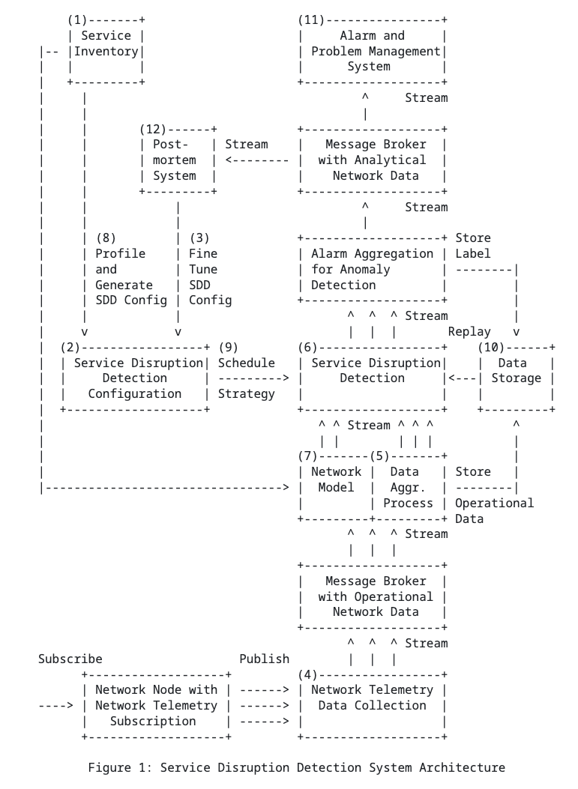
Network Anomaly Detection Architecture Document summary
Motivation:
Human‑driven troubleshooting does not scale due to the growing number of dependencies
Approach:
This draft defines a standardized, architecture‑level framework
Outcome:
Enable automated service disruption detection
draft-ietf-nmop-network-anomaly-architecture

Slide 5
Network Anomaly Detection Architecture Key draft updates since v-05
Terminology update
Change from “customer profile” to “service profile” to ensure consistency across reference documentation (RFC 8969).
Added formal “Rules" definition to distinguish between knowledge-based approach and ML approach.
Restructure
Reorganisation Service Disruption Section to improve reading
Refinement
Clarified the relationship between Semantic, Rule, & Knowledge-based detection.
Refined definition: collective outlier, confidence score, concern score.
Refined clarification: Alarm-raising criteria, Data storage considerations, Operational data aggregation
Explicitly out-scoped Service Degradation based on WG review feedback
Notes:
Out-scoping: Rüdiger Geib

Slide 6
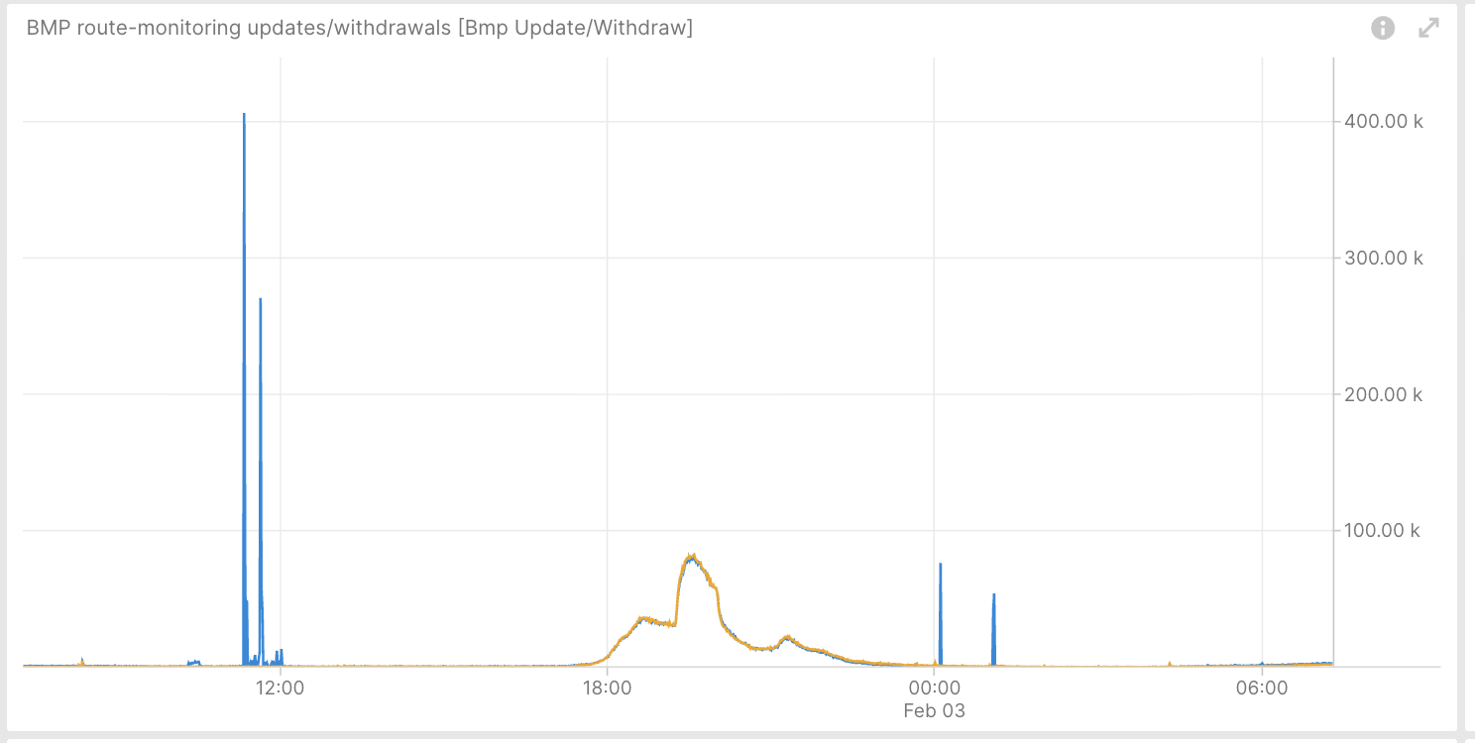
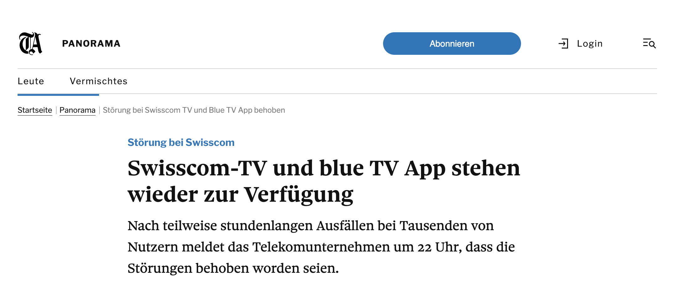
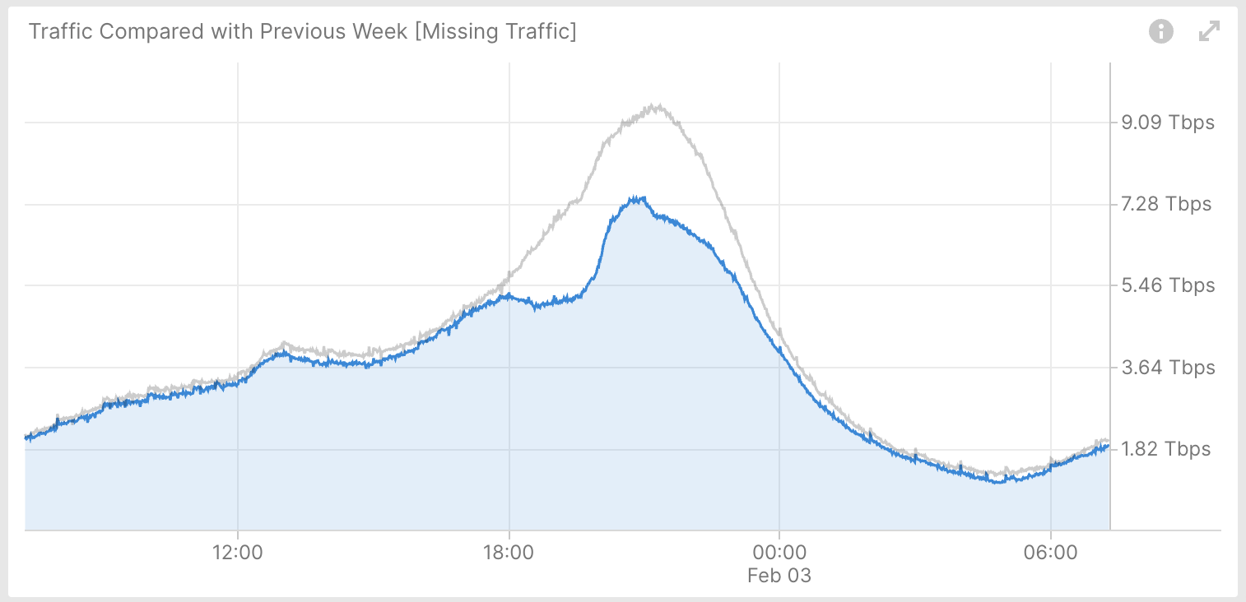
Network Anomaly Detection Architecture Document implementation and operational experience
L3 VPN – Real-Time Incident Analysis
Swisscom TV service was severely impaired during 6 hours due to hardware faults and a software defect, which together led to a DoS condition.
Notes:
Our Blue TV service is currently severely impaired. Both the Blue TV‐boxes and TV Air on the web and in the Blue TV app are affected. When switching on the TV‐ Box, our customers receive an error message. Restarting the TV‐Box does not resolve the fault. Root cause: 2 physical servers crashed in one of the 2 redis clusters, which puts Redis cluster in to an unstable state -> re-authentication new connection burst (Connection timeouts were incorrect
) -> Denial-of-Service → the secondary redis cluster also failed

Slide 7

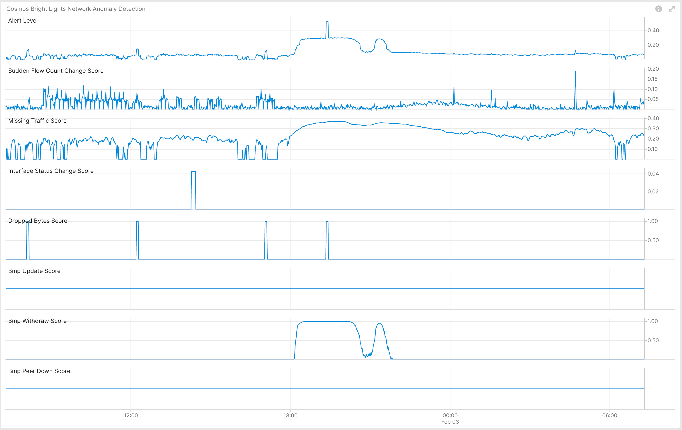
Network Anomaly Detection Architecture Document implementation and operational experience
L3 VPN – Real-Time Incident Analysis
BMP route-monitoring Update/Withdraw check detected continuous and excessive routing topology changes due to users restarting tv boxes.
BMP peer Down/Up check did not apply because the hardware crash happened at the application layer.
Interface Down/Up check did not apply.
Traffic Drop spike recognized drops due to unstable routing topology.
Missing Traffic detected.
Sudden increased or decreased Flow Count was not applicable.
Overall: data plane and control plane checks have detected the excessive routing topology changes with service disruption.
Concern Score: 0.53 Flow Count Spike: 0.03 Missing Traffic: 0.37 Traffic Drop: 1.00
BMP Peer: 0.00 Interface Down: 0.00 BMP Update: 0.00 BMP Withdrawal: 1.00
Notes:
Our Blue TV service is currently severely impaired. Both the Blue TV‐boxes and TV Air on the web and in the Blue TV app are affected. When switching on the TV‐ Box, our customers receive an error message. Restarting the TV‐Box does not resolve the fault. Root cause: 2 physical servers crashed in one of the 2 redis clusters, which puts Redis cluster into an unstable state -> re-authentication new connection burst (Connection timeouts were incorrect
) -> Denial-of-Service → the secondary redis cluster also failed

Slide 8
draft-ietf-nmop-network-anomaly-semantics-05
Semantic Metadata Annotation

Slide 9
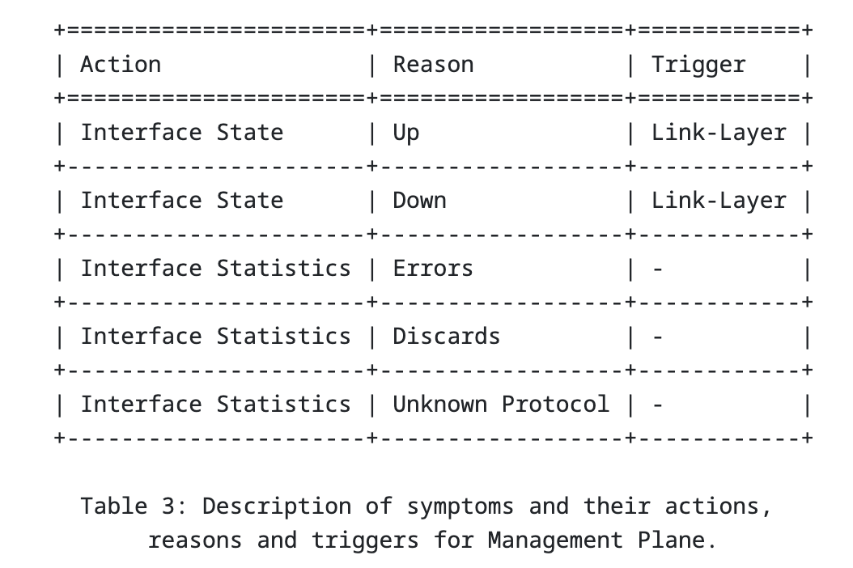
Semantic Metadata Annotation Document summary
Motivation:
Enable the exchange of network anomaly data across diverse systems and support benchmarking of anomaly detection solutions
Approach:
Define a standardized semantic metadata schema and a set of semantically structured terms
Outcome:
Provide human‑readable context for describing and understanding network anomalies

Slide 10
Semantic Metadata Annotation Key draft updates since v-03
Terminology update
Added missing definition of terminologies used in the draft such as concern score and symptom.
Schema change
Removed unused typedef score
Refined vpn-node-termination
Introduced dedicated L2 & L3 groupings for service
Symptom table update
Update symptom: reason “Previous” -> “Drop”, trigger “Time” -> “Outside Monitored Domain”
Avro schema changed accordingly
augment /rsn:relevant-state/rsn:anomaly:
+--rw vpn-node-terminations* [hostname vrf-name]
+--rw hostname inet:host
+--rw vrf-id? uint32
+--rw vrf-name string
+--rw route-distinguisher? string
+--rw interface-id* uint32
+--rw interface-name* string
+--rw peer-ip* inet:ip-address
+--rw next-hop* inet:ip-address
augment /rsn:relevant-state-notification/rsn:service:
+--:(l2vpn)
| +-- l2vpn-service* [vpn-id]
| +-- vpn-id string
| +-- uri? inet:uri
| +-- vpn-name? string
| +-- site-ids* string
| +-- change-id? yang:uuid
| +-- change-start-time? yang:date-and-time
| +-- change-end-time? yang:date-and-time
+--:(l3vpn)
+-- l3vpn-service* [vpn-id]
+-- vpn-id string
+-- uri? inet:uri
+-- vpn-name? string
+-- site-ids* string
+-- change-id? yang:uuid
+-- change-start-time? yang:date-and-time
+-- change-end-time? yang:date-and-time

Slide 11
Semantic Metadata Annotation Document implementation and operational experience
Snippet of message example from Cosmos Bright Lights Implementation
"vpnNodeTerminations": [
{
"hostname": "pcb05ro1010bew",
"vrfId": null,
" vrfName": "null",
"routeDistinguisher": {
"string": "0:64499:100196518"
},
"peerIp": [
"138.187.124.33",
"138.187.124.35"
],
"nextHop": [],
"interfaceId": [],
"interfaceName": []
}
],
"stage": "detection",
"operationalData":
{
" topicName”: null,
" subjectName”: null
}
"service": {
"L3VpnServiceContainer": {
"l3VpnService": [
{
"vpnId": "64497:59121",
"uri": {
"string": "https://thor-ui.thoruipp.corproot.net/cantata/lcs?dstCommunity=64497:59121"
},
"vpnName": {
"string": "64497:59121"
},
"siteIds": null,
"changeId": null,
"changeStartTime": null,
"changeEndTime": null
}
]
}
}
Notes:
*Only the schema has been updated. Operational metadata population not yet implemented.

Slide 12
draft-ietf-nmop-network-anomaly-lifecycle-05
Network Anomaly Lifecycle

Slide 13
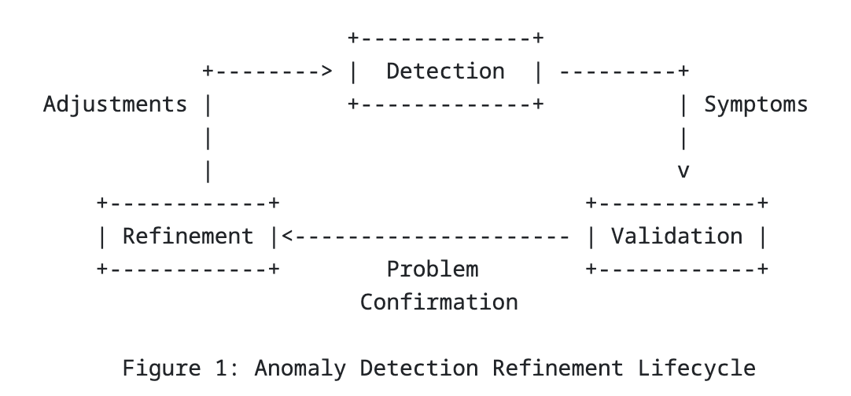
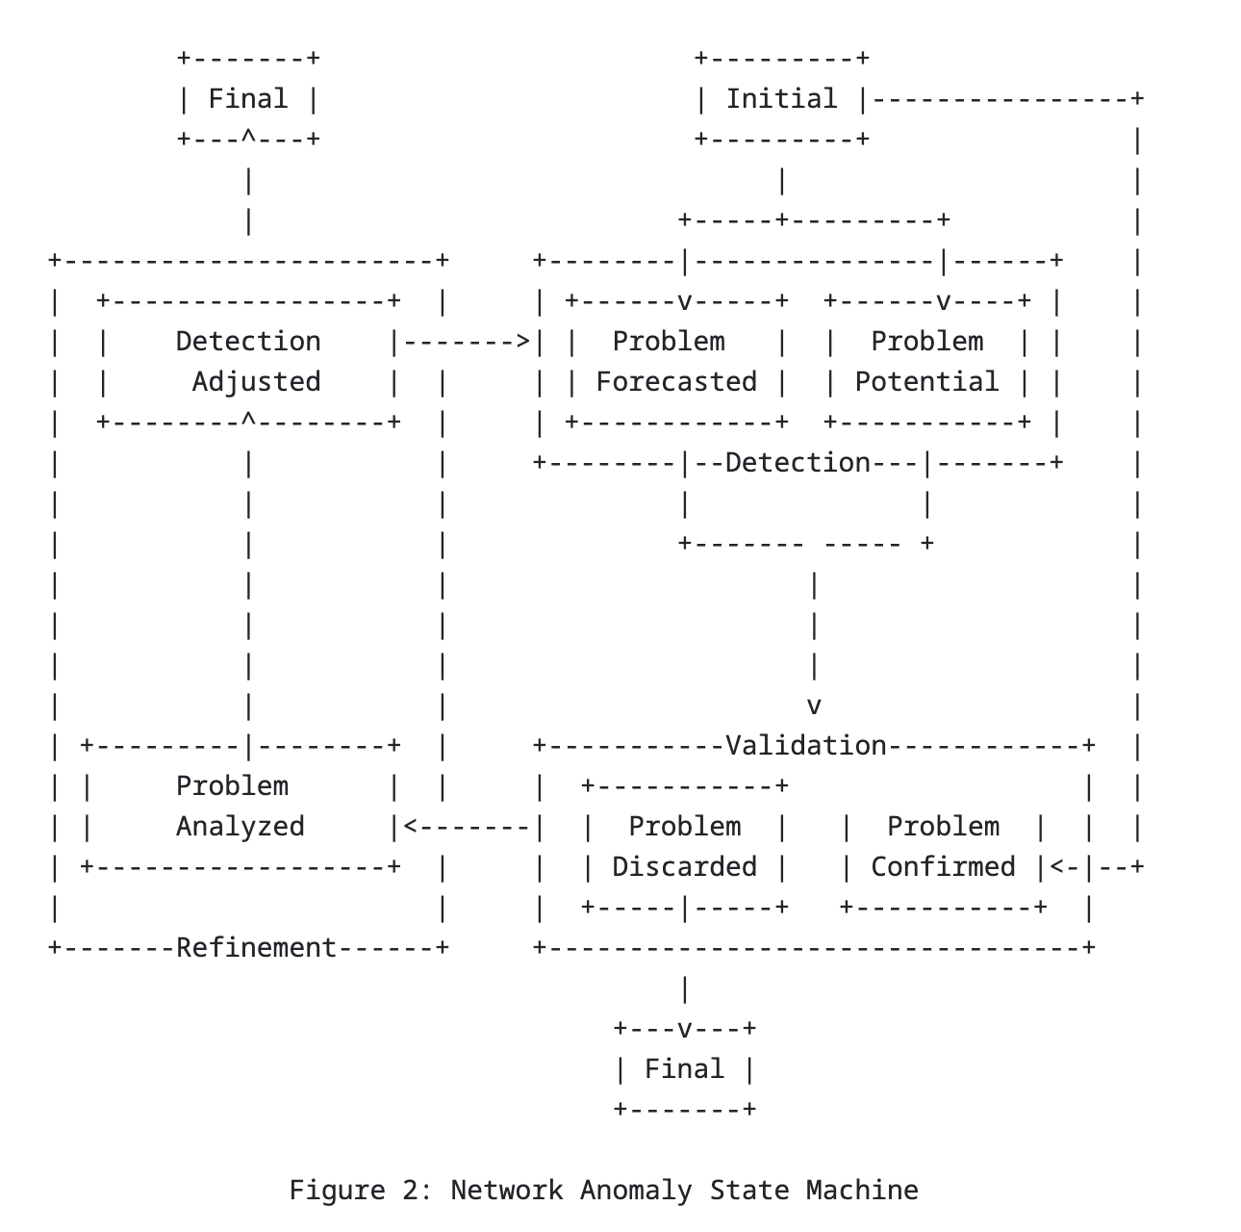
Network Anomaly Lifecycle Document summary
Motivation:
Bridge the gap between automated network anomaly detection and actionable operational tasks
Approach:
Define a standardized, iterative lifecycle for Network anomaly
Outcome:
Continuously Improve the correctness of anomaly detection through human‑in‑the‑loop feedback

Slide 14
Network Anomaly Lifecycle Key draft updates since v-03
Terminology update
Renamed “state/phase” to “stage” to avoid confusion with protocol “states”.
Schema change
Changed “state” -> “stage”
Fixed RFC 8407 related Yang warnings (remove mandatory false)
Include operational data in anomaly and introduce “message-broker-grouping”
Refinement
Refined definition of confidence score and concern score
Optimized Figure 2
Consolidated the usage of score across different drafts
leaf stage {
type identityref {
base network-anomaly-stage;
}
mandatory true;
description
"Stage of the relevant state.";
}
grouping message-broker-grouping {
description
"References message broker draft-ietf-nmop-yang-message-broker-integration entities.";
leaf topic-name {
type inet:host-name;
description
"From which message broker topic the operational data was consumed from.";
}
leaf subject-name {
type inet:host-name;
description
"To which message broker subject the operational data references to.";
}
}

Slide 15
Next Steps and Remaining Issues Feedback on latest changes
Next Steps
Request YANG doctors review for draft-ietf-nmop-network-anomaly-semantics-05 and draft-ietf-nmop-network-anomaly-lifecycle-05.
Implement semantic metadata in Cosmos Bright Lights to replace placeholder values for newly introduced fields, including
site‑ids
interface names
VRF names
Extend the postmortem system requirements, accompanied by an implementation PoC
Remaining Issues
No known remaining issues at this time.

