Slide 1
Export of On-Path Delay in IPFIX draft-opsawg-ipfix-on-path-telemetry-02
Enabling a statistical network delay view, giving insights where delay is being accumulated in the forwarding path
thomas.graf@swisscom.com
benoit.claise@huawei.com
alex.huang-feng@insa-lyon.fr
27. March 2023

Slide 2
On-Path Delay @ IPFIX Draft Status
Extended the introduction and the terminology section with performance registry relevant information's.
Corrected some small nits in the performance registry sections.
Increased IPFIX entity data type sizes based on implementation tests results.
Corrected IPFIX entity data type semantic.
Describing how IPFIX reduced-size encoding is applicable in new operational consideration section.
According input from Greg Mirsky detailing IOAM Application section.
Removed nanosecond granularity.
Added Implementation Status section.

Slide 3
On-Path Delay @ IPFIX Running Code at IETF 116 hackathon
INSA Lyon showed running open-source code based on IOAM-Trace-Type in FD.io VPP (https://github.com/network-analytics/vpp-srh-onpath-telemetry) and Huawei based on IFIT SRH TLV their implementation in VRP.
pmacct data collection calculates PathDelayMeanDeltaMicroseconds by dividing PathDelaySumDeltaMicroseconds by packetDeltaCount.

Slide 4
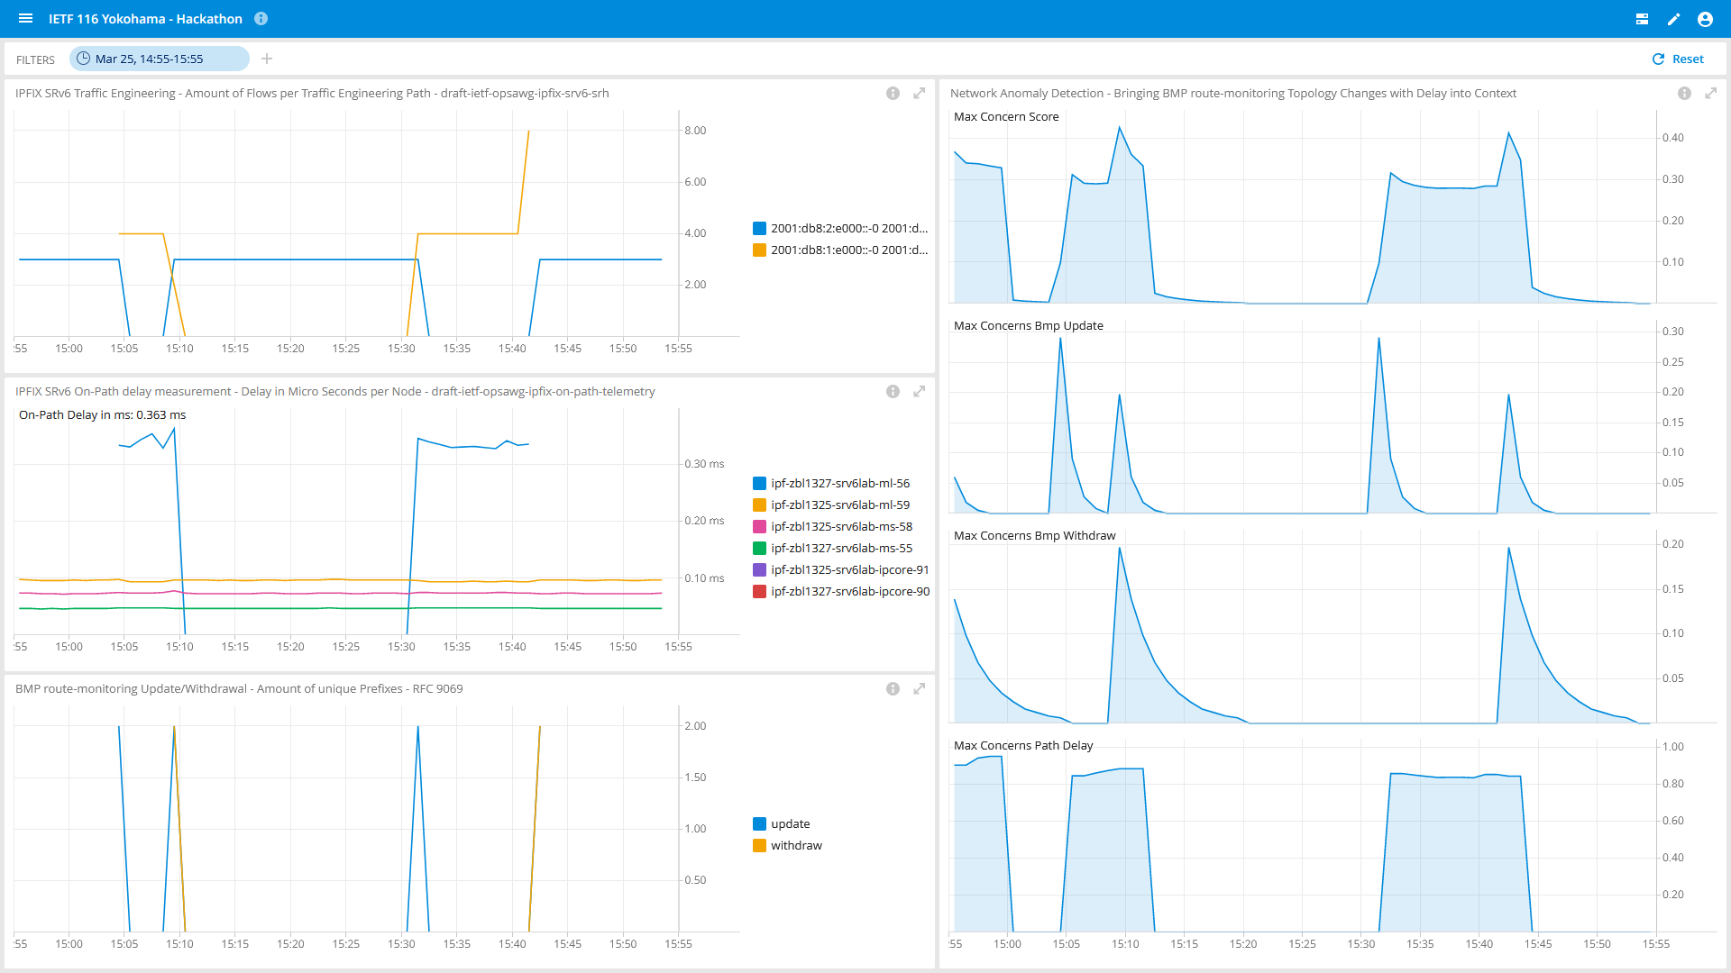
On-Path Delay @ IPFIX Running Code at IETF 116 hackathon
Shows SRv6 SID list change of the traffic engineered paths.
Shows on which node how much on-path delay was being measured.
Shows the BGP update/withdrawals from the topology change.
Shows that Network Anomaly Detection detects the topology and delay change and the Max Concern Score calculation.
1
4
2
3

Slide 5
On-Path Delay @ IPFIX Next steps
Do you recognize the problem statement?
Network operators want to understand
where delay with which network and device dimensions is being accumulated
at highest scale for a statistical network delay view.
IEs in document defined are independent from how the delay is being metered.
Two vendors are validating technical feasibility. Others showing interest.
Draft version -03 will contain data record and template examples.
thomas.graf@swisscom.com
benoit.claise@huawei.com
alex.huang-feng@insa-lyon.fr
27. March 2023

