Slide 1
An Architecture for YANG-Push to Message Broker Integration and Broadband Data Collection
Motivation and architecture of a native
YANG-Push notifications and YANG Schema integration
into Message Broker and YANG Schema Registry
zhenghaomian@huawei.com
david.zhujian@huawei.com
thomas.graf@swisscom.com
6. March 2025

Slide 2
Agenda Items
Subscribing to YANG – State of the Union
Motivation, Architecture and Implementation Status
YANG-Push Notifications and Capability Discovery Developments
Who we are and what MVP's are
Architecture, Component and Interface Comparison
Next Steps and Action Points
Implementation Status and upcoming IETF 122 Hackathon

Slide 3
IETF YANG-Push A 22 years journey
IAB Workshop
Defines operators' requirements in RFC 3535 to lifecycle CLI and SNMP. YANG, Netconf and Restconf development started.
YANG 1.0
Specified in RFC 6020. 1.1 in RFC 7950.
gNMI
gNMI was presented to IETF NETCONF and implementations started at major network vendors.
Data Mesh Integration
Vendor-specific implementations and IETF YANG-Push are hard to manage. New requirements emerged for integrating with the message broker and an automated data processing chain. New specifications are proposed to resolve these challenges.
2002
2010
2017
2022
2015
2019
2024
IETF YANG-Push Specification Started
Development of RFC 8639 and RFC 8641 started at IETF NETCONF.
IETF YANG-Push Specification Finished
Development of RFC 8639 and RFC 8641 concluded at IETF NETCONF without any major network vendor implementations.
IETF YANG-Push Major Implementations Started
Questions arise. Proposing a simplified IETF YANG-Push and an Agile Incremental Driven Development.

Slide 4
Handling Operational YANG Modelled Data State of the Union
Nowadays network operators are using machine and human readable YANG RFC 7950 to model their configurations and obtain YANG modelled data from their networks.
Network operators organize their data in a Data Mesh where a message broker such as Apache Kafka facilitates the exchange of messages among data processing components.
Today, subscribing to a YANG datastore, publishing a YANG modeled notifications message from the network and viewing the data in a time series database, manual labor is needed to perform data transformation to make a message broker and its data processing components with YANG notifications interoperable.
« Even though YANG is intented to ease data management, this promise has not yet been fulfilled for Network Telemetry RFC 9232 »

Slide 5
From YANG-Push to Network Analytics Aiming for an automated data processing pipeline
A network operator aims for:
An automated data processing pipeline which starts with YANG-Push, consolidates at Data Mesh and ends at Network Analytics.
Operational metrics where IETF defines the semantics.
Analytical metrics where network operators gain actionable insights.
We achieve this by integrating YANG-Push into Data Mesh to:
Produce metrics from networks with timestamps when network events were observed.
Hostname, publisher ID and sequence numbers help us to understand from where metrics were exported and measure its delay and loss.
Forward metrics unchanged from networks
Learn semantics from networks and validate messages.
Control semantic changes end to end.

Slide 6
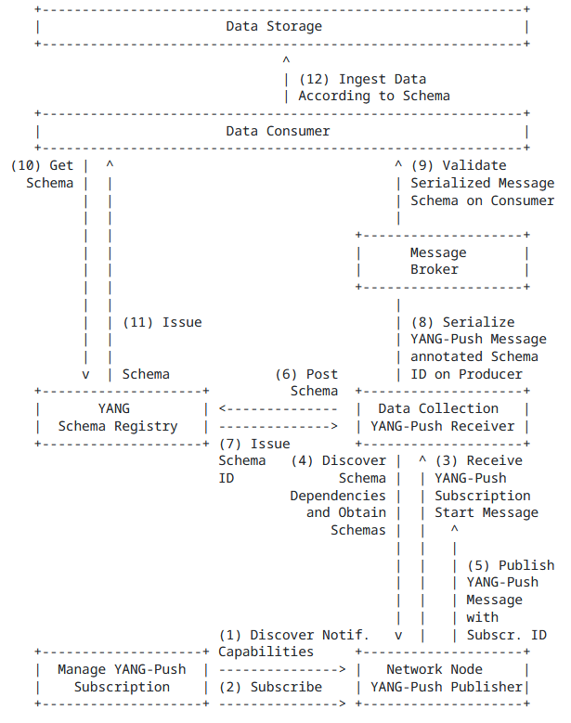
Elements of the Architecture And Document Relationships
4.1. YANG-Push Subscription Thanks to RFC 9196 based YANG modules describing capabilities for systems and notifications, transport (draft-netana-netconf-yp-transport-capabilities), notification extensions (draft-netana-netconf-notif-envelope) and supported xpaths can be discovered.
4.2. YANG-Push Publisher For configured subscriptions, udp-notif, distributed-notif and https-notif are the RFC 8639, RFC 8641 based YANG-Push transport protocols. draft-netana-netconf-notif-envelope provides the notification header with hostname, sequence and observation timestamp extensions.
4.3. YANG-Push Receiver Discovers subscription state changes by detecting changes in xpath/sub-tree, module name, revision, revision-label and YANG library content-id defined in draft-ietf-netconf-yang-notifications-versioning and discovers YANG schema tree through YANG library with ietf-netconf-yang-library-augmentedby extension.
4.6. YANG Message Broker Consumer Validates YANG notifications against schema. Anydata described in Section 7.10 of RFC 7950, validation described in draft-aelhassany-anydata-validation.
4.7. YANG Data Consumer Thanks to hostname, sequence-number and event-time from draft-netana-netconf-notif-envelope, loss and serialization delay can be measured.
4.8. YANG Data Storage Metrics can be indexed in timeseries database thanks to observation timestamp defined in draft-netana-netconf-notif-envelope.

Slide 7

Addressing YANG Specification and Integration Gaps 9 documents at NMOP, NETCONF and NETMOD
YANG-Push Transport Gaps:
UDP-based Transport for Configured Subscriptions draft-ietf-netconf-udp-notif
Subscription to Distributed Notifications draft-ietf-netconf-distributed-notif
YANG-Push Specifications Gaps:
Extensible YANG model for YANG-Push Notifications draft-netana-netconf-notif-envelope
YANG Notification Transport Capabilities draft-netana-netconf-yp-transport-capabilities
Validating anydata in YANG Library context draft-aelhassany-anydata-validation
YANG-Push Integration Gaps and Arch:
Support of Versioning in YANG Notifications Subscription draft-ietf-netconf-yang-notifications-versioning
Augmented-by Addition into the IETF-YANG-Library draft-ietf-netconf-yang-library-augmentation
YANG-Push Simplification:
YANG-Push Operational Data Observability Enhancements draft-wilton-netconf-yp-observability
YANG-Push Message Broker:
An Architecture for YANG-Push to Message Broker Integration draft-netana-nmop-yang-message-broker-integration
Extensible YANG Model for Network Telemetry Notifications draft-netana-nmop-message-broker-telemetry-message
2025
2026
2027
2028

Slide 8
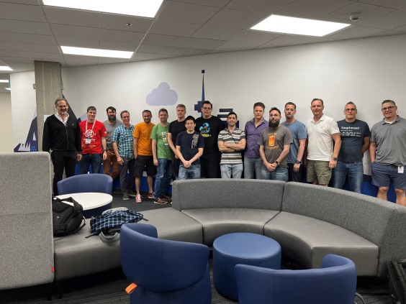
IETF YANG-Push Implementations and Next Steps Who we are and what we like…
The group consisting of: 34 colleagues from Bell Canada, Deutsche Telekom, NTT International, Swisscom, Huawei, Cisco, 6Wind, Ciena Blueplanet, Juniper, Nokia, and INSA Lyon.
Development on first major vendor implementations started at IETF 118. Throughout IETF 119 - 121, vendor implementation and network operator testing scope and interest from other vendors and operators is steadily growing.
This is where we noticed WT-508 at BBF and its potential synergies.
What we like about IETF YANG-Push
Interoperable
Unified with Netconf and Restconf
Transport independent
Push based
What is unique to IETF YANG-Push
Capabilities are discoverable which enables subscription automation
Subscription state change notifications enables the discovery of schema changes
YANG Library enables discovery of schema dependencies
Standardized notification metadata

Slide 9
IETF YANG-Push Implementations and Next Steps Incremental development…
MVP 1 - Works
draft-ietf-netconf-udp-notif transport (with segmentation option) and notifications encoded in RFC 7951 IETF-JSON.
RFC 8641 periodic subscription with anchor-time configurable in ietf-subscribed-notifications.
YANG notifications as defined in draft-netana-netconf-notif-envelope, YANG module name, version and yang-library-content-id as in draft-ietf-netconf-yang-notifications-versioning and notification capabilities (RFC 9196) discoverable as defined in their documents.
YANG-Library as defined in RFC 8525 and draft-ietf-netconf-yang-library-augmentedby.
MVP 2 – Scales and Secures
Distributed notifications as defined in draft-ietf-netconf-distributed-notif.
YANG notifications encoded in CBOR (named identifiers) as defined in RFC 9254.
YANG notifications DTLS (1.2 MUST RFC 6347, 1.3 SHOULD RFC 9147) encrypted as defined in draft-ietf-netconf-udp-notif.
MVP 3 - Optimizes
RFC 8641 on-change subscription configurable in ietf-subscribed-notifications.
RFC 8641 on-change and periodical subscription in RFC 9196 defined capabilities discoverable.
draft-ietf-netconf-udp-notif transport, encoding and encryption capabilities (RFC 9196) discoverable with draft-netana-netconf-yp-transport-capabilities.

Slide 10
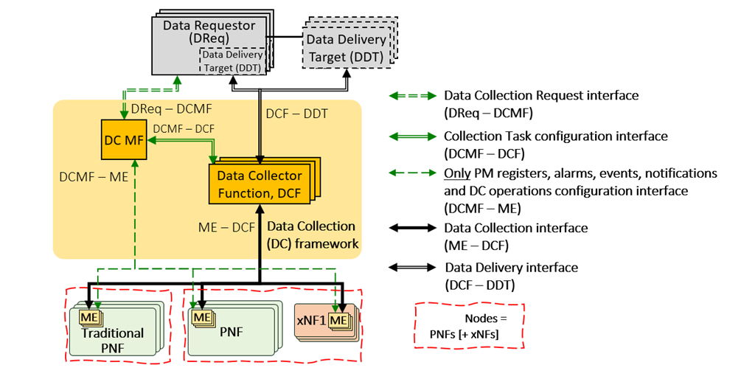
Architecture How they compare

Slide 11
Component and Interface How they compare
BBF Component | IETF Component
Data Requestors (DReqs) | N/A
DC Management Function (DC MF) | YANG-Push Subscription
Managed Entities (MEs) | YANG-Push Publisher
DC Function (DCF) | YANG-Push Receiver YANG Message Broker Producer
Data Delivery Targets (DDTs) | YANG Message Broker Consumer
BBF Interface | IETF Interface
DReq-DCMF | N/A
DCMF-ME | NETCONF, RESTCONF
DCMF-DCF | N/A
DCF-ME | YANG-Push
DCF-DDT | Message Broker / Schema Registry

Slide 12
Discussion Points What are the action points
Describe in IETF architecture how the data collection maintains the subscription when network data is being polled on the network node?
Describe in IETF architecture how IPFIX and BMP could be accommodated by preserving the architecture principles?
Describe in IETF architecture why gNMI/gRPC is not fulfilling the minimum requirements.
Include in the IETF architecture the Data Requestor aspect? How a system can interface with YANG-Push Subscription.
Align terminology between IETF and BBF or describe in each other document how terminology can be mapped on component and interface level?

Slide 13
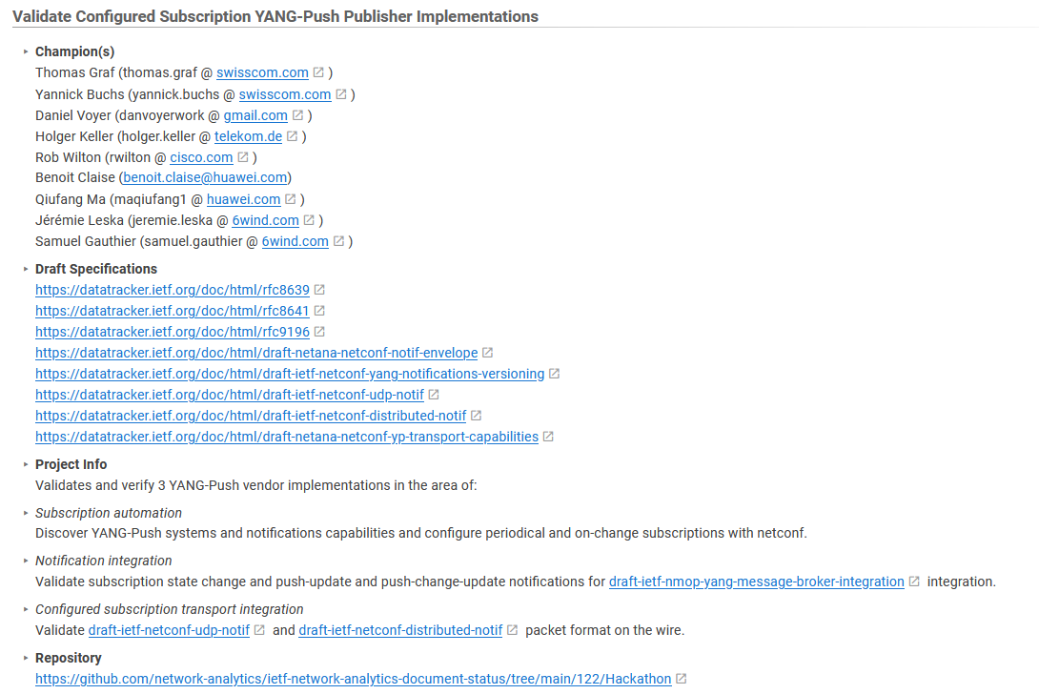
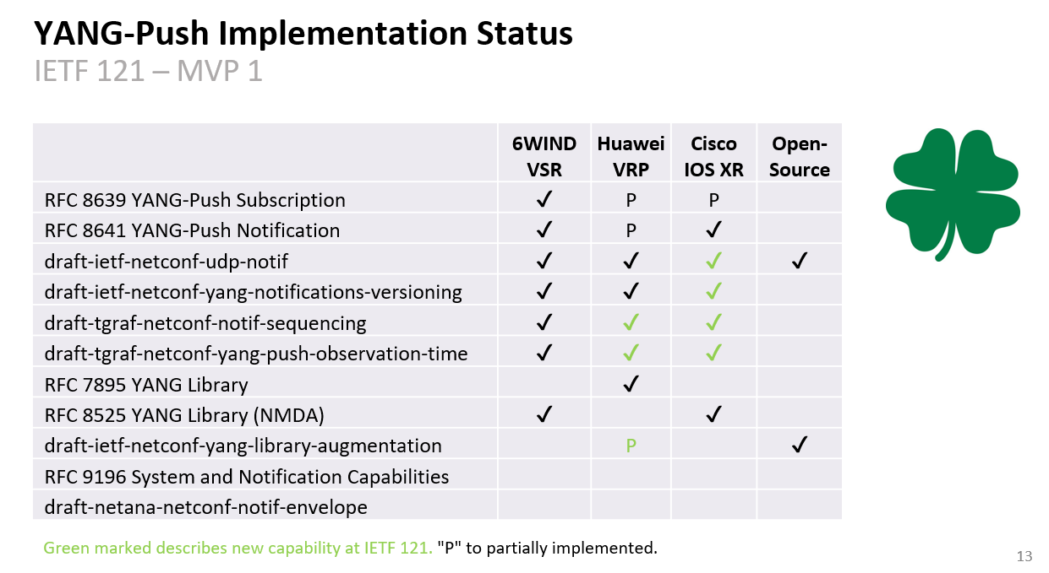
An Architecture for YANG-Push to Message Broker Integration IETF 122 Hackathon

Slide 14


Slide 15
High Level Requirements What we both care
Standard Interface for Subscription Management -> NETCONF and RESTCONF?
Standard Interface for Network Data Collection -> YANG-PUSH and IPFIX?
Standard Data Modelling -> YANG?
Standard Models covering management and forwarding plane -> BBF augmented IETF YANG modules?
Standard Interface for Data Delivery -> Message Broker?

Slide 16
High Level Requirements What IETF cares and BBF probably as well
Discoverable subscription capabilities -> Subscription Automation: Not all network elements have the same capabilities
Notifications of subscriptions state and schema changes -> Subscription Lifecycle: Subscriptions and Schema can change over time
Accessibility of schema and schema tree -> Data Processing Automation: Schema and dependencies needs to be obtainable from publisher and schema registry
Notification metadata (hostname, sequence-number, observation timestamping) -> Data Correlation Automation: From where, when and with which data quality

Slide 17
High Level Requirements What BBF cares and IETF probably as well
Network Telemetry (RFC 9232) -> Holistically: Beyond YANG and management plane, IPFIX forwarding plane, BMP control plane. Not only applies to access but also to a broader IP domain including edge. --> At BBF: Network Trend Analysis, Proactive Assurance, Site/Node/Area Survey, Pre-Qualification, Zero Touch Provisioning, Intensive Care, Trouble-Shooting, Line re-Profiling, Directed data retrieval, Service activation and change, Proactive change on severe degrade/robustness/ rate improvement, Claim based change, Network proactive assurance on THR crossing, Service migration, Profile clean-up --> At IETF: SIMAP, Knowledge Graph, Network Observability, Network Anomaly Detection
YANG Data Modelling -> IETF and IANA YANG modules (ietf-hardware.yang ietf-interfaces.yang iana-hardware.yang iana-if-type.yang iana-if-type.yang) and augmented with BBF TR-383 and TR-385 based YANG modules.

Slide 18
IETF YANG-Push Implementations and Next Steps Challenges and how to solve…
What in IETF YANG-Push could have been defined differently and why?
What prevents IETF YANG-Push for being integrated/used efficiently?
What in IETF YANG-Push is missing and for which purpose?
On-change notification schema different than periodical
Patch-id in On-Change complex to implement.
Reduce YANG complexity (example: augmentations, deviations, xpath, lists)
Each subscribed xpath needs normalization. High effort with many vendor specific YANG modules
Missing end to end open-source implementations
Extensible YANG-Push header combing notification and subscription. Separation of header and subscribed content is needed to allow partial parsing of message in binary encoding for data processing chain.
On-change and periodical notification schema should have identical schema and contain the entire schema tree below subscription and represent current state.
Common alignment on what should be supported in xpath and what not.
Agile incremental driven development. Deployment guide describing implementers and operators what is/should be supported at which MVP stage.

Slide 19
Extensible YANG model for YANG-Push Notifications For XML, JSON or CBOR encoded messages with hostname, sequence-number and observation-time
notifications:
+---n envelope
+--ro event-time yang:date-and-time
+--ro hostname? inet:host
| {notification-hostname-sequence-number}?
+--ro sequence-number? yang:counter32
| {notification-hostname-sequence-number}?
+--ro notification-contents? <anydata>
module: ietf-yp-observation-time
augment /yp:push-update:
+--ro observation-time? yang:date-and-time
+--ro point-in-time? enumeration
augment /yp:push-change-update:
+--ro observation-time? yang:date-and-time
+--ro point-in-time? enumeration
augment /sysc:system-capabilities/notc:subscription-capabilities:
+--ro yang-push-observation-supported?
inotifseq:notification-support
{yang-push-observation-timestamp}?
draft-netana-netconf-notif-envelope defines new extensible notification structure, defined in YANG, for use in YANG-Push Notification messages enabling any YANG compatible encodings such as XML RFC 7950, JSON RFC 7951 or CBOR RFC 9264.
New notification envelope can be enabled in "ietf-subscribed-notification" RFC 8639.
Capability can be discovered through 'ietf-notification-capabilities' RFC 9196.
Supports the following notification metadata extensions
hostname: Describes the node's hostname according to the 'sysName' object definition in RFC 1213 from where the message was published from. This value is usually configured on the node by the administrator to uniquely identify the node in the network.
sequence-number: Generates a unique sequence number for each published message by the publisher process. The number counts up at every published notification message as described in RFC 9187.
observation-time: Describes the measurement observation time for the "push-update" notification in a "periodical" and for the "push-change-update" notification in a "on-change" subscription.
point-in-time: Describes at which point in time the value of observation-time was observed.
{
"ietf-yp-notification:envelope": {
"event-time": "2023-03-25T08:30:11.22Z",
"hostname": "example-router",
"sequence-number": 1,
"notification-contents": {
"ietf-yang-push:push-update": {
"id": 6666,
"ietf-yp-observation-time:observation-time": "2023-02-04T16:30:09.44Z",
"ietf-yp-observation-time:point-in-time": "current-accounting",
"datastore-contents": {
"ietf-interfaces:interfaces": [
{
"interface": {
"name": "eth0",
"type": "iana-if-type:ethernetCsmacd",
"oper-status": "up",
"mtu": 1500

Slide 20
Support of Versioning in YANG Notifications Subscription For subscription state change notification messages
module: ietf-yang-push-revision
augment /sn:establish-subscription/sn:input:
+---w module-version-config* [module-name]
+---w module-name yang:yang-identifier
+---w revision? rev:revision-date-or-label
+---w revision-label? ysver:version
augment /sn:subscription-started:
+--ro module-version* [module-name]
| {yang-push-revision-supported}?
| +--ro module-name yang:yang-identifier
| +--ro revision rev:revision-date
| +--ro revision-label? ysver:version
+--ro yang-library-content-id? -> /yanglib:yang-library/content-id
{yang-push-revision-supported}?
Network operators need to control semantics in its data processing pipeline. That includes YANG-Push.
This is today only possible during YANG-Push subscription but not when nodes are being upgraded or when messages are being published for configured subscription.
draft-ietf-netconf-yang-notifications-versioning extends the YANG push subscription and publishing mechanism defined in RFC 8641:
By adding the ability to subscribe to a specific revision or latest-compatible-semversion of one or more yang modules.
By extending the YANG push Subscription State Change Notifications Message so that the YANG push receiver learns beside the xpath and the sub-tree filter also the yang module name, revision, revision-label and the yang-library-content-id. With YANG Library content-id a YANG-Push receiver is now able to detect changes in the YANG library. This includes also the imported YANG modules of the subscribed xpath.
Extends RFC 9196 defined subscription-capabilities with a yang-push-module-revision-supported leaf.
{
"ietf-notification:notification": {
"eventTime": "2023-03-25T08:30:11.22Z",
"ietf-notification-sequencing:sysName": "example-router",
"ietf-notification-sequencing:sequenceNumber": 1,
"ietf-subscribed-notification:subscription-started": {
"id": 6666,
"ietf-yang-push:datastore": "ietf-datastores:operational",
"ietf-yang-push:datastore-xpath-filter": "/if:interfaces",
"ietf-yang-push-revision:revision": "2014-05-08",
"ietf-yang-push-revision:module-name": "ietf-interfaces",
"ietf-yang-push-revision:revision-label": "",,
"ietf-yang-push-revision:yang-library-content-id": "1",
"ietf-distributed-notif:message-observation-domain-id": [1,2],
"transport": "ietf-udp-notif-transport:udp-notif",
"encoding": "encode-json",
"ietf-yang-push:periodic": {
"ietf-yang-push:period": 100
}
}
}
}

Slide 21
YANG Notification Transport Capabilities Extending System Capabilities for YANG-Push Configured Subscription Transport
module: ietf-notification-transport-capabilities
augment /sysc:system-capabilities/notc:subscription-capabilities:
+--ro transport-capabilities
+--ro transport-capability* [transport-protocol]
+--ro transport-protocol identityref
+--ro security-protocol? identityref
+--ro encoding-format* identityref
augment "/sysc:system-capabilities/notc:subscription-capabilities" {
description "Add system level capability.";
container transport-capabilities {
description "Capabilities related to YANG-Push transports.";
list transport-capability {
key "transport-protocol";
description "Capability list related to notification transport capabilities.";
leaf transport-protocol {
type identityref {
base sn:transport;
}
description "Supported transport protocol for YANG-Push.";
}
leaf security-protocol {
type identityref {
base security-protocol;
}
description "Type of secure transport.";
}
leaf-list encoding-format {
type identityref {
base sn:encoding;
}
description "Supported encoding formats.";
}
}
}
draft-netana-netconf-yp-transport-capabilities augments System Capabilities model and provides additional transport related attributes associated with system capabilities:
Specification of transport protocols the client can request to establish a draft-ietf-netconf-udp-notif or draft-ietf-netconf-https-notif configured transport connection;
Specification of transport encoding, such as JSON or XML as defined in RFC 8040 or CBOR as defined in RFC 9254 the client can request to encode YANG notifications;
Specification of secure transport mechanisms that are needed by the client to communicate with the server such as DTLS as defined in RFC 9147 TLS as defined in RFC 8446 or SSH as defined in RFC 4254;

Slide 22
Augmented-by Addition YANG Library Extension
module: ietf-yang-library
+--ro yang-library
| +--ro module-set* [name]
| | +--ro name string
| | +--ro module* [name]
| | | +--ro name yang:yang-identifier
| | | +--ro revision? revision-identifier
| | | +--ro namespace inet:uri
| | | +--ro location* inet:uri
| | | +--ro submodule* [name]
| | | | +--ro name yang:yang-identifier
| | | | +--ro revision? revision-identifier
| | | | +--ro location* inet:uri
| | | +--ro feature* yang:yang-identifier
| | | +--ro deviation* -> ../../module/name
| | | +--ro yanglib-aug:augmented-by*
-> ../../yanglib:module/name
With YANG-Push xpath or sub-tree a part of the YANG-Push data tree is subscribed.
With YANG Library the relationship among the subscribed YANG modules can be determined from the top of the YANG tree. What is missing is the ability to discover dependencies within the YANG tree.
draft-lincla-netconf-yang-library-augmentation extends the YANG library defined in RFC 8525:
By adding augmented-by YANG module relation.

Slide 23
Validate anydata schema subtree with YANG Library RFC 7950 Extension
notifications:
+---n push-update
| +--ro id? sn:subscription-id
| +--ro datastore-contents? <anydata>
With YANG-Push xpath or sub-tree a part of the YANG-Push data tree is subscribed. The subscribed YANG datastore content is published as anydata, event though the content has a valid schema.
RFC 7950 lacks specification how the data model of anydata content is exposed through YANG library defined in RFC 8525.
draft-aelhassany-anydata-validation extends RFC 7950 by describing:
How anydata can be validated with YANG Library.
{
"ietf-yang-push:push-update": {
"id": 89,
"datastore-contents": {
"ietf-interfaces:interfaces": {
"interface": [
{
"name": "eth0",
"oper-status": "down"
}]
}}
}
}
RFC 7950
7.10. The "anydata" Statement
The "anydata" statement defines an interior node in the schema
tree. It takes one argument, which is an identifier, followed by
a block of substatements that holds detailed anydata information.
The "anydata" statement is used to represent an unknown set of
nodes that can be modeled with YANG, except anyxml, but for which
the data model is not known at module design time. It is
possible, though not required, for the data model for anydata
content to become known through protocol signaling or other means
that are outside the scope of this document.

Slide 24
YANG-Push Operational Data Observability Enhancements Simplifies by combining periodic and on-change subscription
module: ietf-yp-ext
augment /sn:subscription-started/yp:update-trigger:
+--:(periodic-and-on-change) {yp:on-change}?
+-- periodic-and-on-change!
+-- period yp:centiseconds
+-- anchor-time? yang:date-and-time
+-- dampening-period? yp:centiseconds
+-- sync-on-start? boolean
+-- excluded-change* yp:change-type
augment /sn:subscription-started:
+--ro common-notification-format? boolean
augment /sn:subscription-modified/yp:update-trigger:
+--:(periodic-and-on-change) {yp:on-change}?
+-- periodic-and-on-change!
+-- period yp:centiseconds
+-- anchor-time? yang:date-and-time
+-- dampening-period? yp:centiseconds
+-- sync-on-start? boolean
+-- excluded-change* yp:change-type
augment /sn:subscription-modified:
+--ro common-notification-format? boolean
augment /sn:subscriptions/sn:subscription/yp:update-trigger:
+--:(periodic-and-on-change) {yp:on-change}?
+--rw periodic-and-on-change!
+--rw period yp:centiseconds
+--rw anchor-time? yang:date-and-time
+--rw dampening-period? yp:centiseconds
+--rw sync-on-start? boolean
+--rw excluded-change* yp:change-type
augment /sn:subscriptions/sn:subscription:
+--rw common-notification-format? boolean
To reduce complexities in modelling the operational state, the following two YANG-Push enhancements are proposed:
A new YANG-Push encoding format that can be used for both on-change and periodic subscriptions that reports the data from the subscription filter point.
A combined periodic and on-change subscription that reports events on a periodical cadence and also if changes to the data have occurred.
This removes the YANG Patch format RFC 8072 dependency and eases the message broker integration.
Allows the YANG-Push publisher to split a subscription into smaller child subscriptions for more efficient independent and concurrent processing. Reuses the ideas from draft-ietf-netconf-distributed-notif. Child subscriptions remain encoded from the same subscription point.
notifications:
+---n update
+--ro id? sn:subscription-id
+--ro subscription-path? yang:xpath1.0
+--ro target-path? string
+--ro snapshot-type? enumeration
+--ro observation-time? yang:date-and-time
+--ro datastore-snapshot? <anydata>
+--ro incomplete? empty

