Slide 1
WT-508 and YANG-Push to Message Broker Comparison Shared synergies and common interests
zhenghaomian@huawei.com
david.zhujian@huawei.com
thomas.graf@swisscom.com
22. February 2025

Slide 2
Agenda Items
Hight Level Requirements
Architecture, Component and Interface Comparison
Key Findings and Possible Action Points
Next Steps

Slide 3
High Level Requirements What we both care
Standard Interface for Subscription Management -> NETCONF and RESTCONF?
Standard Interface for Network Data Collection -> YANG-PUSH and IPFIX?
Standard Data Modelling -> YANG?
Standard Models covering management and forwarding plane -> BBF augmented IETF YANG modules?
Standard Interface for Data Delivery -> Message Broker?

Slide 4
High Level Requirements What IETF cares and BBF probably as well
Discoverable subscription capabilities -> Subscription Automation: Not all network elements have the same capabilities
Notifications of subscriptions state and schema changes -> Subscription Lifecycle: Subscriptions and Schema can change over time
Accessibility of schema and schema tree -> Data Processing Automation: Schema and dependencies needs to be obtainable from publisher and schema registry
Notification metadata (hostname, sequence-number, observation timestamping) -> Data Correlation Automation: From where, when and with which data quality

Slide 5
High Level Requirements What BBF cares and IETF probably as well
Network Telemetry (RFC 9232) -> Holistically: Beyond YANG and management plane, IPFIX forwarding plane, BMP control plane. Not only applies to access but also to a broader IP domain including edge. --> At BBF: Network Trend Analysis, Proactive Assurance, Site/Node/Area Survey, Pre-Qualification, Zero Touch Provisioning, Intensive Care, Trouble-Shooting, Line re-Profiling, Directed data retrieval, Service activation and change, Proactive change on severe degrade/robustness/ rate improvement, Claim based change, Network proactive assurance on THR crossing, Service migration, Profile clean-up --> At IETF: SIMAP, Knowledge Graph, Network Observability, Network Anomaly Detection
YANG Data Modelling -> IETF and IANA YANG modules (ietf-hardware.yang ietf-interfaces.yang iana-hardware.yang iana-if-type.yang iana-if-type.yang) and augmented with BBF TR-383 and TR-385 based YANG modules.

Slide 6
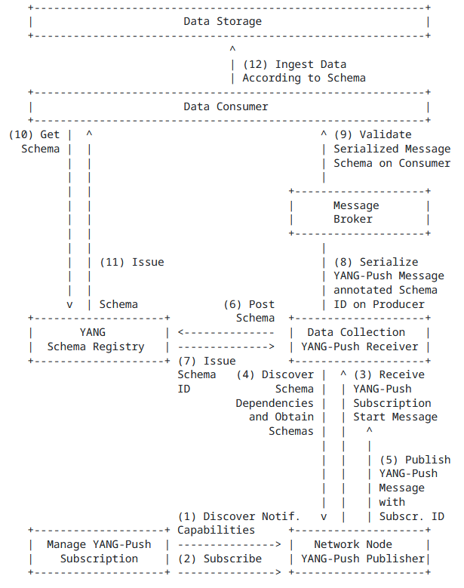
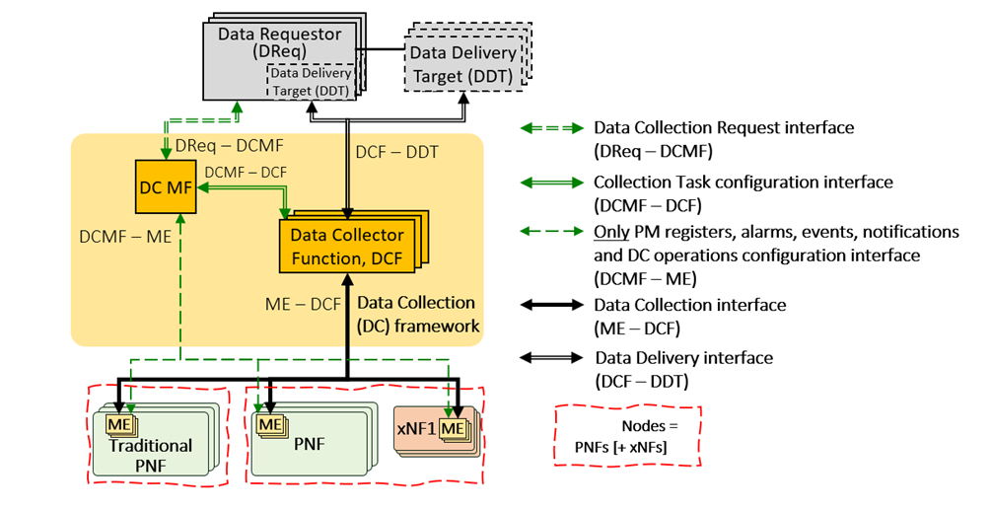
Architecture How they compare

Slide 7
Component and Interface How they compare
BBF Component | IETF Component
Data Requestors (DReqs) | N/A
DC Management Function (DC MF) | YANG-Push Subscription
Managed Entities (MEs) | YANG-Push Publisher
DC Function (DCF) | YANG-Push Receiver YANG Message Broker Producer
Data Delivery Targets (DDTs) | YANG Message Broker Consumer
BBF Interface | IETF Interface
DReq-DCMF | N/A
DCMF-ME | NETCONF, RESTCONF
DCMF-DCF | N/A
DCF-ME | YANG-Push
DCF-DDT | Message Broker / Schema Registry

Slide 8
Discussion Points What are the key findings
Do we agree that the 4 highlighted points from slide 4 should be included in the BBF requirements?
Do we agree that regardless wherever the network data is being polled or pushed the architecture remains the same only the functions move to different systems?
Remark: Only in case of polling an interface between DC Management Function and DC Function resp. YANG-Push Subscription and YANG-Push Receiver is needed.
Shall we align terminology between IETF and BBF or describe in each other document how terminology can be mapped on component and interface level?

Slide 9
Discussion Points What are the possible action points
Shall we describe in the IETF architecture how the data collection maintains the subscription when network data is being polled on the network node?
Shall we describe in the IETF architecture how IPFIX and BMP could be accommodated by preserving the architecture principles?
Shall we include in the IETF architecture the Data Requestor aspect? How a system can interface with YANG-Push Subscription.

Slide 10
Next Steps How we keep updated
Do you agree that both operators' requirements and architecture proposals are very similar?
Do you agree that it is mutually beneficial to align?
Was this exchange useful and should we meet again in 3 months?

