Slide 1
UDP-based Transport for Configured Subscriptions draft-ietf-netconf-udp-notif-10
UDP-based protocol for YANG notifications
to collect data from networking devices
G. Zheng, Huawei T. Zhou, Huawei
T. Graf, Swisscom
P. Francois, INSA-Lyon
A. Huang Feng, INSA-Lyon
P. Lucente, NTT
7. July 2023

Slide 2
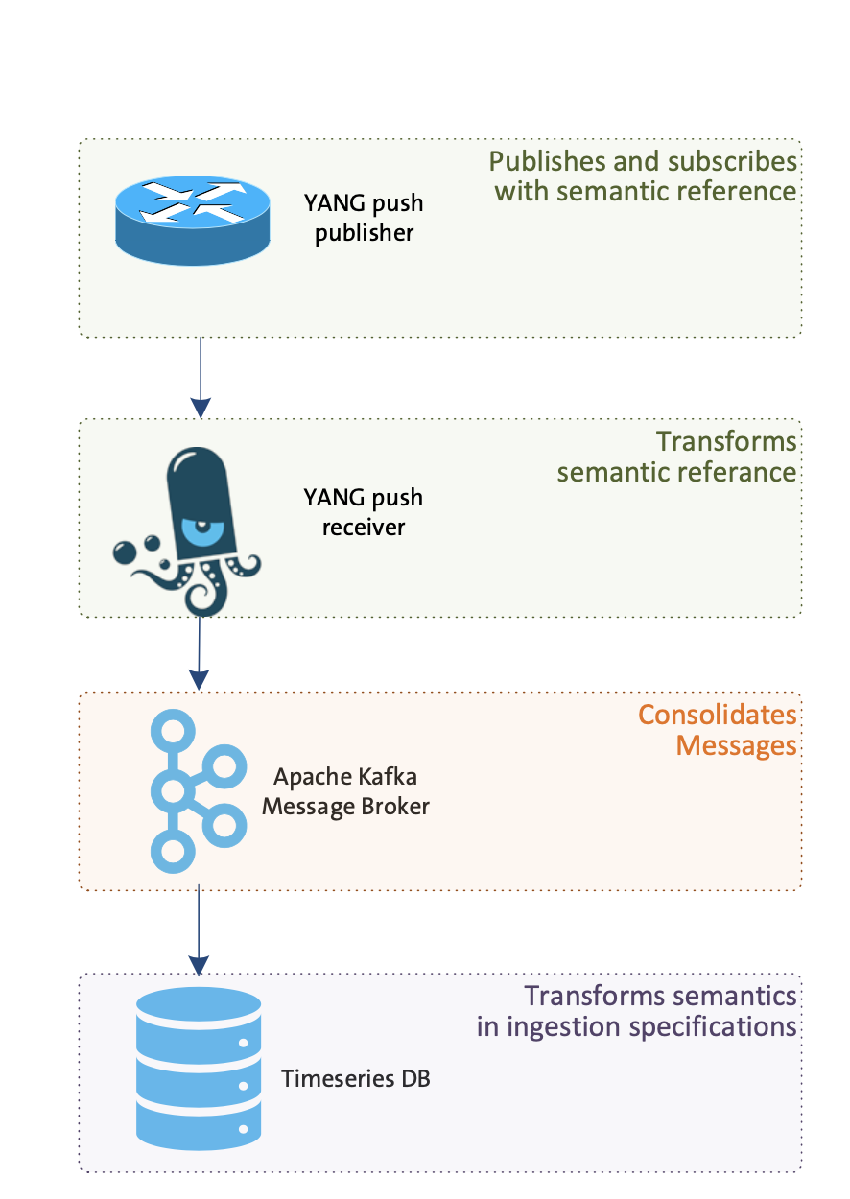
UDP-based Transport for Configured Subscriptions Current status
Status
-10 published
Addressed IETF 116 feedback from Mahesh on udp-client-grouping
Added Implementation Status Section
Editorial updates
-> Requesting feedback and comments
G. Zheng, Huawei T. Zhou, Huawei
T. Graf, Swisscom
P. Francois, INSA-Lyon
A. Huang Feng, INSA-Lyon
P. Lucente, NTT
7. July 2023

Slide 3
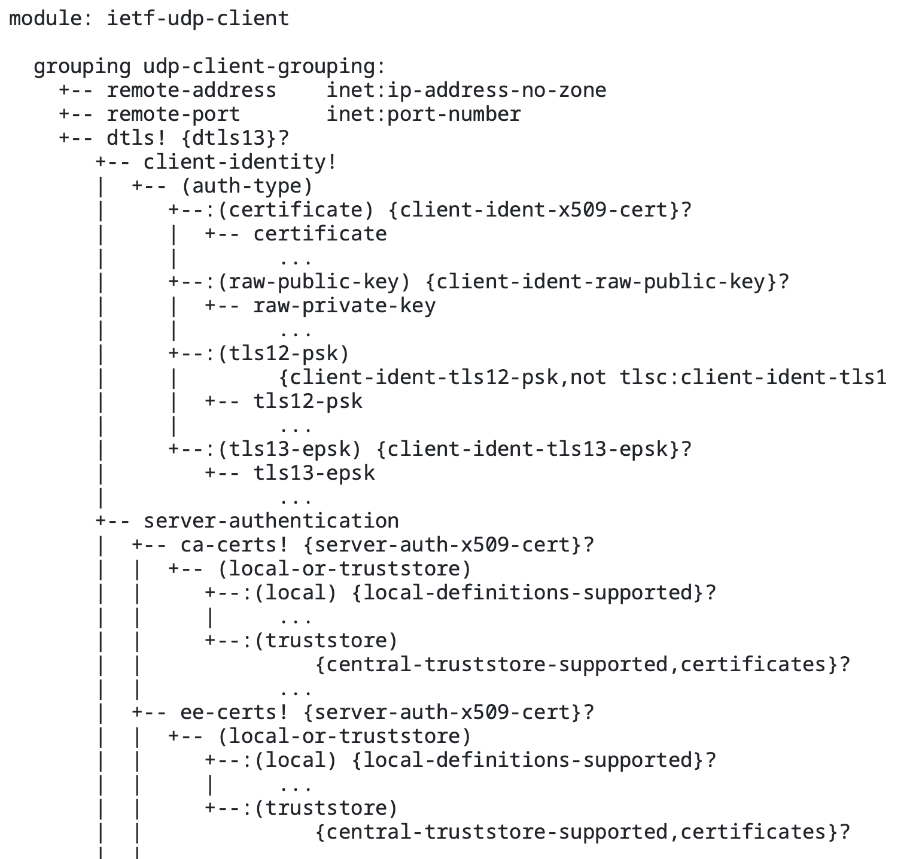
UDP-based Transport for Configured Subscriptions Current ML discussions
Current generic “ietf-udp-client” grouping
“ietf-udp-server” grouping?
Separate “dtls” container into another grouping?
G. Zheng, Huawei T. Zhou, Huawei
T. Graf, Swisscom
P. Francois, INSA-Lyon
A. Huang Feng, INSA-Lyon
P. Lucente, NTT
7. July 2023

