Slide 1
An Architecture for a Network Anomaly Detection Framework draft-ietf-nmop-network-anomaly-architecture-08
draft-ietf-nmop-network-anomaly-semantics-06
draft-ietf-nmop-network-anomaly-lifecycle-06
Motivation and architecture of a Network Anomaly Detection Framework
and the relationships to other documents describing
network symptom semantics and network incident lifecycle
wanting.du@swisscom.com
thomas.graf@swisscom.com pierre.francois@insa-lyon.fr vincenzo.riccobene@huawei-partners.com alex.huang-feng@insa-lyon.fr

Slide 2

Problem Statement and Motivation How it is being addressed in each document
Network Anomaly Detection
To detect service interruptions before users do, network operations must use automated, holistic monitoring across all three network planes.
draft-ietf-nmop-network-anomaly-architecture describes the motivation, architecture and the relationship to other two documents.
By standardizing labeled incident data and automating the postmortem process, operators can improve machine learning models continuously and foster better collaboration between vendors and academia.
draft-ietf-nmop-network-anomaly-semantics defines Symptom semantics to enable standardized data exchange to validate results with network engineers and improve supervised and semi-supervised machine learning systems.
draft-ietf-nmop-network-anomaly-lifecycle describes the lifecycle process, enabling network engineers to interact with the network anomaly detection system to refine the detection abilities over time.

Slide 3
draft-ietf-nmop-network-anomaly-architecture-08
Network Anomaly Detection Architecture

Slide 4
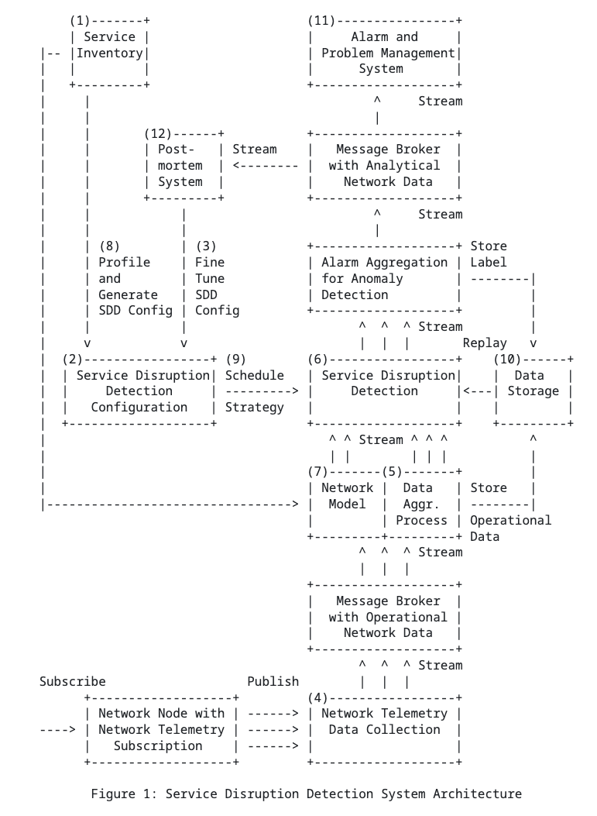
Network Anomaly Detection Architecture Document summary
Motivation:
Human‑driven troubleshooting does not scale due to the growing number of dependencies
Approach:
This draft defines a standardized, architecture‑level framework
Outcome:
Enable automated service disruption detection
draft-ietf-nmop-network-anomaly-architecture

Slide 5
Network Anomaly Detection Architecture Key draft updates since v-07, IETF 125
Changes in References
SIMAP documents downstream references, draft-ietf-nmop-simap-concept and draft-havel-nmop-simap-yang, changed from normative to informative.
Knowledge Graph downstream references, draft-mackey-nmop-kg-for-netops, changed from normative to informative.
Network Incident Contribution
Updated Network Anomaly Detection relationship in draft-ietf-nmop-network-incident-yang-10#section-9.5
Notes:
Out-scoping: Rüdiger Geib

Slide 6
draft-ietf-nmop-network-anomaly-semantics-06
Semantic Metadata Annotation

Slide 7
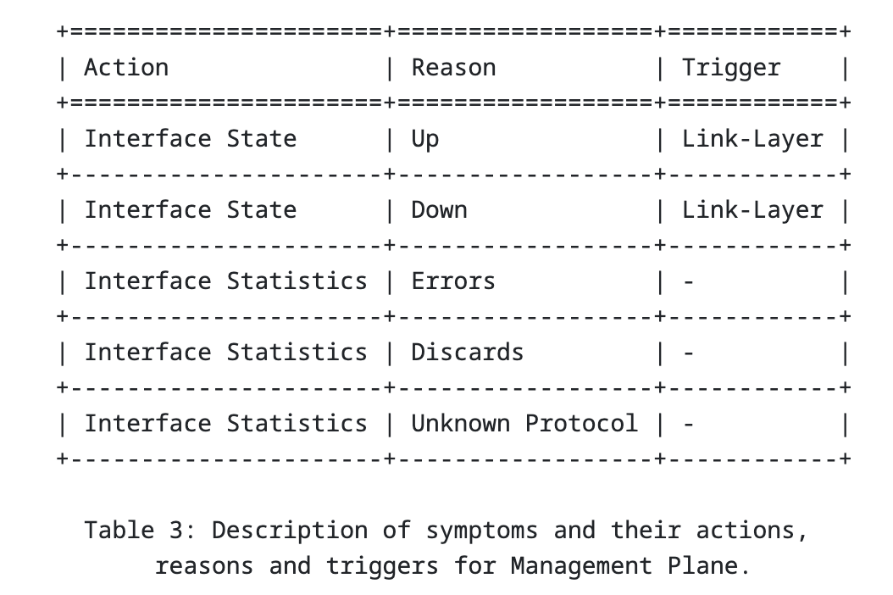
Semantic Metadata Annotation Document summary
Motivation:
Enable the exchange of network anomaly data across diverse systems and support benchmarking of anomaly detection solutions
Approach:
Define a standardized semantic metadata schema and a set of semantically structured terms
Outcome:
Provide human‑readable context for describing and understanding network anomalies

Slide 8
Semantic Metadata Annotation Key draft updates since v-06, IETF 125
module: ietf-network-anomaly-service-topology
augment /rsn:relevant-state/rsn:service:
+--:(l2vpn)
| +--rw l2vpn-service* [vpn-id]
| +--rw vpn-id string
| +--rw uri? inet:uri
| +--rw vpn-name? string
| +--rw site-ids* string
| +--rw change-id? yang:uuid
| +--rw change-start-time? yang:date-and-time
| +--rw change-end-time? yang:date-and-time
+--:(l3vpn)
+--rw l3vpn-service* [vpn-id]
+--rw vpn-id string
+--rw uri? inet:uri
+--rw vpn-name? string
+--rw site-ids* string
+--rw change-id? yang:uuid
+--rw change-start-time? yang:date-and-time
+--rw change-end-time? yang:date-and-time
augment /rsn:relevant-state-notification/rsn:service:
+--:(l2vpn)
| +-- l2vpn-service* [vpn-id]
| +-- vpn-id string
| +-- uri? inet:uri
| +-- vpn-name? string
| +-- site-ids* string
| +-- change-id? yang:uuid
| +-- change-start-time? yang:date-and-time
| +-- change-end-time? yang:date-and-time
+--:(l3vpn)
+-- l3vpn-service* [vpn-id]
+-- vpn-id string
+-- uri? inet:uri
+-- vpn-name? string
+-- site-ids* string
+-- change-id? yang:uuid
+-- change-start-time? yang:date-and-time
+-- change-end-time? yang:date-and-time
augment /rsn:relevant-state/rsn:anomaly:
+--rw vpn-node-terminations* [hostname vrf-name]
+--rw hostname inet:host
+--rw vrf-id? uint32
+--rw vrf-name string
+--rw route-distinguisher? string
+--rw interface-id* uint32
+--rw interface-name* string
+--rw peer-ip* inet:ip-address
+--rw next-hop* inet:ip-address
augment /rsn:relevant-state-notification/rsn:anomaly:
+-- vpn-node-terminations* [hostname vrf-name]
+-- hostname inet:host
+-- vrf-id? uint32
+-- vrf-name string
+-- route-distinguisher? string
+-- interface-id* uint32
+-- interface-name* string
+-- peer-ip* inet:ip-address
+-- next-hop* inet:ip-address
Abstract
Simplified.
Schema change
Term "cbl" removed from YANG module and grouping names.
Updated YANG prefix names.
Uses "ietf-yang-types " and " ietf-inet-types " from RFC 9911 instead of 6991bis.
Examples
Added relevant state instance data example draft-ietf-nmop-network-anomaly-semantics-06#section-4.4.2.
ietf-network-anomaly-service-topology
Detailed on reasoning why this YANG module is needed.
At the IETF 125 ONSEN discussions (slides-125-onsen-proposed-charter-discussion), the point on that the existing L2 and L3 service models lack certain attributes and map ability to SIMAP resp. RFC 8345 was raised. Therefore, therefore opted for having dedicated service and network groupings in ietf-network-anomaly-service-topology. This document is classified experimental. We expect that the IETF NMOP, ONSEN is advancing in these areas so that ietf-network-anomaly-service-topology no longer is needed.

Slide 9
draft-ietf-nmop-network-anomaly-lifecycle-06
Network Anomaly Lifecycle

Slide 10
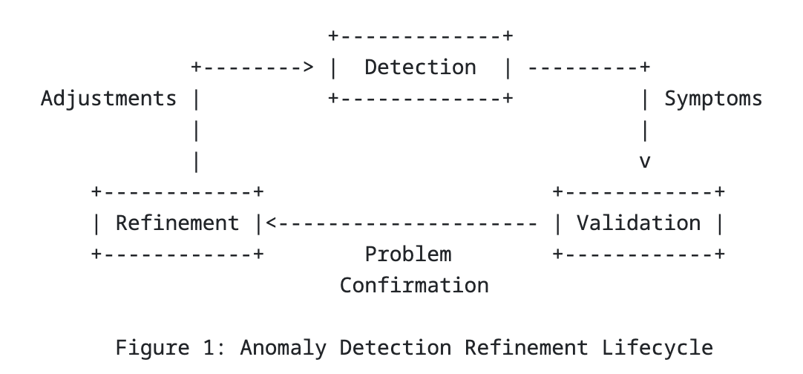
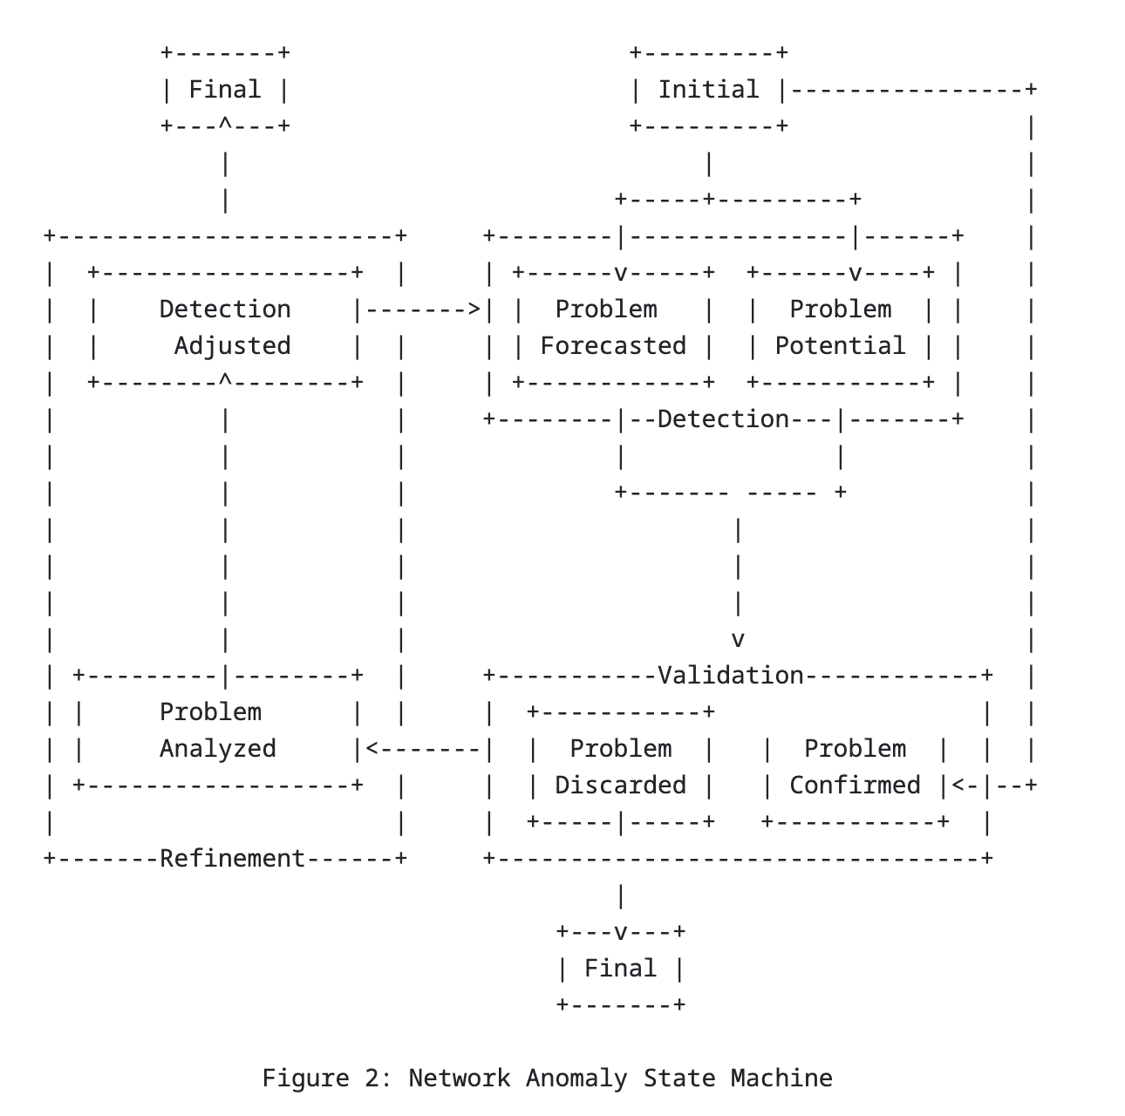
Network Anomaly Lifecycle Document summary
Motivation:
Bridge the gap between automated network anomaly detection and actionable operational tasks
Approach:
Define a standardized, iterative lifecycle for Network anomaly
Outcome:
Continuously Improve the correctness of anomaly detection through human‑in‑the‑loop feedback

Slide 11
Network Anomaly Lifecycle Key draft updates since v-05, IETF 125
Abstract and Introduction
Refactored and simplified abstraction and introduction sections.
Make better use of abstract and introduction section by moving the reasoning from abstract to introduction.
Lifecycle Process
Detailed on when lifecycle process when it changes from validation to refinement stage.
Schema change
"topic-name" and "subject-name" leaves have now their own message broker typedefs aligning with draft-ietf-nmop-yang-message-broker-message-key.
Uses "ietf-yang-types " and " ietf-inet-types " from RFC 9911 instead of 6991bis.
module: ietf-relevant-state
+--rw relevant-state!
+--rw id yang:uuid
+--rw uri? inet:uri
+--rw description? string
+--rw start-time yang:date-and-time
+--rw end-time? yang:date-and-time
+--rw strategy? string
+--rw confidence-score? score
+--rw concern-score score
+--rw stage identityref
+--rw (service)?
+--rw anomaly* [id revision]
+--rw id yang:uuid
+--rw revision yang:counter32
+--rw uri? inet:uri
+--rw stage identityref
+--rw description? string
+--rw start-time yang:date-and-time
+--rw end-time? yang:date-and-time
+--rw confidence-score? score
+--rw pattern? identityref
+--rw annotator
| +--rw id? yang:uuid
| +--rw name string
| +--rw version? string
| +--rw annotator-type? enumeration
+--rw operational-data
| +--rw topic-name? message-broker-topic
| +--rw subject-name? message-broker-subject
+--rw symptom!
+--rw id yang:uuid
+--rw concern-score score

Slide 12
Next Steps and Remaining Issues Feedback on latest changes
Next Steps
Request YANG doctors review for draft-ietf-nmop-network-anomaly-semantics-06 and draft-ietf-nmop-network-anomaly-lifecycle-06.
Extend the postmortem system requirements, accompanied by an implementation PoC
Remaining Issues
No known remaining issues at this time.

