Slide 1
An Architecture for a Network Anomaly Detection Framework draft-ietf-nmop-network-anomaly-architecture-01
Motivation and architecture of a Network Anomaly Detection Framework
and the relationships to other documents describing
network symptom semantics and network incident lifecycle
wanting.du@swisscom.com pierre.francois@insa-lyon.fr
thomas.graf@swisscom.com vincenzo.riccobene@huawei-partners.com alex.huang-feng@insa-lyon.fr
03. November 2024

Slide 2

Problem Statement and Motivation How it is being addressed in which document
Network Anomaly Detection
When operational or configurational changes in connectivity services are happening, the objective is to detect interruption at network operation faster than the users using those connectivity services
In order to achieve this objective, automation in network monitoring is required. This automation needs to monitor network changes holistically by monitoring all 3 network planes simultaneously and detect whether that change is service disruptive.
Through network incidents postmortems we network operators learn and improve so does network anomaly detection and supervised and semi-supervised machine learning. With more and more incidents the postmortem process demands automation and with the standardization of labeled network incident collaboration among network operators, vendors and academia is facilitated.
draft-ietf-nmop-network-anomaly-architecture describes the motivation and architecture and the relationship to other two documents.
draft-netana-nmop-network-anomaly-semantics defines Symptom semantics to enable standardized data exchange to validate results with network engineers and improve supervised and semi-supervised machine learning systems.
draft-netana-nmop-network-anomaly-lifecycle describes on managing the lifecycle process, in order to facilitate network engineers to interact with the network anomaly detection system to refine the detection abilities over time.

Slide 3
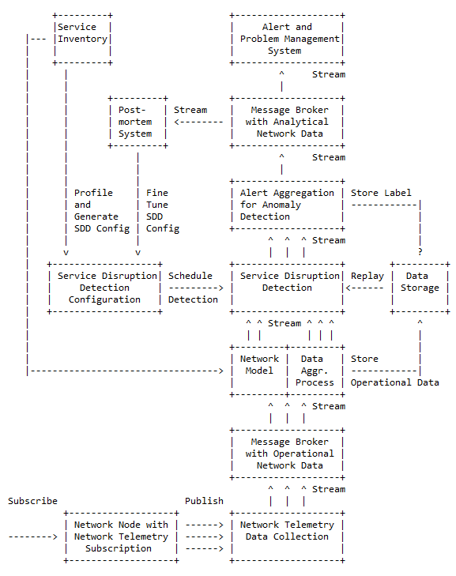
An Architecture for a Network Anomaly Detection Framework Status and Next steps
Deployment Status
Cosmos Bright Lights streaming based implementation deployed in Swisscom production environment. Service auto profiling successfully deployed. Monitoring >12'000 L3 VPN's.
Bell Canada data processing chain is operational. Preparations for deployment started.
Deployment Next Steps
Preparing code for Bell Canada deployment. Code refactoring according to latest annotation and notification semantics.
Continue search for other network operators interested in collaboration and co-development.
Document Status
Knowledge Graph references for rule in section 2.3 and symptom definitions in section 2.4.2 were added as per request from Nacho.
Merged editorial updates from Qin in section 1.2.
Merged terminology input from Adrian in regard to "network topology state" vs. "network state", "alert" vs. "alarm" and "component" vs. "resource" to be aligned with draft-ietf-nmop-terminology.
Document Next Steps
-> Incorporate already received feedback from Michael and look forward for feedback from Nacho on Knowledge Graph related changes.
-> Looking forward for review and feedback from working group.

Slide 4
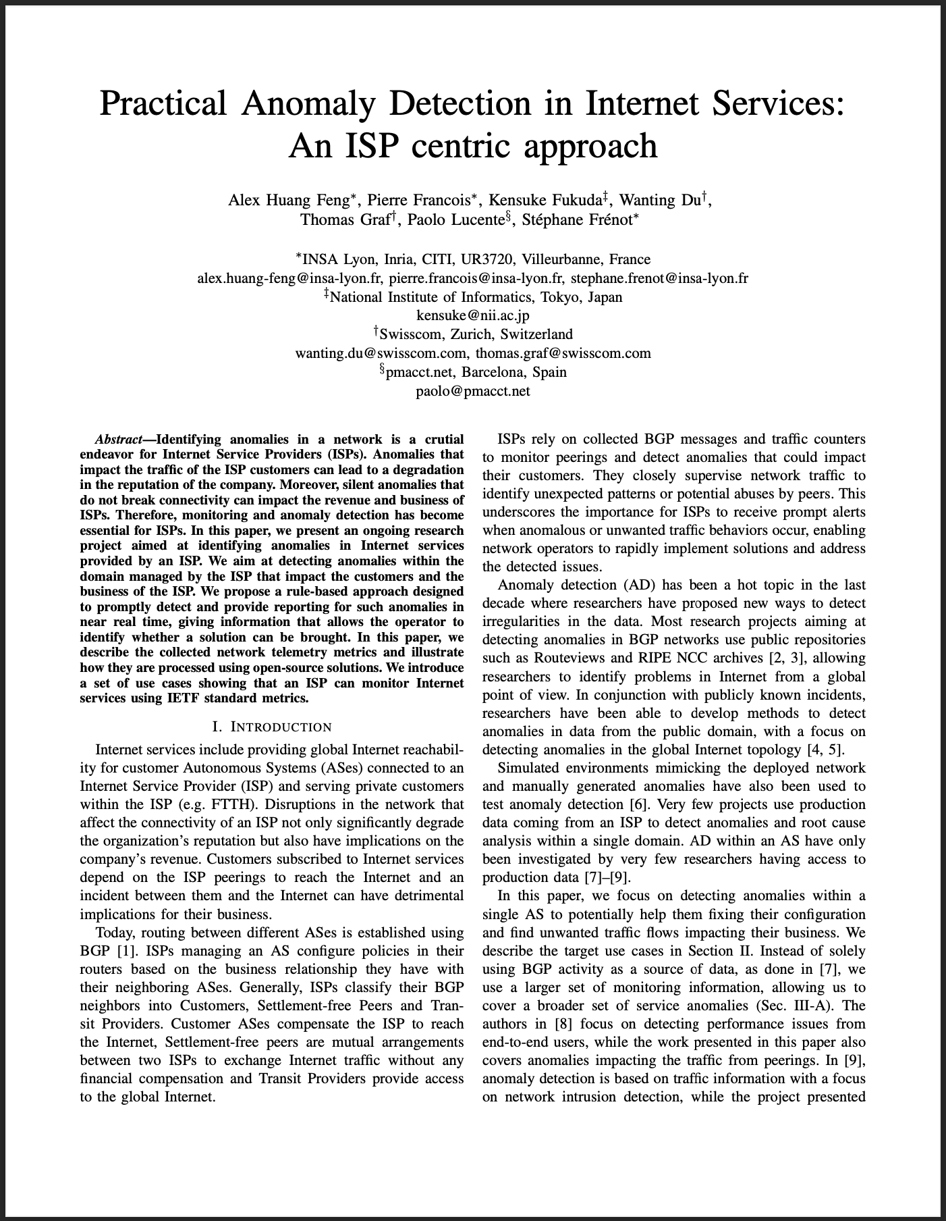
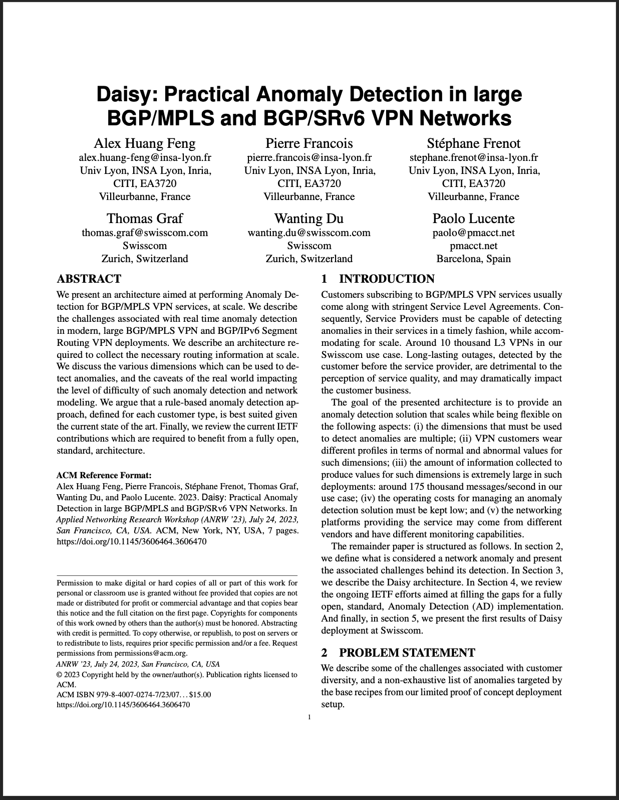
Relevant Papers for more Details
Paper “Practical Anomaly Detection in Internet Services: An ISP centric approach”
Published at AnNet Workshop (In conjunction with IEEE NOMS)
Seoul, South Korea (6–10 May 2024)
Open access: https://hal.science/hal-04655324
Paper “Daisy: Practical Anomaly Detection in large BGP/MPLS and BGP/SRv6 VPN Networks” published at ACM/IRTF ANRW’23
San Francisco, USA (24 July 2023)
Open access: http://hal.science/hal-04307611

Slide 5
Relationship between Service Disruption Detection and Post-mortem
draft-netana-nmop-network-anomaly-semantics
draft-netana-nmop-network-anomaly-lifecycle
Service Disruption System: System consuming operational data and performing disruption detection
Post-mortem: process to improve the Service Disruption Detection System adding learnings from past disruptions

Slide 6
Network Anomaly Lifecycle and Anomaly Semantic draft-netana-nmop-network-anomaly-lifecycle & draft-netana-nmop-network-anomaly-semantics
« Network Anomaly Detection is an iterative process that requires continuous improvement »
The approach proposed in these documents is the introduction of a Label Store for network anomaly detection
It addresses two main challenges in the network anomaly detection domain:
The creation of labelled datasets to train and evaluate anomaly detection algorithms and technologies
The support for the human-in-the-loop paradigm for what concerns the automated anomaly detection process.
Adjustments to
detection system
Detection: The Network Anomaly Detection stage is about the continuous monitoring of the network through Network Telemetry [RFC9232] and the identification of symptoms.
Validation: Decides if the detected symptoms are signaling a real incident or if they are to be treated as false positives.
Refinement: Network operators perform postmortem analysis of incidents, analyze the telemetry data and detected anomalies with the objective to identify useful adjustments in the data collection and Anomaly Detection system.
Detection
Detected Symptoms
Refined Symptoms
Label Store
Labels
Refinement
Validation
Labels
Confirmed Symptoms
The document proposes a standardization of the API of the Label Store

Slide 7
Semantic Metadata Annotation and Anomaly Lifecycle Status and Next steps
Document Status
Merged terminology input from Adrian "alert" vs. "alarm" and "occurrence"
Embraced comment from Lionel on making the lifecycle data model self-contained
Introduce a clearer cut of scope between the two drafts:
The Lifecycle data model now defines the “relevant-state” as a collection of generic anomalies (and it contains all the related fields, (like start / end time, confidence-score, concern-score)
The semantic data model provides a specific augmentation of the lifecycle in relation to the semantic of symptoms for connectivity services according to RFC9232.
Embraced comment from Lionel on making the model more self-contained.
Updated YANG module with relevant-state container and notification augmentations to enable a structured and extensible YANG module tree. -> See next slides for details.
Deployment Status
Antagonist PoC at IETF 121 hackathon, https://github.com/vriccobene/antagonist -> See NMOP presentation in the afternoon’s slot.

Slide 8
Experiment: Network Anomaly Lifecycle draft-netana-nmop-network-anomaly-lifecycle
Relevant State Data Model
module: ietf-relevant-state
+--rw relevant-state
+--rw id yang:uuid
+--rw description? string
+--rw start-time yang:date-and-time
+--rw end-time? yang:date-and-time
+--rw anomalies* [id version]
+--rw id yang:uuid
+--rw version yang:counter32
+--rw state identityref
+--rw description? string
+--rw start-time yang:date-and-time
+--rw end-time? yang:date-and-time
+--rw confidence-score score
+--rw (pattern)?
| +--:(drop)
| | +--rw drop? empty
| +--:(spike)
| | +--rw spike? empty
| +--:(mean-shift)
| | +--rw mean-shift? empty
| +--:(seasonality-shift)
| | +--rw seasonality-shift? empty
| +--:(trend)
| | +--rw trend? empty
| +--:(other)
| +--rw other? string
+--rw annotator!
| +--rw name string
| +--rw (annotator-type)?
| +--:(human)
| | +--rw human? empty
| +--:(algorithm)
| +--rw algorithm? empty
+--rw symptom!
| +--rw id yang:uuid
| +--rw concern-score score
+--rw service!
+--rw id yang:uuid
module: ietf-network-anomaly-symptom-cbl
+--rw symptom!
| +--rw smcblsymptom:action? string
| +--rw smcblsymptom:reason? string
| +--rw smcblsymptom:cause? string
| +--rw (smcblsymptom:plane)?
| +--:(smcblsymptom:forwarding)
| | +--rw smcblsymptom:forwarding? empty
| +--:(smcblsymptom:control)
| | +--rw smcblsymptom:control? empty
| +--:(smcblsymptom:management)
| +--rw smcblsymptom:management? empty
module: ietf-network-anomaly-symptom-cbl
+--rw service!
+--rw id yang:uuid
+--rw smtopology:vpn-service-container
| +--rw smtopology:vpn-service* [vpn-id]
| +--rw smtopology:vpn-id string
| +--rw smtopology:vpn-name? string
| +--rw smtopology:site-ids* string
+--rw smtopology:vpn-node-termination-container
+--rw smtopology:vpn-node-termination* [hostname route-distinguisher]
+--rw smtopology:hostname inet:host
+--rw smtopology:route-distinguisher string
+--rw smtopology:peer-ip*
| inet:ip-address
+--rw smtopology:next-hop*
| inet:ip-address
+--rw smtopology:interface-id* int32
Symptom
Data Model
augmentation
Service
Data Model

Slide 9
Discussion Points
draft-netana-nmop-network-anomaly-lifecycle
Any feedback on the new structure of the model?
Is this draft the right place where to define the “relevant-state”?
draft-netana-nmop-network-anomaly-semantics
Any feedback on the new structure of the Symptom and the Service metadata?
Discussion with authors draft-havel-nmop-digital-map to identify proper ways to structure “service-topology” augmenting the right IETF models.

Slide 10
Backup

Slide 11
Experiment: Network Anomaly Lifecycle draft-netana-nmop-network-anomaly-lifecycle
module: ietf-relevant-state
+--rw relevant-state
+--rw id yang:uuid
+--rw description? string
+--rw start-time yang:date-and-time
+--rw end-time? yang:date-and-time
+--rw anomalies* [id version]
+--rw id yang:uuid
+--rw version yang:counter32
+--rw state identityref
+--rw description? string
+--rw start-time yang:date-and-time
+--rw end-time? yang:date-and-time
+--rw confidence-score score
+--rw (pattern)?
| +--:(drop)
| | +--rw drop? empty
| +--:(spike)
| | +--rw spike? empty
| +--:(mean-shift)
| | +--rw mean-shift? empty
| +--:(seasonality-shift)
| | +--rw seasonality-shift? empty
| +--:(trend)
| | +--rw trend? empty
| +--:(other)
| +--rw other? string
+--rw annotator!
| +--rw name string
| +--rw (annotator-type)?
| +--:(human)
| | +--rw human? empty
| +--:(algorithm)
| +--rw algorithm? empty
+--rw symptom!
| +--rw id yang:uuid
| +--rw concern-score score
+--rw service!
+--rw id yang:uuid
Goal: A generic relevant-state container, anomaly and annotator groupings.
Defines relevant-state-notification notification and relevant-state container with unique id and start and end time of relevant-state.
Anomalies provides unique id and start and end time of the anomaly with a confidence score. Pattern describes the identified pattern of the anomaly.
Annotator describes wherever the anomaly was detected by a human or algorithm and uniquely identifies the entity who/which detected.
Symptoms and Service provides unique id and a concern score.

Slide 12
Semantic Metadata Annotation for Network Anomaly Detection draft-netana-nmop-network-anomaly-semantics
Goal: Enable the exchange of labelled dataset between operators, vendors and academia
Augments symptom-grouping in ietf-relevant-state used in relevant-state-notification notification and relevant-state container defined in draft-netana-nmop-network-anomaly-lifecycle.
Observed Symptoms as in Action, Reason, Cause semantic triplet described in Section 3 of draft-netana-nmop-network-anomaly-semantics.
Network Plane relation as described in Section 2.4.1 of draft-ietf-nmop-network-anomaly-architecture.
module: ietf-network-anomaly-symptom-cbl
augment /rsn:relevant-state/rsn:anomalies/rsn:symptom:
+--rw action? string
+--rw reason? string
+--rw cause? string
+--rw (plane)?
+--:(forwarding)
| +--rw forwarding? empty
+--:(control)
| +--rw control? empty
+--:(management)
+--rw management? empty
augment /rsn:relevant-state-notification/rsn:anomalies/rsn:symptom:
+-- action? string
+-- reason? string
+-- cause? string
+-- (plane)?
+--:(forwarding)
| +-- forwarding? empty
+--:(control)
| +-- control? empty
+--:(management)
+-- management? empty

Slide 13
Semantic Metadata Annotation for Network Anomaly Detection draft-netana-nmop-network-anomaly-semantics
Goal: Should relate to existing service and network topology YANG modules to enable topology visualization.
Augments service-grouping in ietf-relevant-state used in relevant-state-notification notification and relevant-state container defined in draft-netana-nmop-network-anomaly-lifecycle.
Observed Service connectivity service. Relate to connectivity service topology YANG nodes.
Observed network topology. Relate to peer and next-hop IP address and node and interface id YANG nodes.
module: ietf-network-anomaly-service-topology
+--ro service!
+--ro id
| yang:uuid
+--ro smtopology:vpn-service-container
| +--ro smtopology:vpn-service* [vpn-id]
| +--ro smtopology:vpn-id string
| +--ro smtopology:vpn-name? string
| +--ro smtopology:site-ids* string
+--ro smtopology:vpn-node-termination-container
+--ro smtopology:vpn-node-termination*
[hostname route-distinguisher]
+--ro smtopology:hostname inet:host
+--ro smtopology:route-distinguisher string
+--ro smtopology:peer-ip*
| inet:ip-address
+--ro smtopology:next-hop*
| inet:ip-address
+--ro smtopology:interface-id*int32

Slide 14
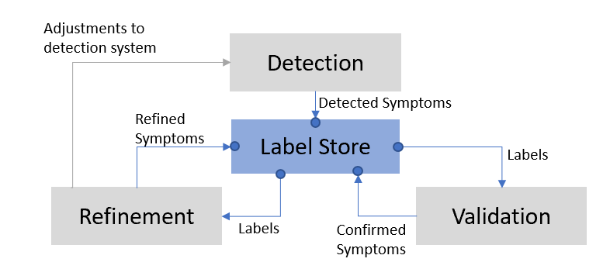
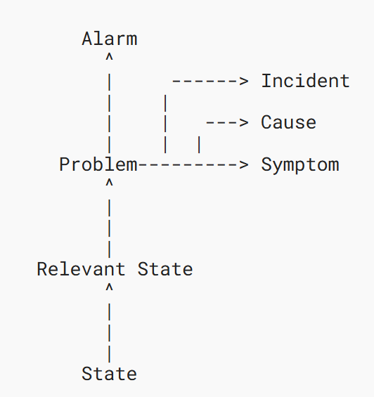
Discussion: Alignment with Incident Documents From terminology to modelling
From draft-ietf-nmop-terminology
draft-ietf-nmop-network-incident-yang
Alert and Problem Management System
Post-mortem system
notification
notification
Detection
draft-netana-nmop-network-anomaly-semantics
draft-netana-nmop-network-anomaly-lifecycle
Results of the Network Anomaly Lifecycle

