Slide 1
An Architecture for a Network Anomaly Detection Framework draft-ietf-nmop-network-anomaly-architecture-00
Status update and next steps
wanting.du@swisscom.com pierre.francois@insa-lyon.fr
thomas.graf@swisscom.com
11. September 2024

Slide 2
Why This I-D? A Reminder
This document describes motivation and a generic and extensible architecture of a Network Anomaly Detection Framework.
Anchors draft-netana-nmop-network-anomaly-semantics and draft-netana-nmop-network-anomaly-lifecycle documents.
Different applications will be described and exampled with open-source running code.

Slide 3




What does Network Anomaly Detection mean Monitor changes, called outliers, in networks
Answers
What changed and when, on which connectivity service, and how does it impact the customers?
Focuses
Provides meaningful connectivity service impact information before customer is aware of and support in root-cause analysis.
Data Mesh
Consumes operational real-time Forwarding Plane, Control Plane and Management Plane metrics and produces analytical alerts.
Direction
From connectivity service to network platform.
Network Anomaly Detection
For Connectivity Services, Network Anomaly Detection constantly monitors and detects any network or device topology change, along with their associated forwarding consequences for customers as outliers. Notifications are sent to the Network Operation Center before the customer is aware of service disruptions. It offers operational metrics for in-depth analysis, allowing to understand in which platform the problem originates and facilitates problem resolution.

Slide 4
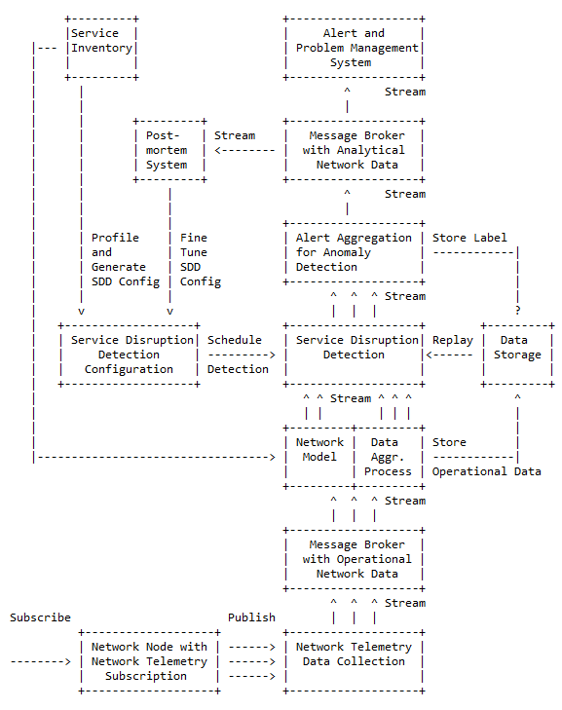
Elements of the Architecture
Service Inventory contains list of the connectivity services.
Service Disruption Detection processes aggregated network data to decide whether a service is degraded or not.
Service Disruption Detection Configuration defines the set of approaches that need to be applied to perform SDD.
Operational Data Collection manages network telemetry subscriptions and transforms data into message broker.
Operational Data Aggregation produces data upon which detection of a service disruption can be performed.
Network Modeling establishes knowledge of network relationships.
Data Profiling categorizes nondeterministic customer related data.
Detection Strategies for a profile a detection strategy is defined.
Machine Learning is commonly used to detect outliers or anomalies.
Storage some algorithms may relay on historical (aggregated) operational data to detect anomalies.
Alerting consolidates analytical insights and notifies.
Postmortem refines and stores the network anomaly and symptom labels into the Label Store.
Replaying to validate refined anomaly and symptom labels, historical operational data is replayed.

Slide 5
An Architecture for a Network Anomaly Detection Framework Status, Open issues and Next steps
Status of draft-ietf-nmop-network-anomaly-architecture
Reference document to anchor anomaly detection work items.
Working group adopted. Thanks Alex and Nacho for feedback.
Open issues and feedback
Optimize document structure
Detail architecture elements
References suggestion:
[draft-marcas-nmop-knowledge-graph-yang]
[draft-tailhardat-nmop-incident-management-noria-01]
[draft-mackey-nmop-kg-for-netops]
[draft-netana-nmop-network-anomaly-semantics]
[RFC9232]
Terminology consolidation
Service VS Customer
Symptom
Next Steps
Update draft-ietf-nmop-network-anomaly-architecture to address working group comments

