Slide 1
Addressing Network Operator Challenges in YANG push Data Mesh Integration
zhuoyao.lin@huawei.com, jean.quilbeuf@huawei.com
ahmed.elhassany@swisscom.com, alex.huang-feng@insa-lyon.fr
benoit.claise@huawei.com, thomas.graf@swisscom.com
24. July 2023

Slide 2
Data Mesh is a big data architecture where different domains can exchange data with a bounded context and SLO's are defined in Data Products. Same principle as in networks.
Semantics are needed to describe the data. A gauge32 is not the same as counter32. Values can increase or decrease. Needs monotonic increasing counter normalization or not.
Versioning is needed to not only understand that the semantic has changed, but also wherever the new semantic is backward compatible or not. Preventing to break the data processing pipeline.
Hostname, publisher ID, sequence numbers and observation timestamping are needed to measure loss and delay for SLO's.
YANG push as defined in RFC8641 is missing hostname, sequence numbers, observation timestamping and versioning. draft-ahuang-netconf-notif-yang, draft-tgraf-netconf-notif-sequencing, draft-tgraf-yang-push-observation-time and draft-ietf-netconf-yang-notifications-versioning addresses this.
When Big Data and Network becomes one Marrying two messaging protocols

Slide 3
Obtaining YANG semantics and Module dependencies Overview - Step 1 and 2 in the workflow
module: a-module
+--rw a-container
+--rw x? b:bar
+--rw d:y
+--rw d:y-leaf? b:myenum
Goal: Based on semantic reference in YANG push message, find YANG module dependencies
<subscriptions>
<subscription>
<id>2222</id>
<datastore>ds:operational</datastore>
<datastore-xpath-filter>
/a-module:a-container
</datastore-xpath-filter>
<encoding>encode-xml</encoding>
<periodic>
<period>30000</period>
</periodic>
</subscription>
</subscriptions>
b.yang
import
a.yang
deviate
augment
a-deviation.yang
d.yang
Subscribe to: /a-module:a-container
Require to fetch all these modules.
Then register then into schema registry.

Slide 4
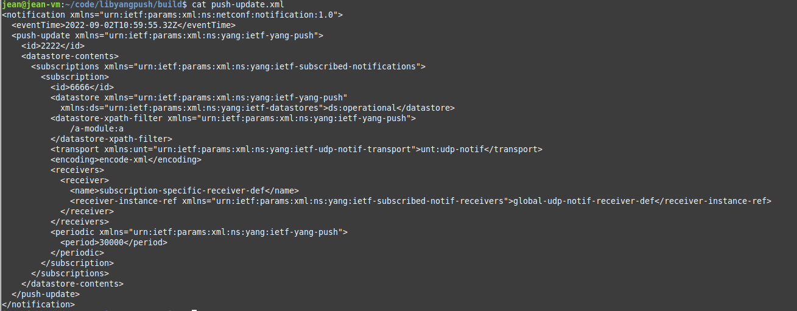
Obtaining the YANG semantics and Module dependencies Step 1 – Receiving the YANG Push Message
This message is passed to libyangpush. It indicates that a new subscription with 6666 is created and that subscription targets the xpath /a-module:a.
Before executing the next step, “modules” folder that caches YANG modules received from the device is empty:

Slide 5
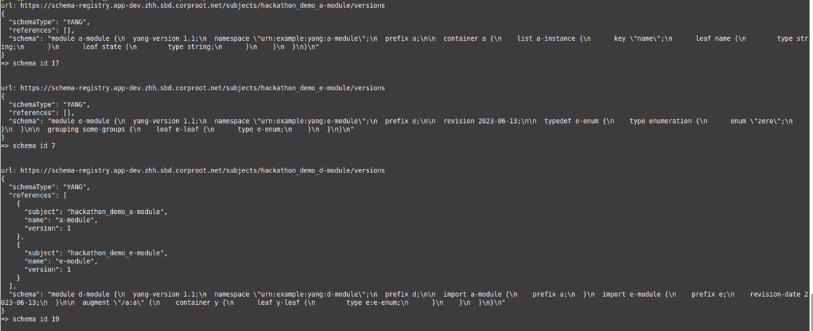
Obtaining the YANG semantics and Module dependencies Step 2 – Obtaining the YANG semantics
The demo fetches all YANG modules from the NETCONF server, parses the input messages and selects the corresponding YANG module needed to build the schema for incoming messages on that subscription to register in the Confluent schema register for serializing the messages in Apache Kafka.

Slide 6
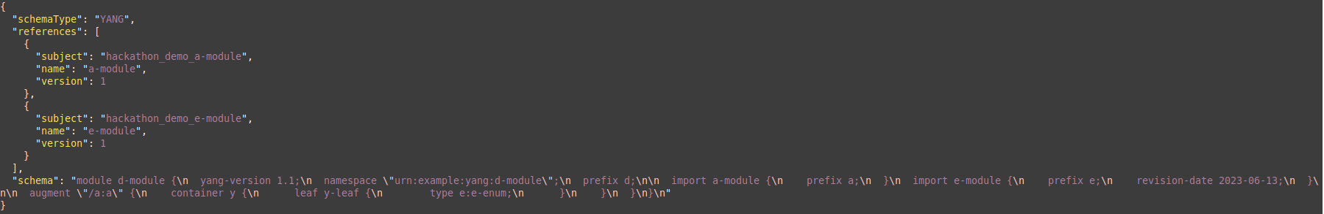
Obtaining the YANG semantics and Module dependencies Step 2 – Finding the YANG Module dependencies
The modules are registered in the correct order into the YANG schema registry and the corresponding schema-ids are returned. Here is the list of messages for registering the modules: First module-a (no dependencies)
Then module e (no dependencies)
Then module d (augements a and thus depends on a, depends on e)

Slide 7
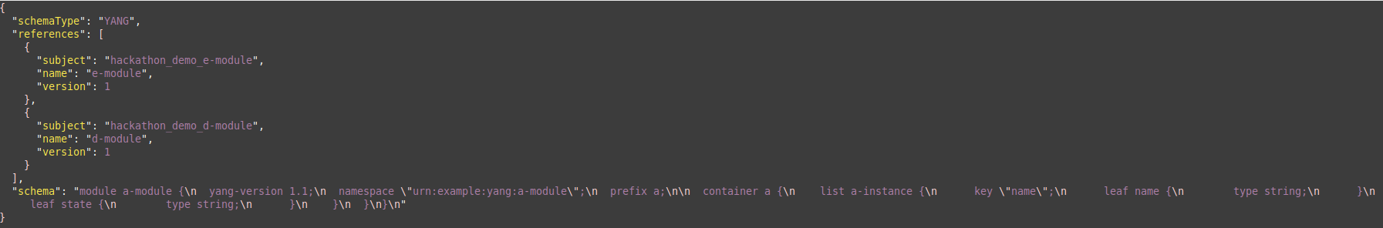
Obtaining the YANG semantics and Module dependencies Step 2 – Register the YANG Semantics in Confluent Schema Registry
Finally, the augmented version of YANG module a, which is the one that matches the passed subscription is registered in the Confluent schema registry. Returning schema id 8 which then can be used to serialize the YANG push push-update message in a Apache Kafka topic.

Slide 8
Obtaining the YANG semantics and Module dependencies Step 2 – Caching YANG Modules
After the run, the YANG modules are cached in the “modules” folder:

Slide 9
Obtaining the YANG semantics and Module dependencies Status and Next Steps
Status
Parse YANG push subscription state change notification messages for semantic and subscription reference, push-update messages for subscription reference and cache them.
Determine YANG module dependencies based on YANG library RFC 8525
Obtain YANG modules and register in Confluent Schema Registry
Able to compare two YANG module revisions and determine which part of the semantics are not backward compatible
Next Step
Propose changes in netconf notification header to validate properly in libyang
Enable schema validation and data serialization in Apache Kafka
zhuoyao.lin@huawei.com, jean.quilbeuf@huawei.com
ahmed.elhassany@swisscom.com, alex.huang-feng@insa-lyon.fr
benoit.claise@huawei.com, thomas.graf@swisscom.com
24. July 2023

Slide 10
Validating Semantics in YANG Push messages Status and Next Steps
Status
YANG modules defines the schema body of the notification message.
The body of the message is defined as XPath over the YANG module.
Various RFCs and drafts define the NETCONF envelop to send the message.
YANG Validators uses special flags to validate notifications:
yanglint -strict --type nc-notif -f xml notification.yang test.xml
Kafka serdes expects one schema to describe a message.
Next Step
Check if the existing validators can validate seamlessly NETCONF and YANG push envelope extensions.
Develop algorithm to generate a single YANG module that describe a full message including the NETCONF and YANG push headers.
zhuoyao.lin@huawei.com, jean.quilbeuf@huawei.com
ahmed.elhassany@swisscom.com, alex.huang-feng@insa-lyon.fr
benoit.claise@huawei.com, thomas.graf@swisscom.com
24. July 2023

Slide 11
Netconf Working Group update

Slide 12
Versioning in YANG Notifications Subscription Status and Next Steps
-03 NETCONF adoption call for draft-ietf-netconf-yang-notifications-versioning concluded
Feedback from Andy during adoption call
xpath can refer to more than one YANG module
subscription section 2 is not fully aligned with section 4.1
Instead of sn:target, sn:stream-filter, sn:within-subscription and yp:within-subscription should be augmented
All addressed in -01 revision -> Requesting feedback and comments.
thomas.graf@swisscom.com
benoit.claise@huawei.com
alex.huang-feng@insa-lyon.fr
15. July 2023

Slide 13
Extend Datastore Selection and Subscription State Change Notifications with module name, revision and revision-label
module: ietf-yang-push-revision
augment /sn:establish-subscription/sn:input/sn:target/sn:stream
/sn:stream-filter/sn:within-subscription:
+-- module-version* [module-name]
+-- module-name yang:yang-identifier
+-- revision? rev:revision-date-or-label
+-- revision-label? ysver:version
augment /sn:establish-subscription/sn:input/sn:target/yp:datastore
/yp:selection-filter/yp:within-subscription:
+-- module-version* [module-name]
+-- module-name yang:yang-identifier
+-- revision? rev:revision-date-or-label
+-- revision-label? ysver:version
augment /sn:subscription-started/sn:target/sn:stream
/sn:stream-filter/sn:within-subscription:
+--ro module-version* [module-name]
+--ro module-name yang:yang-identifier
+--ro revision rev:revision-date-or-label
+--ro revision-label? ysver:version
augment /sn:subscription-started/sn:target/yp:datastore
/yp:selection-filter/yp:within-subscription:
+--ro module-version* [module-name]
+--ro module-name yang:yang-identifier
+--ro revision rev:revision-date-or-label
+--ro revision-label? ysver:version
Network operators need to control semantics in its data processing pipeline. That includes YANG push.
This is today only possible during YANG push subscription but not when nodes are being upgraded or messages are being published for configured subscription.
draft-ietf-netconf-yang-notifications-versioning extends the YANG push subscription and publishing mechanism defined in RFC8641:
By adding the ability to subscribe to a specific revision or latest-compatible-semversion of one or more yang modules.
By extending the YANG push Subscription State Change Notifications Message so that the YANG push receiver learns beside the xpath and the sub-tree filter also the yang module name, revision and revision-label.
{
"ietf-restconf:notification" : {
"eventTime": "2023-01-03T10:00:00Z",
"ietf-subscribed-notifications:subscription-modified": {
"id": 101,
"stream-xpath-filter": "/ietf-interfaces:interfaces",
"stream": "NETCONF",
"ietf-yang-push-revision:module-version": [{
"module-name": "ietf-interfaces"
"revision": "2014-05-08",
"revision-label": "1.0.0",
}],
}
}
}

Slide 14
Backup

Slide 15

State of the Union From data mess to data mesh
Network Vendor/Operator
IETF
Data Industry

Slide 16
Evolving YANG Push Missing puzzle pieces
YANG Push | Today at Network Operators | Today at IETF
Transport Protocol | Many and non-standard | netconf-https-notif and netconf-udp-notif
Encoding | JSON widely adopted. Propriety protobuf in various variants. CBOR not implemented yet. | XML in RFC7950, JSON in RFC7951, CBOR in RFC9254
Subscription | Non-standard, periodical widely adopted. On-change sparse. | RFC8639 and RFC8641
Metadata | Non-standard. Partially among message content. | netconf-yang-notifications-versioning, draft-tgraf-netconf-notif-sequencing, draft-tgraf-yang-push-observation-time, draft-claise-opsawg-collected-data-manifest, draft-claise-netconf-metadata-for-collection
Versioning | Neither covered in subscription nor in publishing. | netmod-yang-module-versioning
YANG module | Non-standard widely adopted. IETF coverage non-existent. | Many RFC's defined

Slide 17
YANG datastores enabling Closed Loop Operation Automated data onboarding with bounded context
YANG is a data modelling language which will not only transform how we managed our networks; it will transform also how we manage our services.
24 industry leading colleagues from 4 network operators, 2 network and 3 analytics providers, and 3 universities commit on a project to integrate YANG and CBOR into data mesh. IETF 117 public side meeting on Monday July 24th 17:00 – 17:45.
Automated networks can only run with a common data model. A digital twin YANG data store enables a comparison between intent and reality. Schema preservation enables closed loop operation. Closed Loop is like an autopilot on an airplane. We need to understand what the flight envelope is to keep the airplane within. Without, we crash.

Slide 18
From YANG push to Analytics Aiming for an automated processing pipeline
A network operator aims for:
An automated data processing pipeline which starts with YANG push, consolidates at Data Mesh and ends at Network Analytics.
Operational metrics where IETF defines the semantics.
Analytical metrics where network operators gain actionable insights.
We achieve this by integrating YANG push into Data Mesh to:
Produce metrics from networks with timestamps when network events were observed.
Hostname, Publisher ID and sequence numbers help us to understand from where metrics were exported and measure its delay and loss.
Forward metrics unchanged from networks
Learn semantics from networks and validate messages.
Control semantic changes end to end.

Slide 19
Evolving Big Data Architecture Domain oriented, like networks
1st Generation
Proprietary Enterprise Data Warehouse
2nd Generation
Data lake Big data ecosystem
3rd Generation
current
Kappa Adds streaming for real-time data
4th Generation
next-step
Data Mesh Distributed and organized in domains.
From Principles to Logical Architecture

Slide 20
From Network to Alert Event Observe multiple perspectives at different times
A single link down results in multiple device topology, control-plane and forwarding-plane events being exposed at different times.
Determine which interfaces and BGP peerings are being used first and then observe state. Observe BGP withdrawals and updates, traffic drop spikes and missing traffic. Generate multiple concerns.
Calculate for each observation a concern score between 0 and 1. The higher, the more probable the changes impacted forwarding.
Unify several concerns for one VPN connectivity service to one alert identifier.

Slide 21
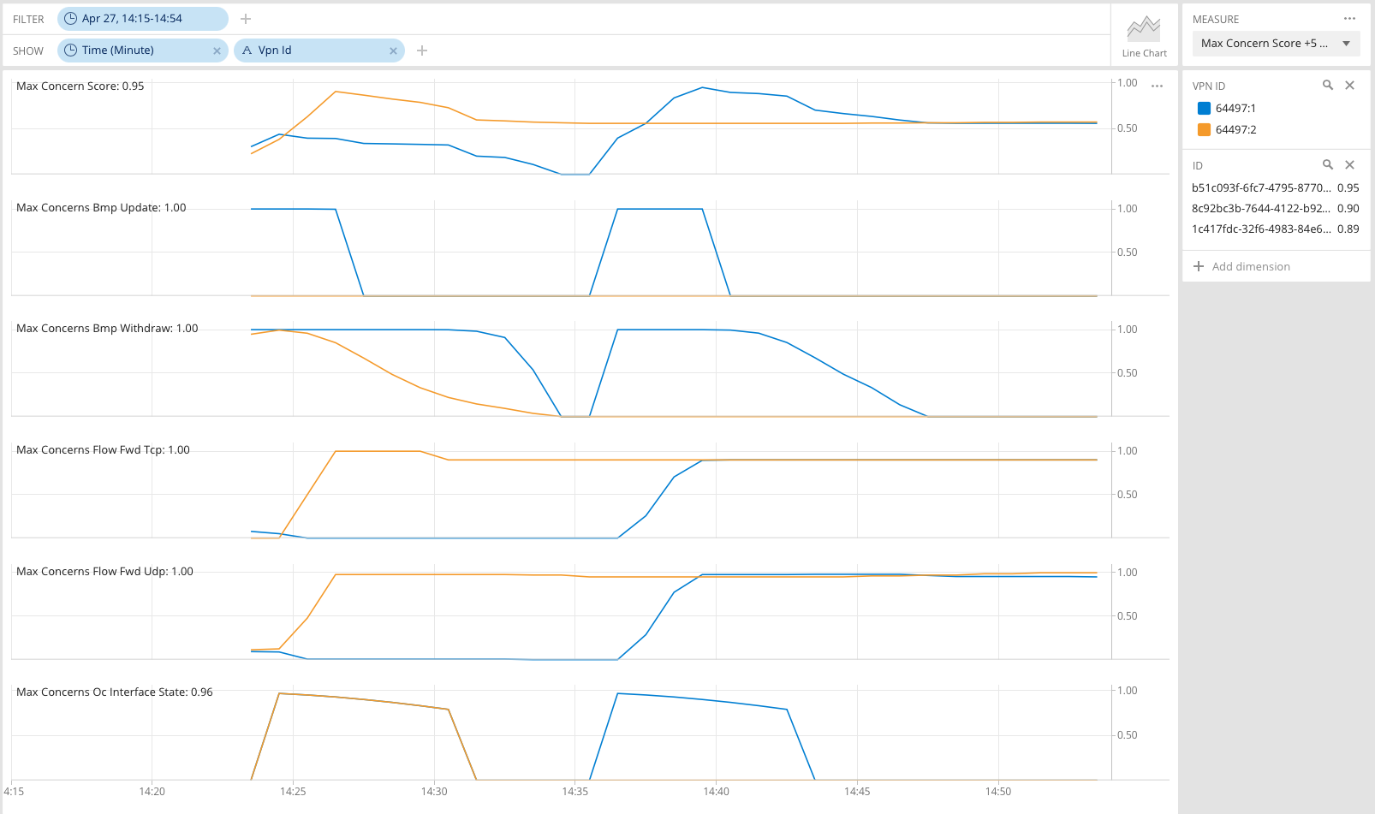
L3 VPN Network Anomaly Detection Verify operational changes automatically
Analytical Perspectives
Monitors the network service and wherever it is congested or not.
BGP updates and withdrawals.
UDP vs. TCP missing traffic.
Interface state changes.
Network Events
VPN orange lost connectivity. VPN blue lost redundancy.
VPN blue lost connectivity.
Key Point
AI/ML requires network intent and network modelled data to deliver dependable results.

Slide 22
Define YANG module for Netconf Notifications Closing the semantic gap
module: ietf-notification
structure notification:
+-- eventTime yang:date-and-time
With RFC 5277 the XML schema for NETCONF event notification was defined.
With draft-ahuang-netconf-notif-yang updates RFC 5277 by defining the schema as a YANG module.
This enables YANG-push to define semantics for the entire YANG push message and use other encodings than XML such as YANG-JSON RFC 7951 or YANG-CBOR RFC 9264.
<notification xmlns="urn:ietf:params:xml:ns:netconf:notification:1.0">
<eventTime>2023-02-04T16:30:11.22Z</eventTime>
<push-update xmlns="urn:ietf:params:xml:ns:yang:ietf-yang-push">
<id>1011</id>
<datastore-contents>
<interfaces xmlns="urn:ietf:params:xml:ns:yang:ietf-interfaces">
<interface>
<name>eth0</name>
<oper-status>up</oper-status>
</interface>
</interfaces>
</datastore-contents>
</push-update>
</notification>

Slide 23
Define YANG module for Netconf Notifications Status
The yang module prefix has changed to “inotif” to be more explicit.
The namespace is changed to the one used in RFC5277 : urn:ietf:params:xml:ns:netconf:notification:1.0
In IANA section, instead of asking for a new URI, we ask IANA to add this document as a reference to the URI from RFC5277
Requesting NETCONG working group adoption.

Slide 24
Extend Streaming Update Notifications with Hostname and Sequencing For push-update and push-change-update
module: ietf-notification-sequencing
augment-structure /inotif:notification:
+-- sysName inet:host
+-- publisherId yang:gauge32
+-- sequenceNumber yang:counter32
When the NETCONF event notification message is forwarded from the YANG push receiver to another system, such as a messaging system or a time series database where the message is stored, the transport context is lost since it is not part of the NETCONF event notification message metadata. Therefore, the downstream system is unable to associate the message to the publishing process (the exporting router), nor able to detect message loss or reordering.
draft-tgraf-netconf-notif-sequencing extends the NETCONF notification defined in RFC5277 with:
sysName: Describes the hostname following the 'sysName' object definition in RFC1213 from where the message was published from.
publisherId: netconf-distributed-notif describes the ability to publish from network processors directly. With this identifier the publishing process from where the message was published from can be uniquely identified.
sequenceNumber: Generates a unique sequence number as described in RFC9187 for each published message.
<notification xmlns="urn:ietf:params:xml:ns:netconf:notification:1.0">
<eventTime>2023-02-04T16:30:11.22Z</eventTime>
<sysName xmlns="urn:ietf:params:xml:ns:yang:ietf-notification-sequencing">
example-router
</sysName>
<publisherId xmlns="urn:ietf:params:xml:ns:yang:ietf-notification-sequencing">
1
</publisherId>
<sequenceNumber xmlns="urn:ietf:params:xml:ns:yang:ietf-notification-sequencing">
187653
</sequenceNumber>
<push-update xmlns="urn:ietf:params:xml:ns:yang:ietf-yang-push">
<id>1011</id>
<datastore-contents>
<interfaces xmlns="urn:ietf:params:xml:ns:yang:ietf-interfaces">
<interface>
<name>eth0</name>
<oper-status>up</oper-status>
</interface>
</interfaces>
</datastore-contents>
</push-update>
</notification>

Slide 25
Extend Streaming Update Notifications with Observation Timestamping For push-update and push-change-update
module: ietf-yang-push-netobs-timestamping
augment /yp:push-update:
+--ro observation-time? yang:date-and-time
augment /yp:push-change-update:
+--ro state-changed-observation-time? yang:date-and-time
To correlate network data among different Network Telemetry planes as described in Section 3.1 of RFC9232 or among different YANG push subscription types defined in Section 3.1 of RFC8641, network observation timestamping is needed to understand the timely relationship among these different planes and YANG push subscription types.
draft-tgraf-yang-push-observation-time extends the YANG push streaming update notification defined in RFC8641 with:
observation-time: Describes the measurement observation time for the "push-update" notification in a "periodical" subscription.
state-changed-observation-time: Describes in the "push-change-update" notification in an "on-change" subscription the time when the network state change was observed after the subscription was initially established. In case of an "on-change sync on start" subscription it describes the time when the network state change was observed before the subscription was established.
{
"ietf-notification:notification": {
"eventTime": "2023-02-04T16:30:11.22Z",
"sysName": "example-router",
"sequenceNumber": 187653,
"ietf-yang-push:push-update": {
"id": 1011,
"observation-time": "2023-02-04T16:30:09.44Z",
"datastore-xpath-filter": "ietf-interfaces:interfaces",
"datastore-contents": {
"ietf-interfaces:interface": {
"name": {
"eth0": {
"oper-status": "up"
}
}
}
}
}
}
}

Slide 26
From YANG push to Analytics Next steps
Do you realize the gaps and how it could be resolved?
By defining a YANG module for NETCONF notification and adding hostname, publisher ID, sequence number, observation time, YANG module name, revision and revision-label into YANG push-update and Subscription State Change notification messages an automated data processing pipeline which starts with YANG push, consolidates at Data Mesh and ends at Network Analytics would become at reach.
-> What are your thoughts and comments?
-> Interested to learn more? Join the IETF 117 public side meeting on Monday July24th 17:00-17:45 in room Continental 2-3 or look at the project page: https://github.com/graf3net/draft-daisy-kafka-yang-integration/blob/main/draft-daisy-kafka-yang-integration-04.md
zhuoyao.lin@huawei.com, jean.quilbeuf@huawei.com
ahmed.elhassany@swisscom.com, alex.huang-feng@insa-lyon.fr
benoit.claise@huawei.com, thomas.graf@swisscom.com
24. July 2023

