Slide 1
Extensible YANG Model for YANG-Push Notifications
I-D: draft-ietf-netconf-notif-envelope-03
A. Huang Feng, INSA-Lyon
P. Francois, INSA-Lyon
T. Graf, Swisscom
B. Claise, Huawei
November 3rd 2025

Slide 2
Extensible YANG model for YANG-Push Notifications Status of the draft
Draft under WGLC since 28th August [1]
Extended WGLC to facilitate early reviews by OPSDIR and YANGDOCTORS
YANGDOCTOR review by Jürgen Schönwälder: “Almost Ready”
OPSDIR review by Joe Clarke: “Has Issues”
WGLC forwarded to CORE WG for review
No feedback received from CORE WG yet
Received reviews from Paul Aitken, Qin Wu, Rob Wilton, Reshad Rahman, Jürgen Schönwälder and Joe Clark
Thanks a lot for the reviews!
2 last-minute “open discussions”
[1] https://mailarchive.ietf.org/arch/msg/netconf/V0awk3huXZg7V_DIQn5fFNn5kvo/

Slide 3
Extensible YANG model for YANG-Push Notifications Changes since -02
Editorial changes fixing ambiguity
Fixed XML/JSON/CBOR examples
Removed “The 'contents' element MUST be located at the end of the notification envelope structure.”
Removed references
RFC3339 (Timestamps) → Rely on ietf-yang-types@2025-06-23.yang for the compliance with RFC3339 and RFC9557 (Timestamps with Additional Information)
RFC1213 (MIB, for the definition of sysName) → Rely on ietf-yang-types@2025-06-23.yang for the newly defined “type inet:host-name”
Changed “type inet:hostname” to “type inet:host-name” for the definition of a hostname
New text: “The hostname MUST be configured before by the administrator to identify the node uniquely.”
Made .sid file normative
New YANG features:
“feature notification-envelope”: Support of the notif-envelope
“feature hostname-sequence-number”: Support of the hostname and sequence number

Slide 4
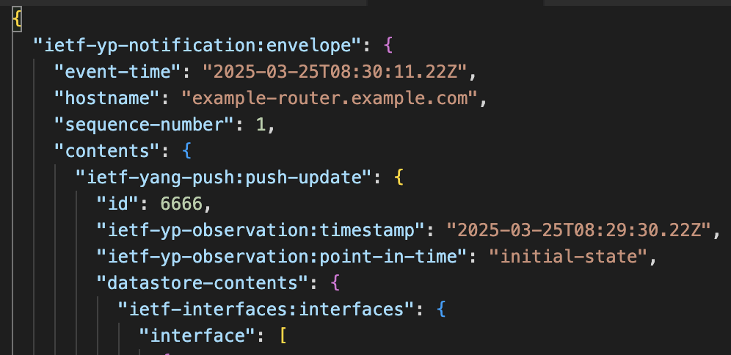
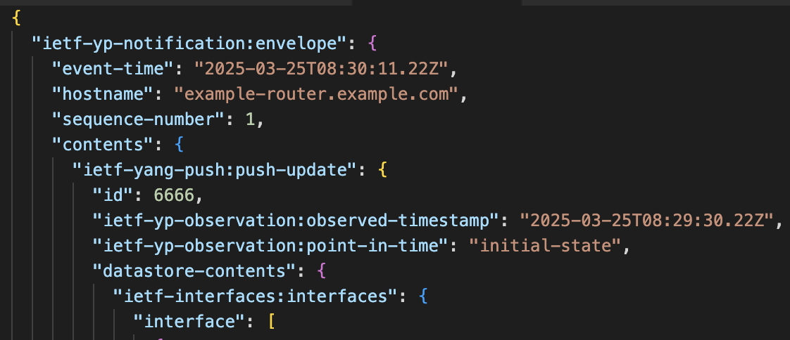
Extensible YANG model for YANG-Push Notifications Last minute discussion (1)
Reshad suggested changing “timestamp” to “observed-timestamp”
(Current version & position from the authors)
Proposal from Reshad
Reasons in favor of “observed-timestamp”:
XML readability
Arguments against “observed-timestamp”:
draft-ietf-netmod-rfc8407bis-28#section-4.3.1 states that the name should not be repeated within a container

Slide 5
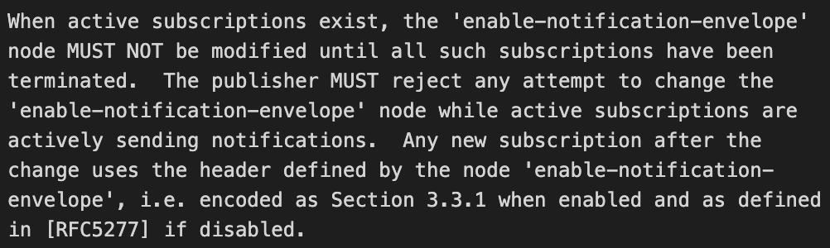
Extensible YANG model for YANG-Push Notifications Last minute discussion (2)
Current:
Toggling “enable-notification-envelope” kills all the active subscriptions (both dynamic and configured)
Joe Clarke (OPSDIR review) proposes to
Enable toggling “enable-notification-envelope” only if all active subscriptions are terminated (less disruptive)
Proposal from the authors

Slide 6
Extensible YANG model for YANG-Push Notifications Next steps
OPSDIR review
Send to the IESG for publication

Slide 7
BACKUP

Slide 8
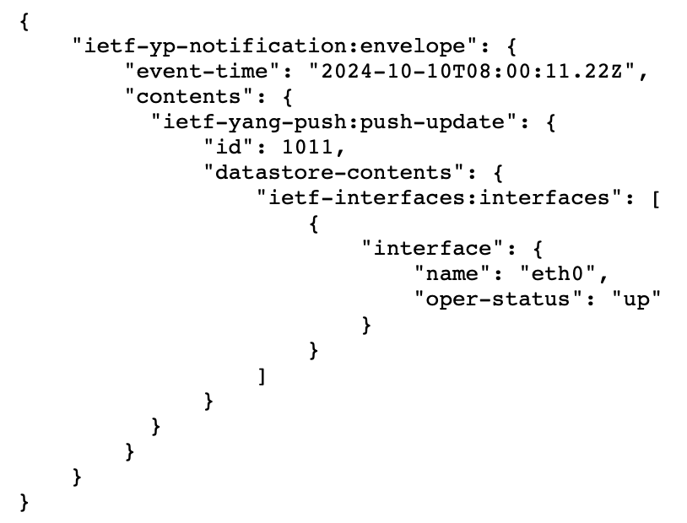
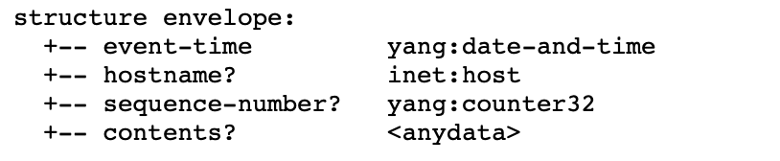


Extensible YANG model for YANG-Push Notifications Proposal of this I-D
Structure defined as a notification containing
event-time
metadata(s)
contents
JSON example without metadata
Configured Subscriptions
Dynamic Subscriptions
enable-notif-envelope=True
enable-notif-envelope=True
Notification-envelope
Collector
Notification-envelope

Slide 9
Extensible YANG model for YANG-Push Notifications Proposal of this I-D
YANG Notification structure for YANG-Push Notifications [RFC 8639/8641]
(1) Option to “opt-in” to this notification envelope
(2) Able to discover the capability of this new header through “ietf-notification-capabilities”
(3) Extensible header defined in YANG 1.1
(4) Definition of each encoding (XML, JSON, CBOR)
(5) Defines the first base extensions (I-D.tgraf-netconf-notif-sequencing; I-D.tgraf-netconf-yang-push-observation-time)

Slide 10
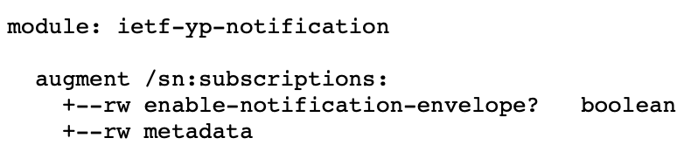
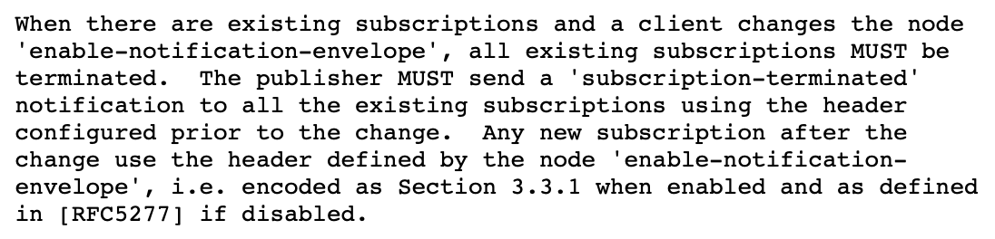
Extensible YANG model for YANG-Push Notifications Reminder on current proposal
Initial proposal was centralizing requests via an RPC call
Feedback: complex to manage
Current proposal:
Switch headers using “/sn:subscriptions/inotenv:enable-notification-envelope”
When switching this node, existing Subscriptions are tore down:

Slide 11
YANG model for NETCONF Event Notifications Interim 2024-09-19 – draft-ahuang-netconf-notif-yang
https://datatracker.ietf.org/doc/minutes-interim-2024-netconf-02-202409191300/
Thorough review of draft-ahuang-netconf-notif-yang/YANG-Push/NETCONF Event Notifications
Conclusion
draft-ahuang-netconf-notif-yang fixes a gap for YANG-Push but might be worth putting the effort on a brand new header
We need:
Bypass RFC5277, thus use YANG-Push only
Extensible header
be able to add new metadata (sequencing, versioning, others…)
A client should be able to “opt-in”
Clients that don’t support this new header should continue working seamlessly
The notification should be a YANG-based solution
Fix JSON and CBOR underspecification
including CBOR-SID allocation

Slide 12
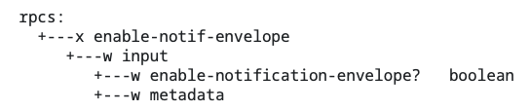
Extensible YANG model for YANG-Push Notifications (1) Option to “opt-in” through a YANG-Push Subscription
Configuration on Globally on the server via the RPC “enable-notif-envelope”
Currently
Default=False
enable-notification-envelope=false
Old Header as RFC5277
Collector
enable-notification-envelope=true
New envelope Header
Collector

Slide 13
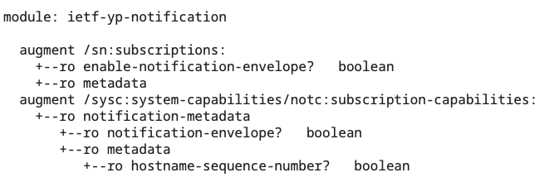
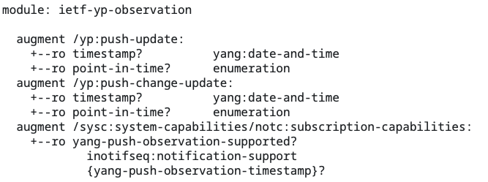
Extensible YANG model for YANG-Push Notifications (2) Able to discover the capability of this new header
Augmentation on notification capabilities (RFC9196)
Get Capabilities
notification-envelope=True

Slide 14
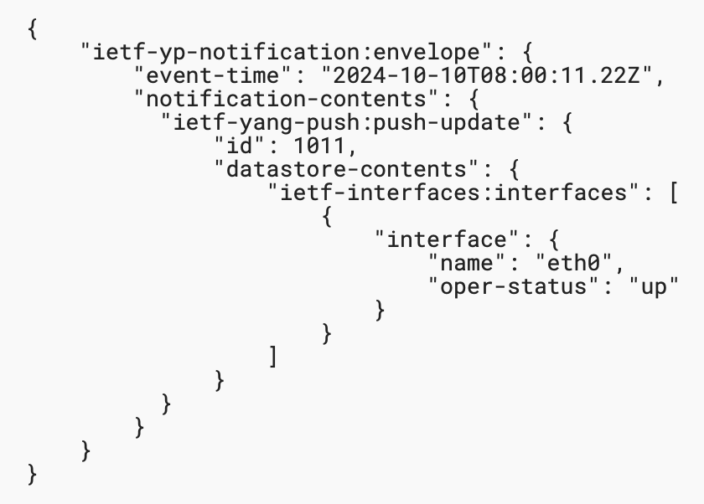
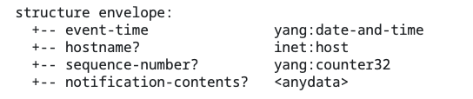
Extensible YANG model for YANG-Push Notifications (3) Extensible header defined in YANG
Structure defined as a notification containing
event-time
metadata(s)
notification-contents
JSON example without metadata
Configured Subscriptions
Dynamic Subscriptions
enable-notif-envelope=True
enable-notif-envelope=True
Notification-envelope
Collector
Notification-envelope

Slide 15
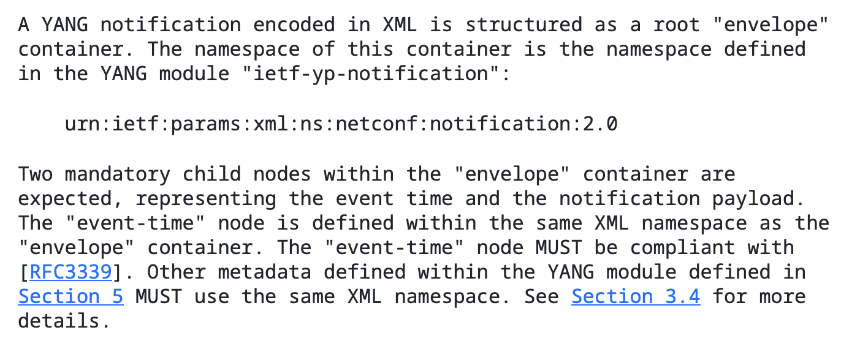
Extensible YANG model for YANG-Push Notifications (4) Definition of each encoding (XML, JSON, CBOR)
Explicit definition of the content of the “envelope” (solving gap for JSON and CBOR)
Definition of the namespace (urn:ietf:params:xml:ns:netconf:notification:2.0)
Mandatory event-time node
Mandatory notification-contents node
Metadata present when configured

Slide 16
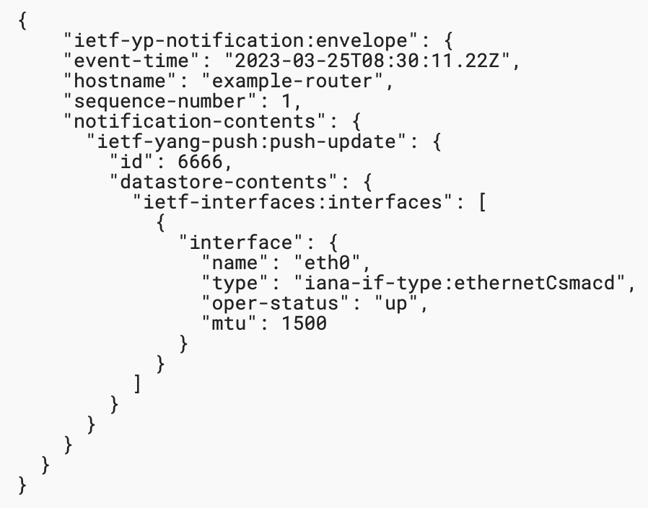
Extensible YANG model for YANG-Push Notifications (5) Extensions for hostname and sequence-number
Definition of hostname and sequence-number extensions (draft-tgraf-netconf-notif-sequencing)
Present by default when the envelope is enabled
Discovery of support of this header through RFC9196

