Slide 1
An Architecture for a Network Anomaly Detection Framework draft-netana-nmop-network-anomaly-architecture-00
Motivation and architecture of a Network Anomaly Detection Framework
and the relationship to other documents describing
network symptom semantics and network incident lifecycle
wanting.du@swisscom.com pierre.francois@insa-lyon.fr
thomas.graf@swisscom.com vincenzo.riccobene@huawei-partners.com
14. July 2024

Slide 2






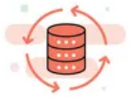

Data Mesh organizes Data in Organizations Enables Network Analytics use cases
Alert
Postmortem
RFC 8632
draft-netana-nmop-network-anomaly-semantics draft-netana-nmop-network-anomaly-lifecycle
Analytical Data draft-netana-nmop-yang-message-broker-integration
Network Device Trend Detection
Verify, Troubleshoot and Notify
Network Anomaly Detection
Network Visualization
Network SLI and SLO
Closed Loop Operation
draft-netana-nmop-network-anomaly-architecture
Operational Data draft-netana-nmop-yang-message-broker-integration
Network Data Collection
Network Telemetry (RFC 9232) IPFIX (RFC 7011, RFC 9487, RFC 9160, draft-ietf-opsawg-ipfix-on-path-telemetry)
BMP (RFC 7854, RFC 8671, RFC 9069, draft-ietf-grow-bmp-tlv, draft-ietf-grow-bmp-path-marking-tlv, draft-lucente-grow-bmp-rel)
YANG-Push (RFC 8639, RFC 8641, draft-ietf-netconf-udp-notif, draft-ietf-netconf-distributed-notif, draft-ahuang-netconf-notif-yang, draft-ietf-netconf-yang-notifications-versioning, draft-tgraf-netconf-notif-sequencing, draft-tgraf-netconf-yang-push-observation-time)

Slide 3
What to monitor Which operational metrics are collected
« Network operators connect customers in routing tables called Connectivity Services »
« Network Telemetry (RFC 9232) describes how to collect data from all 3 network planes efficiently »

Slide 4
Monitoring L3 VPN's with IPFIX, BMP and YANG Push From Connectivity Service to Realtime Network Analytics
Connectivity Service perspective, Connection Points are connected through Logical Connections.
From a BGP control-plane perspective, IPv4/6 unicast prefixes in VRF's are tagged with BGP standard communities.
One BGP standard community to identify the Logical Connection. One BGP standard community to identify each Connection Point.
When IPv4/6 prefixes are exported from VRF's, a BGP route-distinguisher, BGP extended community route-targets and a SRv6 VPN SID for the IPv6 next-hop are allocated.
From a forwarding plane perspective, when IPv4/6 unicast traffic is received from the edge at the SRv6 PE, a lookup is performed, the SRv6 VPN SID is obtained and IPv6 next-hop is added when forwarded to the core.
Swisscom collects MPLS and SRv6 provider data plane, IPv4/6 unicast customer data-plane in IPFIX and at provider edge BGP VPNv4/6 unicast in production to perform real-time data correlation.

Slide 5
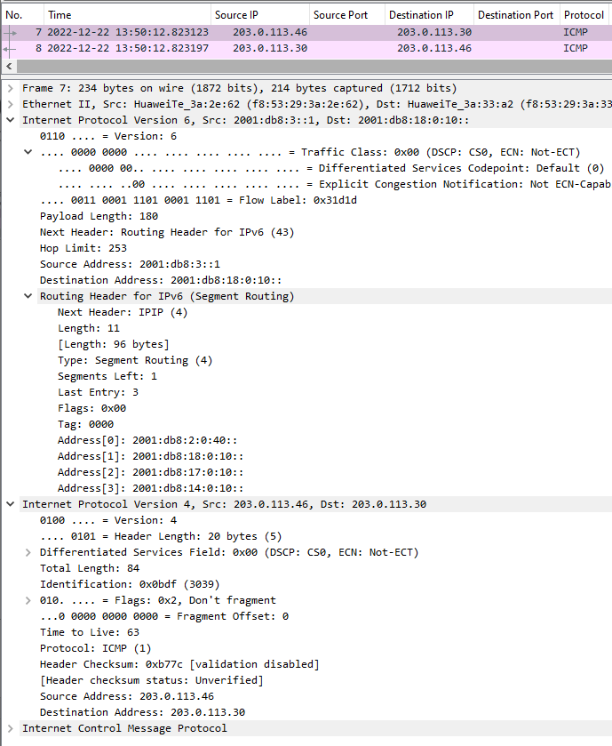
Segment Routing IPv6 Encapsulation RFC 9487 provides IPFIX Visibility
Provider data-plane Divided into an IPv6 and Segment Routing Header. The IPv6 header shows from which PE to which next-hop it is being forwarded. The Segment Routing Header the list of segments this packet needs to pass through and points to the active segment.
Customer data-plane This is what we receive from the customer and encapsulate for transport through the SRv6 core.

Slide 6
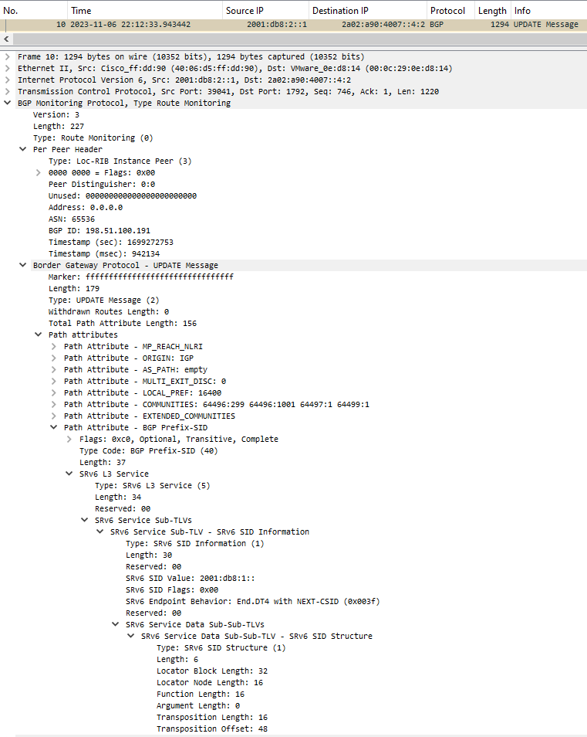
BMP – Address Family Agnostic RFC 9069 provides Local RIB Visibility
BMP Per Peer Header Shows at which RIB (Adj-RIB In, Local or Adj-RIB Out, Pre or Post Policy) and from which Peering the BGP PDU at which time was obtained.
Encapsulated BGP PDU Shows the encapsulated BGP PDU. In case of BMP route-monitoring, it describes whether it was a topology update or withdrawal and for BGP community, NLRI and BGP Prefix SID path attributes.

Slide 7
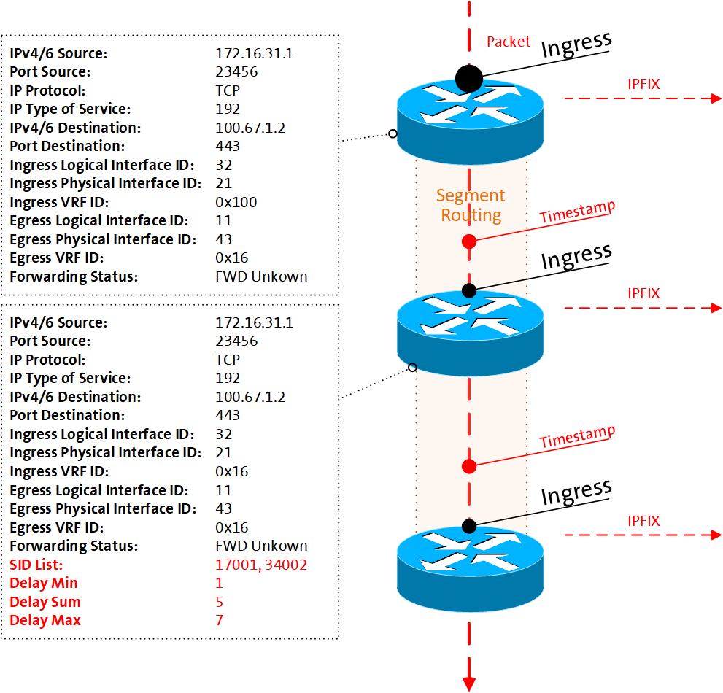
Measure On-Path Delay with Network Context With draft-ietf-opsawg-ipfix-on-path-telemetry
Packets are captured ingress with an optional sampler, data plane dimensions extracted, enriched with management and control plane dimensions and added with a unique flow ID to a flow cache on the node for aggregation.
A direct export marking bit and optionally a timestamp is added to the packet when entering the OAM domain by leveraging Enhanced Alternate Marking (RFC 9341, draft-zhou-ippm-enhanced-alternate-marking) or IOAM (RFC 9378) Direct Export or E2E Option Type.
Each subsequent packet for the same flow increases byte and packet count. Each new flow creates a new flow ID in the flow cache.
At each node in transit or only at the decapsulation node, delay is calculated by comparing the observation timestamp in the packet and when packet is received. Delay is populated into the flow cache together with packet and byte count as defined in draft-ietf-opsawg-ipfix-on-path-telemetry.

Slide 8
IPFIX provides statistical data plane visibility Comprehensive IPv6 data plane coverage
Hop-by-Hop processed
Endpoint processed
draft-ietf-opsawg-ipfix-on-path-telemetry defines OAM agnostic on-path delay IPFIX entities.
draft-ietf-opsawg-ipfix-alt-mark defines Alternate Marking IPFIX entities.
draft-spiegel-ippm-ioam-rawexport defines IOAM IPFIX entities.
RFC 9487 defines Segment Routing Header IPFIX entities

Slide 9

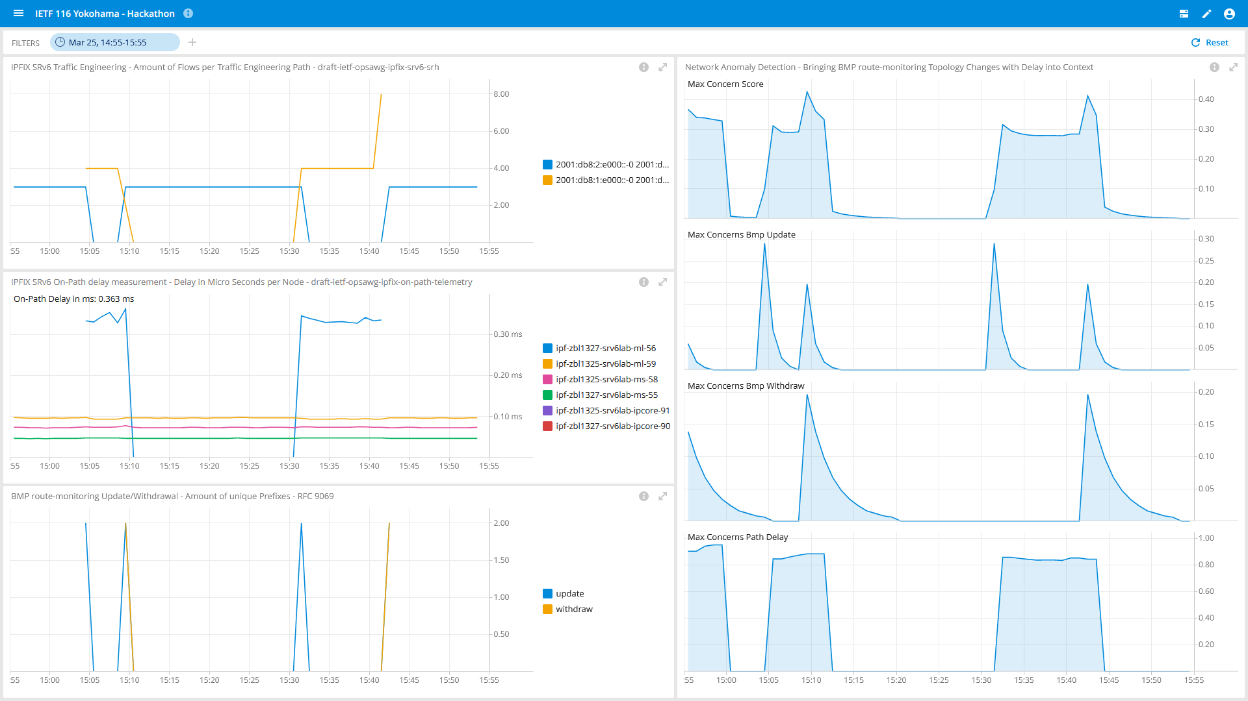
Network Observability
System Demo Detect L3 VPN Topology changes and its Forwarding Plane impact in Near Real-Time

Slide 10



What does Network Anomaly Detection mean Monitor changes, called outliers, in networks
Answers
What changed and when, on which connectivity service, and how does it impact the customers?
Focuses
Provides meaningful connectivity service impact information before customer is aware of and support in root-cause analysis.
Data Mesh
Consumes operational real-time Forwarding Plane, Control Plane and Management Plane metrics and produces analytical alerts.
Direction
From connectivity service to network platform.
Network Anomaly Detection
For Connectivity Services, Network Anomaly Detection constantly monitors and detects any network or device topology change, along with their associated forwarding consequences for customers as outliers. Notifications are sent to the Network Operation Center before the customer is aware of service disruptions. It offers operational metrics for in-depth analysis, allowing to understand in which platform the problem originates and facilitates problem resolution.

Slide 11
What our motivation is Automate learn and improve
From network incidents postmortems we network operators learn and improve so does network anomaly detection and supervised and semi-supervised machine learning.
The more network incidents are observed, the more we can improve. With more incidents the postmortem process needs be automated, let's get organized first by defining human and machine-readable metadata semantics and annotate operational and analytical data.
Let's get further organized by exchanging standardized labeled network incident data among network operators, vendors and academia to collaborate on academic research.
« The community working on Network Anomaly Detection is probably the only group wishing for more network incidents »

Slide 12
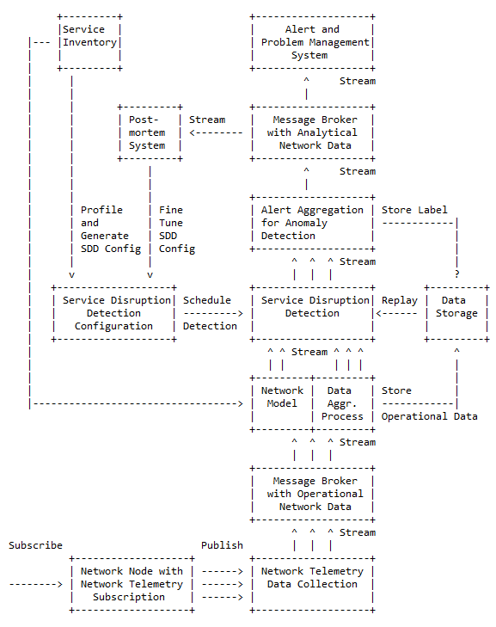
Elements of the Architecture
Service Inventory contains list of the connectivity services.
Service Disruption Detection processes aggregated network data to decide whether a service is degraded or not.
Service Disruption Detection Configuration defines the set of approaches that need to be applied to perform SDD.
Operational Data Collection manages network telemetry subscriptions and transforms data into message broker.
Operational Data Aggregation produces data upon which detection of a service disruption can be performed.
Network Modeling establishes knowledge of network relationships.
Data Profiling categorizes nondeterministic customer related data.
Detection Strategies for a profile a detection strategy is defined.
Machine Learning is commonly used to detect outliers or anomalies.
Storage some algorithms may relay on historical (aggregated) operational data to detect anomalies.
Alerting consolidates analytical insights and notifies.
Postmortem refines and stores the network anomaly and symptom labels into the Label Store.
Replaying to validate refined anomaly and symptom labels, historical operational data is replayed.

Slide 13
Semantic Metadata Annotation for Network Anomaly Detection draft-netana-nmop-network-anomaly-semantics
module: ietf-symptom-semantic-metadata
+--rw symptom
+--rw id? yang:uuid
+--rw event-id? yang:uuid
+--rw description? string
+--rw start-time? yang:date-and-time
+--rw end-time? yang:date-and-time
+--rw confidence-score? score
+--rw concern-score? score
+--rw tags* [key]
| +--rw key string
| +--rw value string
+--rw (pattern)?
| +--:(drop)
| | +--rw drop empty
| +--:(spike)
| | +--rw spike empty
| +--:(mean-shift)
| | +--rw mean-shift empty
| +--:(seasonality-shift)
| | +--rw seasonality-shift empty
| +--:(trend)
| | +--rw trend empty
| +--:(other)
| +--rw other string
+--rw annotator
+--rw (annotator-type)
| +--:(human)
| | +--rw human empty
| +--:(algorithm)
| +--rw algorithm empty
+--rw name? string
Symptom ID and description uniquely identifies the detected anomaly. Event ID, start/end-time and confidence/concern-score uniquely identifies the network event with its start and end time, how confident the system identified the anomaly and how concerned an operator should be.
Tags allows to add customer information.
Pattern describes the identified pattern of the anomaly.
Annotator Name, Type, describes wherever the anomaly was detected by a human or algorithm and uniquely identifies the system who/which detected.

Slide 14
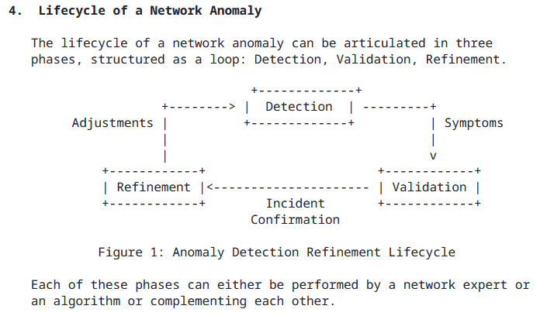
Experiment: Network Anomaly Lifecycle draft-netana-nmop-network-anomaly-lifecycle
Detection: The Network Anomaly Detection stage is about the continuous monitoring of the network through Network Telemetry [RFC9232] and the identification of symptoms.
Validation: Decides if the detected symptoms are signaling a real incident or if they are to be treated as false positives.
Refinement: Network operator performs detailed postmortem analysis of the network incident, collected Network Telemetry data and detected anomaly with the objective to identify useful adjustments in the Network Telemetry data collection and Anomaly Detection system.
« Network Anomaly Detection is an iterative process that requires continuous improvement »

Slide 15
Experiment: Network Anomaly Lifecycle draft-netana-nmop-network-anomaly-lifecycle
module: ietf-network-anomaly-metadata
+--rw network-anomalies
+--rw network-anomaly* [id version]
+--rw id yang:uuid
+--rw version uint32
+--rw description? string
+--rw state identityref
+--rw annotator
| +--rw (annotator-type)
| | +--:(human)
| | | +--rw human empty
| | +--:(algorithm)
| | +--rw algorithm empty
| +--rw name? empty
+--rw symptoms* [symptom_id]
+--rw symptom_id yang:uuid
ID and Description uniquely identifies the detected network anomaly (as a container of symptoms).
Description and State provide general information regarding the anomaly and .
Annotator describes the entity that observed the network anomaly: this can be a human or an algorithm (anomaly detection system).
Symptoms provides a list of symptoms (based on ietf-symptom-metadata) that are part of this network anomaly.

Slide 16
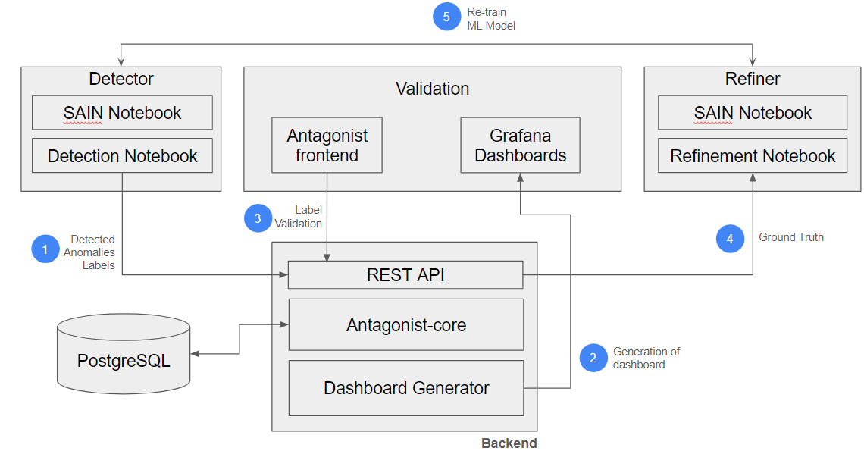
Experiment: Antagonist anomaly tagging on historical data
Goals:
Prove that YANG models contain all the necessary information
Validate models across a wide range of use-cases
Show interoperability between
Done so far:
Validation with real operational data (Cloud monitoring)
Validation with rule-based Network Anomaly Detector (SAIN RFC9417/RFC9418)
Validation with a ML-based Network Anomaly Detector (Autoencoder)
Add support for Re-training of ML-based models
Add partial support for Metadata Filtering and search
YANG model refinements to reflect the results of the coding
Automatic dashboard generation
Next Steps:
Improve scalability
Validate with Swisscom Data

Slide 17


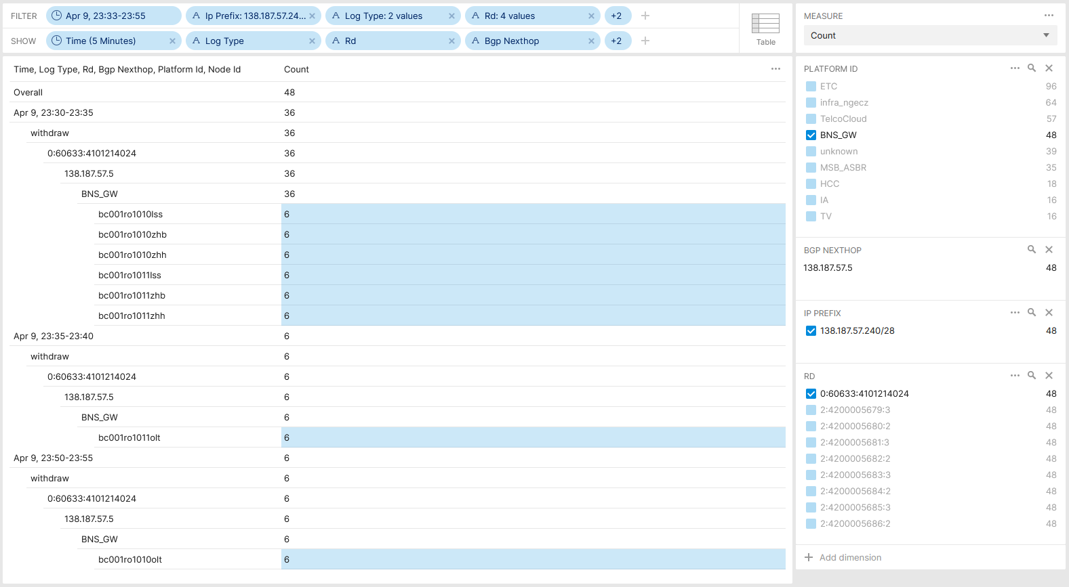

Postmortem, L3 VPN Pilot Migration - Voice Over IP Post Maintenance Window Analysis
Maintenance window was scheduled to start on April 9th 22:00 with a total of 4 migration steps.
At 12:45 CE facing interfaces on first PE node to be phased out was disabled. Triggering a VPNv4 withdrawal of 138.187.57.240/28 from 138.187.57.6 Lo0 towards route-reflectors and then to Inter-AS Option B ASBR. BMP route-monitoring and CLI show commands verified successful route propagation.
At 23:02 CE facing interfaces on first PE node to be migrated to was enabled. Triggering a VPNv4 update of 138.187.57.240/28 from 138.190.129.180 Lo0 towards route-reflectors and then to Inter-AS option B ASBR. BMP route-monitoring and CLI show commands verified successful route propagation.
At 23:34 CE facing interfaces on second PE node to be phased out was disabled. Triggering a VPNv4 withdrawal of 138.187.57.240/28 from 138.187.57.5 Lo0 towards route-reflectors and then to Inter-AS option B ASBR. BMP route-monitoring and CLI show commands verified successful route propagation to route-reflector and on two Option B ASBR, but on other six after 20 mins delay.
Overall BGP Update/withdrawals Across Swisscom MPLS/SRv6 Cores

Slide 18
Postmortem, L3 VPN Pilot Migration - Voice Over IP Show command drove to wrong conclusion
show route table bgp.l3vpn.0 protocol bgp 138.187.57.240/28 detail
60633:4101214024:138.187.57.240/28 (1 entry, 1 announced)
BGP Preference: 170/-101
Route Distinguisher: 60633:4101214024
Next hop type: Indirect, Next hop index: 0
Address: 0x1a963a3c
Next-hop reference count: 8
Source: 138.190.128.116
Protocol next hop: 138.187.57.5
Label operation: Push 83714
Label TTL action: prop-ttl
Load balance label: Label 83714: None;
Indirect next hop: 0x2 no-forward INH Session ID: 0x0
State: <Delete Int Ext ProtectionPath ProtectionCand>
Local AS: 64088.1116 Peer AS: 64088.1116
Age: 5:28 Metric: 805 Metric2: 4
Validation State: unverified
Resolving-AIGP: 4
Effective metric: 8 (IGP metric plus resolving AIGP)
Task: BGP_64088.1116.138.190.128.116
Announcement bits (1): 1-BMP
AS path: 60633 64088.5 ?
Communities: 60633:204 60633:208 60633:1002 64497:4965 64499:13338 target:60633:1100006314
Accepted
BMP: Pre: withdraw Station: DAISY_BMP_1
BMP: Pre: withdraw Station: DAISY_BMP_2
BMP: Station: <unassigned>
Color: VPN Label: 83714
Localpref: 100
Router ID: 138.190.128.116
Thread: junos-main
show route table bgp.l3vpn.0 protocol bgp 138.187.57.240/28 detail
60633:4103214024:138.187.57.240/28 (3 entries, 1 announced)
*BGP Preference: 170/-101
Route Distinguisher: 60633:4103214024
Next hop type: Indirect, Next hop index: 0
Address: 0x1526757c
Next-hop reference count: 4
Source: 138.187.57.3
Protocol next hop: 138.190.128.180
Label operation: Push 83118
Label TTL action: prop-ttl
Load balance label: Label 83118: None;
Indirect next hop: 0x2 no-forward INH Session ID: 0x0
State: <Active Ext ProtectionPath ProtectionCand>
Local AS: 64088.1116 Peer AS: 60633
Age: 14:29:45 Metric: 800 Metric2: 4
Validation State: unverified
Resolving-AIGP: 4
Effective metric: 8 (IGP metric plus resolving AIGP)
Task: BGP_60633.138.187.57.3
Announcement bits (2): 0-BGP_RT_Background 1-BMP
AS path: 60633 64088.1180 ?
Communities: 60633:204 60633:208 60633:1001 60633:1111 64497:4965 64499:13338 target:60633:1100006314
Accepted
BMP: Pre: advertise Station: DAISY_BMP_1
BMP: Pre: advertise Station: DAISY_BMP_2
Color: VPN Label: 83118
Localpref: 100
Router ID: 138.187.57.3
Thread: junos-main
Juniper JunOS CLI show command shows that path is for 20min no longer primary active but still as backup path inactive. Output mislead network engineer to believe that path is still installed.

Slide 19
Postmortem, L3 VPN Pilot Migration - Voice Over IP Data collection timestamp drove to wrong conclusion
"timestamp": "Tue Apr 09 2024 23:34:21",
"writer_id": "bew03bmp45c 20240220-1 (45ae4201)",
"peer_ip": "138.190.128.117",
"string": "Tue Apr 09 2024 23:52:34"
"timestamp": "Tue Apr 09 2024 23:34:21",
"writer_id": "bew03bmp45c 20240220-1 (45ae4201)",
"peer_ip": "138.187.57.4",
"string": "Tue Apr 09 2024 23:52:34"
"timestamp": "Tue Apr 09 2024 23:34:21",
"writer_id": "bew03bmp45c 20240220-1 (45ae4201)",
"peer_ip": "138.187.57.3",
"string": "Tue Apr 09 2024 23:52:34"
"timestamp": "Tue Apr 09 2024 23:34:21",
"writer_id": "bew03bmp45c 20240220-1 (45ae4201)",
"peer_ip": "138.190.128.117",
"string": "Wed Apr 10 2024 01:04:00"
"timestamp": "Tue Apr 09 2024 23:34:21",
"writer_id": "zoi03bmp45c 20240220-1 (45ae4201)",
"peer_ip": "138.187.57.3",
"string": "Tue Apr 09 2024 23:54:09"
"timestamp": "Tue Apr 09 2024 23:34:21",
"writer_id": "zoi03bmp45c 20240220-1 (45ae4201)",
"peer_ip": "138.187.57.4",
"string": "Tue Apr 09 2024 23:54:17"
"timestamp": "Tue Apr 09 2024 23:34:21",
"writer_id": "zoi03bmp45c 20240220-1 (45ae4201)",
"peer_ip": "138.190.128.117",
"string": "Tue Apr 09 2024 23:54:24"
"timestamp": "Tue Apr 09 2024 23:34:21",
"writer_id": "zoi03bmp45c 20240220-1 (45ae4201)",
"peer_ip": "138.190.128.117",
"string": "Wed Apr 10 2024 00:54:51"
The yellow marked timestamp shows the optional BMP per-peer header observation timestamp.
The blue marked timestamp shows the timestamp being augmented on the BMP data collection and being used for the time series database.
Because BMP per-peer timestamp is optional, in the time series database ingestion, the data collection augmentation timestamp is used instead. Leading to false conclusions when the state change was observed.

Slide 20
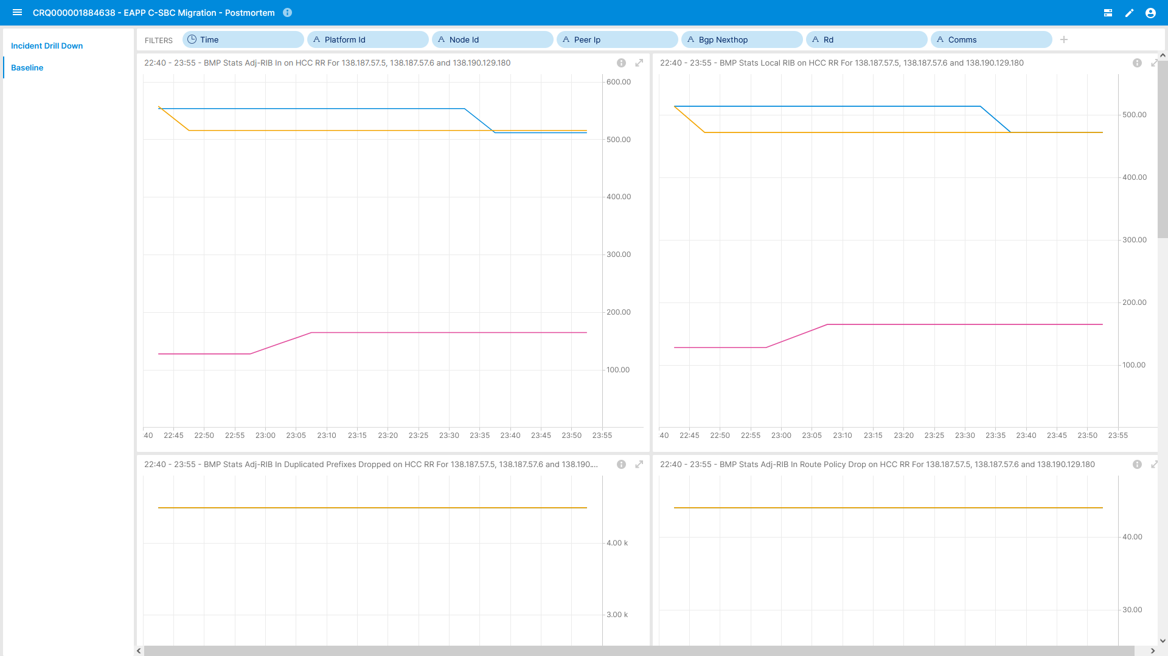
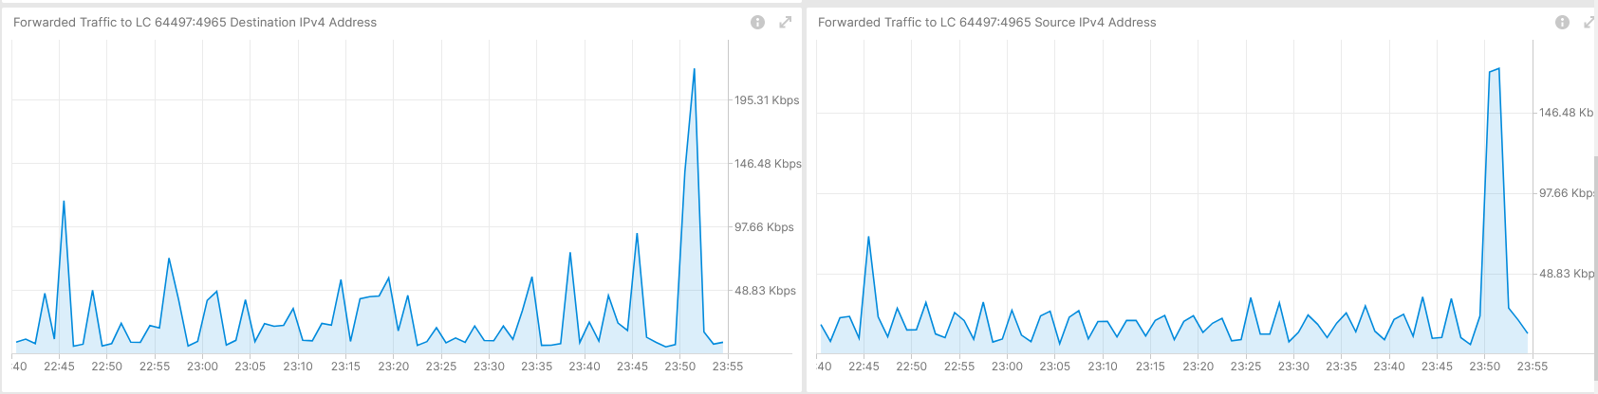

Postmortem, L3 VPN Pilot Migration - Voice Over IP Route-Reflector Peering and L3 VPN Traffic View
IPFIX configured on PE but not on involved MPLS Inter-AS option B ASBRs due to PR1567039.
BMP ADJ-RIB In pre-policy on BGP VPNv4 /6 on MPLS PE's. BMP ADJ-RIB In pre-policy on BGP VPNv4 /6 on Route Reflectors and BMP ADJ-RIB In pre-policy and ADJ-RIB Out post-policy on Inter-AS Option B ASBR.
YANG Push on most nodes but not relevant for this use case.
BMP Peering Statistics on Route Reflectors
Traffic to Voice over IP Service on affected L3 VPN

Slide 21
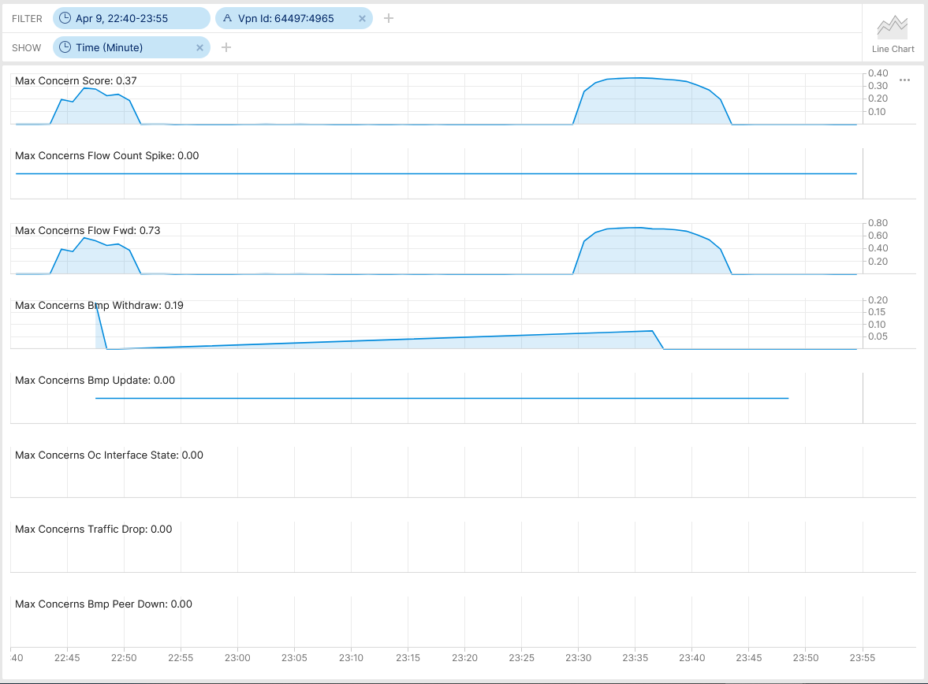

Postmortem, L3 VPN Pilot Migration - Voice Over IP 64497:4965 - Anomaly Detection - Live
Real-Time Streaming under Development
Max Concern Score: NA
BMP Withdrawal Score: 0.19
BMP route-monitoring Update/Withdraw check recognize withdrawal.
BMP peer Down/Up check did not apply.
Interface Down/Up check did not recognize.
Traffic Drop spike did not apply.
Missing Traffic check did not apply. (not fully implemented yet).
Increased or decreased Flow Count did not apply.
Overall: 1 out of 6 checks have detected the BGP topology change. Real-time streaming implementation work in progress as expected.
Cosmos Bright Lights Anomaly Detection – 64497:4965

Slide 22
What went well?
Work in progress Cosmos Bright Lights real-time streaming Anomaly Detection BMP route-monitoring withdrawal rule detected topology change.
BMP collected metrics are consistent across multiple vendors vs. CLI show output is vendor dependent.
Postmortem
What to do next?
Support on upcoming maintenance window with verification dashboard and active monitoring. -> Done
What could be improved?
BMP per-peer observation timestamp should be mandatory. See https://datatracker.ietf.org/doc/html/draft-boucadair-nmop-rfc3535-20years-later-02#section-4.7. -> To be addressed in GROW/NMOP.
BMP per-peer header should have an export timestamp. See https://datatracker.ietf.org/doc/html/draft-boucadair-nmop-rfc3535-20years-later-02#section-4.7. -> To be addressed in GROW/NMOP.
With RFC 8671 (Support for Adj-RIB-Out in BMP) path propagation could have been observed on route-reflectors.
With draft-lucente-grow-bmp-rel (Logging of routing events in BMP) path drops could been observed on Inter-AS option B ASBRs and route-reflectors.
With draft-ietf-grow-bmp-path-marking-tlv path status changed could have been observed on Inter-AS option B ASBRs.
Clarify why Juniper JunOS delayed BMP export for 20 resp. 80 minutes. Due to fact that the path was still passive in the BGP RIB?
With IPFIX (deconfigured due to PR1567039) and support of IE90 ForwardingStatus (not supported on Juniper JunOS) forwarding drops could have been observed on Inter-AS option B ASBRs.

Slide 23
Swisscom - Cosmos Bright Lights PoC Summary After 20 Incidents and 18 Months Time
Key Facts in V0 (2023-2024)
16 L3 VPNs proactively monitored.
Individual Service Disruption Detection rule accuracy is beyond 90%. Summed accuracy is beyond 95%.
Max Concern score ranged between 0.06 and 0.85. In average 0.46.
In 4 cases additional YANG, in 13 cases additional BMP, in 2 cases Netconf Transaction-ID and 1 case additional L2 IPFIX metrics would have helped to gain more visibility.
Key observability feature missing: BMP Local RIB with Path Marking.
5
In Replay Incident Detected
72 Alert Notifications
15
In Near Real-Time Incident Detected
46
Falls Positive due to Apache Druid delayed ingestion
6
Falls Positive due to previous week data not comparable

Slide 24
Swisscom - Cosmos Bright Lights PoC Detail Multiple Perspectives increases Accuracy
Key Improvements in V1 (2024)
>12000 L3 VPNs proactively monitored since June 2024.
Realtime Streaming eliminates delayed ingestion falls positives and scaling.
Improved profiling. Compares to multiple previous weeks and discard largest deviation eliminates falls positives. -> Work In progress
Key Improvements in V2 (2025)
Annotate operational and analytical Network Incident data for reproduction.
Enabling automated workflow. From PowerPoint slide decks to data driven actionable insights.
3
One out of Six checks
2
Four out of Six checks
20 Network Incidents
6
Three out of Six checks
8
Two out of Six checks

Slide 25
Network Anomaly Detection Framework Detect service interruption faster then humans can
« Addressing the need to detect connectivity service interruption faster than humans can and facilitate collaboration by enabling exchange on labeled data with standardized semantics on a common framework. Please consider to attend IETF 120 NMOP working group session on Friday 13:00 – 15:00
or go onto the mailing list and contribute to the discussion. »
Incident and Problem Management:
Some Key Terms for Network Incident and Problem Management draft-ietf-nmop-terminology
Network Anomaly Detection:
An Architecture for a Network Anomaly Detection Framework draft-netana-nmop-network-anomaly-architecture
Semantic Metadata Annotation for Network Anomaly Detection draft-netana-nmop-network-anomaly-semantics
Experiment: Network Anomaly Lifecycle draft-netana-nmop-network-anomaly-lifecycle

Slide 26
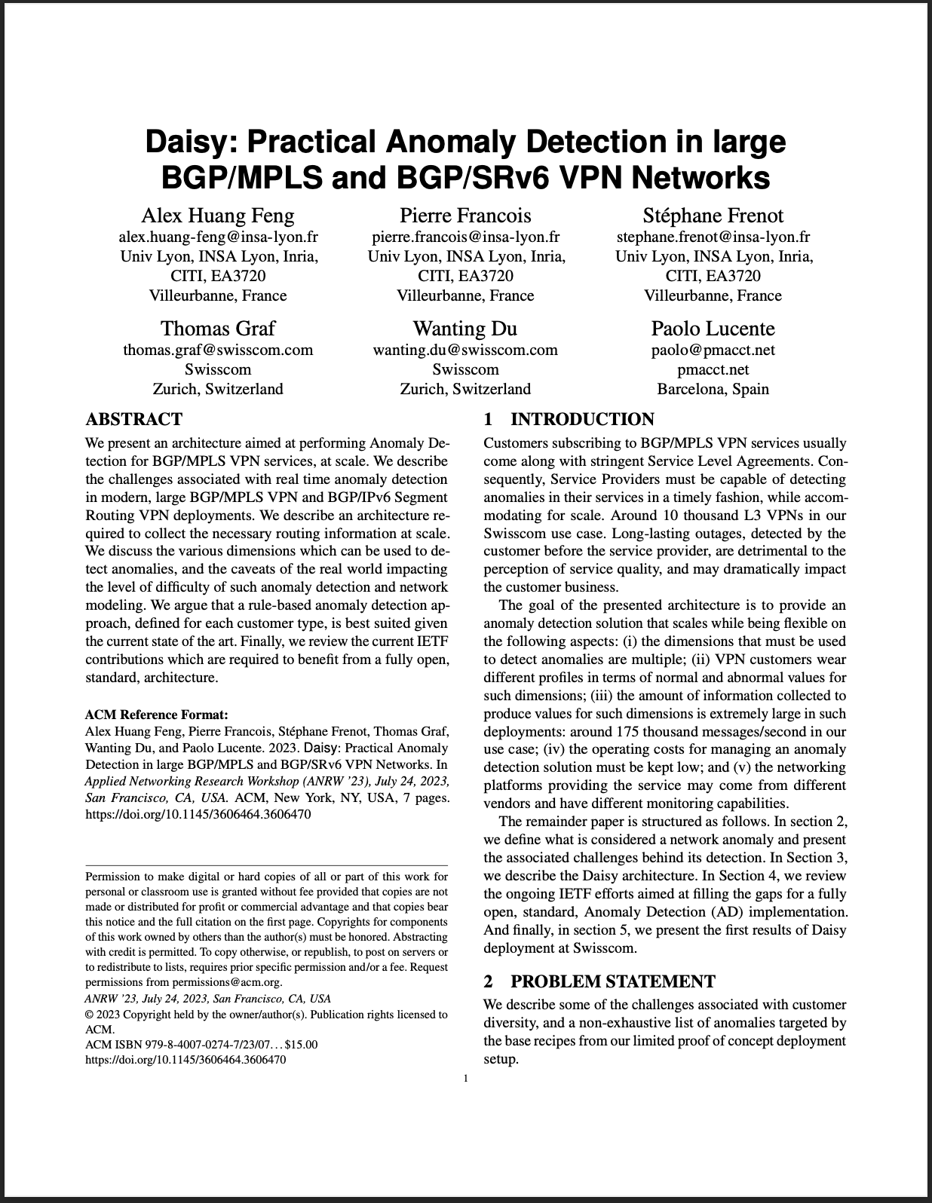
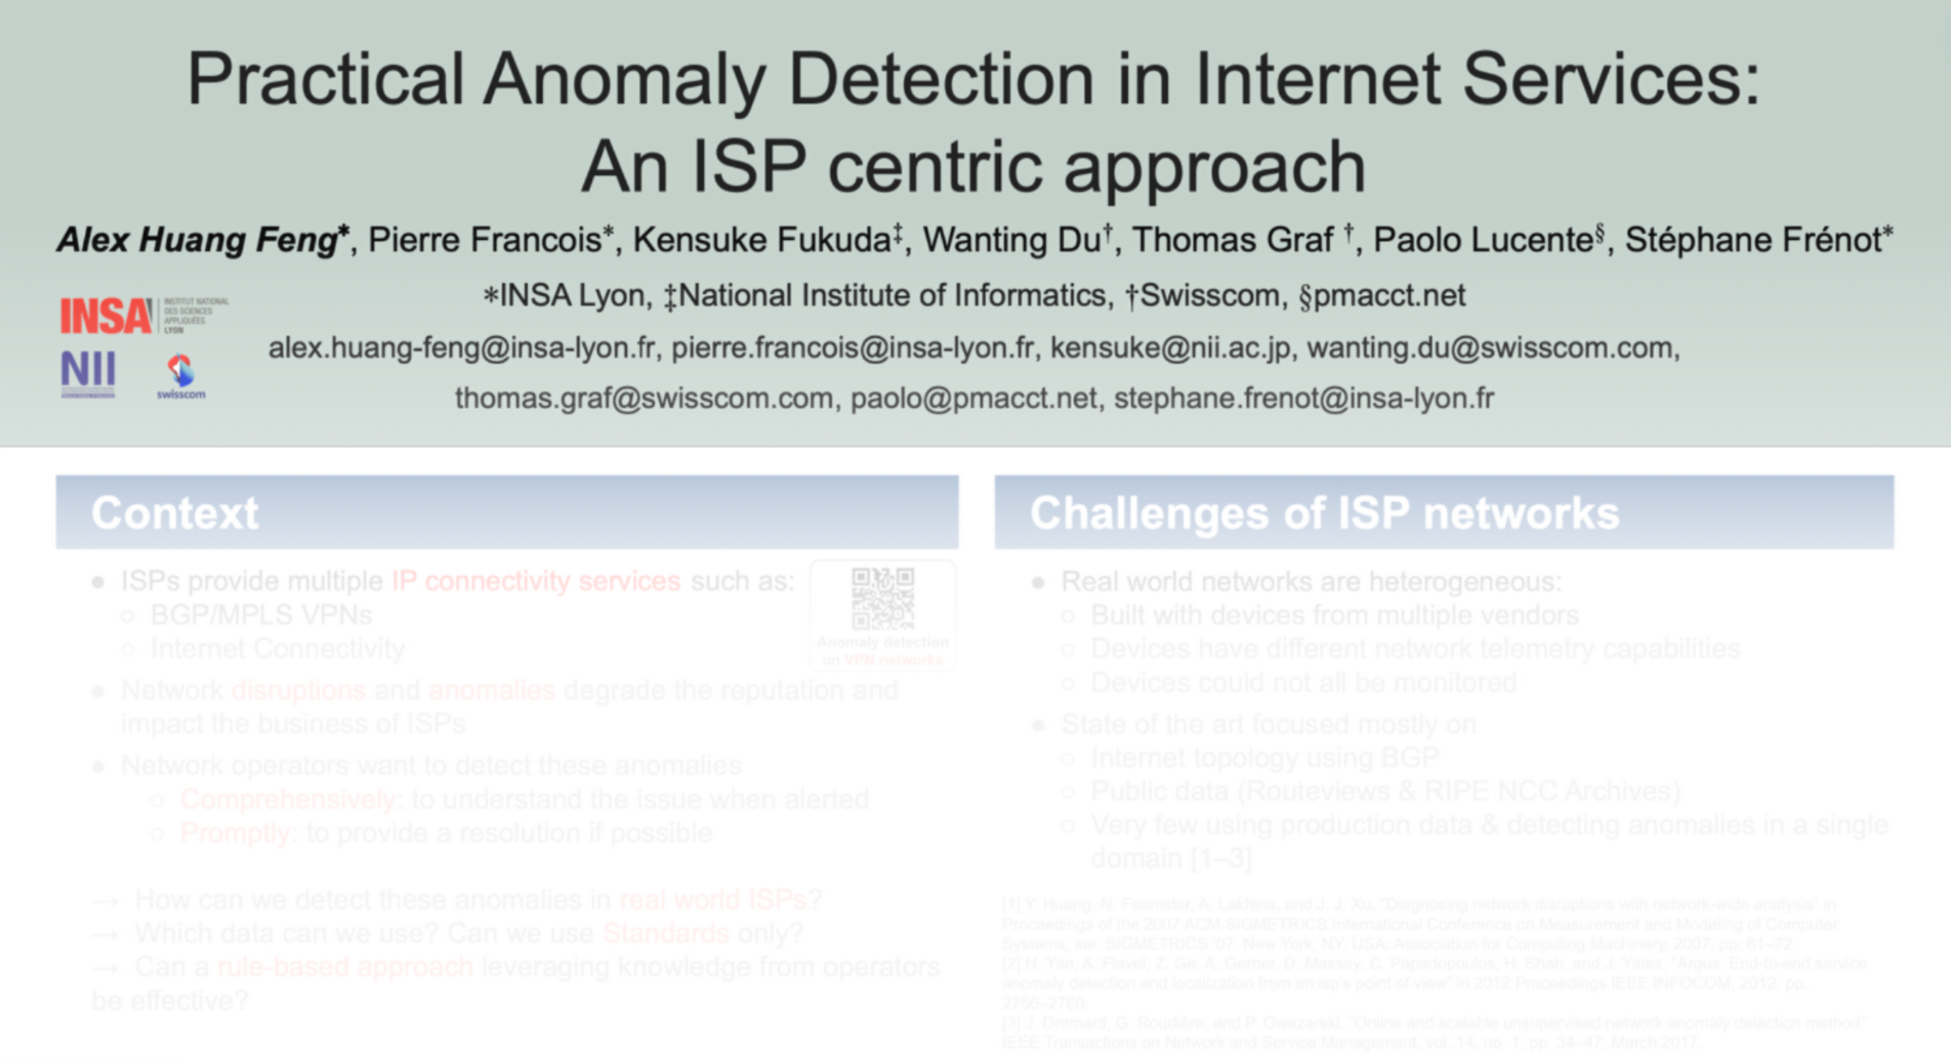
Relevant Papers for more Details
Paper “Practical Anomaly Detection in Internet Services: An ISP centric approach”
accepted at AnNet’24
(in conjunction with IEEE NOMS’24)
Seoul, Korea (6–10 May 2024)
[Will be presented as a poster the May 6th 2024]
Paper “Daisy: Practical Anomaly Detection in large BGP/MPLS and BGP/SRv6 VPN Networks” published at ACM/IRTF ANRW’23
San Francisco, USA (24 July 2023)
Open access: http://hal.science/hal-04307611

Slide 27


Slide 28
Handling Operational YANG Modelled Data State of the Union
Nowadays network operators are using machine and human readable YANG RFC 7950 to model their configurations and obtain YANG modelled data from their networks.
Network operators organizing their data in a Data Mesh where a message broker such as Apache Kafka facilitates the exchange of messages among data processing components.
Today, subscribing to a YANG datastore, publishing a YANG modeled notifications message from the network and viewing the data in a time series database, manual labor is needed to perform data transformation to make a message broker and its data processing components with YANG notifications interoperable.
« Even though YANG is intend to ease the handling of data, this promise has not yet been fulfilled for Network Telemetry RFC 9232 »

Slide 29
From YANG-Push to Network Analytics Aiming for an automated data processing pipeline
A network operator aims for:
An automated data processing pipeline which starts with YANG-Push, consolidates at Data Mesh and ends at Network Analytics.
Operational metrics where IETF defines the semantics.
Analytical metrics where network operators gain actionable insights.
We achieve this by integrating YANG-Push into Data Mesh to:
Produce metrics from networks with timestamps when network events were observed.
Hostname, publisher ID and sequence numbers help us to understand from where metrics were exported and measure its delay and loss.
Forward metrics unchanged from networks
Learn semantics from networks and validate messages.
Control semantic changes end to end.

Slide 30
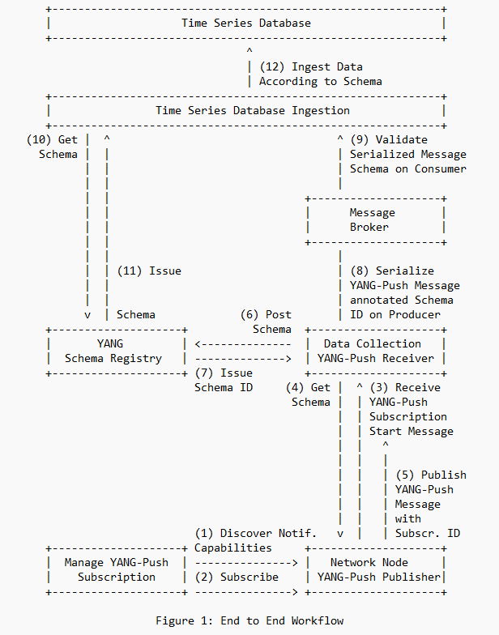
Elements of the Architecture Workflow Diagram
Network Orchestration subscribes to YANG datastore.
Network Node informs Data Collection on subscription state and publishes YANG metrics with YANG-Push.
Data Collection obtains for each subscription the YANG module dependencies and the YANG modules on the network node, registers it in the YANG Schema Registry and prefixes the forwarded YANG notifications with the obtained schema ID.
YANG Schema Registry issues for a Message Broker subject a schema ID for each new schema tree, compares a new schema tree with an existing and versions it.
Time Series Database Ingestion consumes YANG-Push notifications from Message Broker, obtains schema tree from YANG schema registry, validates YANG notifications against schema and uses schema to populate into database table.

Slide 31
Address YANG Specification and Integration Gaps Aiming for an automated data processing pipeline
« Addressing those gaps are a prerequisite to enable an automated data processing chain as described in draft-ietf-nmop-yang-message-broker-integration. Please consider to attend IETF 120 NMOP working group session on Friday 13:00 – 15:00
or go onto the mailing list and contribute to the discussion. »
YANG Specifications Gaps:
YANG model for NETCONF Event Notifications draft-ahuang-netconf-notif-yang
Validating anydata in YANG Library context draft-aelhassany-anydata-validation
YANG Integration Gaps:
Support of Network Observation Timestamping in YANG Notifications draft-tgraf-netconf-yang-push-observation-time
Support of Hostname and Sequencing in YANG Notifications draft-tgraf-netconf-notif-sequencing
Support of Versioning in YANG Notifications Subscription draft-ietf-netconf-yang-notifications-versioning
Augmented-by Addition into the IETF-YANG-Library draft-lincla-netconf-yang-library-augmentation

