Slide 1

Validate BMP Extension for Path Status TLV GROW WG
BMP Monitoring Station
Frrouting https://github.com/mxyns/frr/commits/bmp-draft-path-marking/
BMP Data Collection
Pmacct https://github.com/pmacct/pmacct
Tools
Wireshark dissector https://www.wireshark.org/download//automated/ https://github.com/network-analytics/wireshark/tree/draft-cppy-grow-bmp-path-marking-tlv
Many thanks to…
Paolo Lucente – Pmacct
Maxence Younsi – INSA Lyon
Yannick Buchs – Swisscom
Thomas Graf – Swisscom

Slide 2

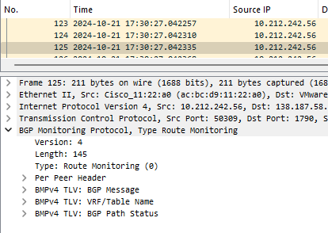
BMP Data Processing Pipeline
Apache Kafka
{
"ietf-subscribed-notifications:notification": {
"eventTime": "2024-03-08T16:20:03.520570812+00:00",
"sysName": "daisy-ietf-ipf-zbl1843-r-daisy-58",
"publisherId": 0,
"sequenceNumber": 1502,
"ietf-subscribed-notifications:subscription-terminated": {
"id": 12345678,
"reason": "no-such-subscription"
}
}
}
BMP Monitoring Station
BMP Data Collection
BMP Packet Capture
Apache Kafka
JSON Message

Slide 3
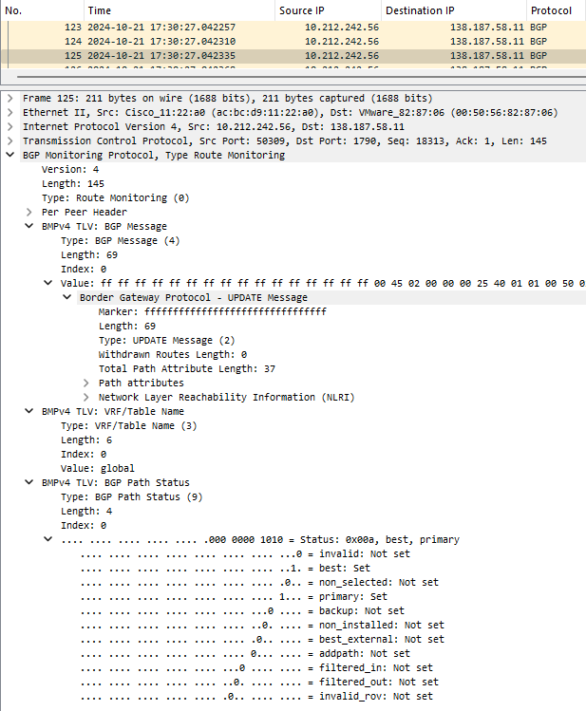
BMPv4 route-monitoring Path Status TLV
BMPv4 Path Status TLV for route-monitoring
{
"ietf-notification:notification": {
"eventTime": "2024-11-02T14:38:22.598Z",
"ietf-notification:sysName": "ipf-zbl1327-r-daisy-91",
"ietf-notification:sequenceNumber": 13,
"ietf-subscribed-notifications:subscription-started": {
"id": 1,
"ietf-yang-push:datastore": "IOS-XR",
"ietf-yang-push:datastore-xpath-filter": "Cisco-IOS-XR-pfi-im-cmd-oper:interfaces/interface-xr/interface[interface-name='Loopback13']",
"transport": "transport",
"module-version": [
{
"module-name": "Cisco-IOS-XR-pfi-im-cmd-oper",
"revision": "2024-02-29"
}
],
"encoding": "encode-json",
"ietf-yang-push:periodic": {
"period": 4500
}
}
}
}

