Slide 1
Antagonist (Anomaly Tagging on historical data)
IETF 119 - Hackathon
March 16-17th, 2024
https://datatracker.ietf.org/doc/draft-netana-nmop-network-anomaly-semantics/
https://datatracker.ietf.org/doc/draft-netana-nmop-network-anomaly-lifecycle/

Slide 2
Problem Statement
Want to solve Automated Network Anomaly Detection?
How do you know if you are doing a good job?
How do you know how to iteratively improve?
How can you learn from this iterative process?
One step towards the solution:
A YANG model to standardize the way anomalies are described
A YANG model to standardize knowledge of what went well and what not
This enables a structured and consistent exchange of anomaly related metadata:
Between Network Operators, Academia, Vendors, etc.
Between Network Experts and AI Algorithms (Ground Truth, Validation)

Slide 3
Hackathon - Plan
Validate the new version of the YANG models defined in the drafts, providing an implementation:
Extend the Proof-of-concept to:
Expose an API based on the above YANG models
Make the project agnostic of the timeseries database used
Enable Antagonist to supports two use cases:
A Network Operator tags symptoms and network issues (ground truth)
A Network Operator validates anomaly detection generated by AI algorithms

Slide 4
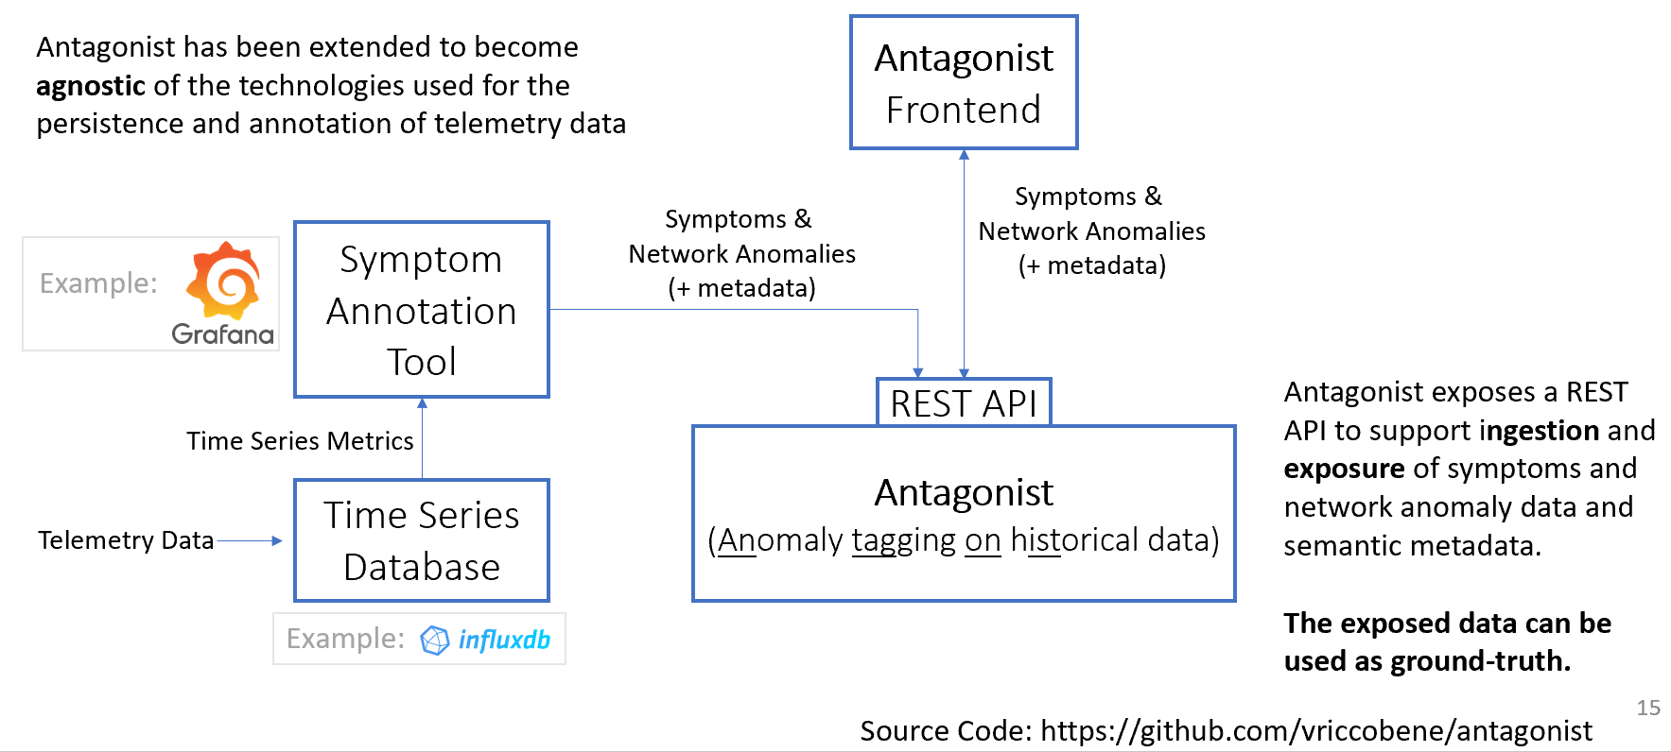
Hackathon – Software

Slide 5
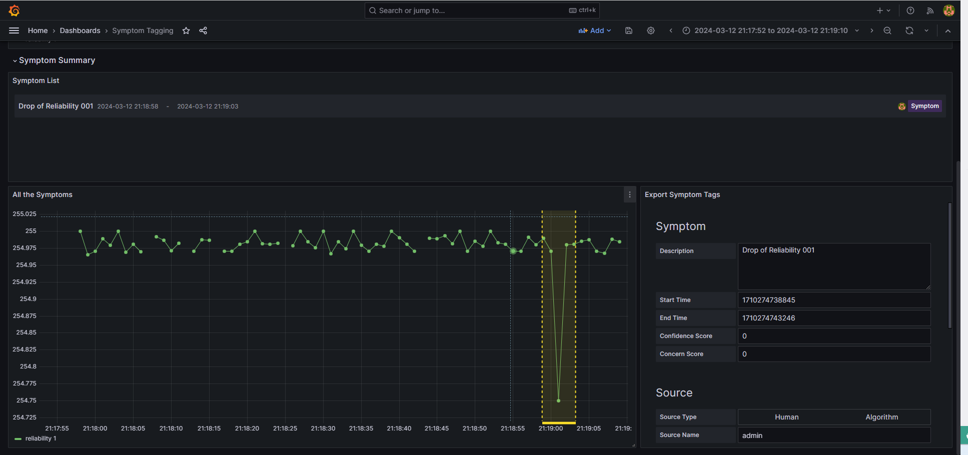
Antagonist – Labelling a Symptom

Slide 6
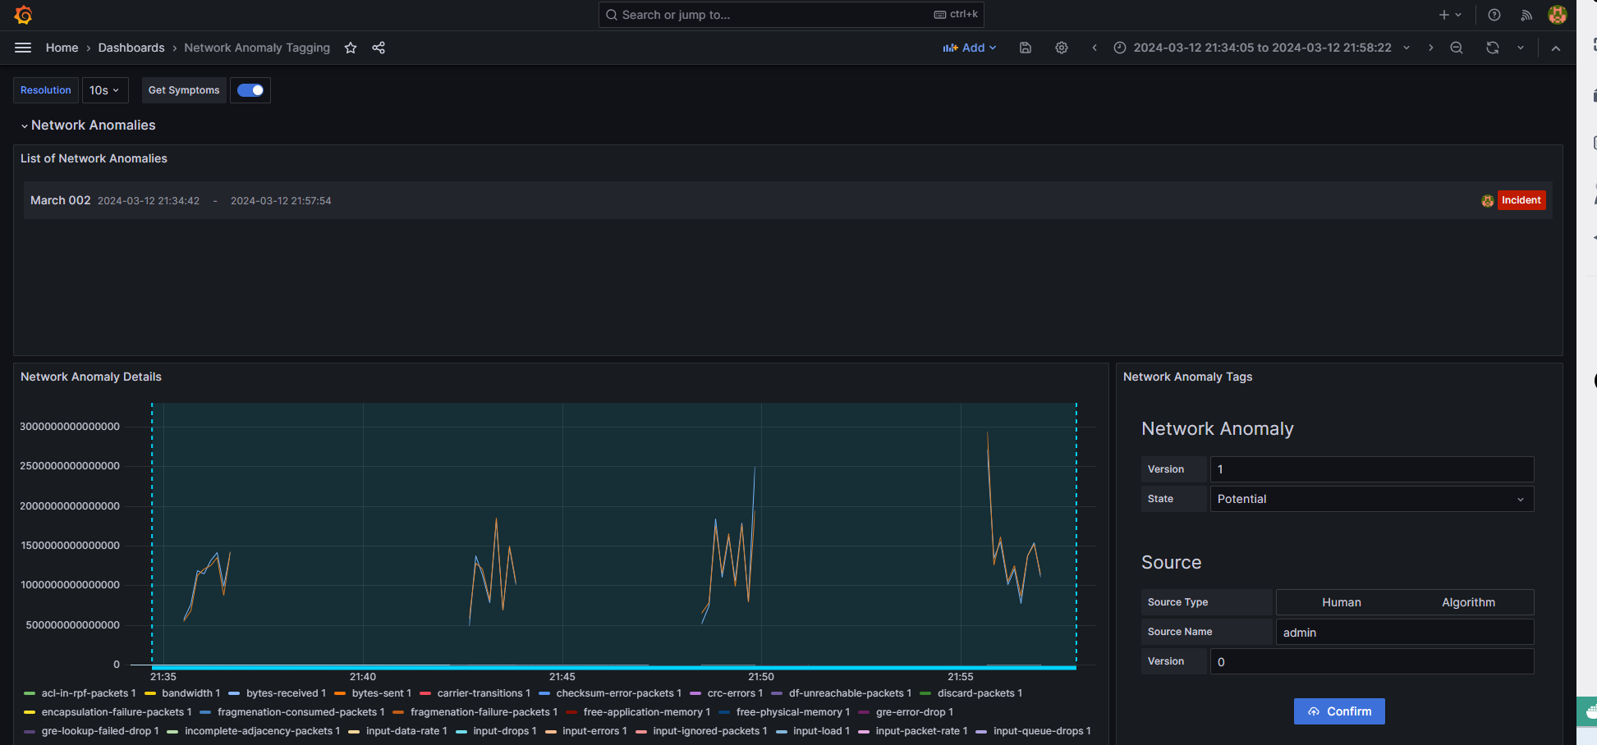
Antagonist – Labelling incidents

Slide 7
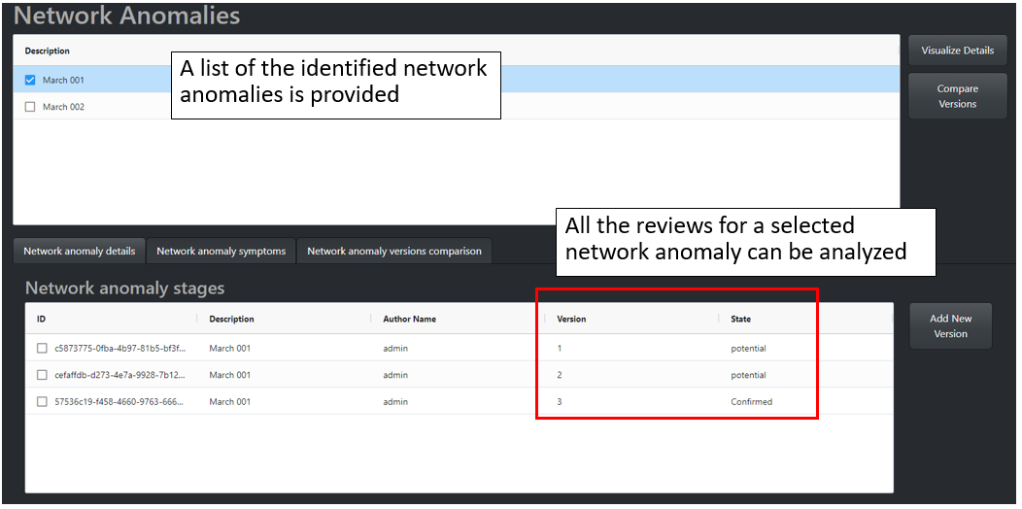
Antagonist – Exposure of the Network Anomalies

Slide 8
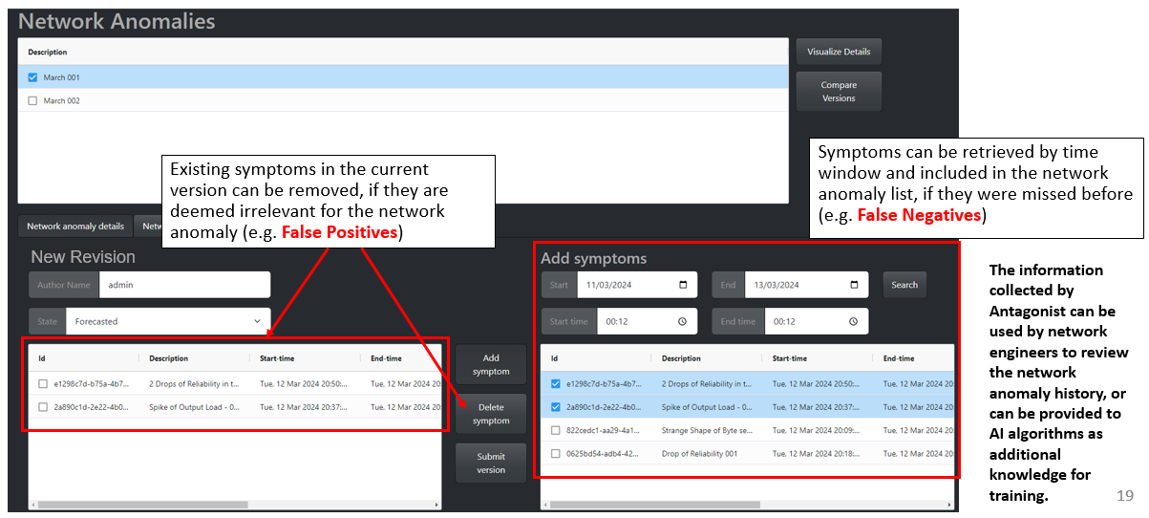
Antagonist – Exposure of the Network Anomalies

Slide 9
What’s next?
Validate the project with network operational data from operators
Finalize validation of that the data models are satisfactory and sufficient to reflect the necessary information

Slide 10
Thanks to…
Vincenzo Riccobene – Huawei
Antonio Roberto - Huawei
Benoit Claise - Huawei
Thomas Graf – Swisscom
Wanting Du - Swisscom
Alex Huang Feng – INSA Lyon

