Slide 1
An Architecture for YANG-Push to Message Broker Integration
draft-ietf-nmop-yang-message-broker-integration-09
Motivation and architecture of a native
YANG-Push notifications and YANG Schema integration
into Message Broker and YANG Schema Registry
thomas.graf@swisscom.com
ahmed.elhassany@swisscom.com
1. November 2025

Slide 2
An Architecture for YANG-Push to Message Broker Integration
Status and Summary from -08
Addressed comments from Paul Aitken. Many thanks for the review! (https://mailarchive.ietf.org/arch/msg/nmop/dc8w2524j2RoV3ZduR7t8T0Rt7o/).
Paul raised a valid point on YANG and Data Mesh industry adoption claims.
That external references for this claims would help to undermine that this not just the authors opinion.
  The authors believe that the two references would undermine the claim best. Please speak up if you disagree or have a better proposal.
  Towards Avoiding the Data Mess: Industry Insights from Data Mesh Implementations: https://arxiv.org/html/2302.01713v4
  Toward Building a Semantic Network Inventory for Model-Driven Telemetry: https://arxiv.org/html/2402.06511v1

Slide 3
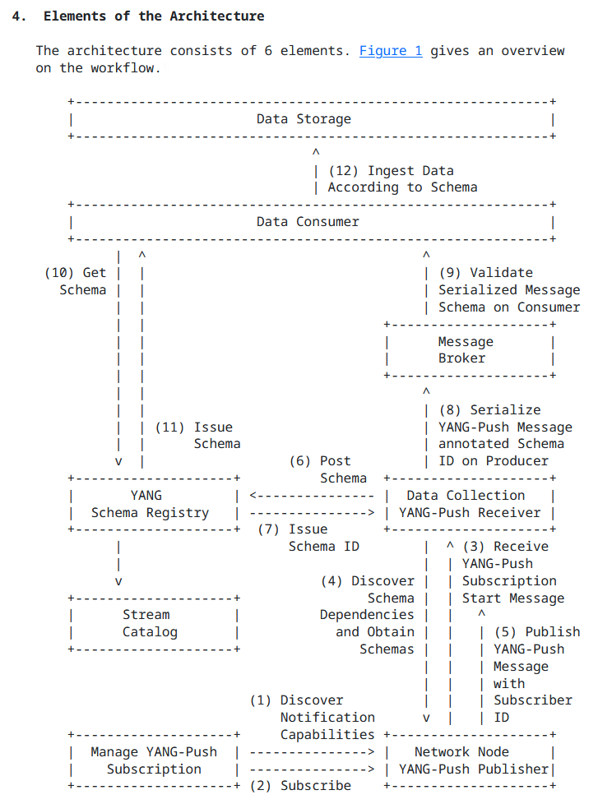
An Architecture for YANG-Push to Message Broker Integration
Status and Summary from -09
Section 4.5, "Stream Catalog" was added. The term "Stream Catalog" was previously already defined. That semantics are exported to "Stream Catalog" and that end users interact with the "Streaming Catalog" is now clearly defined in the document. All other functional aspects of a "Stream Catalog" is out of document scope.
Nacho mentioned in during IETF 123 that "Data Catalog" would be a better term than "Stream Catalog". The authors believe that "Stream Catalog" is a more commonly used term in context of Message Brokers. What is the working group opinion?
Changed from "sysName" to "hostname" to adapt to changes in draft-ietf-netconf-notif-envelope.
Changed message broker examples from RabbitMQ to Apache Pulsar since Apache Pulsar also supports draft-netana-nmop-yang-message-broker-message-key aspects.

Slide 4
An Architecture for YANG-Push to Message Broker Integration
Next Steps
Next Steps
The milestones in the NMOP charter aims September 2025 for "Submit Architecture for YANG-Push to Message Broker Integration to the IESG"
The document went through several iterations and has multiple implementations. The last remaining normative referenced documents which did not pass working group last call yet are:
  draft-ietf-netconf-yang-notifications-versioning (requested working group last call at IETF 124)
  draft-ietf-nmop-message-broker-telemetry-message (second implementation at IETF 124, intend to request working group at IETF 125)
The authors suggest to trigger an early OPS directorate review to gauge wherever we have missed anything from an operations or management perspective.
The authors believe that the document is stable and ready for working group last call and be submitted together with draft-ietf-nmop-message-broker-telemetry-message to IESG at IETF 125.
thomas.graf@swisscom.com
ahmed.elhassany@swisscom.com
1. November 2025

Slide 5
Extensible YANG Model for Network Telemetry Messages
draft-ietf-nmop-message-broker-telemetry-message-03
Defines an extensible message schema in YANG
to be used at data collection to transform Network Telemetry messages into external systems such as Message Brokers
thomas.graf@swisscom.com
ahmed.elhassany@swisscom.com
1. November 2025

Slide 6
Extensible YANG Model for Network Telemetry Messages
YANG Schema Trees
module: ietf-telemetry-message
structure message:
+-- network-node-manifest {network-node-manifest}?
| +-- name? string
| +-- vendor? string
| +-- vendor-pen? uint32
| +-- software-version? string
| +-- software-flavor? string
| +-- os-version? string
| +-- os-type? string
+-- telemetry-message-metadata
| +-- node-export-timestamp? yang:date-and-time
| +-- collection-timestamp yang:date-and-time
| +-- notification-event
| | telemetry-notification-event-type
| +-- session-protocol telemetry-session-protocol-type
| +-- export-address inet:host
| +-- export-port? inet:port-number
| +-- collection-address? inet:host
| +-- collection-port? inet:port-number
+-- data-collection-manifest {data-collection-manifest}?
| +-- name? string
| +-- vendor? string
| +-- vendor-pen? uint32
| +-- software-version? string
| +-- software-flavor? string
| +-- os-version? string
| +-- os-type? string
+-- network-operator-metadata
| +-- labels* [name]
| +-- name string
| +-- (value)
| +--:(string-choice)
| | +-- (string-choice)?
| | +--:(string-value)
| | +-- string-value? string
| +--:(anydata-choice)
| +-- (anydata-choice)?
| +--:(anydata-values)
| +-- anydata-values? anydata
+-- payload? anydata
Optional network node and collector data manifest reused from draft-ietf-opsawg-collected-data-manifest.
Telemetry Protocol Metadata.
Optional network operator metadata.
YANG-Push notification received from the network node.
YANG-Push subscription received from network node.
1
module: ietf-yang-push-telemetry-message
augment-structure /tm:message/tm:telemetry-message-metadata:
+-- yang-push-subscription
+-- id? sn:subscription-id
+-- (filter-spec)?
| +--:(subtree-filter)?
| | +-- subtree-filter? anydata
| +--:(xpath-filter)?
| +-- xpath-filter? yang:xpath1.0
+-- (target)?
| +--:(stream)
| | +-- stream? string
| +--:(datastore)
| +-- datastore? identityref
+-- transport? sn:transport
+-- encoding? sn:encoding
+-- purpose? string
+-- (update-trigger)?
| +--:(periodic)
| | +-- periodic!
| | +-- period? yp:centiseconds
| | +-- anchor-time? yang:date-and-time
| +--:(on-change)
| +-- on-change!
| +-- dampening-period? yp:centiseconds
| +-- sync-on-start? boolean
+-- module* [name]
| +-- name yang:yang-identifier
| +-- revision? rev:revision-date
| +-- version? ysver:version
+-- yang-library-content-id? string
5
2
1
3
4

Slide 7
Extensible YANG Model for Network Telemetry Messages
Status and Summary from -02
Addressed comments from Reshad (https://mailarchive.ietf.org/arch/msg/nmop/MfIthPyz61aJ9fX5WgJPuJud0us/) and Rob (https://mailarchive.ietf.org/arch/msg/nmop/Yi-WE5SgZ1hIxDfYtlgSQQfbC7U/). Many thanks for the review!
Reflected changes in ietf-yang-push-telemetry-message yang module node name changes from "draft-ietf-netmod-yang-semver" from "revision-label" to" version" and "module-name" to "name" to align with https://datatracker.ietf.org/doc/html/draft-ietf-netmod-rfc8407bis-22#section-4.3.1.
  Please note that the described changes also had implications on draft-ietf-netconf-yang-notifications-versioning-09 https://mailarchive.ietf.org/arch/msg/nmop/aefFROi7Pgm3m6xxfovqX_LIQ1c/.

Slide 8
Extensible YANG Model for Network Telemetry Messages
Status and Summary from -03
Many thanks to Martin Björklund for the early YANG doctors review. Comments were addressed as bellow. See also https://mailarchive.ietf.org/arch/msg/nmop/cgOnUQDVc_8hb0YOkIMDyBXyCrU/
identity name change from "yp-push" to "yang-push".
Introduced missing leaf "notification-event" referencing "telemetry-notification-event-type" identityref to declare notification type of telemetry message. Wherever real-time transformed from network node or generated or removed out of cache in data collector as state update.
Martin suggested to change "message" container to sx:structure (RFC 8791, data structure) or notification (Section 4.2.10 of RFC 7950). Considering that it envelops draft-ietf-netconf-notif-envelope, authors opted for "sx:structure".
  We like to hear from the working group wherever the YANG doctors input and authors choice make sense. Other opinions?

Slide 9
Extensible YANG Model for Network Telemetry Messages
Next steps at IETF 124 and 125
Next Steps
The document describes in the implementation status section the NetGauze YANG Message Broker Producer implementation which was validated at IETF 123 hackathon.
We validated Pmacct as second YANG Message Broker Producer implementation at IETF 124 hackathon.
  See separate presentation for details.
Workflow Engine from Ciena Blue Planet UAA is a YANG Message Broker Consumer implementation which is currently under development and testing.
The last remaining normative referenced document which did not pass working group last call is draft-ietf-nmop-yang-message-broker-integration.
Clarify with NMOP and OPS AD wherever the document should be "informational" or "standards track".
The authors believe that the document is stable and once YANG doctors review and input from second implementation has been merged, working group last call at IETF 125 and submitted together with
draft-ietf-nmop-yang-message-broker-integration to IESG can be considered.
thomas.graf@swisscom.com
ahmed.elhassany@swisscom.com
1. November 2025

Slide 10
Backup

Slide 11
An Architecture for YANG-Push to Message Broker Integration
Normative References, State and Reviewers
Working Group | Document Name | Document State | Reviews
NETCONF | draft-ietf-netconf-notif-envelope-03 | WG Document (passed working group last call) | OPSDIR Early review by Joe Clarke * YANGDOCTORS Early review (of -02) by Jürgen Schönwälder
NETCONF | draft-ietf-netconf-yang-library-augmentedby-12 | Submitted to IESG for Publication | OPSDIR Early review (of -08) by Sheng Jiang YANGDOCTORS Early review (of -07) by Andy Bierman
NETCONF | draft-ietf-netconf-yang-notifications-versioning-09 | WG Document (request for working group last call at IETF 124) | YANGDOCTORS Early Review due 2025-10-29 *
NETCONF | draft-ietf-netconf-yp-transport-capabilities-05 | Submitted to IESG for Publication | OPSDIR IETF Last Call review by Xiao Min TSVART IETF Last Call review by Tommy Pauly * YANGDOCTORS IETF Last Call review by Jan Lindblad * OPSDIR Early review (of -03) by Xiao Min YANGDOCTORS Early review (of -01) by Jan Lindblad SECDIR IETF Last Call Review due 2025-10-18
NMOP | draft-ietf-nmop-yang-message-broker-integration-09 | WG Document (request for working group last call at IETF 124)
NMOP | draft-ietf-nmop-message-broker-telemetry-message-03 | WG Document (request for working group last call at IETF 125) | YANGDOCTORS Early review (of -02) by Martin Björklund
* = Currently Ongoing

Slide 12
An Architecture for YANG-Push to Message Broker Integration
Informative References, State and Reviewers
Working Group | Document Name | Document State | Reviews
NETCONF | draft-ietf-netconf-udp-notif-23 | WG Consensus: Waiting for Write-Up | OPSDIR Early review (of -21) by Tina Tsou YANGDOCTORS Early review (of -20) by Jürgen Schönwälder TSVART Early review (of -11) by Michael Tüxen TSVART Early Review due 2025-10-23 *
NETCONF | draft-ietf-netconf-udp-client-server-08 | Publication Requested | OPSDIR Early review (of -07) by Ran Chen TSVART Early review (of -06) by Joerg Ott YANGDOCTORS Early review (of -06) by Jürgen Schönwälder
NETCONF | draft-ietf-netconf-distributed-notif-16 | Waiting for WG Chair Go-Ahead | OPSDIR Early review (of -14) by Jürgen Schönwälder YANGDOCTORS Early review (of -13) by Martin Björklund
NETMOD | draft-netana-nmop-yang-anydata-validation-01 | Individual Document
* = Currently Ongoing

