Slide 1
Experiment: Network Anomaly Lifecycle
NMOP – Anomaly Detection Interim Meeting
11th September 2024
Presenter: Vincenzo Riccobene
Authors: Vincenzo Riccobene, Antonio Roberto, Thomas Graf, Wanting Du, Alex Huang Feng

Slide 2
Network Anomaly Detection Lifecycle
Detection
Network anomaly detection requires continuous learning from new network behaviours
Based on empirical evidence, a lifecycle has been identified as a suitable solution to learn and incorporate this learning iteratively into the anomaly detection process
This learning can be “codified” by a set of labels
Labels → symptoms
Symptoms grouped into network anomalies
Network anomalies can be updated (i) over time and in (ii) different stages of the lifecycle
Goal: Provide more information to be fed into the detection stage
Symptoms
& Network Anomalies
Adjustments
Refinement
Validation
Problem Confirmation
Proposed solution: introduce a label store into the network anomaly architecture
Functionality of the label store: persistency, upgrade and retrieval of labels for multiple actors across the 3 lifecycle stages
Actors:
In the Detection stage: Network Engineers and/or Automatic detectors
Rule-based detectors
ML-based detectors
In the Validation stage: Network Engineers manually validating the labels
In the Refinement stage: Data Scientists and/or Automatic Refiners
Systems automatically refining detection systems, based on the validated labels
Detectors and Refiners can be implemented by operators, vendors, etc.

Slide 3
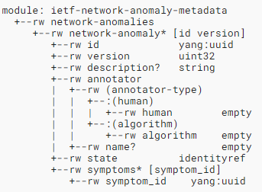
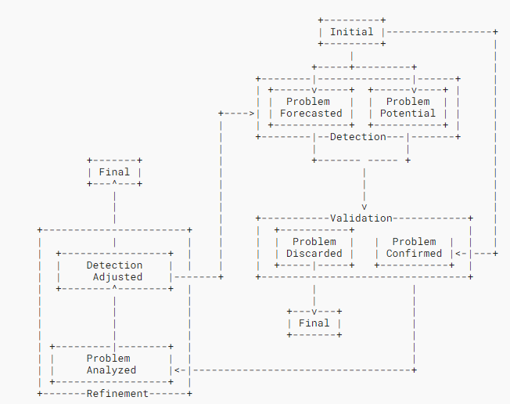
Problem Statement (from Draft)
Adjustments to
detection system
Data Model for data exchange
Detection
Detected Symptoms
State machine of the anomaly label management
Refined Symptoms
Label Store
Labels
Refinement
Validation
Labels
Confirmed Symptoms
The label store supports this exchange and it must expose an API to provide this service.
The data model of the API (for the label exchange) is subject to the following requirements:
It must be semantically consistent from a networking point of view → let’s use the semantic metadata draft
It must be both human and machine readable
It must allow different detection, validation and refinement solutions to interoperate
It must provide support for network experts for validation and adjustment of network anomaly labels
Any additional requirements worth adding to the list?

Slide 4
Experiment Plan
Experiments Goals
Define and validate a suitable data model for label exchange between different actors and detection stages
Validate the data model in a wide set of use case scenarios
Validate the data model with real network data
Demonstrate interaction with different kinds of detection:
Human-based detection, validation and refinement
Machine Learning -based detection
Automated Rule-based detection [Work in Progress]
Work done so far – Antagonist
Implement Anomaly Label persistency and retrieval
Implement Anomaly Label exposure via the API
Integrate with timeseries data
Implement GUI for data exploration and validation
Implement ML-based use case and integration
Implement automatic dashboard generation
Code Repo: https://github.com/vriccobene/antagonist
It includes: instructions for deployment and demo data
It’s a PoC, so any help needed please get in touch
Antagonist Backend
REST API
Antagonist-core
Dashboard Generator
PostgreSQL
Grafana
Time Series DB

Slide 5
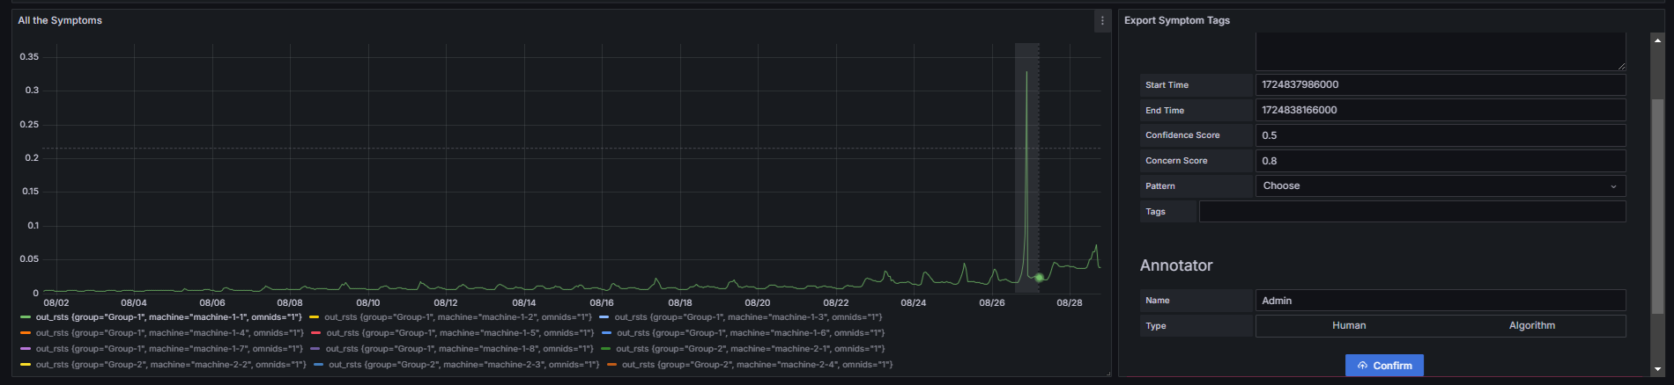
Human-based Detection
Using Antagonist, the user can select a specific metric and tag new symptoms and network anomalies specifying all the information defined in the data model, including the following two items (see draft-netana-nmop-network-anomaly-semantics-02):
Concern Score: how badly the experienced symptom is service impacting
Confidence Score: how sure you are this symptom is impacting or not
can be used to prioritize symptoms
can be used to identify symptoms that require validation
Currently this is done in Grafana, but via the REST API any tool can be integrated

Slide 6
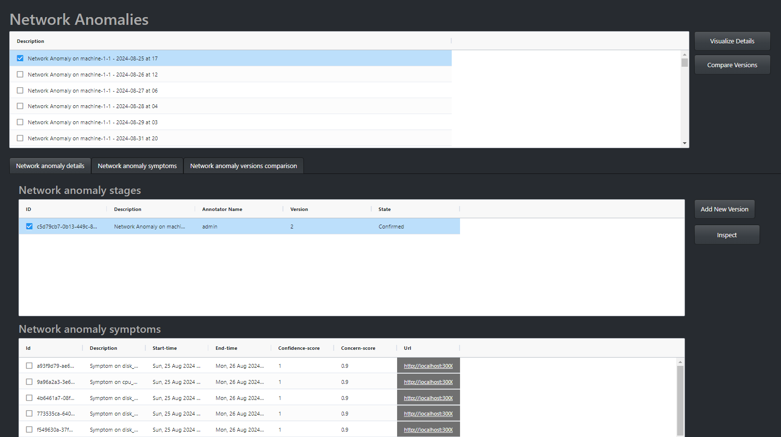
Human-based validation
Review the list of network anomalies
Review the list of stages for a specific network anomaly
Add new stages for the network anomaly
(Add new symptoms and remove existing ones)
Review the list of symptoms
Link to the Dashboard

Slide 7
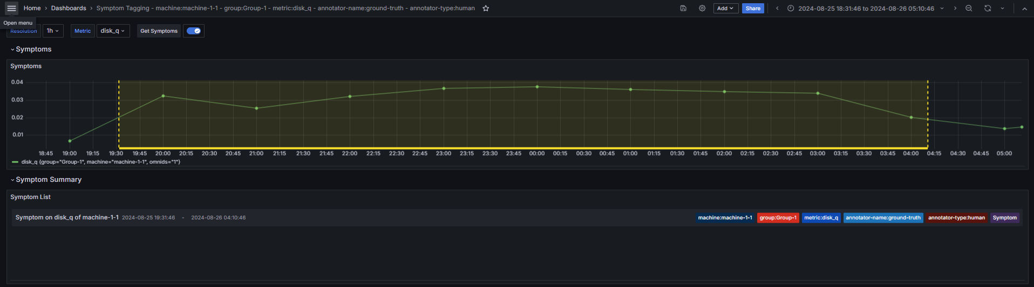
Human-based validation
Symptom Time Series Dashboard
Check the details of the symptom annotation

Slide 8
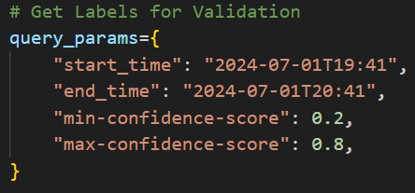
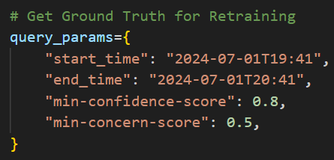
Machine Learning based detection and refinement
A Network Engineer has to validate only those symptoms for which the ML had low confidence (Active Learning)
A Data scientist only wants to use the symptoms for which we have high confidence and high service impact in order to achieve high detection accuracy
5
Re-train ML Model
4
Validation
Time Series DB
ML-based Detector
Antagonist frontend
Grafana Dashboards
Refinement
Store Labels for detected symptoms
1
Retrieve Labels
Validated Labels (Ground Truth)
3
Retrieve
Ground Truth
4
2
REST / Apache Kafka
REST
Antagonist
(Label Store)

Slide 9
Experiment Roadmap
What was achieved so far
Validation of Human label management
Validation of ML-based anomaly detection
Validation of rule-based (WIP – data model validation)
What needs to be finalized
Formalize connection between metrics and symptoms
Improve performance and scalability
Finalize YANG data model validation
Roadmap
Phase 1: Implement very basic PoC for data retrieval, API exposure and GUI (based on Grafana)
Phase 2: Enhance GUI and extend API
Phase 3: Validate the PoC with AIOps related data and a ML-based anomaly detector
Phase 4: Finalize validation of the PoC with SAIN [RFC 9417-9418] (as a rule-based anomaly detector)
Phase 5: Integrate with Swisscom Lab Environment
Phase 6: Finalize YANG data model
Phase 1
Phase 2
Phase 3
Phase 4
Phase 5
Phase 6
Nov 23
Mar 24
Jul 24
Nov 24
Validation of the approach with more operators:
Does the process fit with your processes?
Does the data model support your use cases?
Is this problem something you would like to cooperate?
Time horizon to be defined
Notes:
Use Cases:
Human Labelling of network anomalies,
Rule-based network anomaly detection systems (e.g. SAIN),
Machine Learning -based network anomaly detection systems

