Slide 1
Extensible YANG Model for Network Telemetry Messages draft-ietf-nmop-message-broker-telemetry-message-03
Defines an extensible message schema in YANG to be used at data collection to transform Network Telemetry messages into external systems such as Message Brokers
thomas.graf@swisscom.com ahmed.elhassany@swisscom.com
25. October 2025

Slide 2
Extensible YANG Model for Network Telemetry Messages YANG Schema Trees
module: ietf-telemetry-message
structure message:
+-- network-node-manifest {network-node-manifest}?
| +-- name? string
| +-- vendor? string
| +-- vendor-pen? uint32
| +-- software-version? string
| +-- software-flavor? string
| +-- os-version? string
| +-- os-type? string
+-- telemetry-message-metadata
| +-- node-export-timestamp? yang:date-and-time
| +-- collection-timestamp yang:date-and-time
| +-- notification-event
| | telemetry-notification-event-type
| +-- session-protocol telemetry-session-protocol-type
| +-- export-address inet:host
| +-- export-port? inet:port-number
| +-- collection-address? inet:host
| +-- collection-port? inet:port-number
+-- data-collection-manifest {data-collection-manifest}?
| +-- name? string
| +-- vendor? string
| +-- vendor-pen? uint32
| +-- software-version? string
| +-- software-flavor? string
| +-- os-version? string
| +-- os-type? string
+-- network-operator-metadata
| +-- labels* [name]
| +-- name string
| +-- (value)
| +--:(string-choice)
| | +-- (string-choice)?
| | +--:(string-value)
| | +-- string-value? string
| +--:(anydata-choice)
| +-- (anydata-choice)?
| +--:(anydata-values)
| +-- anydata-values? anydata
+-- payload? anydata
Optional network node and collector data manifest reused from draft-ietf-opsawg-collected-data-manifest.
Telemetry Protocol Metadata.
Optional network operator metadata.
YANG-Push push notification received from the network node.
YANG-Push subscription received from network node.
1
module: ietf-yang-push-telemetry-message
augment-structure /tm:message/tm:telemetry-message-metadata:
+-- yang-push-subscription
+-- id? sn:subscription-id
+-- (filter-spec)?
| +--:(subtree-filter)?
| | +-- subtree-filter? anydata
| +--:(xpath-filter)?
| +-- xpath-filter? yang:xpath1.0
+-- (target)?
| +--:(stream)
| | +-- stream? string
| +--:(datastore)
| +-- datastore? identityref
+-- transport? sn:transport
+-- encoding? sn:encoding
+-- purpose? string
+-- (update-trigger)?
| +--:(periodic)
| | +-- periodic!
| | +-- period? yp:centiseconds
| | +-- anchor-time? yang:date-and-time
| +--:(on-change)
| +-- on-change!
| +-- dampening-period? yp:centiseconds
| +-- sync-on-start? boolean
+-- module* [name]
| +-- name yang:yang-identifier
| +-- revision? rev:revision-date
| +-- version? ysver:version
+-- yang-library-content-id? string
5
2
1
3
4

Slide 3
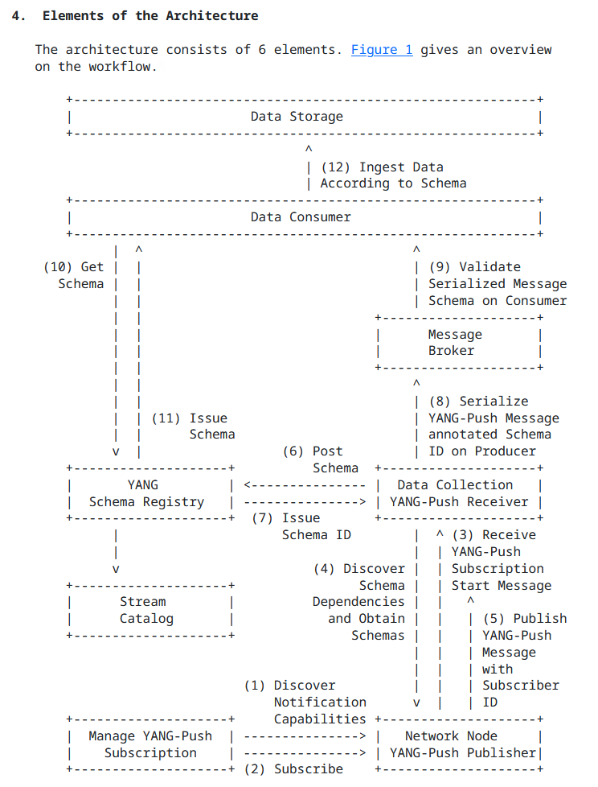
Extensible YANG Model for Network Telemetry Messages Status and Summary from -02
Addressed comments from Reshad (https://mailarchive.ietf.org/arch/msg/nmop/MfIthPyz61aJ9fX5WgJPuJud0us/) and Rob (https://mailarchive.ietf.org/arch/msg/nmop/Yi-WE5SgZ1hIxDfYtlgSQQfbC7U/). Many thanks for the review!
Reflected changes in ietf-yang-push-telemetry-message yang module node name changes from "draft-ietf-netmod-yang-semver" from "revision-label" to" version" and "module-name" to "name" to align with https://datatracker.ietf.org/doc/html/draft-ietf-netmod-rfc8407bis-22#section-4.3.1.
Please note that the described changes also had implications on draft-ietf-netconf-yang-notifications-versioning-09 https://mailarchive.ietf.org/arch/msg/nmop/aefFROi7Pgm3m6xxfovqX_LIQ1c/.

Slide 4
Extensible YANG Model for Network Telemetry Messages Status and Summary from -03
Many thanks to Martin Björklund for the early YANG doctors review. Comments were addressed as bellow. See also https://mailarchive.ietf.org/arch/msg/nmop/cgOnUQDVc_8hb0YOkIMDyBXyCrU/
identity name change from "yp-push" to "yang-push".
Introduced missing leaf "notification-event" referencing "telemetry-notification-event-type" identityref to declare notification type of telemetry message. Wherever real-time transformed from network node or generated or removed out of cache in data collector as state update.
Martin suggested to change "message" container to sx:structure (RFC 8791, data structure) or notification (). Considering that it envelops draft-ietf-netconf-notif-envelope, authors opted for "sx:structure".
We like to hear from the working group wherever the YANG doctors input and authors choice make sense. Other opinions?

Slide 5
Extensible YANG Model for Network Telemetry Messages Next steps at IETF 124 and 125
Next Steps
The document describes in the implementation status section the NetGauze YANG Message Broker Producer implementation which was validated at IETF 123 hackathon.
We validated Pmacct as second YANG Message Broker Producer implementation at IETF 124 hackathon.
See separate presentation for details.
Workflow Engine from Ciena Blue Planet UAA is a YANG Message Broker Consumer implementation which is currently under development and testing.

