Slide 1
An Architecture for YANG-Push to Message Broker Integration draft-ietf-nmop-yang-message-broker-integration-09
Motivation and architecture of a native
YANG-Push notifications and YANG Schema integration
into Message Broker and YANG Schema Registry
thomas.graf@swisscom.com ahmed.elhassany@swisscom.com
25. October 2025

Slide 2
An Architecture for YANG-Push to Message Broker Integration Status and Summary from -08
Adressed comments from Paul Aitken (https://mailarchive.ietf.org/arch/msg/nmop/dc8w2524j2RoV3ZduR7t8T0Rt7o/). Many thanks for the review!
Paul raised a valid point on YANG and Data Mesh industry adoption claims. That external references for this claims would help to undermine that this not just the authors opinion.
We like to hear from the working group wherever references to the following documents would help or other if you have other proposals.
Towards Avoiding the Data Mess: Industry Insights from Data Mesh Implementations: https://arxiv.org/html/2302.01713v4
Toward Building a Semantic Network Inventory for Model-Driven Telemetry: https://arxiv.org/html/2402.06511v1

Slide 3
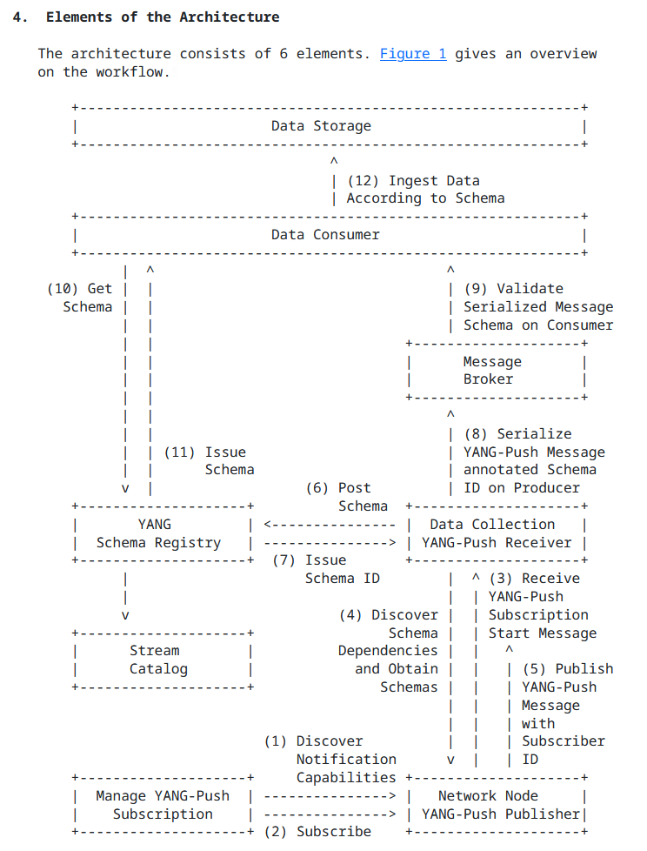
An Architecture for YANG-Push to Message Broker Integration Status, Summary and Next Steps from -09
Section 4.5, "Stream Catalog" was added. The term "Stream Catalog" was previously already defined. That semantics are exported to "Stream Catalog" and that end users interact with the "Streaming Catalog" is now clearly defined in the document. All other functional aspects of a "Stream Catalog" is out of document scope.
Nacho mentioned in during IETF 123 that "Data Catalog" would be a better term than "Stream Catalog". The authors believe that "Stream Catalog" is a more commonly used term in context of Message Brokers. What is the working groups opinion?
Changed from "sysName" to "hostname" to adapt to changes in draft-ietf-netconf-notif-envelope.
Changed message broker examples from RabbitMQ to Apache Pulsar since Apache Pulsar also supports draft-netana-nmop-yang-message-broker-message-key aspects.
Next Steps
The authors believe that the document is stable and ready for working group last call.

