Slide 1
Extensible YANG Model for YANG-Push Notifications I-D: draft-netana-netconf-notif-envelope-02
I-D: draft-ietf-netconf-notif-envelope-00/01
A. Huang Feng, INSA-Lyon
P. Francois, INSA-Lyon
T. Graf, Swisscom
B. Claise, Huawei
March 18th 2025

Slide 2
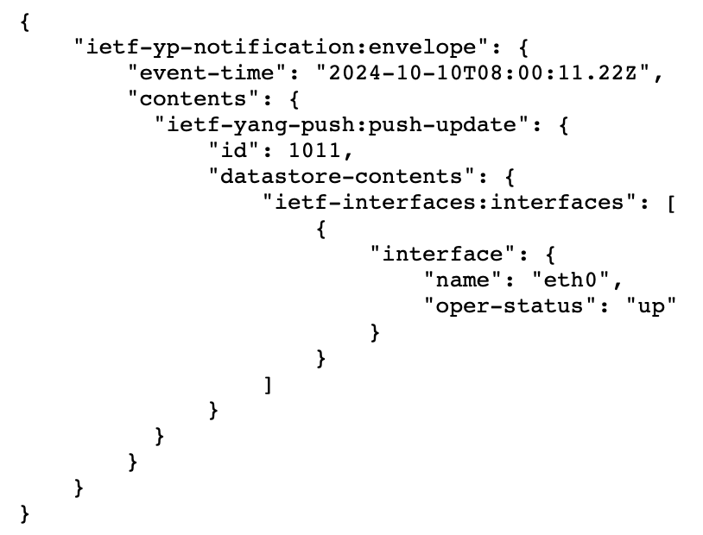
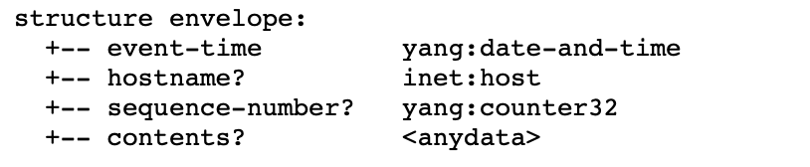


Extensible YANG model for YANG-Push Notifications Proposal of this I-D
Structure defined as a notification containing
event-time
metadata(s)
notification-contents
JSON example without metadata
Configured Subscriptions
Dynamic Subscriptions
enable-notif-envelope=True
enable-notif-envelope=True
Notification-envelope
Collector
Notification-envelope

Slide 3
Extensible YANG model for YANG-Push Notifications Proposal of this I-D
YANG Notification structure for YANG-Push Notifications [RFC 8639/8641]
(1) Option to “opt-in” to this notification envelope
(2) Able to discover the capability of this new header through “ietf-notification-capabilities”
(3) Extensible header defined in YANG 1.1
(4) Definition of each encoding (XML, JSON, CBOR)
(5) Defines the first base extensions (I-D.tgraf-netconf-notif-sequencing; I-D.tgraf-netconf-yang-push-observation-time)

Slide 4
Extensible YANG model for YANG-Push Notifications Status
draft-netana-netconf-notif-envelope-02 discussed in the NMOP/NETCONF joint interim (Feb 10th) (https://meetecho-player.ietf.org/playout/?session=IETF-NETCONF-20250210-1500)
Thanks to all the participants joining the discussions!
Conclusions from the interim
Need to simplify the solution (Don’t add new RPCs!)
Confirmed interest of having Observation-timestamp as an extension (I-D.tgraf-netconf-yang-push-observation-time)
WG Adoption Call ends on March 7th (successfully adopted)

Slide 5
Extensible YANG model for YANG-Push Notifications Changes since -00
(1) Envelope is enabled and disabled globally
(2) Added Observation Timestamp extension [draft-tgraf-netconf-yang-push-observation-time]
(3) Other minor changes

Slide 6
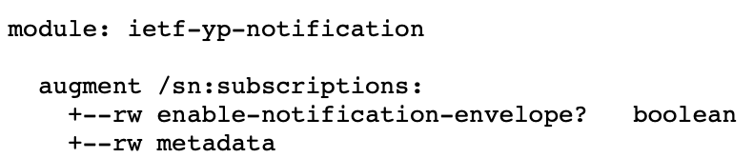
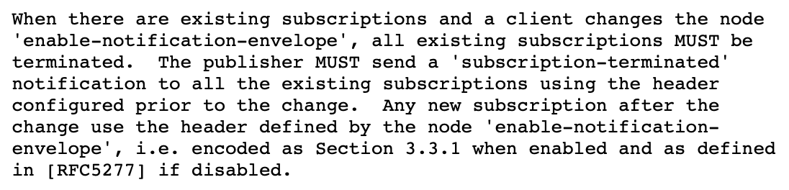
Extensible YANG model for YANG-Push Notifications Discussion on change (1) Enabling the envelope globally
Initial proposal was centralizing requests via an RPC call
Feedback: complex to manage
Current proposal:
Switch headers using “/sn:subscriptions/inotenv:enable-notification-envelope”
When switching this node, existing Subscriptions are tore down:

Slide 7
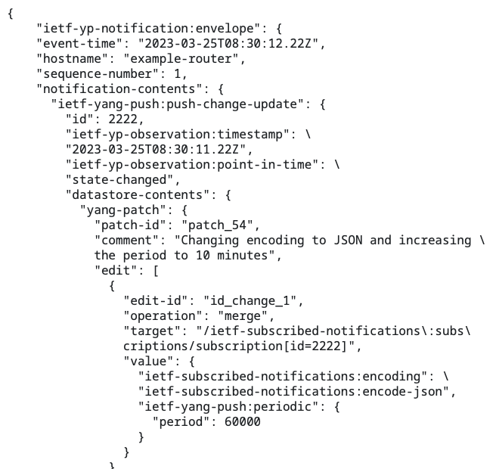
Extensible YANG model for YANG-Push Notifications (2) Added Observation Timestamp extension
Timestamp representing
The time the metrics were polled
The time the exported event occurred
Extensions to YANG-Push
Impact the following YANG-Push Notification only:
push-update
push-change-update
Use same mechanism to get the support of this extension via “/sysc:system-capabilities/notc:subscription-capabilities”
Based on: draft-tgraf-netconf-yang-push-observation-time

Slide 8
Extensible YANG model for YANG-Push Notifications (3) Other minor changes
The XML namespace has been changed to “urn:ietf:params:xml:ns:yang:ietf-yp-notification”
“notification-contents” node shorten to “contents”
“The 'contents' element SHOULD be located at the end of the notification envelope structure.”
Idea: have the header located at the beginning of the message
Updated Security Considerations
Removed “Updates: RFC7950 RFC7951 RFC9254 (if approved)”
Align examples using “ietf-interfaces” as Xpath
Editorial explaining the examples

Slide 9
Extensible YANG model for YANG-Push Notifications What’s next?
All issues/requests have been addressed
Starting to get ready for WG Last Call

Slide 10
BACKUP

Slide 11
YANG model for NETCONF Event Notifications Interim 2024-09-19 – draft-ahuang-netconf-notif-yang
https://datatracker.ietf.org/doc/minutes-interim-2024-netconf-02-202409191300/
Thorough review of draft-ahuang-netconf-notif-yang/YANG-Push/NETCONF Event Notifications
Conclusion
draft-ahuang-netconf-notif-yang fixes a gap for YANG-Push but might be worth putting the effort on a brand new header
We need:
Bypass RFC5277, thus use YANG-Push only
Extensible header
be able to add new metadata (sequencing, versioning, others…)
A client should be able to “opt-in”
Clients that don’t support this new header should continue working seamlessly
The notification should be a YANG-based solution
Fix JSON and CBOR underspecification
including CBOR-SID allocation

Slide 12
YANG model for NETCONF Event Notifications Problem statement - (draft-ahuang-netconf-notif-yang)
<notification xmlns="urn:ietf:params:xml:ns:netconf:notification:1.0">
<eventTime>2022-09-02T10:59:55.32Z</eventTime>
<push-update xmlns="urn:ietf:params:xml:ns:yang:ietf-yang-push">
<id>101</id>
<datastore-contents>
<interfaces xmlns="urn:ietf:params:xml:ns:yang:ietf-interfaces">
<interface>
<name>eth0</name>
<oper-status>up</oper-status>
</interface>
</interfaces>
</datastore-contents>
</push-update>
</notification>
{
"ietf-notification:notification": {
"eventTime": "2017-10-25T08:00:11.22Z",
"ietf-yang-push:push-update": {
"id": 1011,
"datastore-contents": {
"ietf-interfaces:interfaces": [
"interface": {
"name": "eth0",
"oper-status": "up"
}
]
}
}
}
}
Implementation Issues:
(1) YANG module not defined
(2) Non-existing Normative text defining this header
RFC 5277 - Netconf Event Notifications
RFC 8641 - YANG Push
YANG encodings:
RFC 7950 - YANG XML
RFC 7951 - YANG JSON
RFC 9254 - YANG CBOR
Thanks Andy for confirming the approach was not correct.

Slide 13
Extensible YANG model for YANG-Push Notifications Proposal (comments)
As requested
Scoped to YANG-Push (both dynamic and configured subscriptions)
Can be implemented with NETCONF and RESTCONF
Use a “notification” statement rather than a “sx:structure”
Given that it’s intended for YANG-Push, the following notifications are impacted:
push-update; push-change-update
subscription-started; subscription-modified; subscription-terminated
subscription-suspended; subscription-resumed; subscription-completed
replay-completed

Slide 14
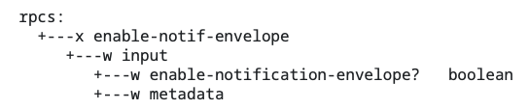
Extensible YANG model for YANG-Push Notifications (1) Option to “opt-in” through a YANG-Push Subscription
Configuration on Globally on the server via the RPC “enable-notif-envelope”
Currently
Default=False
enable-notification-envelope=false
Old Header as RFC5277
Collector
enable-notification-envelope=true
New envelope Header
Collector

Slide 15
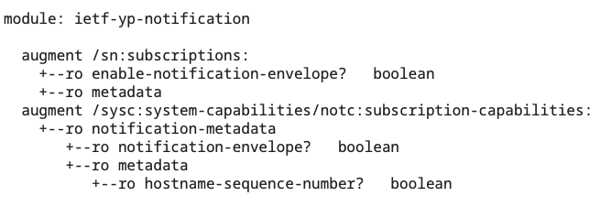
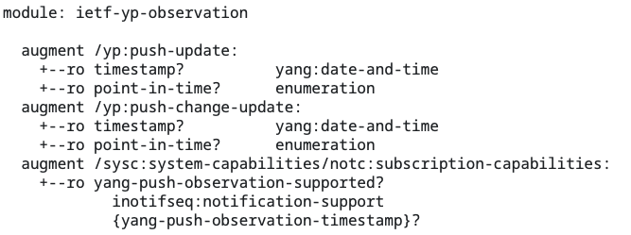
Extensible YANG model for YANG-Push Notifications (2) Able to discover the capability of this new header
Augmentation on notification capabilities (RFC9196)
Get Capabilities
notification-envelope=True

Slide 16
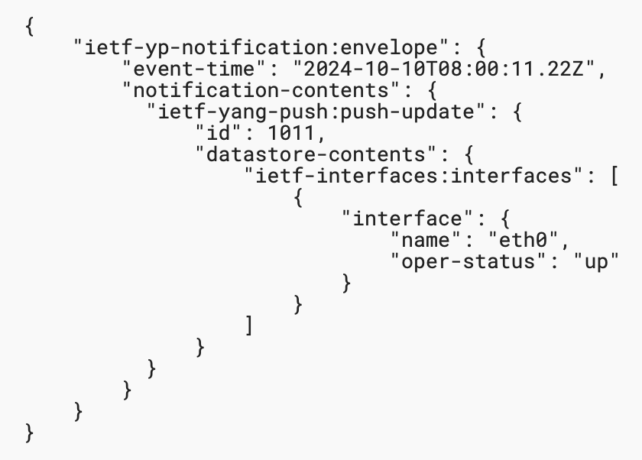
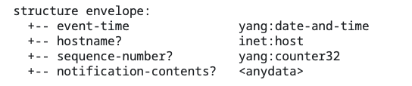
Extensible YANG model for YANG-Push Notifications (3) Extensible header defined in YANG
Structure defined as a notification containing
event-time
metadata(s)
notification-contents
JSON example without metadata
Configured Subscriptions
Dynamic Subscriptions
enable-notif-envelope=True
enable-notif-envelope=True
Notification-envelope
Collector
Notification-envelope

Slide 17
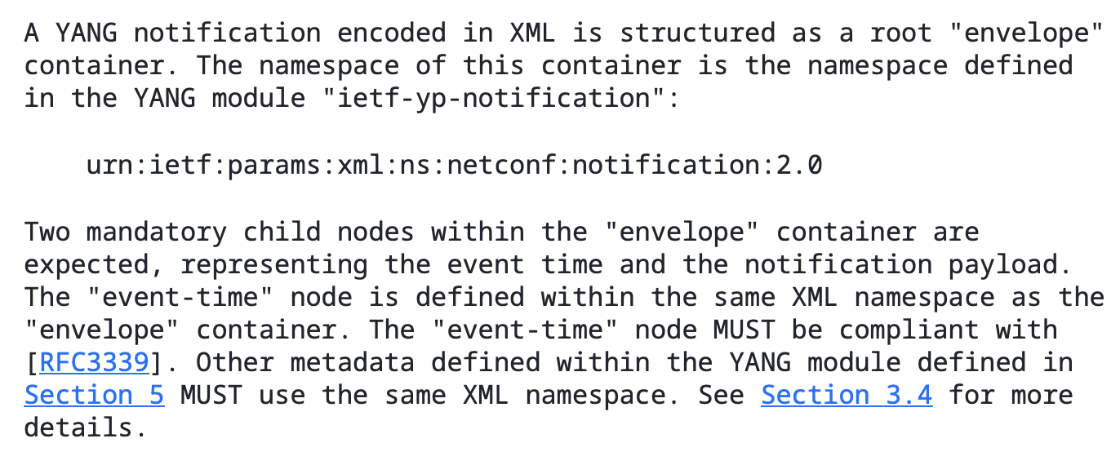
Extensible YANG model for YANG-Push Notifications (4) Definition of each encoding (XML, JSON, CBOR)
Explicit definition of the content of the “envelope” (solving gap for JSON and CBOR)
Definition of the namespace (urn:ietf:params:xml:ns:netconf:notification:2.0)
Mandatory event-time node
Mandatory notification-contents node
Metadata present when configured

Slide 18
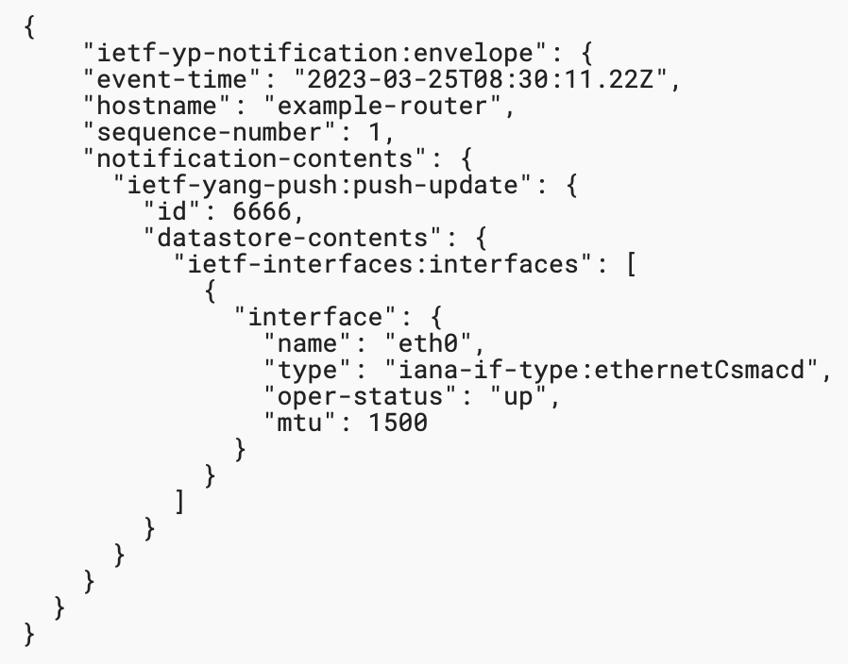
Extensible YANG model for YANG-Push Notifications (5) Extensions for hostname and sequence-number
Definition of hostname and sequence-number extensions (draft-tgraf-netconf-notif-sequencing)
Present by default when the envelope is enabled
Discovery of support of this header through RFC9196

