Slide 1
Swisscom: Network Incident Network Analytics Postmortem
Describes an incident in terms of what happened, which operational metrics where available, which analytical metrics described the symptoms and what improvements in the network anomaly detection system and network telemetry protocols are proposed.
thomas.graf@swisscom.com
06. September 2024

Slide 2






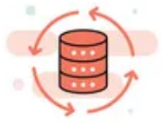

Data Mesh organizes Data in Organizations Enables Network Analytics use cases
Alert
Postmortem
RFC 8632
draft-netana-nmop-network-anomaly-semantics draft-netana-nmop-network-anomaly-lifecycle
Analytical Data draft-netana-nmop-yang-message-broker-integration
Network Device Trend Detection
Verify, Troubleshoot and Notify
Network Anomaly Detection
Network Visualization
Network SLI and SLO
Closed Loop Operation
draft-netana-nmop-network-anomaly-architecture
Operational Data draft-netana-nmop-yang-message-broker-integration
Network Data Collection
Network Telemetry (RFC 9232) IPFIX (RFC 7011, RFC 9487, RFC 9160, draft-ietf-opsawg-ipfix-on-path-telemetry)
BMP (RFC 7854, RFC 8671, RFC 9069, draft-ietf-grow-bmp-tlv, draft-ietf-grow-bmp-path-marking-tlv, draft-lucente-grow-bmp-rel)
YANG-Push (RFC 8639, RFC 8641, draft-ietf-netconf-udp-notif, draft-ietf-netconf-distributed-notif, draft-ahuang-netconf-notif-yang, draft-ietf-netconf-yang-notifications-versioning, draft-tgraf-netconf-notif-sequencing, draft-tgraf-netconf-yang-push-observation-time)

Slide 3
Monitoring L3 VPN's with IPFIX, BMP and YANG Push From Connectivity Service to Realtime Network Analytics
Connectivity Service perspective, Connection Points are connected through Logical Connections.
From a BGP control-plane perspective, IPv4/6 unicast prefixes in VRF's are tagged with BGP standard communities.
One BGP standard community to identify the Logical Connection. One BGP standard community to identify each Connection Point.
When IPv4/6 prefixes are exported from VRF's, a BGP route-distinguisher, BGP extended community route-targets and a SRv6 VPN SID for the IPv6 next-hop are allocated.
From a forwarding plane perspective, when IPv4/6 unicast traffic is received from the edge at the SRv6 PE, a lookup is performed, the SRv6 VPN SID is obtained and IPv6 next-hop is added when forwarded to the core.
Swisscom collects MPLS and SRv6 provider data plane, IPv4/6 unicast customer data-plane in IPFIX and at provider edge BGP VPNv4/6 unicast in production to perform real-time data correlation.

Slide 4


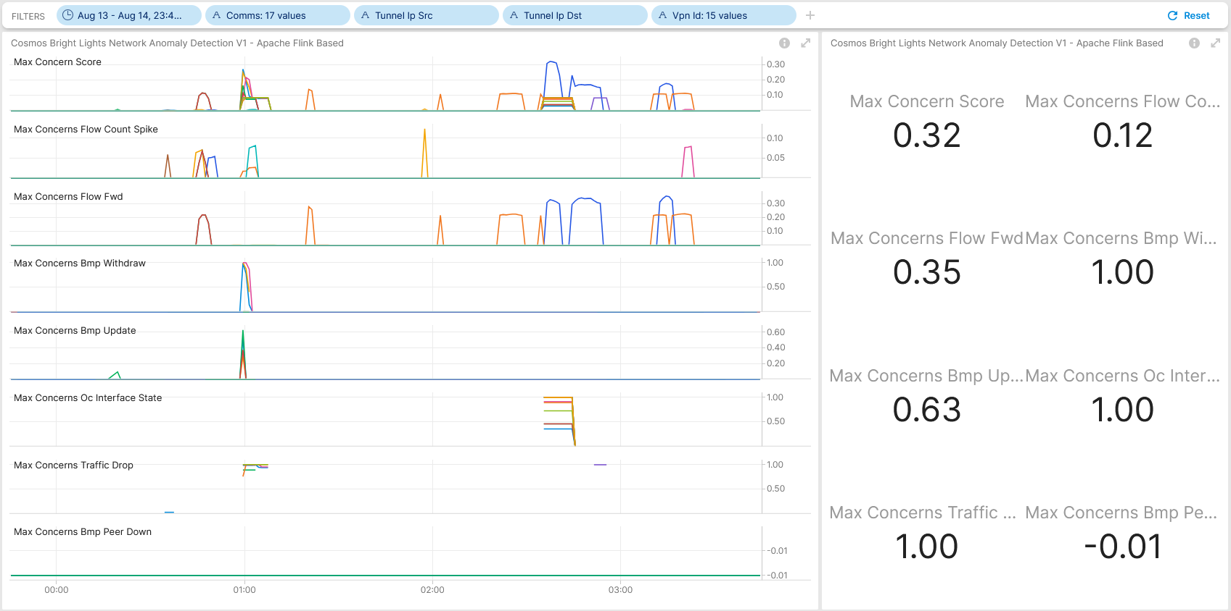

August 14th, SRv6 IS-IS ABR Route Aggregation Post Maintenance Window Analysis
Maintenance Window with 15 configuration steps started on August 14th 00:04 and ended at 01:12. These configuration steps involved: IS-IS overload-bit on ABR, ABR IS-IS L1/2 to L2/L2 and PE L1 to L2 migration, IS-IS locator summarization.
Throughout the maintenance window, in overlay topology changes, traffic volume and flow count changes, forwarding plane drops and customer data plane TCP congestion were measured and observed but nor alerted. In SRv6 underlay, forwarding plane drops were measured and observed but not alerted.
Network operation center was alerted. 10 VOIP service calls were dropped, and mobile subscriber control plane was interrupted. Both platform teams were notified but did not find causality.
At 01:51, the maintenance window implementers informed network operation center that all configuration changes were performed, and no connectivity service impact was observed.
At 10:22, network operation center was being asked wherever connectivity service impact was visible and reasoning behind.
At 11:12, network operation center confirmed that connectivity service impact is visible and most likely being related with performed maintenance window.
During Post Maintenance Window Analysis, connectivity service impact on 3 previous maintenance windows, August 6th, August 7th and August 13th were discovered.
Cosmos Bright Lights Anomaly Detection Results for 15 L3 VPN's Traversing SRv6 Core

Slide 5


August 14th, SRv6 IS-IS ABR Route Aggregation Network Telemetry Coverage
IPFIX configured on P and PE SRv6 nodes on SRv6 and IPv4/6 VRF unicast enabled interfaces. Capturing L3 IPv4/6 and L2 Ethernet overlay customer data plane and underlay SRv6 provider data plane metrics on SRv6 enabled interfaces, and IPv4/6 and L2 Ethernet overlay customer data plane metrics on IPv4/6 VRF unicast enabled interfaces.
-> Shape, means that we are engaged in IETF standardization, vendor implementations and running code. IPv4/6 unicast customer data plane visibility is in vital, SRv6 data plane visibility is in applied, On-Path delay is in operational stage.
BMP Adj-RIB In post-policy on BGP VPNv4 /6 and IPv4/6 VRF unicast peers and Local-RIB on all RIB's configured on SRv6 PE's. BMP Adj-RIB In post-policy on BGP VPNv4 /6 peers on Route Reflectors configured.
-> Shape, means that we are engaged in IETF standardization, vendor implementations and running code. BMP Local RIB data plane visibility is in applied, BMP Path Marking is in operational stage.
YANG Push Legacy on most nodes enabled but not relevant for this use case.
-> Take, means that current YANG-Push legacy implementation is used without any vendor code change and is in accepted stage. However, IETF YANG-Push is shape and is in operational state.

Slide 6
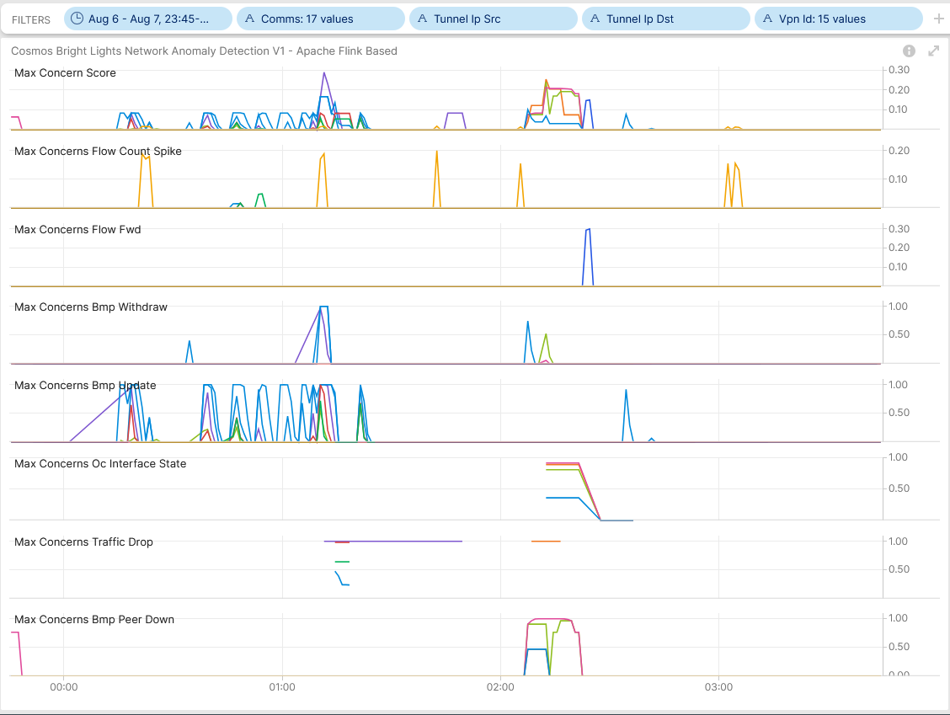
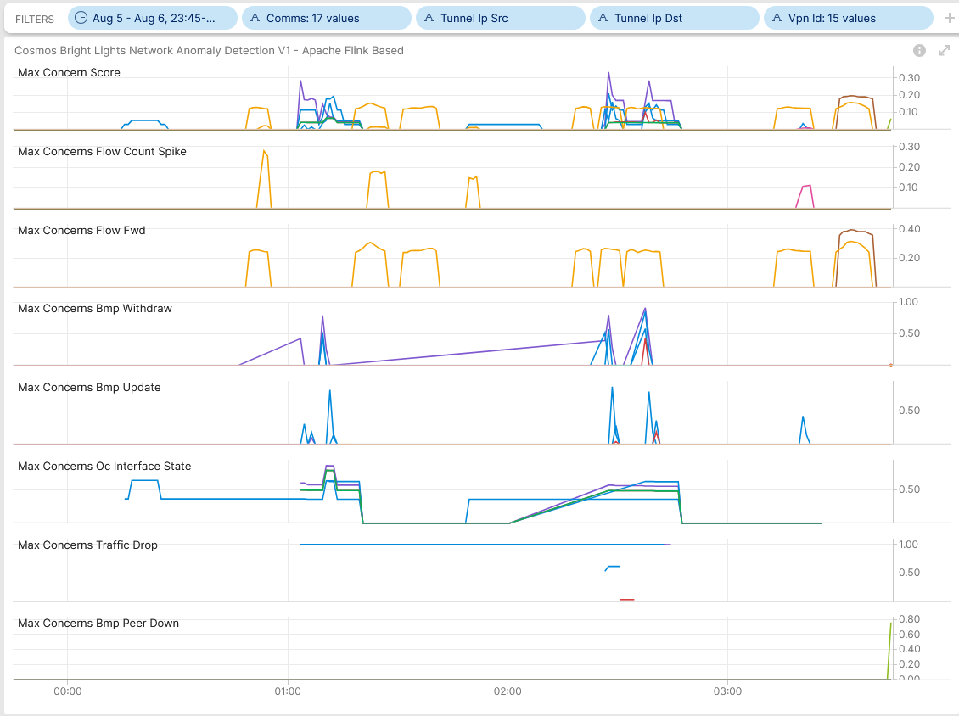
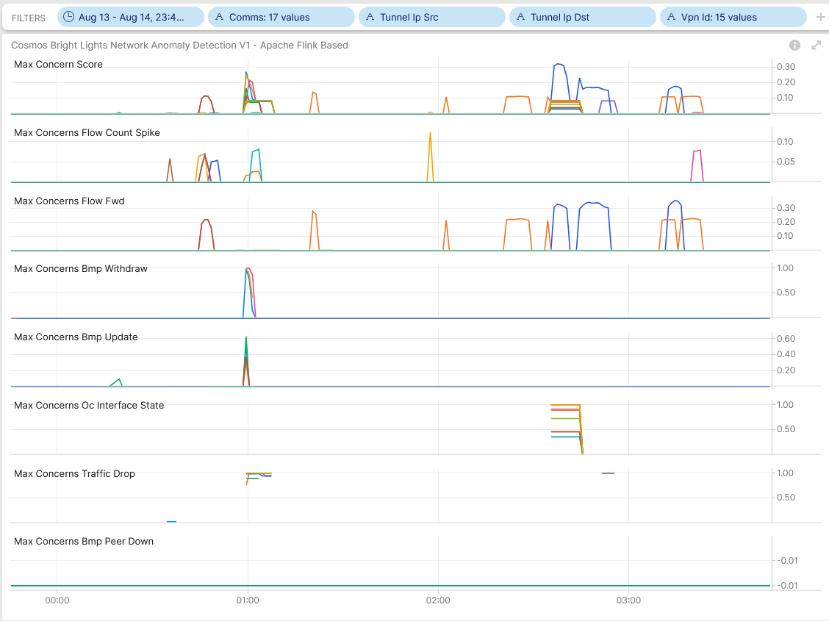
August 6/7th, SRv6 IS-IS ABR Route Aggregation Post Maintenance Window Analysis
Cosmos Bright Lights Anomaly Detection Results for 15 L3 VPN's Traversing SRv6 Core at Location AAR
Cosmos Bright Lights Anomaly Detection Results for 15 L3 VPN's Traversing SRv6 Core at Location OLT

Slide 7
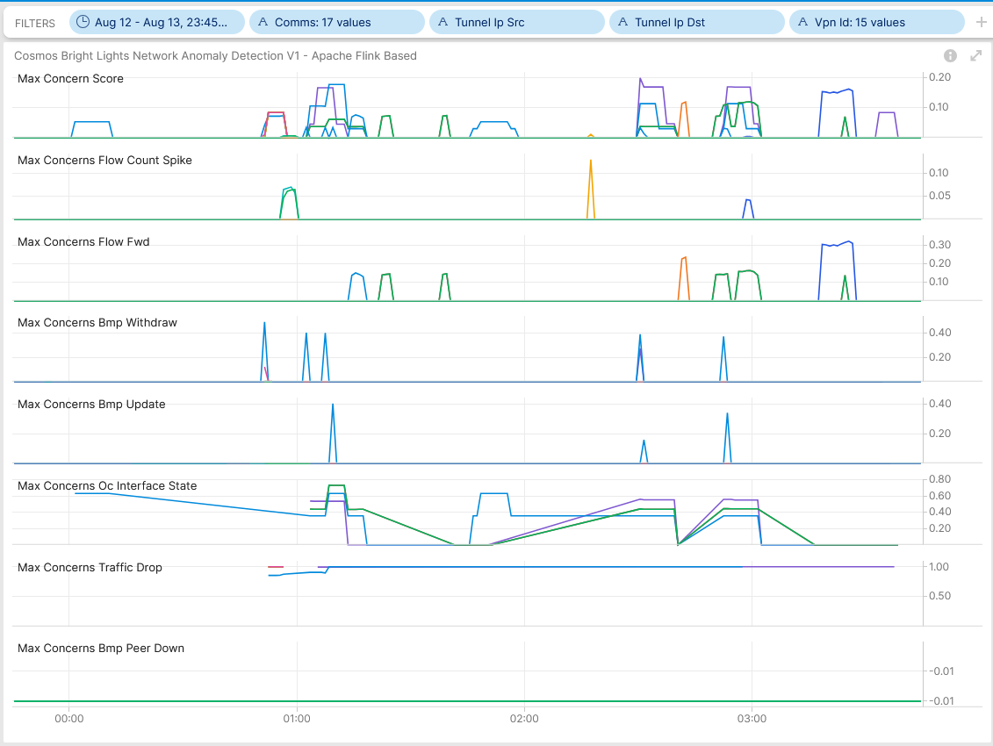

August 13/14th, SRv6 IS-IS ABR Route Aggregation Post Maintenance Window Analysis
Cosmos Bright Lights Anomaly Detection Results for 15 L3 VPN's Traversing SRv6 Core at Location ZHB
Cosmos Bright Lights Anomaly Detection Results for 15 L3 VPN's Traversing SRv6 Core at Location ZHH

Slide 8
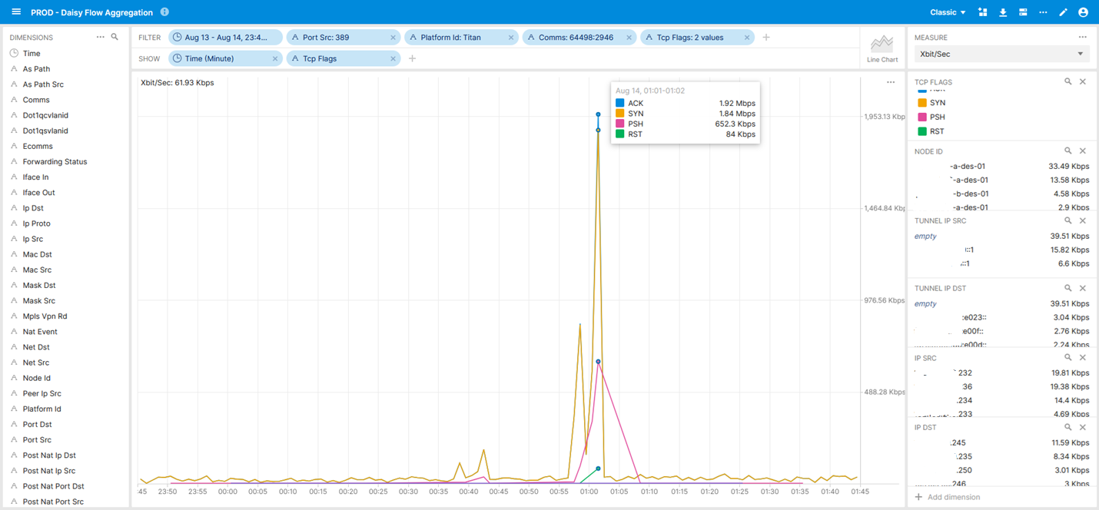
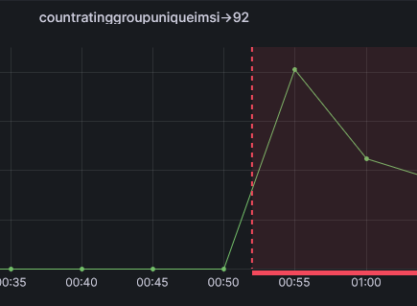
August 14th, SRv6 IS-IS ABR Route Aggregation Mobile Subscriber Management Control Plane
SRv6 forwarding plane and customer data plane. Shows on a particular L3 VPN the amount of TCP SYN and RST from L4 port 389 were originated and through which PE nodes and with which SRv6 SID's the traffic was forwarded with. Remark: IE6 tcpControlBits is a none key field.
Resulted in Mobile Fallback Subscriber Session Count
Mobile Subscriber Management Control Plane Overlay Congestion

Slide 9
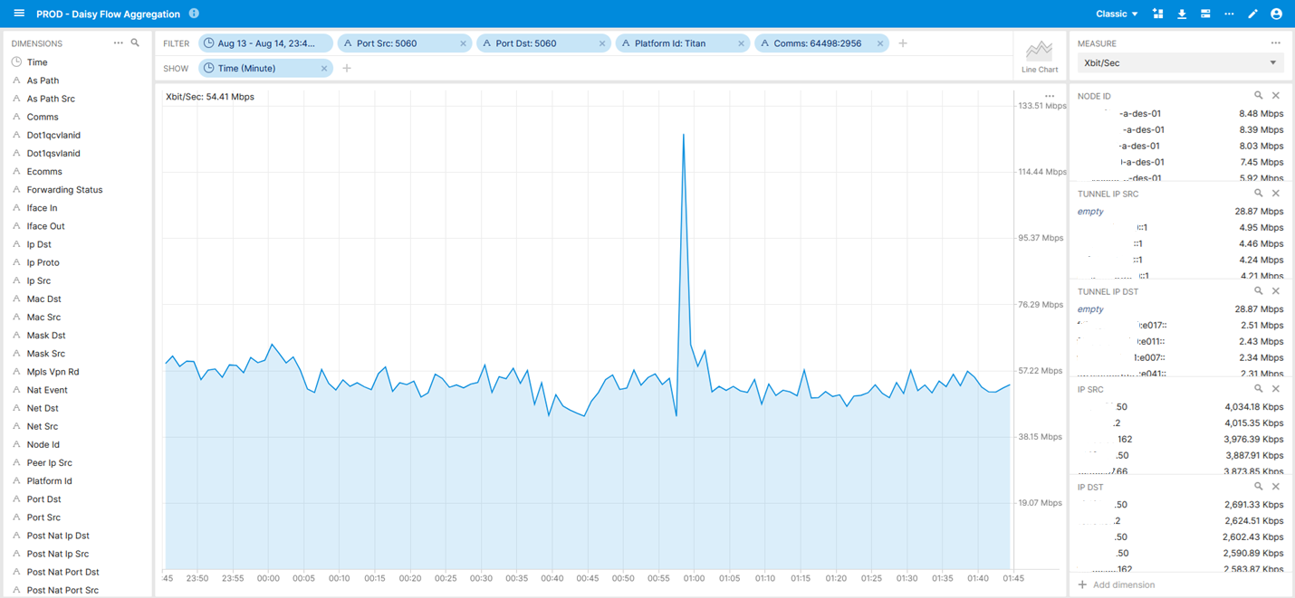
August 14th, SRv6 IS-IS ABR Route Aggregation Mobile Subscriber Management Control Plane
SRv6 forwarding plane and customer data plane. Shows on a particular L3 VPN the amount of traffic between L4 port 5060 and through which PE nodes and with which SRv6 SID's the traffic was forwarded with.
VOIP SIP Signaling Overlay Congestion

Slide 10
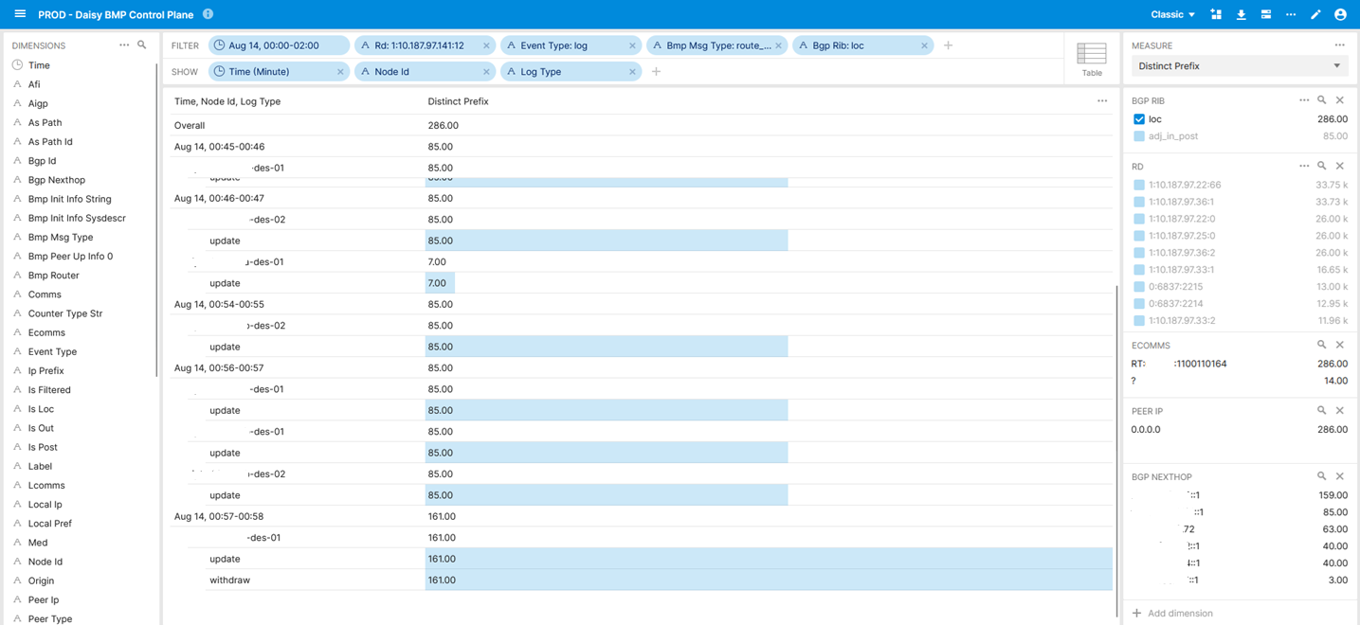
August 14th, SRv6 IS-IS ABR Route Aggregation L3 VPN Overlay Topology Change
BMP BGP Local-RIB L3 VPN topology change for a particular BGP route-distinguisher. Only best path is exported due to implementation limitation. Shows in time frame 00:57-58 that prefixes were removed from the VRF routing table on a particular PE node. Leading to potential blackholing.
BGP Overlay VRF Endpoint Topology Change

Slide 11
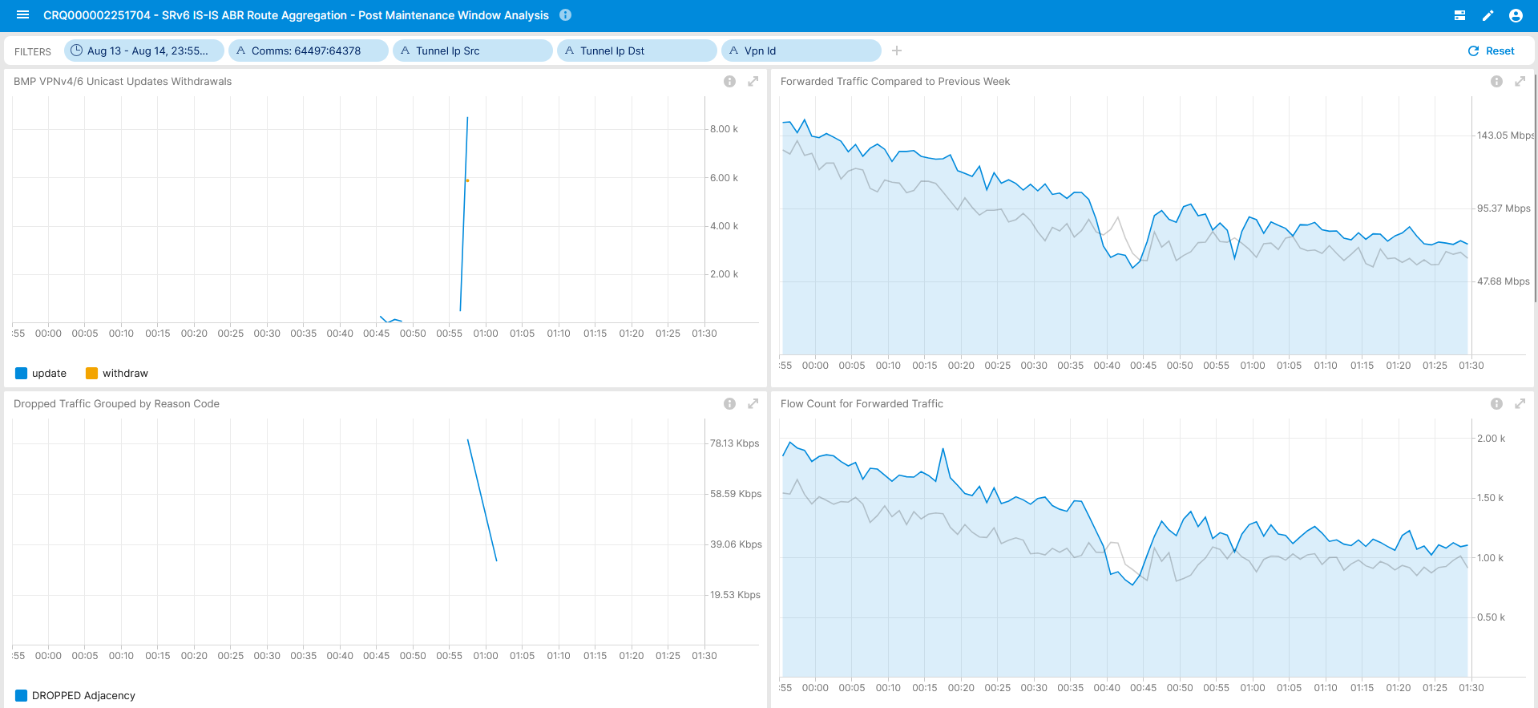
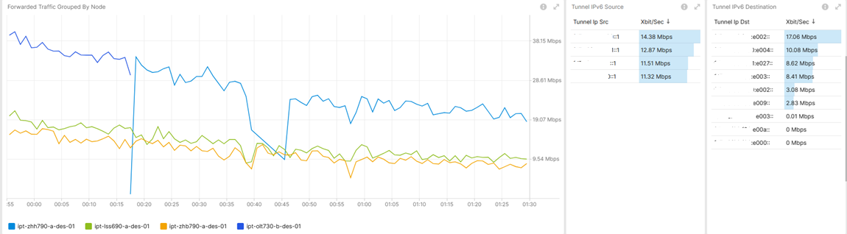
August 14th, SRv6 IS-IS ABR Route Aggregation 64497:64378 SRv6 L3 VPN – Operational Network Telemetry Metrics
Logical Connection 64497:64378 SRv6 L3 VPN Overlay Operational Metrics
Logical Connection 64497:64378 SRv6 L3 VPN Overlay and Underlay Operational Metrics

Slide 12
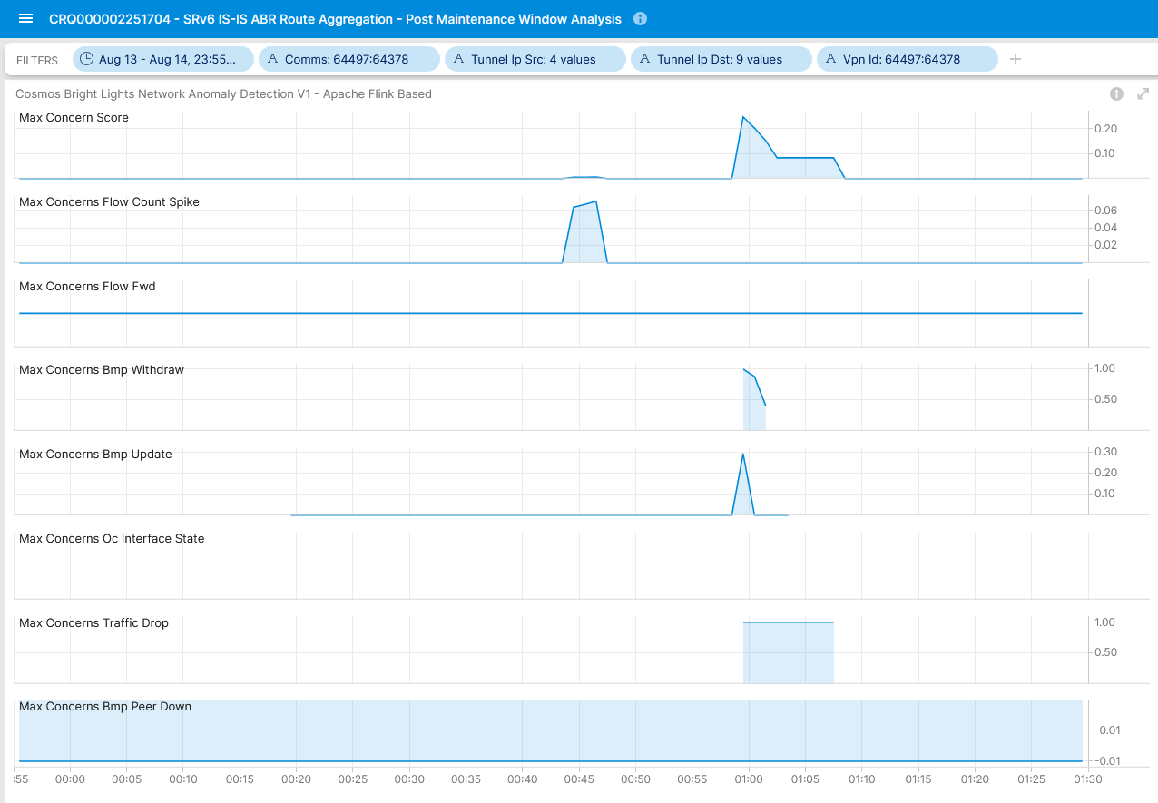

Concern Score: 0.25
Flow Count Spike: 0.07
Missing Traffic: 0.22
Traffic Drop: 1.00
BMP Update/Withdrawal: 0.29/ 1.00
Real-Time Streaming under Development
August 14th, SRv6 IS-IS ABR Route Aggregation 64497:64378 SRv6 L3 VPN – Anomaly Detection - Live
BMP route-monitoring Update/Withdraw check recognized topology change.
BMP peer Down/Up check did not apply.
Interface Down/Up check did not apply.
Traffic Drop spike check recognized traffic drop due to topology change.
Missing Traffic check recognized traffic loss.
Increased or decreased Flow Count check recognized congestion.
Overall: 4 out of 6 checks have detected the BGP topology change. Real-time streaming implementation exceeds expectations.

Slide 13
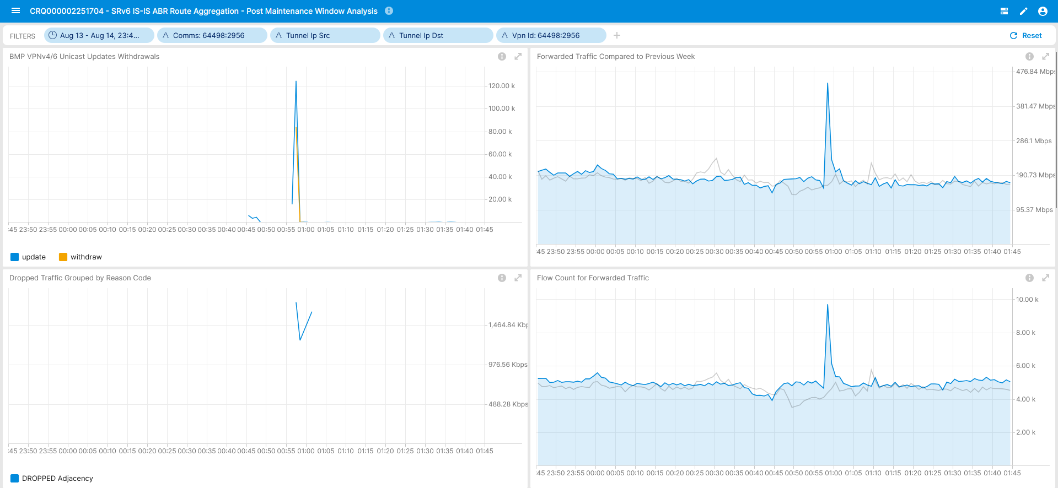
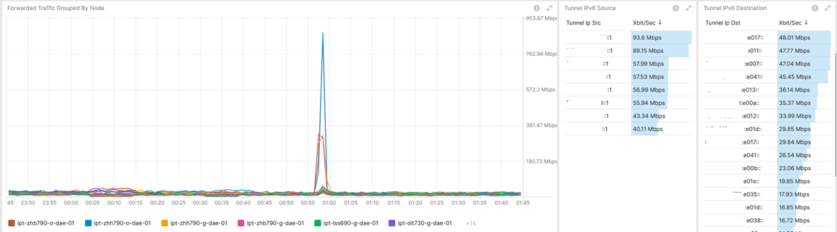
August 14th, SRv6 IS-IS ABR Route Aggregation 64497:2956 SRv6 L3 VPN – Operational Network Telemetry Metrics
Logical Connection 64498:2956 SRv6 L3 VPN Overlay Operational Metrics
Logical Connection 64498:2956 SRv6 L3 VPN Overlay and Underlay Operational Metrics

Slide 14
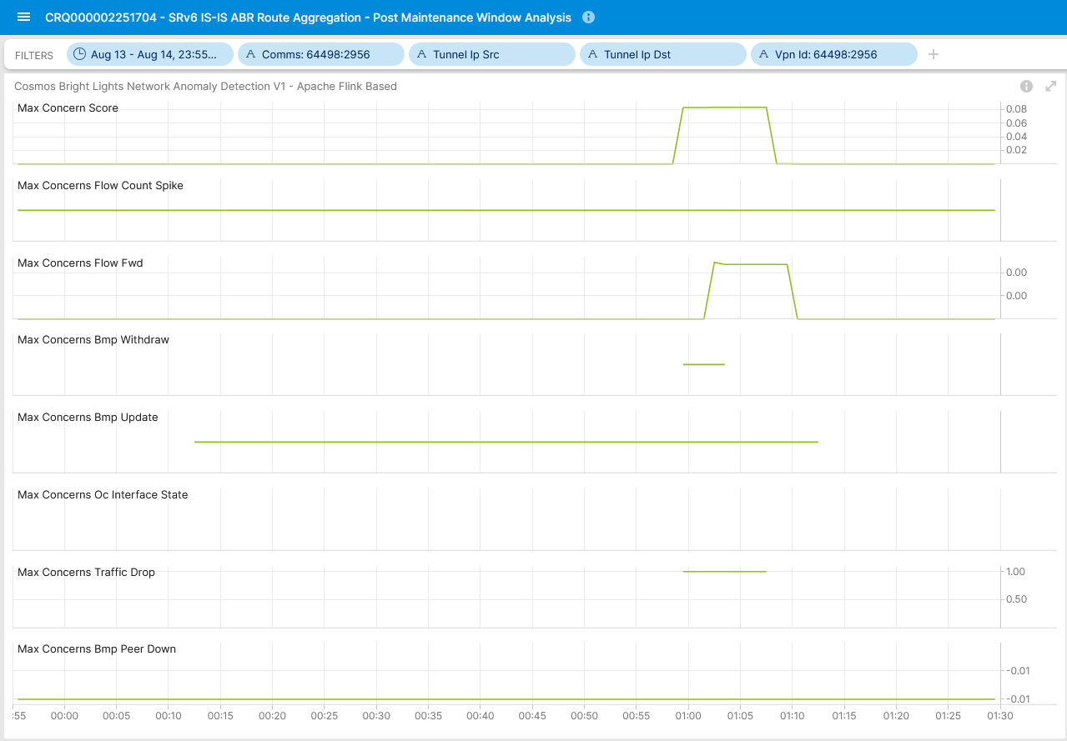
Concern Score: 0.08
Flow Count Spike: 0.00
Missing Traffic: 0.00 Traffic Drop: 1.00
BMP Update/Withdrawal: 0.00/ 0.00
Real-Time Streaming under Development
August 14th, SRv6 IS-IS ABR Route Aggregation 64497:2956 SRv6 L3 VPN – Anomaly Detection - Live
BMP route-monitoring Update/Withdraw check did not recognize topology change.
BMP peer Down/Up check did not apply.
Interface Down/Up check did not apply.
Traffic Drop spike check recognized traffic drop due to topology change.
Missing Traffic check did not apply.
Increased or decreased Flow Count check did not recognized congestion.
Overall: 1 out of 6 checks have detected the BGP topology change. Real-time streaming implementation. Auto profiling under implementation.

Slide 15
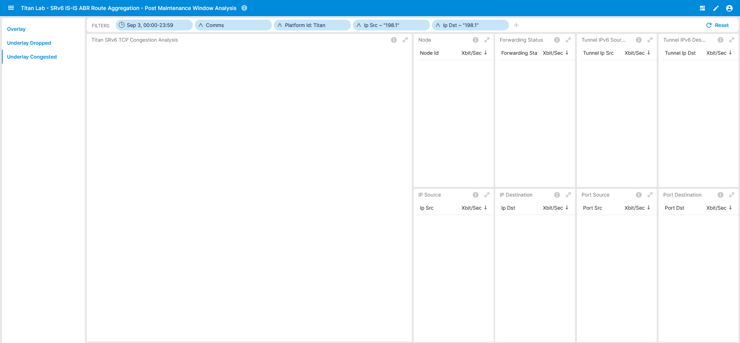
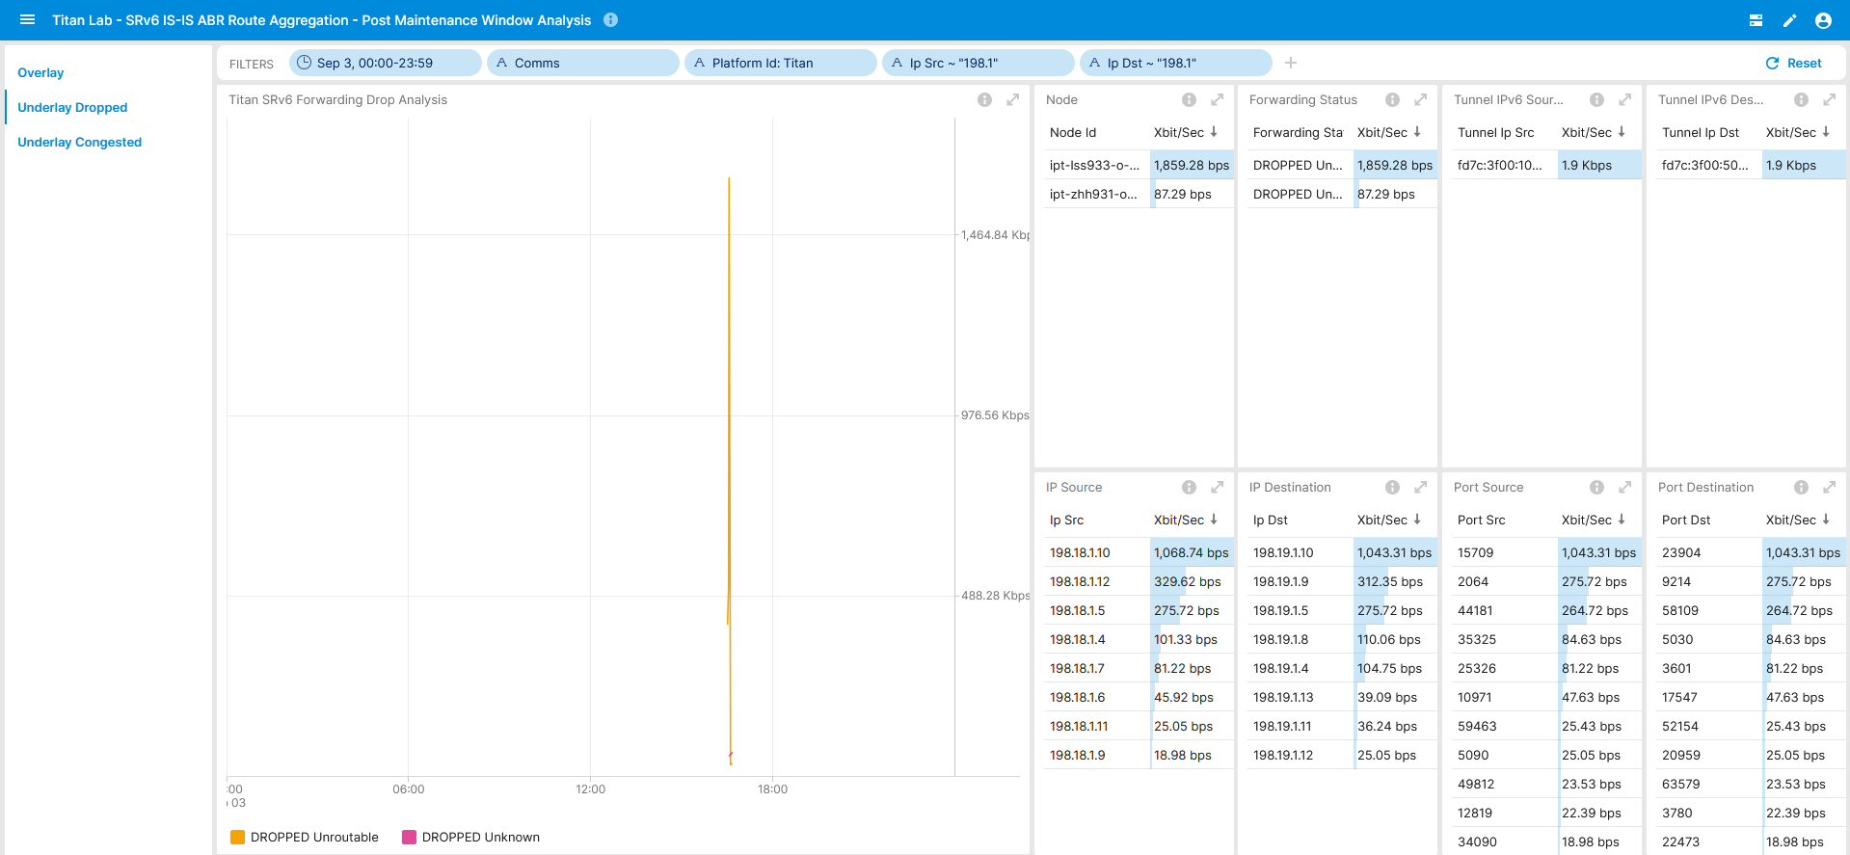
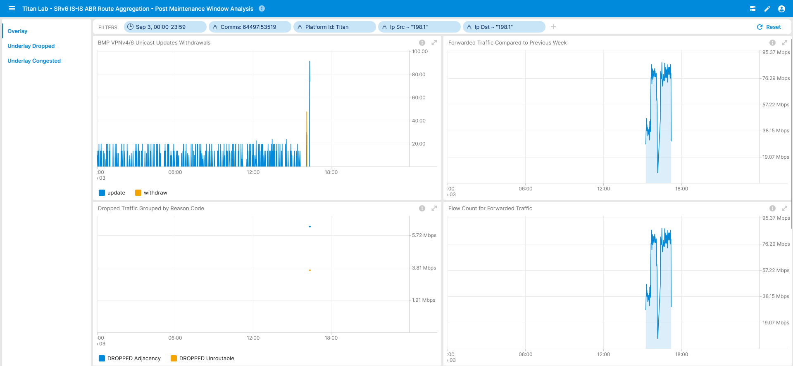
August 14th, SRv6 IS-IS ABR Route Aggregation Lab Repro In Progress
Reproduction Partial Successful
Identified Root Cause and Configuration Item
Pre Defined Dasboard for Lab Reproduction

Slide 16
What went well?
Work in progress Cosmos Bright Lights real-time streaming Anomaly Detection exceeded in 2 out of 6 cases expectations, matching 100% our intend. Alert notifications were sent 120-180 seconds after operational metrics in the network were observed. 60 seconds variable delay is due to 2 step flow aggregation process. The other 4 cases would have also worked as intended if auto profiling feature would have been implemented already.
Based on experience in Seamless MPLS-SR migration, indirect visibility on provider edge is not sufficient to monitor core. We derived the necessity to monitor underlay, however had to compromise in SRv6 limiting to forwarding plane only, which works exceptionally well, and unfortunately not monitoring IS-IS control plane on day 1 since innovation curve was too high to ensure network being monitored in all aspects.
Anycast fast failover from ZHH to OLT with pre cached BMP collected BGP routing table avoided that undesired underlay routing topology change had negative impact on the Network Telemetry data collection.
Same dashboard with different data cubes helped to reproduce the issue in the lab more easily and identified a configuration error in the IS-IS redistribution.
What to do next?
Establish a network topology and Network Telemetry lab reproduction and verify configuration change with collected operational metrics. -> Showing first results
SRv6 Mobile Connectivity NRE REP-8 Preparation and Execution -> Has started
What could be improved?
False positive due to partially missing profiling (work in progress) for flow aggregation. Consider profiling for BMP update/withdrawals as well.
Missing IS-IS control plane visibility. This would have helped to understand the routing topology state changes. Cisco IOS XR does not support BGP-LS in BMP Local-RIB. At IETF, two proposals, draft-raszuk-lsr-imp and draft-gu-opsawg-network-monitoring-igp have been proposed to export IGP LSDB directly without redistributing to BGP-LS, which for SRv6 is very desirable due to SRv6 feature dependency on BGP-LS.
Missing Forwarding plane path visibility (Passive Hybrid Type 1). This would have helped to understand the exact forwarding path for each packet.
With SRv6 next-hop attribute (SRv6 Endpoint Behaviors) in data collection decoded, changes in VPNv4/6 unicast paths would have been visible. Reducing the 1min granularity in TSDB would have helped to detect race condition.
The connectivity service, the network relationship, was not taken into account; none of the involved connectivity service incident parties were able to understand that their activity is related to each other.
Observing configuration state change with Transaction ID (draft-ietf-netconf-transaction-id , draft-ietf-netconf-configuration-tracing) would have helped to understand which config change contributed to which topology change.

Slide 17
Swisscom - Cosmos Bright Lights PoC Summary After 21 Incidents and 18 Months Time
Key Facts in V0 (2023-2024)
16 L3 VPNs proactively monitored.
Individual Service Disruption Detection rule accuracy is beyond 90%. Summed accuracy is beyond 95%.
Max Concern score ranged between 0.06 and 0.85. In average 0.46.
In 4 cases additional YANG, in 13 cases additional BMP, in 2 cases Netconf Transaction-ID and 1 case additional L2 IPFIX metrics would have helped to gain more visibility.
Key observability feature missing: BMP Local RIB with Path Marking.
5
In Replay Incident Detected
73 Alert Notifications
16
In Near Real-Time Incident Detected
46
Falls Positive due to Apache Druid delayed ingestion
6
Falls Positive due to previous week data not comparable

Slide 18
Swisscom - Cosmos Bright Lights PoC Detail Multiple Perspectives increases Accuracy
Key Improvements in V1 (2024)
>12000 L3 VPNs proactively monitored since June 2024.
Realtime Streaming eliminates delayed ingestion falls positives and scaling.
Improved profiling. Compares to multiple previous weeks and discard largest deviation eliminates falls positives. -> Work In progress
Key Improvements in V2 (2025)
Annotate operational and analytical Network Incident data for reproduction.
Enabling automated workflow. From PowerPoint slide decks to data driven actionable insights.
3
One out of Six checks
4
Four out of Six checks
21 Network Incidents
6
Three out of Six checks
8
Two out of Six checks

