Slide 1
BMP YANG Model for Network Telemetry Messages draft-netana-nmop-message-broker-bmp-telemetry-msg-02
A BGP Monitoring Protocol (BMP) message schema extension in YANG to be used at data collection to transform Network Telemetry messages into external systems such as Message Brokers
thomas.graf@swisscom.com paolo@ntt.net leonardo.rodoni@swisscom.com
maxence.younsi@insa-lyon.fr
14. March 2026

Slide 2
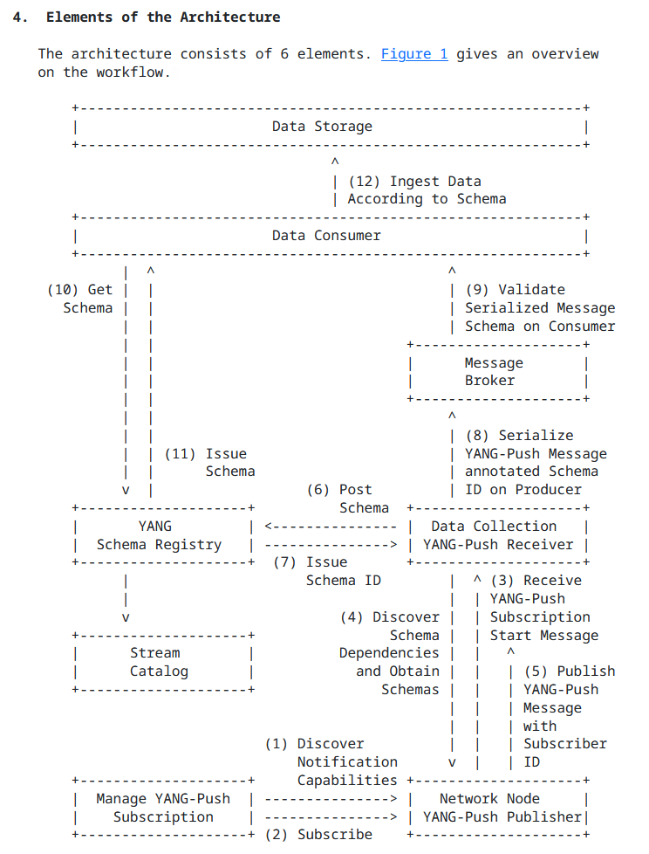
An Architecture for YANG-Push to Message Broker Integration From YANG-Push, BMP and IPFIX to Network
A network operator aims for:
An automated data processing pipeline which starts with YANG-Push, BMP and IPFIX, consolidates at Data Mesh with YANG and ends at Network Analytics.
Operational metrics where IETF defines the semantics.
Analytical metrics where network operators gain actionable insights.
These are the documents relate to the Message Broker integration:
draft-ietf-nmop-yang-message-broker-integration defines the YANG-Push to message broker integration architecture.
draft-ietf-nmop-message-broker-telemetry-message defines the message schema being used between YANG data producer and consumer.
draft-ietf-nmop-yang-message-broker-message-key defines how YANG-Push metrics can be indexed and addressed efficiently and therefore reduce the number of consumed messages and reduce the number of stored metrics with topic compaction.
New: draft-netana-nmop-message-broker-bmp-telemetry-msg defines the message schema extensions for BMP transformation and how message keys and topic names are derived.

Slide 3
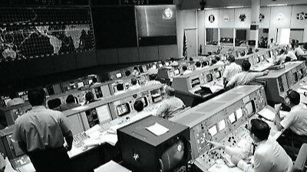
We have a dream Digital Twin at your fingertips
« Imagine that your entire life as network engineer you have logged into routers to perform show commands to get a glimpse into the current state of your networks. »
« Suddenly you see your colleague on the right querying the current network state in seconds directly from a real-time data stream. No access to routers needed. No databases needed. »
"NASA Mission Control Digital Twin in the 60s, Digital Twin is not Rocket Science"

Slide 4
BMP Monitors BGP BGP RIB's with path decision and route-policy metadata
Integrates natively into the BGP process by mirroring BGP PDU's. Exports peering states and statistics and with route-monitoring the BGP RIB tables, BGP path decision and route-policy metadata.
BGP Monitoring Protocol (BMP) https://datatracker.ietf.org/doc/html/rfc7854
Support for Adj-RIB-Out in BGP Monitoring Protocol https://tools.ietf.org/html/rfc8671
Support for Local RIB in BGP Monitoring Protocol https://datatracker.ietf.org/doc/html/rfc9069
TLV support for BMP Route Monitoring and Peer Down Messages https://tools.ietf.org/html/draft-ietf-grow-bmp-tlv
BMP Extension for Path Marking TLV https://tools.ietf.org/html/draft-cppy-grow-bmp-path-marking-tlv
Logging of routing events in BGP Monitoring Protocol https://datatracker.ietf.org/doc/html/draft-ietf-grow-bmp-rel

Slide 5
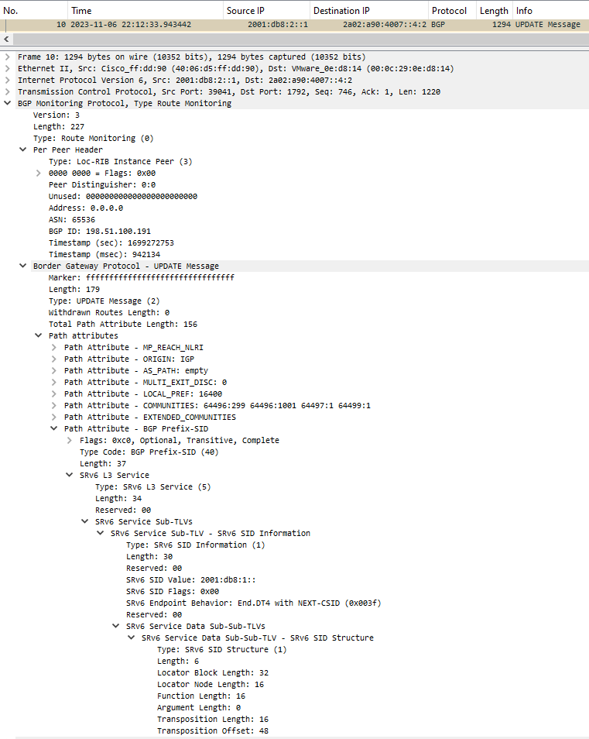
BGP Monitoring Protocol Address Family Agnostic
BMP Per Peer Header Shows at which RIB (Adj-RIB In, Local or Adj-RIB Out, Pre or Post Policy) and from which Peering the BGP PDU at which time was obtained.
Encapsulated BGP PDU Shows the encapsulated BGP PDU. In case of BMP route-monitoring, it describes whether it was a topology update or withdrawal and for BGP community, NLRI and BGP Prefix SID path attributes.

Slide 6

Message Broker Terminology
Subject: A named communication channel where a schema registry assigned schema id is associated.
Topic: A communication channel for publishing and subscribing messages between producer and consumer with one or more subjects.
Topic Compaction: The act of compressing messages in a topic to the latest state.
Partition: Messages in a topic are spread over hash buckets where a hash bucket refers to a partition.
Message: A piece of structured data sent between data processing components to facilitate communication in a distributed system
Message Key: Metadata associated with a message to facilitate deterministic hash bucketing.
Segment: A physical file containing multiple messages.
https://www.confluent.io/thank-you/resources/ebook/kafka-the-definitive-guide/

Slide 7
YANG Data Terminology
module: ietf-interfaces
+--rw interfaces
+--rw interface* [name]
+--rw name string
+--rw description? string
+--rw type identityref
+--rw enabled? boolean
+--rw link-up-down-trap-enable? enumeration {if-mib}?
+--ro admin-status enumeration {if-mib}?
+--ro oper-status enumeration
+--ro last-change? yang:date-and-time
+--ro if-index int32 {if-mib}?
+--ro phys-address? yang:phys-address
+--ro higher-layer-if* interface-ref
+--ro lower-layer-if* interface-ref
+--ro speed? yang:gauge64
+--ro statistics
+--ro discontinuity-time yang:date-and-time
+--ro in-octets? yang:counter64
+--ro in-unicast-pkts? yang:counter64
+--ro in-broadcast-pkts? yang:counter64
+--ro in-multicast-pkts? yang:counter64
+--ro in-discards? yang:counter32
+--ro in-errors? yang:counter32
+--ro in-unknown-protos? yang:counter32
+--ro out-octets? yang:counter64
+--ro out-unicast-pkts? yang:counter64
+--ro out-broadcast-pkts? yang:counter64
+--ro out-multicast-pkts? yang:counter64
+--ro out-discards? yang:counter32
+--ro out-errors? yang:counter32
Dimensional Data: Structured information in a data store [Ralph Kimball]. Example: YANG with data taxonomy.
Data Taxonomy: Is a hierarchical system for classifying and organizing data into categories and subcategories
YANG Schema Tree: The definition hierarchy specified within a module. See RFC 8340.
YANG Data Node: An instantiated node in the schema tree such as container, leaf, leaf-list, list, choice and case elements.

Slide 8
BGP Monitoring Protocol Subscribe to BGP metrics
Through Netconf/Restconf and draft-ietf-grow-bmp-yang defined YANG mopdules BMP metrics are subscribed.
With BMPv3 defined in RFC 7854 resp. RFC 8671 and RFC 9069 information, peer-up, peer-down, route-monitoring, route-mirroring and statistic messages are exported to BMP monitoring station.
At the BMP monitoring station, the received BMP messages are transformed to YANG according to draft-netana-nmop-message-broker-bmp-telemetry-msg defined YANG modules.

Slide 9
YANG Schema Registry Register BMP Telemetry Message Schemas
module: ietf-bmp-telemetry-message
structure message:
+-- version? uint8
+-- (message-type)?
+--:(route-monitoring)
+-- route-monitoring
+-- peer-type? peer-type
+-- peer-flags? uint8
+-- peer-distinguisher? rt-types:route-distinguisher
+-- peer-address? inet:ip-address
+-- peer-as? uint32
+-- timestamp? yang:date-and-time
+-- afi-safi-type identityref
+-- rib-entry
+-- (afi-safi)
+--:(ipv4-unicast)
| +-- ipv4-unicast
| +-- (rib-type)
| +--:(loc-rib)
| | +-- loc-rib
| | +-- route
| | +-- prefix inet:ipv4-prefix
| | +-- origin? union
| | +-- path-id? uint32
| | +-- attributes
| | | +-- origin? bt:bgp-origin-attr-type
| | | +-- as-path
| | | | +-- segment*
| | | | +-- type? identityref
| | | | +-- member* inet:as-number
| | | +-- next-hop? inet:ip-address
| | | +-- link-local-next-hop? inet:ipv6-address
| | | +-- med? uint32
| | | +-- local-pref? uint32
| | | +-- as4-path
| | | | +-- segment*
| | | | +-- type? identityref
| | | | +-- member* inet:as-number
| | | +-- aggregator
| | | | +-- as? inet:as-number
| | | | +-- identifier? yang:dotted-quad
| | | +-- aggregator4
| | | | +-- as4? inet:as-number
| | | | +-- identifier? yang:dotted-quad
| | | +-- atomic-aggregate? boolean
| | | +-- originator-id? yang:dotted-quad
| | | +-- cluster-list* yang:dotted-quad
| | | +-- aigp-metric? uint64
| | +-- community* union
| | +-- ext-community* bct:bgp-ext-community-type
| | +-- ext-community-raw* string
| | +-- ipv6-ext-community* bct:bgp-ipv6-ext-community-type
| | +-- ipv6-ext-community-raw* string
| | +-- large-community* bct:bgp-large-community-type
| | +-- last-modified? yang:timeticks
| | +-- eligible-route? boolean
| | +-- ineligible-reason? identityref
| | +-- unknown-attributes
| | | +-- unknown-attribute* [attr-type]
| | | +-- attr-type uint8
| | | +-- optional? boolean
| | | +-- transitive? boolean
| | | +-- partial? boolean
| | | +-- extended? boolean
| | | +-- attr-len? uint16
| | | +-- attr-value? binary
| | +-- reject-reason? union
For all BMP message types, YANG schema registration and comparison is performed.
All BMP message types share the same YANG schema tree. Depending on BMP message type and BGP address family monitored, different parts of the YANG schema tree is used for serialization.

Slide 10
Message Broker Topics, Subjects, Partitions, Segments and Message Keys
The YANG data producer creates for each YANG schema a new message broker topic, a message key and defines the number of partitions being used for the topic.
It serializes the message with the previously generated message key and message content according to draft-ietf-nmop-message-broker-telemetry-message and draft-netana-nmop-message-broker-bmp-telemetry-msg augment.
Each message is prefixed with the previously obtained schema ID representing a unique message subject. The messages are distributed according to the hashed message key across the partitions into continuous segments.

Slide 11
BMP YANG Message Broker Topic Naming Created at the YANG Message Broker Producer
BMP data can be subscribed for BMP session and BGP peering session state-changes, BGP peering statistics or BGP RIB states. as defined in Section 3.1 of RFC 7854.
Message Brokers topics are addressed with a unique name. Usually, topics are named hierarchically similar to the DNS namespace where "." delaminates hierarchies.
The document defines "statistics", "states" and "state-changes" in the topic name as the first part to denote the types of data. Followed by "bmp" to denote BMP data. Followed by the BGP RIB type and the BMP message type name.
For example, if BMP route-monitoring is being subscribed to BGP Local-RIB, the Message Broker topic name would be as following. In the example the project name and environment (prod, dev, test etc.) is prefixed.
project.environment.state.bmp.local-rib.route-monitoring

Slide 12
YANG Message Keys and Indexes Calculated and Used at the YANG Message Broker Producer
A Message Broker uses a Message Key to index the Message and a value to carry the Message content. The Message Key is being used as input for the Message Broker Producer hash function to distribute across Partitions and at the Message Broker for topic compaction.
For BMP, the network node hostname, what BMP Message Type the data represents and apart from the initiation-message and termination-message the BMP index is used to generate the Message Key. The BMP index is calculated depending on BMP Message Type as following:
peer-up-notification: "peer-distinguisher" and "peer-address".
peer-down-notification: "peer-distinguisher" and "peer-address".
statistics: "peer-distinguisher" and "peer-address".
route-monitoring: "peer-distinguisher", "peer-address" afi-safi name, address family, name of the BGP RIB, "prefix" "origin" "path-id" route attributes and the index of the used attr-set.
route-mirroring: "peer-distinguisher", "peer-address" afi-safi name, address family, name of the BGP RIB, "prefix" "origin" "path-id" route attributes, index of the used attr-set and information enumeration.

Slide 13
BMP YANG Data Consumption Discover and Subscribe to BMP YANG metrics
A user or AI application/agent subscribes discovers through the stream catalog interesting metrics and subscribes to message broker topic.
More than one topic can be consumed at once by using a wildcard such as: project.environment.state.bmp.local-rib.* to consume all BMP Local-RIB metrics.
The consumer hashes the message key and applies modulo with the number of partitions to determine the partition it needs to consume from to obtain messages with desired message key.

Slide 14
YANG Converged Network Telemetry Data Processing Pipeline From network nodes to message broker nodes
At the YANG data producer, thanks to the YANG awareness to the YANG data producer and the YANG schema registry, for each unique YANG schema tree a message broker topic and subject is being created, and messages are being indexed and hashed according to the message key.
At the message broker, thanks to the dedicated topic per BMP message type and its YANG message key, BMP YANG state metrics such as BGP peer, BGP RIB and BMP session state can be compacted to the latest state; reducing the number of stored messages.
At the YANG data consumer, thanks to the YANG awareness of the stream catalog and consumer, a specific topic, partition and subject can be consumed for the interested BMP YANG metrics; reducing the number of messages to be consumed.

Slide 15
Use Cases From network engineer to network controller to network management
A network engineer performs a SQL query on "project.environment.state.bmp.adj-rib-in-post.*" and "project.environment.statistics.bmp.adj-rib-in-post.*" message broker topics to obtain the current state and state-change for a set of BGP peerings to verify a maintenance window or perform troubleshooting instead of logging into each network node to perform a show command.
A network controller performs a SQL query on "project.environment.state.bmp.local-rib.*" and "project.environment.statistics.bmp.local-rib.*" to obtain the current state and statistics of a given BGP path to verify before and after the SRv6 traffic engineering configuration change instead of obtaining the metrics from the network. See: Section 3.8 of draft-ietf-nmop-simap-concept.
A network management or network anomaly detection system obtains the current BMP Local-RIB state from "project.environment.state.bmp.local-rib.*" for building a network topology. See: Section 3.2 from draft-ietf-nmop-simap-concept. From "project.environment.statistics.bmp.local-rib.*" it obtains statistics and maps them to the previously obtained network topology.

Slide 16
Questions to… NMOP and GROW
Do you resonate of having BMP and IPFIX data being transformed to YANG and integrated uniformly to Message Broker to ease data consumption for network operation and next generation AI applications?
YANG-Push Message Broker integration has its home at NMOP, BMP at GROW and IPFIX at OPSAWG. Do you agree that having all Message Broker documents in NMOP regardless which Network Telemetry data is being collected and transformed would ease conformity?
The document introduces "ietf-bmp-bgp-rib-entry". Compared to "ietf-bgp-rib" that structure supports that each BGP path can be streamed individually or as JSON array in a message broker message. Do you agree that this should be defined in this document and groupings reused from "ietf-bgp-rib-attributes" and "ietf-bgp-rib-tables"?

Slide 17
Questions to… draft-ietf-idr-bgp-model authors and IDR
Section 3.2 of draft-netana-nmop-message-broker-bmp-telemetry-msg describes the relationship to draft-ietf-idr-bgp-model and proposes changes to "ietf-bgp-rib-attributes" and "ietf-bgp-rib-tables" YANG modules. The draft-netana-nmop-message-broker-bmp-telemetry-msg authors ask feedback from the draft-ietf-idr-bgp-model authors and IDR working group on document status, intended timeline and wherever proposed changes can be incorporated or not.
draft-ietf-idr-bgp-model states that the model supports ipv4-unicast and ipv6-unicast address-families and defers the remaining AFI/SAFI to other or future drafts. draft-netana-nmop-message-broker-bmp-telemetry-msg authors intend to cover l3vpn-ipv4-unicast, l3vpn-ipv6-unicast, l2vpn-evpn and ipv4-labeled-unicast for covering operational BGP RIB. The current understanding is that this has not been addressed at the IETF yet correct?

Slide 18
Next Steps Extend model, working group adoption and code contribution
Extend document to cover:
BGP Open Message from Section 4.2 of RFC 4271 and its BGP Capabilities from RFC 5492 in BMP peer-up message type by leveraging ietf-bgp-capabilities@2024-10-21.yang from draft-ietf-idr-bgp-model.
BMP Information TLV from Section 4.4 of RFC 7854 in BMP peer-up message type.
BMP Group TLV, Stateless TLV and VRF TLV from draft-ietf-grow-bmp-tlv and BGP Best Path metadata from draft-ietf-grow-bmp-path-marking-tlv
VRF Name and ID for peer-up and route-monitoring message types from Section 5.2.1 of RFC 9069
Additional BGP address families
Request NMOP, GROW and IDR working group feedback and adoption at NMOP or GROW.
Contribute to NetGauze BMP data collection and YANG Message Broker Producer.

Slide 19
Conclusion What we learned at IETF 124 and now at IETF 125
At IETF 124 we introduced NMOP to the differences between topics, partitions, subjects, segments, messages and message keys and how the apply to topic naming and compaction and how YANG-Push capabilities and YANG catalogs facilitate YANG metrics subscription in the network and data mesh.
At this IETF 125 we introduced NMOP and GROW to the YANG models for subscribing and transforming BMP data and their relationship. How topics are named and indexed based on BMP message types. There are action items on modelling BGP and BMP data in YANG.

Slide 20
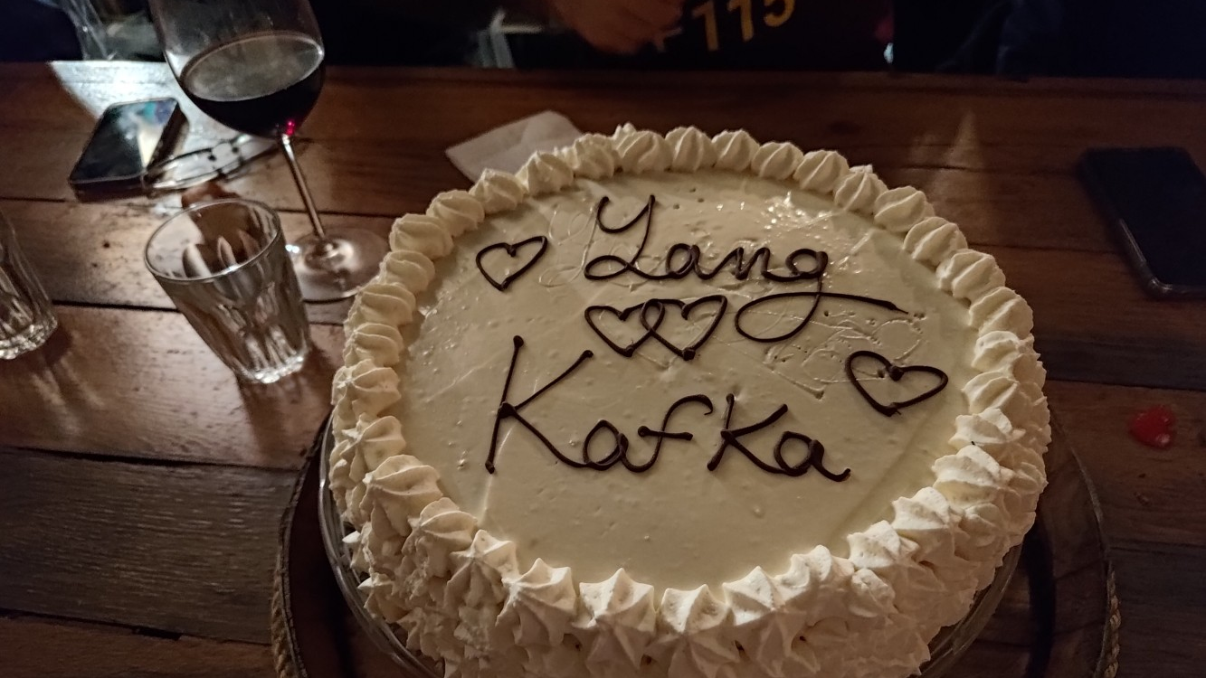
…and BMP and soon also IPFIX as well

Slide 21
YANG-Push Discover and Subscribe to YANG metrics
From discovering YANG-Push subscription capabilities defined in RFC 9196, subscribing interesting metrics periodical (statistics), on-change (state changes) or on-change with sync-on-start (states) defined in RFC 8641.
Each subscription refers to network node, datastore (RFC 8342) and a schema tree.
In this RFC 8343 example ietf-interface statistics are subscribed periodically and ietf-interface states on-change sync-on-start. YANG-Push subscription ID's are per network node significant.
Data Collection obtains for each subscription the YANG schema tree by leveraging <get-schema> (RFC 6022), YANG Library (RFC 8525) and draft-ietf-netconf-yang-library-augmentedby.

Slide 22
YANG Schema Registry From 4 subscription ID's to 2 schema ID's
For all 4 YANG-Push subscriptions, YANG schema registration and comparison is performed.
Since the two YANG schema trees for both YANG-Push subscriptions are identical on both network nodes, two YANG globally unique schema ID's are being issued from the YANG schema registry to the YANG data producer.

Slide 23
Message Broker Topics, Subjects, Partitions, Segments and Message Keys
The YANG data producer creates for each YANG schema a new message broker topic, a message key and defines the number of partitions being used for the topic.
It serializes the message with the previously generated message key and message content according to draft-ietf-nmop-message-broker-telemetry-message.
Each message is prefixed with the previously obtained schema ID representing a unique message subject. The messages are distributed according to the hashed message key across the partitions into continuous segments.

Slide 24
YANG Message Keys and Indexes Calculated and Used at the YANG Data Producer
To calculate the YANG Index of the Message Key, the YANG item identifier needs to be extracted from the used YANG-Push subtree or xpath subscription filter. If the YANG item identifier is a YANG list as defined in Section 7.8 of RFC 7950 the YANG list key defined in Section 7.8.2 of RFC 7950 statement is suffixed with a "/" to the YANG item identifier.
For example, if the "ietf-interface:interfaces/interface[type='ianaift:ethernetCsmacd']" xpath filter is being used, the YANG item identifier is "ietf-interface:interfaces/interface". Interface is a YANG list with name as key. Therefore, the YANG Index of the Message Key is:
ietf-interface:interfaces/interface/name
When the Message is being produced to the Message Broker, the Network node hostname and YANG datastore name is used from the structured YANG data defined in "ietf-yang-push-telemetry-message" Section 3 of draft-ietf-nmop-message-broker-telemetry-message where the YANG Index is derived from subtree and xpath filters, respectively from their YANG schema tree.

Slide 25
YANG-Push Message Broker Topic Naming Created at the YANG Data Producer
YANG can be subscribed periodically, on-change or on-change with sync-on-start. Periodical subscriptions are used for obtaining statistical metrics. On-Change subscriptions are used for obtaining State Changes and on-change with sync-on-start for obtaining States.
Message Brokers topics are addressed with a unique name. Usually, topics are named hierarchically similar to the DNS namespace where "." delaminates hierarchies.
This document proposes to include "statistics", "states" and "state-changes" in the topic name as the first part to denote the types of data. Followed by "yang" to denote YANG data. Followed by the YANG module names subscribed and followed by the YANG Schema Node Identifier where "/" is substituted by "_".
For example, if the "ietf-interface:interfaces/interface" xpath filter is being used, the Message Broker topic name would be as following. In the example the project name and environment (prod, dev, test etc.) is prefixed:
project.enviroment.statistics.yang.ietf-interfaces.interfaces_interface

