Slide 1
Export of Gigabit Passive Optical Network Encapsulation Mode in IPFIX draft-netana-opsawg-ipfix-gpon-gem
Enabling data plane visibility in passive optical transport
of the optical distribution network in broadband access
thomas.graf@swisscom.com
zhenghaomian@huawei.com
15. July 2026

Slide 2
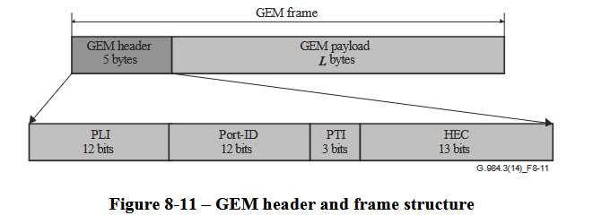
Export of GPON Encapsulation Mode in IPFIX ITU-T G.984.3 defines the GEM transmission convergence layer
ITU-T G.984.3 defines the GEM transmission convergence layer.
Figure 8-11 in Section 8.3.1 shows the GEM header.
The GEM header contains the payload length indicator (PLI), Port-ID, payload type indicator (PTI) and a 13-bit header error control (HEC) field.
Red marked highlights the GEM Port-ID and PTI which is of interest to account frames and bytes in IPFIX [RFC 7011], [RFC 7012] and [RFC 7015].
Payload length indicator (PLI) and header error control (HEC) are for tracing and debugging purposes interesting but not relevant for accounting. Therefore, excluded from IPFIX.

Slide 3
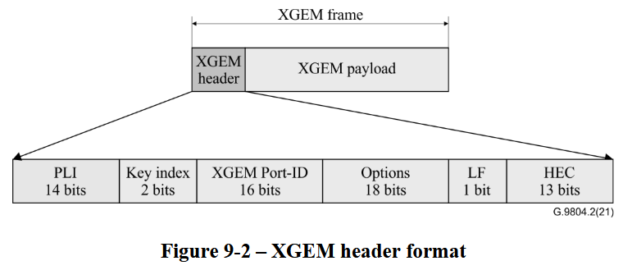
Export of GPON Encapsulation Mode in IPFIX ITU-T G.9804.2 defines the XGEM transmission convergence layer
ITU-T G.9804.2 defines the XGEM transmission convergence layer.
Figure 8-11 in Section 9.1.2 shows the XGEM header.
The XGEM header contains the payload length indicator (PLI), Key index, Port-ID, Options, Last Fragment (LF) and Hybrid error correction (HEC).
Red marked highlights the GEM Port-ID which is of interest to account frames and bytes in IPFIX [RFC 7011], [RFC 7012] and [RFC 7015].
Payload length indicator (PLI), key index, options, last fragment and header error control (HEC) are for tracing and debugging purposes interesting but not relevant for accounting. Therefore, excluded from IPFIX.

Slide 4
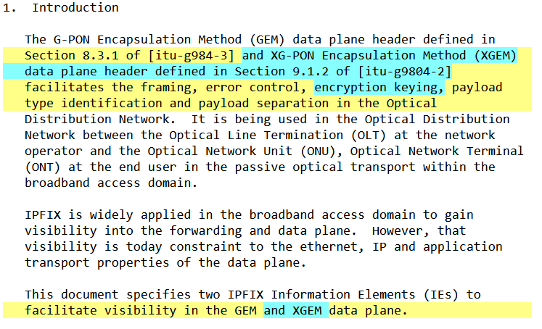
Export of GPON Encapsulation Mode in IPFIX draft-netana-opsawg-ipfix-gpon-gem defines IPFIX entities
5.1.1. gponGemPti
Name: gponGemPti
ElementID: TBD1
Description: Values for this Information Element are listed in the Section 8.3.1 of [itu-g984-3]. "G-PON Encapsulation Method PTI" subregistry, see [IANA-IPFIX].
Abstract Data Type: unsigned8
Data Type Semantics: flags
Range: The valid range is 0-7.
Additional Information: See the assigned types in [IPFIX G-PON content type list. Encapsulation Method PTI Subregistry]. The values encoded in the 3 least significant bits of the IE.
Reference: [RFC-to-be]
5.1.2. gponGemPortId
Name: gponGemPortId
ElementID: TBD2
Description: The 12-bit GEM Port-ID field defined in Section 8.3.1 of [itu-g984-3] and XGEM Port-ID field in Section 9.1.2 of [itu-g9804-2].
Abstract Data Type: unsigned16
Data Type Semantics: identifier
Additional Information: See Section 8.3.1 of [itu-g984-3] for the content type list.
Reference: [RFC-to-be]

Slide 5
Export of GPON Encapsulation Mode in IPFIX Document Status and Next Steps
First document revision published on April 7th 2025 and presented at CCAMP.
Second revision includes review from Paul Aitken and IANA.
Adopted at OPSAWG September 2025.
Implementation on Huawei MA5800T-X17 verified at IETF hackathon 125.
Received review from Chonfeng Xie and Paul Aitken many thanks!
Addressed review from Chonfeng and working on addressing feedback from Paul
Request working group last call.
thomas.graf@swisscom.com
zhenghaomian@huawei.com
15. July 2026

