Slide 1
An Architecture for a Network Anomaly Detection Framework draft-ietf-nmop-network-anomaly-architecture-05
draft-ietf-nmop-network-anomaly-semantics-03
draft-ietf-nmop-network-anomaly-lifecycle-03
Motivation and architecture of a Network Anomaly Detection Framework
and the relationships to other documents describing
network symptom semantics and network incident lifecycle
wanting.du@swisscom.com pierre.francois@insa-lyon.fr
thomas.graf@swisscom.com vincenzo.riccobene@huawei-partners.com alex.huang-feng@insa-lyon.fr
17. July 2025

Slide 2

Problem Statement and Motivation How it is being addressed in which document
Network Anomaly Detection
When operational or configurational changes in connectivity services are happening, the objective is to detect interruption at network operation faster than the users using those connectivity services
In order to achieve this objective, automation in network monitoring is required. This automation needs to monitor network changes holistically by monitoring all 3 network planes simultaneously and detect whether that change is service disruptive.
Through network incidents postmortems we network operators learn and improve so does network anomaly detection and supervised and semi-supervised machine learning. With more and more incidents the postmortem process demands automation and with the standardization of labeled network incident collaboration among network operators, vendors and academia is facilitated.
draft-ietf-nmop-network-anomaly-architecture describes the motivation and architecture and the relationship to other two documents.
draft-ietf-nmop-network-anomaly-semantics defines Symptom semantics to enable standardized data exchange to validate results with network engineers and improve supervised and semi-supervised machine learning systems.
draft-ietf-nmop-network-anomaly-lifecycle describes on managing the lifecycle process, in order to facilitate network engineers to interact with the network anomaly detection system to refine the detection abilities over time.

Slide 3
Network Anomaly Detection Architecture Document Updates
Updated terminology. Change from "cause" to "trigger" based on Adrian's feedback.
Updated Service Disruption Detection Section to cover templates.
Changed Service Model reference from RFC 8309 to RFC 8969.
Merged editorial input from Rüdiger Geib (offlist), Reshad Rahman and Paul Aitken. Thanks a lot for the review!

Slide 4
Semantic Metadata Annotation Document Updates
Updated YANG modules.
Added "template", see section 3.2 in Network Anomaly Detection Architecture, and "season" into ietf-network-anomaly-symptom-cbl.
Added maintenance related information into ietf-network-anomaly-service-topology.
Updated terminology. Change from "cause" to "trigger" based on Adrian's feedback.
Added in Section 4.4 Apache AVRO data model translation.
Completed Security Considerations according to draft-ietf-netmod-rfc8407bis-28#appendix-B.
Described service model context and added normative reference to RFC 8969.
Added Cosmos Bright Lights in Implementation status section.
module: ietf-network-anomaly-symptom-cbl
augment /rsn:relevant-state/rsn:anomaly/rsn:symptom:
+--rw action? string
+--rw reason? string
+--rw trigger? string
+--rw network-plane? enumeration
+--rw template? string
+--rw season? Enumeration
module: ietf-network-anomaly-service-topology
augment /rsn:relevant-state/rsn:service:
+--:(l2vpn)
| +--rw vpn-service* [vpn-id]
| +--rw vpn-id string
| +--rw uri? inet:uri
| +--rw vpn-name? string
| +--rw site-ids* string
| +--rw change-id? yang:uuid
| +--rw change-start-time? yang:date-and-time
| +--rw change-end-time? yang:date-and-time
+--:(l3vpn)
+--rw vpn-service* [vpn-id]
+--rw vpn-id string
+--rw uri? inet:uri
+--rw vpn-name? string
+--rw site-ids* string
+--rw change-id? yang:uuid
+--rw change-start-time? yang:date-and-time
+--rw change-end-time? yang:date-and-time

Slide 5
Network Anomaly Lifecycle Document Updates
Updated relevant-state YANG module
Added global uri, confidence-score and strategy
Added service container
Renamed anomaly grouping from anomalies to anomaly according to RFC 8407.
Annotator-type is now an enumeration.
Merged terminology input from Adrian
Completed Security Considerations according to draft-ietf-netmod-rfc8407bis-28#appendix-B.
Received review from Paul Aitken which will be addressed in -04.
module: ietf-relevant-state
+--rw relevant-state
+--rw id yang:uuid
+--rw uri? inet:uri
+--rw description? string
+--rw start-time yang:date-and-time
+--rw end-time? yang:date-and-time
+--rw strategy? string
+--rw confidence-score? score
+--rw concern-score score
+--rw (service)?
+--rw anomaly* [id revision]
+--rw id yang:uuid
+--rw revision yang:counter32
+--rw uri? inet:uri
+--rw state identityref
+--rw description? string
+--rw start-time yang:date-and-time
+--rw end-time? yang:date-and-time
+--rw confidence-score? score
+--rw pattern? identityref
+--rw annotator
| +--rw id? yang:uuid
| +--rw name string
| +--rw version? string
| +--rw annotator-type? enumeration
+--rw symptom!
+--rw id yang:uuid
+--rw concern-score score

Slide 6
Network Anomaly Lifecycle and Semantic Metadata Annotation Combined YANG Schema Tree
notifications:
+---n relevant-state-notification
+--ro publisher
| +--ro id? yang:uuid
| +--ro name string
| +--ro version? string
+--ro id yang:uuid
+--ro uri? inet:uri
+--ro description? string
+--ro start-time yang:date-and-time
+--ro end-time? yang:date-and-time
+--ro smcblsymptom:strategy? string
+--ro confidence-score? score
+--ro concern-score score
+--ro (service)?
| +--:(smtopology:l2vpn)
| | +--ro smtopology:vpn-service* [vpn-id]
| | +--ro smtopology:vpn-id string
| | +--ro smtopology:uri? inet:uri
| | +--ro smtopology:vpn-name? string
| | +--ro smtopology:site-ids* string
| | +--ro smtopology:change-id? yang:uuid
| | +--ro smtopology:change-start-time?
| | | yang:date-and-time
| | +--ro smtopology:change-end-time?
| | yang:date-and-time
| +--:(smtopology:l3vpn)
| +--ro smtopology:vpn-service* [vpn-id]
| +--ro smtopology:vpn-id string
| +--ro smtopology:uri? inet:uri
| +--ro smtopology:vpn-name? string
| +--ro smtopology:site-ids* string
| +--ro smtopology:change-id? yang:uuid
| +--ro smtopology:change-start-time?
| | yang:date-and-time
| +--ro smtopology:change-end-time?
| yang:date-and-time
notifications:
+---n relevant-state-notification
+--ro anomaly* [id revision]
+--ro id yang:uuid
+--ro revision yang:counter32
+--ro uri? inet:uri
+--ro state identityref
+--ro description? string
+--ro start-time
| yang:date-and-time
+--ro end-time?
| yang:date-and-time
+--ro confidence-score? score
+--ro pattern? identityref
+--ro annotator
| +--ro id? yang:uuid
| +--ro name string
| +--ro version? string
| +--ro annotator-type? enumeration
+--ro symptom!
| +--ro id yang:uuid
| +--ro concern-score score
| +--ro smcblsymptom:action? string
| +--ro smcblsymptom:reason? string
| +--ro smcblsymptom:trigger? string
| +--ro smcblsymptom:network-plane? enumeration
| +--ro smcblsymptom:template? string
| +--ro smcblsymptom:season? Enumeration
+--ro smtopology:vpn-node-terminations*
[hostname route-distinguisher]
+--ro smtopology:hostname inet:host
+--ro smtopology:route-distinguisher string
+--ro smtopology:peer-ip* inet:ip-address
+--ro smtopology:next-hop* inet:ip-address
+--ro smtopology:interface-id* uint32
Shows the observed symptoms, the network dimensions triggering and connectivity service impacted.

Slide 7
Network Anomaly Lifecycle and Semantic Metadata Annotation Example Message from Cosmos Bright Lights Implementation
{
"id": "616963b4-1f4f-4abe-94b5-7e1354653d49",
"uri": {
"string": "https://pivot-url-proxy.app.zhh.sbd.corproot.net/pivot/c/926d/CBL_LC_Overview_Dev?vpn_id=64497:19313&comms=64497:19313"
},
"description": null,
"startTime": 1745333220000,
"endTime": {
"long": 1745333280000
},
"confidenceScore": null,
"concernScore": 8,
"anomaly": [
{
"id": "ffdfb6d8-2a00-5219-b458-add2ce57e2db",
"revision": 0,
"uri": null,
"state": "detection",
"description": null,
"startTime": 1745332860000,
"endTime": {
"long": 1745333220000
},
"confidenceScore": null,
"pattern": null,
"annotator": {
"id": {
"string": "ffdfb6d8-2a00-5219-b458-add2ce57e2db"
},
"name": "com.swisscom.daisy.cosmos.brightlights.bmp.functions.BmpCountScoringPerWindow",
"annotatorType": {
"AnnotatorType": "algorithm"
}
},
"symptom": {
"Symptom": {
"id": "1bee6d7e-923b-4990-b33f-208ed1bd9cf4",
"concernScore": 0,
"action": null,
"reason": null,
"trigger": null,
"networkPlane": null
}
}
}
],
"vpnNodeTerminations": [
{
"hostname": "138.190.128.227",
"routeDistinguisher": "2:4260047718:10440",
"peerIp": [
"10.94.87.138"
],
"nextHop": [],
"interfaceId": []
}
],
"service": {
"L3VpnServiceContainer": {
"l3VpnService": [
{
"vpnId": "64497:19313",
"uri": {
"string": "https://thor-ui.thoruipp.corproot.net/cantata/lcs?dstCommunity=64497:19313"
},
"vpnName": {
"string": "64497:19313"
},
"siteIds": null,
"changeId": null,
"changeStartTime": null,
"changeEndTime": null
}
]
}
},
"publisher": {
"id": "161495ba-3c0a-5f13-90ae-b907259be226",
"name": "Brightlights - Streaming",
"version": {
"string": "1.0.9-alert-1"
}
}
}
Shows the observed symptoms, the network dimensions triggering and connectivity service impacted.

Slide 8
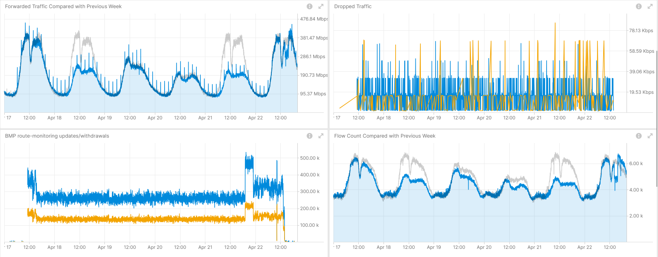
April 17-22th, OSPF/BGP Routing Instability 64497:471 L3 VPN – Real-Time Incident Analysis
Shows traffic bad TTL, adjacency drops and traffic volume changes due to public holidays, Measured with IPFIX and Correlated with BGP VPNv4/6.
Shows constant BGP topology changes and flow count changes due to public holidays. Measured with IPFIX and Correlated with BGP VPNv4/6, BMP Adj-RIB In and Local RIB.
Operational Network Telemetry forwarding plane, IPFIX, BMP measured control plane metrics.

Slide 9
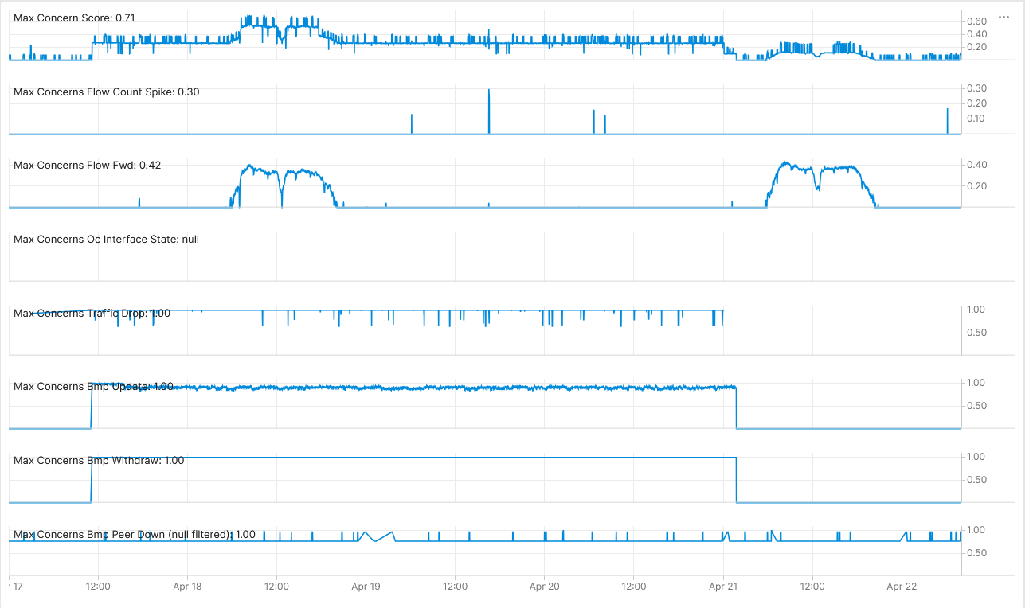



April 17-22th, OSPF/BGP Routing Instability 64497:471 L3 VPN – Network Anomaly Detection – Live
Concern Score: 0.71
Flow Count Spike: 0.30
Missing Traffic: 0.41
Traffic Drop: 1.00
BMP Peer: 0.96
Interface Down: 0.00 BMP Update: 1.00
BMP Withdrawal: 1.00
BMP route-monitoring Update/Withdraw check recognized excessive topology changes.
BMP peer Down/Up check recognized issue with unstable peer on another network platform..
Interface Down/Up check did not apply.
Traffic Drop spike recognized drops due to instable routing topology.
Missing Traffic recognized traffic volume changes due to public holidays.
Increased or decreased Flow Count was not applicable.
Overall: 2 out of 6 checks have detected the excessive routing topology changes with drops. Customer profiling related false positives see in conclusion.
Cosmos Bright Lights monitoring 64497:471 L3 VPN in real-time during maintenance window.

Slide 10
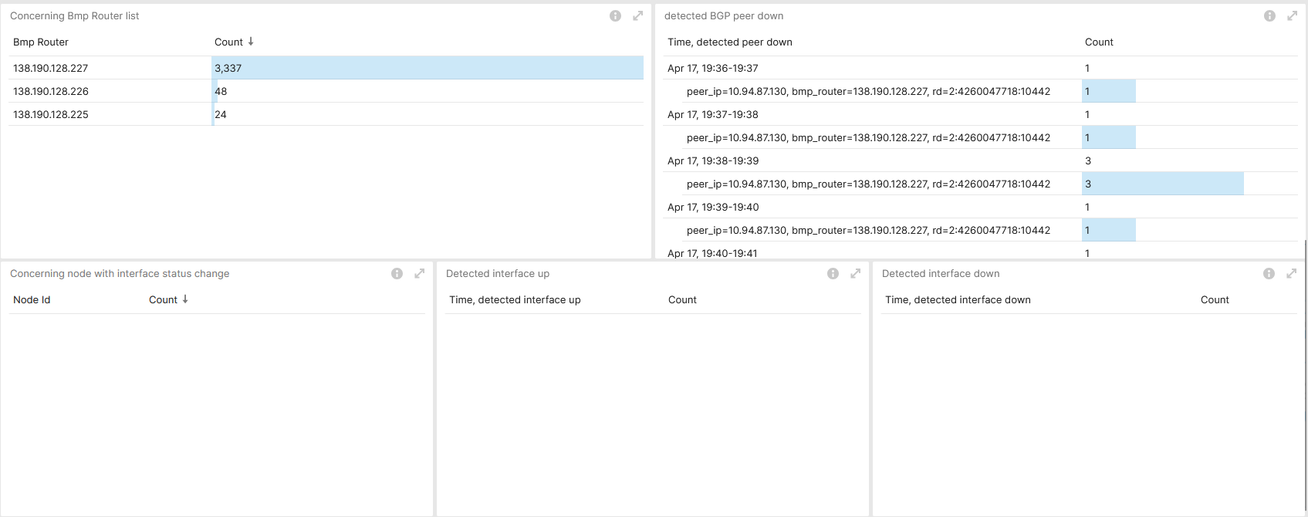
April 17-22th, OSPF/BGP Routing Instability Provider Impact Analysis – Concern Objects declare Causality
Showing excessive BGP peer downs on MPLS Inter-AS Option A Platform unrelated to Incident.
Measured with BMP Adj-RIB In.
Analytical Cosmos Bright Lights observed metrics.

Slide 11
April 17-22th, OSPF/BGP Routing Instability Semantic Metadata Annotation - National Holidays
National holiday information should be considered to improve accuracy of Contextual outliers for seasonal traffic volume and flow count change categorized profiles in the missing traffic and flow count spike strategies and declared in symptom semantics.
Operational Network Telemetry forwarding plane, IPFIX, BMP measured control plane metrics.
+--ro symptom!
| +--ro id yang:uuid
| +--ro concern-score score
| +--ro smcblsymptom:action? string
| +--ro smcblsymptom:reason? string
| +--ro smcblsymptom:trigger? string
| +--ro smcblsymptom:network-plane? enumeration
| +--ro smcblsymptom:strategy? string
| +--ro smcblsymptom:template? string
| +--ro smcblsymptom:season? Enumeration

Slide 12
Next Steps and Remaining Issues Feedback on latest changes, YANG Doctors review, SIMAP Integration
Next Steps
Requesting working group feedback on the updated YANG models and editorial changes.
Request YANG doctors review for draft-ietf-nmop-network-anomaly-semantics-03 and draft-ietf-nmop-network-anomaly-lifecycle-03.
Remaining Issue
Clarify with working group relationship between rule-based and knowledge-based.
smtopology:vpn-node-terminations defines hostname, route-distinguisher, peer-ip and next-hop and interface-id instead of augmenting /nw:networks/nw:network/nw:node:termination-point from Section 4.2 of RFC 8345.
How should we address to achieve Postmortem Replay in SIMAP, Section 3.9 of draft-ietf-nmop-simap-concept.

Slide 13
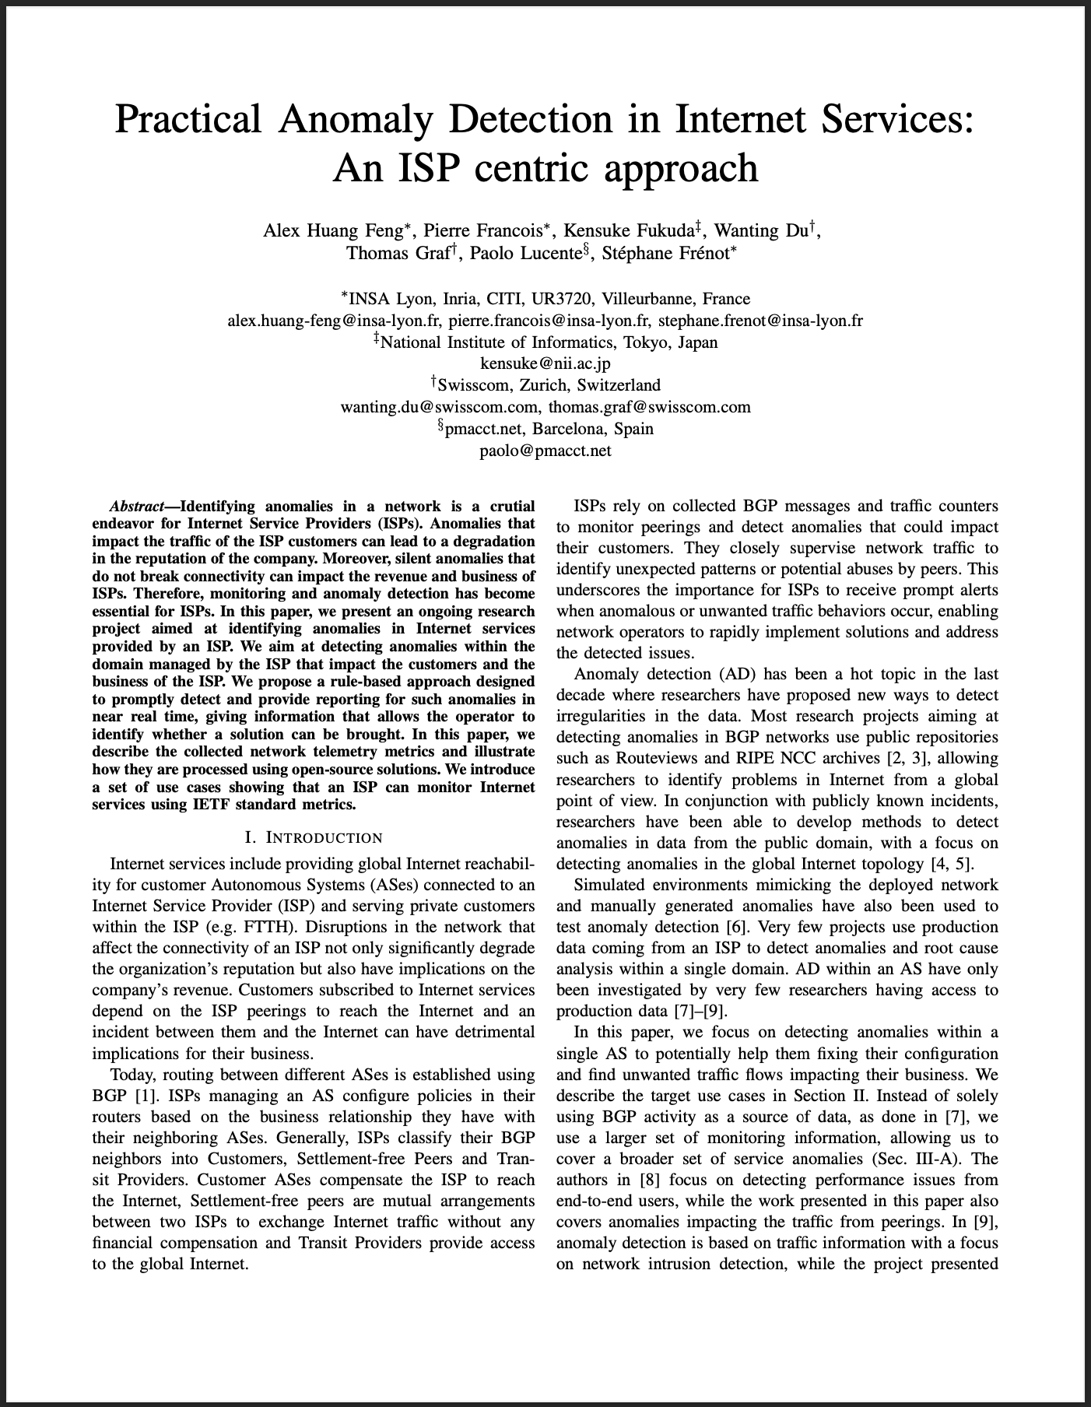
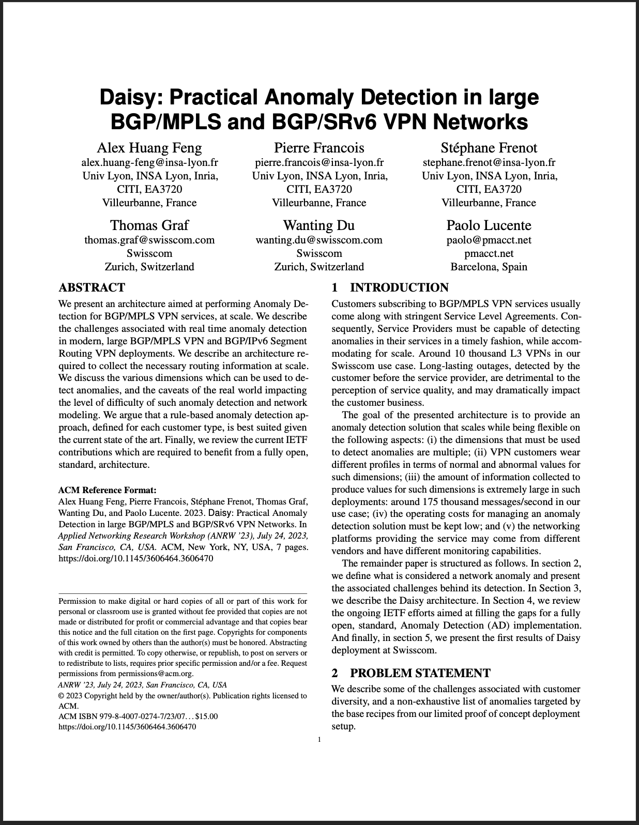
Relevant Papers for more Details
Paper “Practical Anomaly Detection in Internet Services: An ISP centric approach”
Published at AnNet Workshop (In conjunction with IEEE NOMS)
Seoul, South Korea (6–10 May 2024)
Open access: https://hal.science/hal-04655324
Paper “Daisy: Practical Anomaly Detection in large BGP/MPLS and BGP/SRv6 VPN Networks” published at ACM/IRTF ANRW’23
San Francisco, USA (24 July 2023)
Open access: http://hal.science/hal-04307611

