Slide 1
An Architecture for YANG-Push to Message Broker Integration draft-ietf-nmop-yang-message-broker-integration-13
Motivation and architecture of a native
YANG-Push notifications and YANG Schema integration
into Message Broker and YANG Schema Registry
thomas.graf@swisscom.com ahmed.elhassany@swisscom.com
19. July 2026

Slide 2
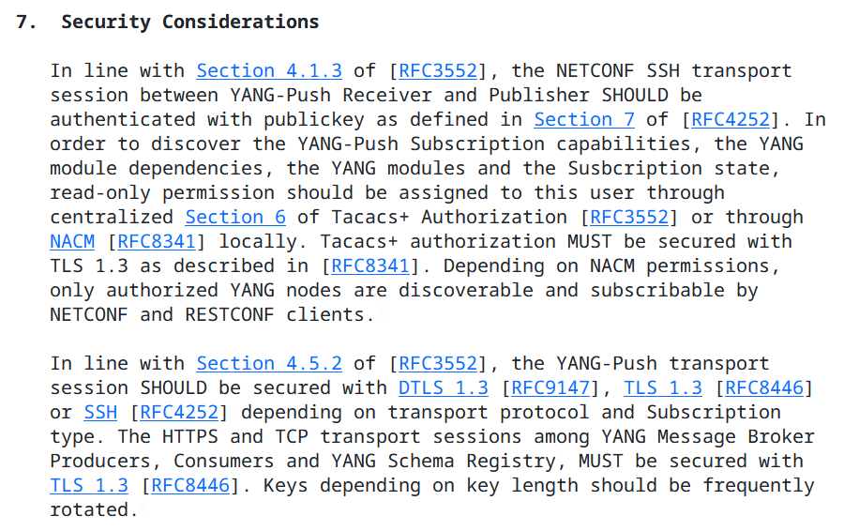
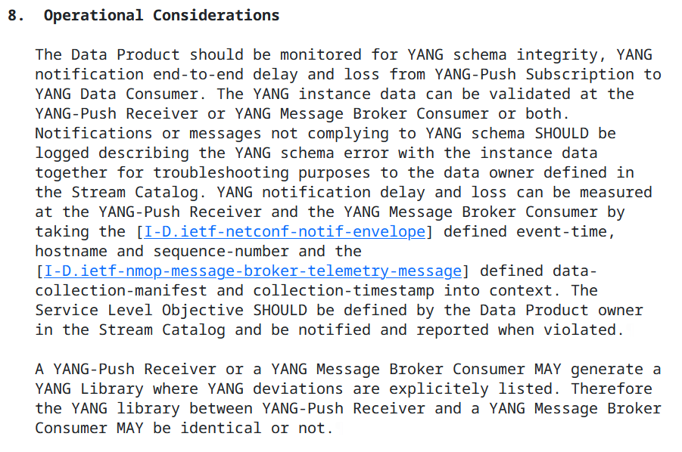
An Architecture for YANG-Push to Message Broker Integration Operational and Considerations Sections in -12

Slide 3
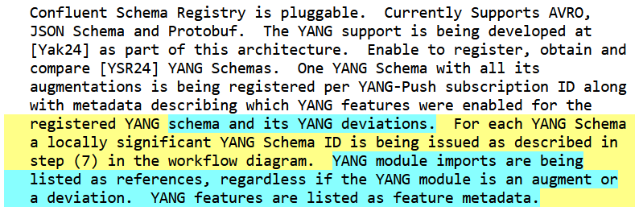
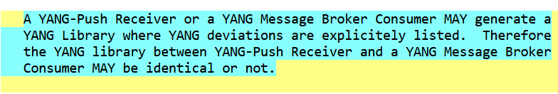
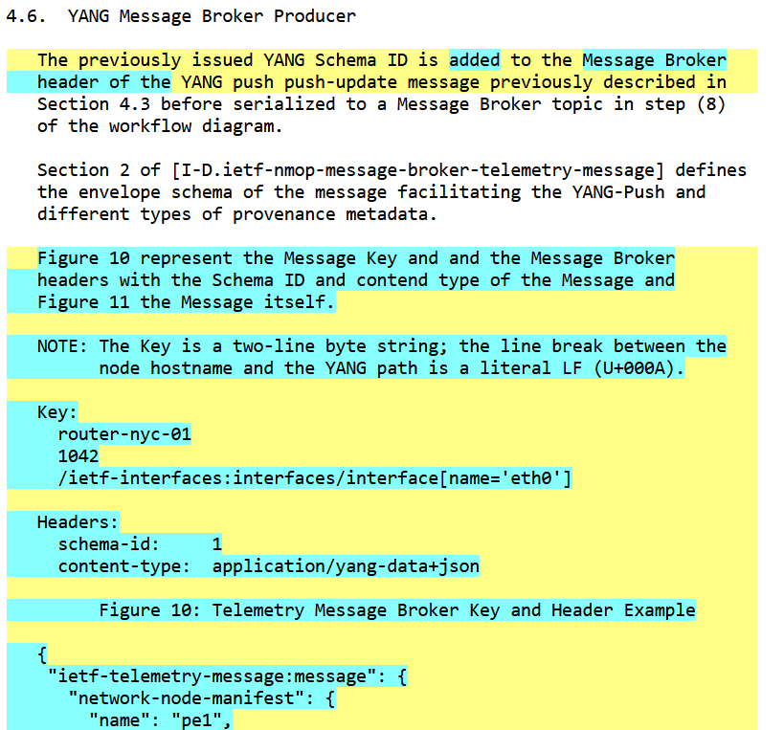
An Architecture for YANG-Push to Message Broker Integration Changes in -13 and Next Steps
Many thanks to Heng Cui for contributing the operational and security consideration sections, Deepya Mandadi on sharpening the YANG deviations aspects of the document and Reshad on reviewing normative downward references.
Status
Detail on how YANG deviations are handled in YANG-Push Receiver YANG library, YANG schema registry and Message Broker YANG library.
Example how the message key and schema id is encoded in Message Broker header meta data. How message keys are crafted us defined in draft-ietf-nmop-yang-message-broker-message-key.
https://datatracker.ietf.org/doc/html/draft-ietf-netconf-udp-notif is now a normative downward reference.
Next Steps
No action items pending.

Slide 4
An Architecture for YANG-Push to Message Broker Integration Normative References, State and Reviewers
Working Group | Document Name | Document State | Reviews
NETCONF | draft-ietf-netconf-notif-envelope-05 | Shepherd writeup concluded | OPSDIR Early review by Joe Clarke YANGDOCTORS Early review (of -02) by Jürgen Schönwälder
NETCONF | draft-ietf-netconf-yang-library-augmentedby-18 | RFC editor queue | OPSDIR Early review (of -08 and -14) by Sheng Jiang, Xiao Min YANGDOCTORS Early review (of -07 and -13) by Andy Bierman SECDIR review (of -14 and -15) by Rich Salz
NETCONF | draft-ietf-netconf-yang-notifications-versioning-14 | Submitted to IESG for Publication | YANGDOCTORS Early review (of -09) by Robert Wills OPSDIR review (of -10) by Gabriele Galimberti
NETCONF | draft-ietf-netconf-yp-transport-capabilities-06 | Submitted to IESG for Publication | OPSDIR IETF Last Call review by Xiao Min TSVART IETF Last Call review by Tommy Pauly YANGDOCTORS IETF Last Call review by Jan Lindblad OPSDIR Early review (of -03) by Xiao Min YANGDOCTORS Early review (of -01) by Jan Lindblad SECDIR IETF Last Call Review due 2025-10-18
NMOP | draft-ietf-nmop-yang-message-broker-integration-13 | WG Document (request for working group last call at IETF 124)
NMOP | draft-ietf-nmop-message-broker-telemetry-message-04 | WG Document (request for working group last call at IETF 125) | YANGDOCTORS Early review (of -02) by Martin Björklund

Slide 5
An Architecture for YANG-Push to Message Broker Integration Informative References, State and Reviewers
Working Group | Document Name | Document State | Reviews
NETCONF | draft-ietf-netconf-udp-notif-25 | WIT AD review received. | OPSDIR Early review (of -21) by Tina Tsou YANGDOCTORS Early review (of -20) by Jürgen Schönwälder TSVART Early review (of -11) by Michael Tüxen TSVART Early Review due 2025-10-23
NETCONF | RFC 9984 | RFC | OPSDIR Early review (of -07) by Ran Chen TSVART Early review (of -06) by Joerg Ott YANGDOCTORS Early review (of -06) by Jürgen Schönwälder GENART review (of -09) by Elwin Davies DNSDIR review (of -09) by Peter Van Dijk
NETCONF | draft-ietf-netconf-distributed-notif-19 | WIT AD review received. | OPSDIR Early review (of -14) by Jürgen Schönwälder YANGDOCTORS Early review (of -13 and -17) by Martin Björklund
NETMOD | draft-ietf-nmop-yang-anydata-validation-00 | Reviews from Rob Wilton and James Cumings received.

Slide 6

Validate YANG-Push to Message Broker End-To-End Data Processing Chain IETF 126 Hackathon, July 18/19th 2026
NMOP & NETCONF WG

Slide 7
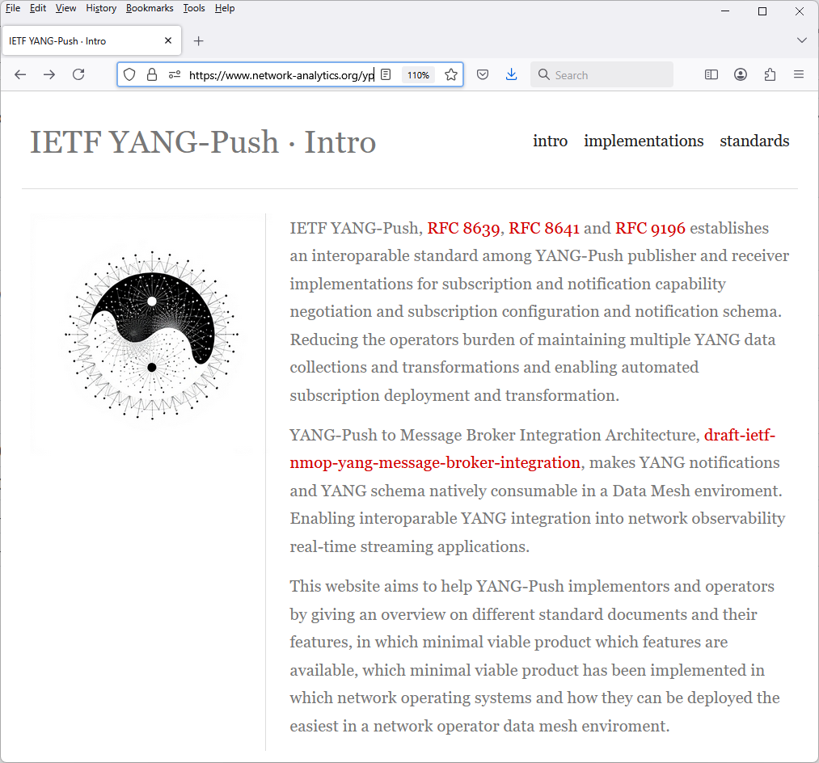
Hackathon Plan, Software and Website
Test Plan
Validate and verify
5 YANG-Push Publishers
2 YANG-Push Receivers
2 YANG-Push Network Telemetry Message
1 YANG Message Broker Producer and Schema Registry
3 YANG Message Broker Consumers
implementation in YANG data integration automation. Subscribe to YANG data on YANG-Publisher, obtain and register all YANG modules necessary to build YANG schema tree, register YANG schemas to Schema Registry and verify YANG notifications against scheme trees and produce and consume from Message Broker.
Software
YANG-Push Publisher - Cisco IOS XR, 6WIND VSR, Huawei NE (Router),MA (OLT), Arrcus Arcos and Ductus DMAP
YANG-Push Receiver – NetGauze™ and Pmacct
YANG Message Broker Producer – NetGauze™
YANG Message Broker Consumer – NetGauze™, Ciena Blue Planet UAA Workflow Engine, Cisco Crosswork Ingestion Service
YANG Schema Registry – Apache Kafka YANG Plugin
Libyang - https://github.com/CESNET/libyang/releases/tag/v5.4.9
Yangkit - https://github.com/yang-central/yangkit/
Wireshark - udp-notif dissector
NMOP & NETCONF WG
https://www.network-analytics.org/yp/how-to-deploy.html

Slide 8
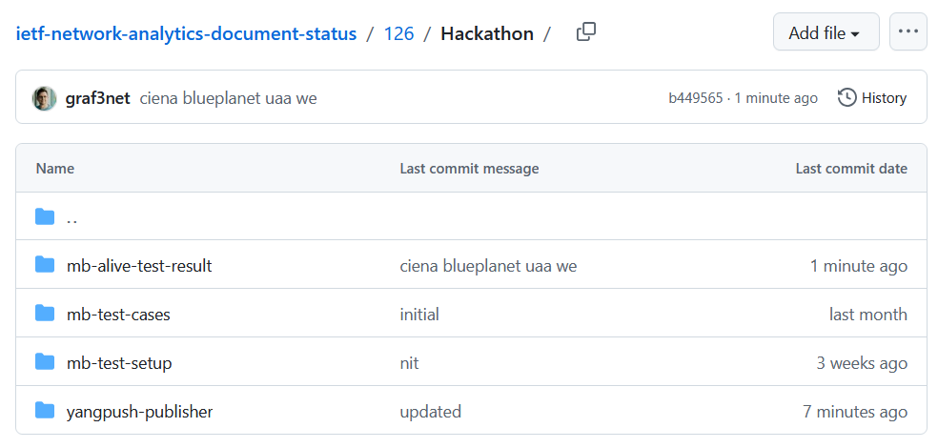
Hackathon – Repositories
The results of the end-to-end tests
Netconf RPCs and YANG-Push JSON and CBOR encoded notifications with wire captures from receiver
YANG-Push Receiver cache content generation with YANG library context, YANG modules, metadata and notification schema validation logs
YANG Message Broker Producer serialization logs
YANG Schema Registry schema examples
YANG Message Broker Consumer, serialization logs, YANG library context, YANG modules and message schema validation
NMOP & NETCONF WG
https://github.com/network-analytics/ietf-network-analytics-document-status/tree/main/126/Hackathon/

Slide 9
An Architecture for YANG-Push to Message Broker Integration draft-ietf-nmop-yang-message-broker-integration draft-ietf-nmop-message-broker-telemetry-message draft-ietf-nmop-yang-message-broker-message-key draft-netana-nmop-message-broker-bmp-telemetry-message
+------------------------------------------------------------+
| Data Storage |
+------------------------------------------------------------+
^
| (12) Ingest Data
| According to Schema
+------------------------------------------------------------+
| Data Consumer |
+------------------------------------------------------------+
| ^ ^
(10) Get | | | (9) Validate
Schema | | | Serialized Message
| | | Schema on Consumer
| | +--------------------+
| | | Message |
| | | Broker |
| | +--------------------+
| | ^
| | | (8) Serialize
| | (11) Issue | YANG-Push Message
| | Schema | annotated Schema
v | (6) Post | ID on Producer
+--------------------+ Schema +--------------------+
| YANG | <--------------- | Data Collection |
| Schema Registry | ---------------> | YANG-Push Receiver |
+--------------------+ (7) Issue +--------------------+
| Schema ID | ^ (3) Receive
| | | YANG-Push
v (4) Discover | | Subscription
+--------------------+ Schema | | Start Message
| Stream | Dependencies | | ^
| Catalog | and Obtain | | | (5) Publish
+--------------------+ Schemas | | | YANG-Push
| | | Message
| | | with
(1) Discover | | | Subscriber
Notification v | | ID
+--------------------+ Capabilities +--------------------+
| Manage YANG-Push | ---------------> | Network Node |
| Subscription | ---------------> | YANG-Push Publisher|
+--------------------+ (2) Subscribe +--------------------+
Subscription to YANG Notifications RFC 8639
Subscription to YANG Notifications for Datastore Updates RFC 8641
UDP-based Transport for Configured Subscriptions draft-ietf-netconf-udp-notif
Subscription to Distributed Notifications draft-ietf-netconf-distributed-notif
Extensible YANG Model for YANG-Push Notifications draft-ietf-netconf-notif-envelope
Support of Versioning in YANG Notifications Subscription draft-ietf-netconf-yang-notifications-versioning
YANG Modules Describing Capabilities for Systems and Datastore Update Notifications RFC 9196
YANG Notification Transport Capabilities draft-ietf-netconf-yp-transport-capabilities
YANG Library RFC 8525
Augmented-by Addition into the IETF-YANG-Library draft-ietf-netconf-yang-library-augmentation
Validating anydata in YANG Library context draft-ietf-netmod-yang-anydata-validation
Encoding of Data Modeled with YANG in the CBOR RFC 9254
NMOP & NETCONF WG

Slide 10
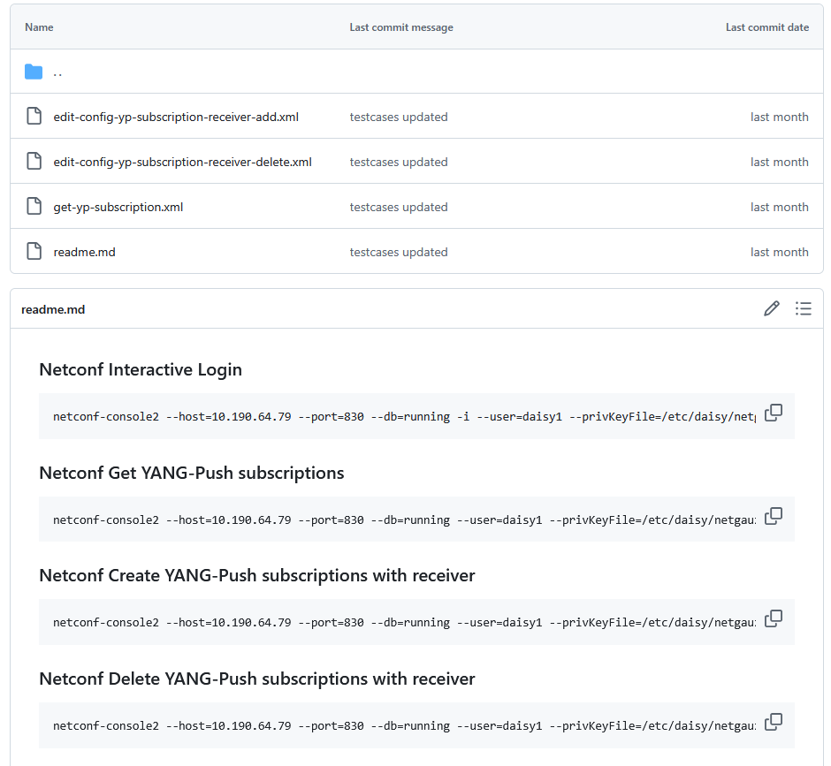
YANG-Push Publisher - Subscription
Netconf RPC calls to create, delete and obtain YANG-Push subscriptions and receiver configurations.
NMOP & NETCONF WG

Slide 11
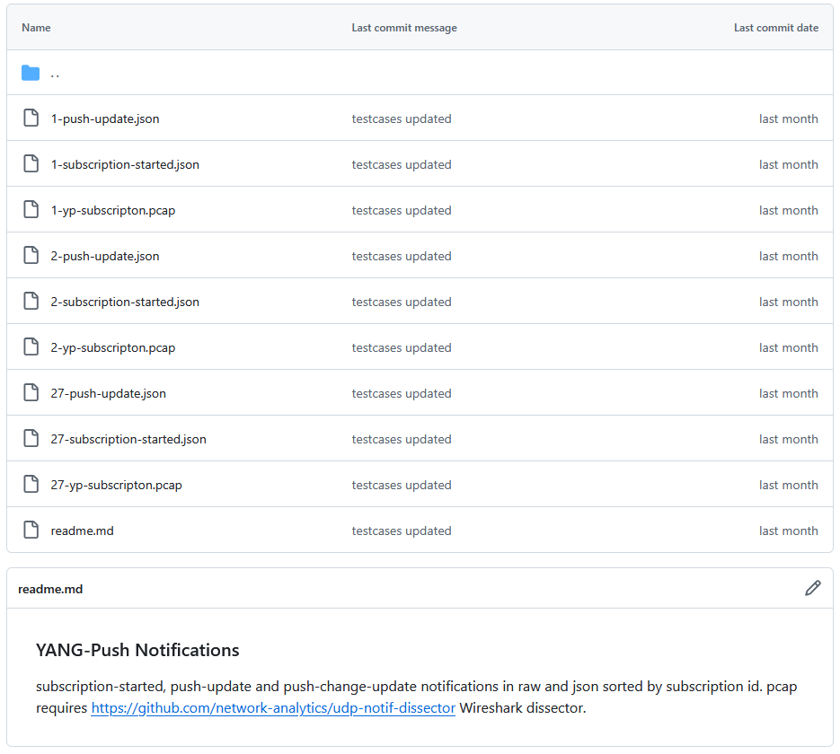
YANG-Push Publisher - Notifications
Subscription state change notifications as JSON and PCAP.
Push update and change-update notifications as JSON and PCAP.
NMOP & NETCONF WG

Slide 12
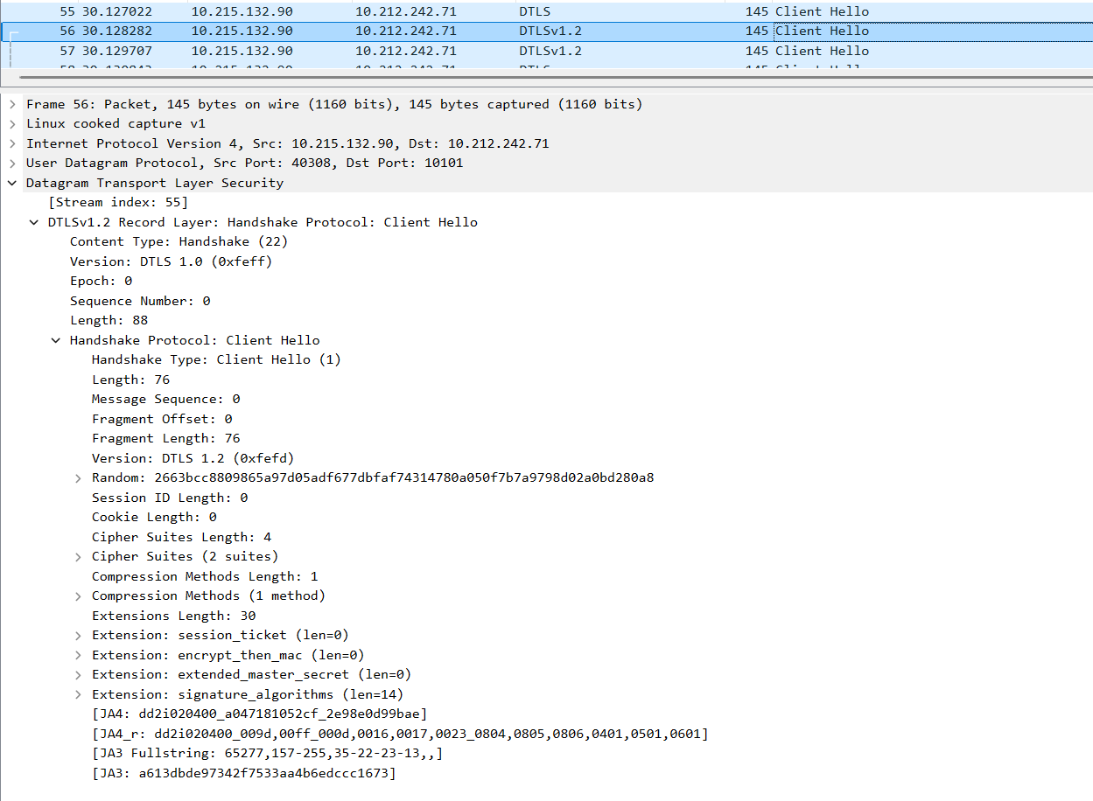
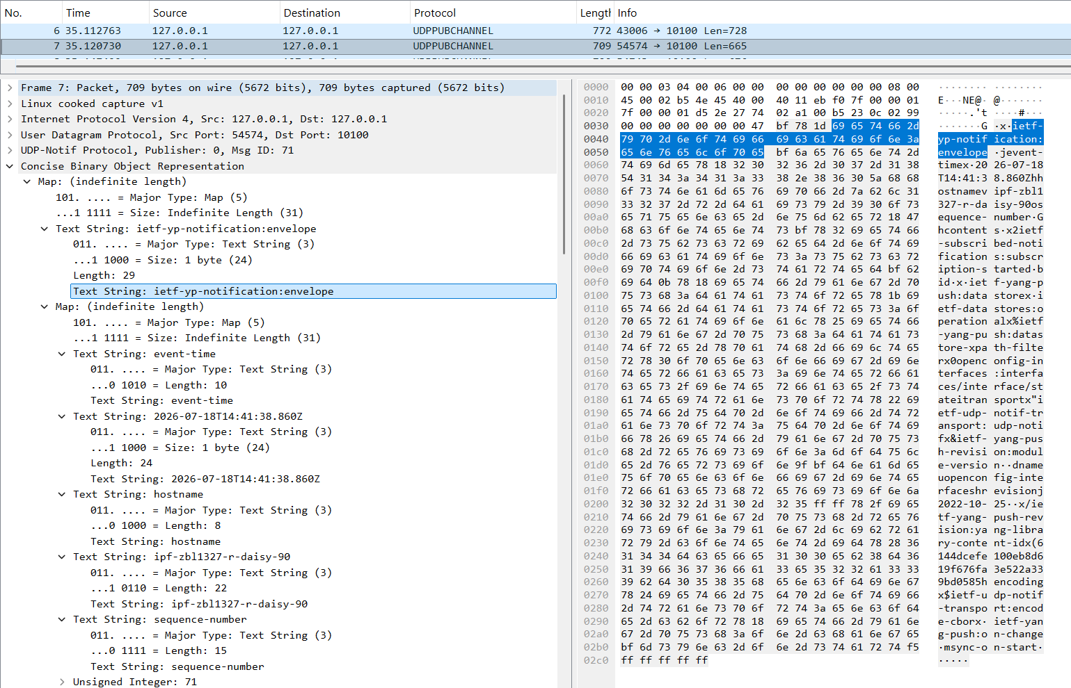
YANG-Push UDP-Notif – DTLS and CBOR
With Cisco IOS XR and 6Wind VSR we have now two implementations support CBOR Name Identifiers
With Cisco IOS XR we have the first implementation support DTLS 1.2 in UDP-Notif.
NMOP & NETCONF WG

Slide 13
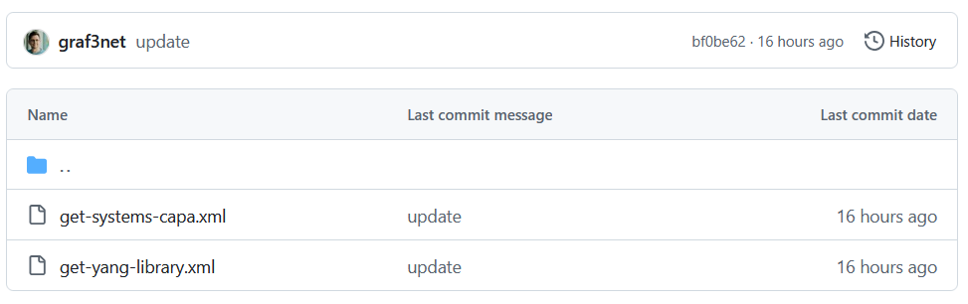
YANG-Push Capabilities & YANG Library - RPC
Netconf XML encoded reply for RFC 9196 YANG-Push capabilities.
Netconf XML encoded reply for RFC 8525 with draft-ietf-netconf-yang-library-augmentedby.
NMOP & NETCONF WG

Slide 14

YANG-Push IETF 126 Publisher Implementation Status
 | 6WIND VSR | Huawei NE | Huawei MA | Cisco IOS XR | Arrcus Arcos | Open-Source | Ductus DMAP
RFC 8639 YANG-Push Subscription | ✔ | ✔ | ✔ | ✔ | ✔ |  | ✔
RFC 8641 YANG-Push Notification | ✔ | ✔ | ✔ | ✔ | ✔ |  | ✔
draft-ietf-netconf-udp-notif | ✔ | ✔ | ✔ | ✔ | ✔ | ✔
draft-ietf-netconf-udp-notif with DTLS |  |  |  | ✔
draft-ietf-netconf-distributed-notif | ✔ | ✔ | ✔ |  | na
draft-ietf-netconf-notif-envelope | ✔ | ✔ | ✔ | ✔ | ✔ |  | P
draft-ietf-netconf-yang-notifications-versioning | ✔ | ✔ | ✔ | ✔ | ✔
RFC 8525 YANG Library | ✔ | ✔ | ✔ | ✔ | ✔ |  | ✔
draft-ietf-netconf-yang-library-augmentation | ✔ | ✔ | ✔ | ✔ |  | ✔ | ✔
RFC 9196 System and Notification Capabilities |  |  | ✔ | P | ✔ |  | ✔
draft-netana-netconf-yp-transport-capabilities |  |  | ✔ | ✔ | ✔
RFC 9254 CBOR Named Identifiers | ✔ |  |  | ✔
NMOP & NETCONF WG
Green marked describes new capability at IETF 125. "P" to partially implemented.

Slide 15
Operational IETF/IEEE YANG IETF 126 Module Implementation Status
 | 6WIND VSR | Huawei NE | Huawei MA | Cisco IOS XR | Arrcus Arcos
ietf-interfaces.yang (inventory, state and statistic) | ✔ | ✔ | ✔
ietf-hardware.yang (inventory, state and statistic) | ✔ | ✔ | ✔
ietf-alarms.yang (state) | ✔ | ✔ | ✔
ieee802-dot1ab-lldp.yang (inventory and state) | ✔ | ✔
ieee802-dot1ax.yang (inventory, state and statistic)
ietf-bfd-ip-sh.yang (state)
ietf-bfd-ip-mh.yang (state)
ietf-bfd-lag.yang (state)
ietf-isis.yang (state)
NMOP & NETCONF WG
Green marked describes new capability at IETF 126. "P" to partially implemented.

Slide 16

YANG Message Broker IETF 126 Implementation Status
 | NetGauze™ | Pmacct | Apache Kafka | Ciena Blueplanet | Cisco Crosswork
draft-ietf-nmop-message-broker-telemetry-message | ✔ | ✔
YANG-Push Receiver | ✔ | ✔
YANG Schema Retrieval | ✔
YANG Message Broker Producer | ✔
YANG Schema Registry | na | na | ✔ | na | na
YANG Message Broker Consumer | ✔ |  |  | ✔ | ✔
Validate Telemetry Message against YANG Schema | ✔ |  |  | P | P
draft-ietf-netmod-yang-anydata-validation | ✔
YANG Schema Comparison | na | na | ✔ | na | na
NMOP & NETCONF WG
Green marked describes new capability at IETF 126. "P" to partially implemented.

Slide 17
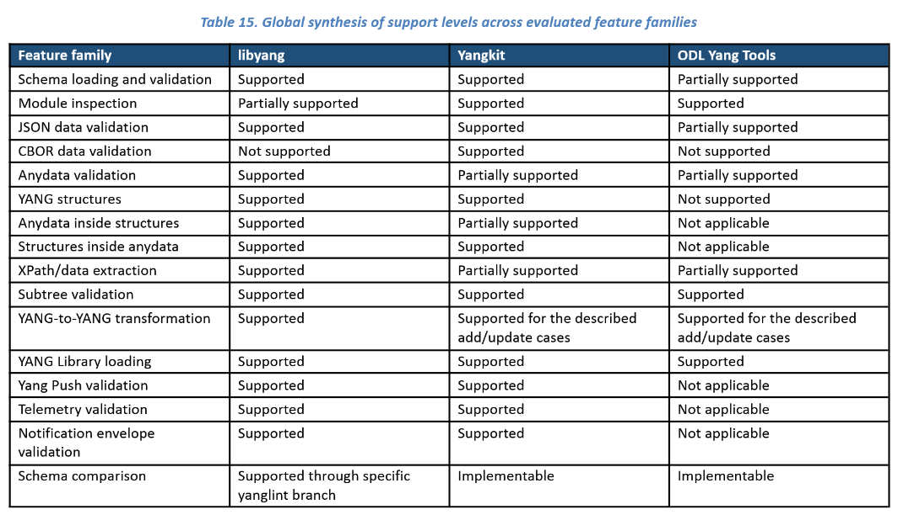
YANG Library Feature Comparison
An extensive YANG feature comparison between the different YANG library open-source implementations.
Focuses on YANG features needed to validate YANG instance data against YANG schema and performing YANG to YANG transformations.
NMOP & NETCONF WG
https://github.com/network-analytics/yang_tests/blob/master/report_v2.pdf

Slide 18

Next Steps from IETF 125 Hackathon…
Re-do YANG Message Broker Consumer tests on updated testbed with Ciena Blue Planet UAA Workflow Engine
Complete IETF YANG module subscription tests with 6Wind VSR
Compare YANG feature coverage between libyang, yangkit and yangtools
Revert import only modules for augmented-by workaround
Preserve cached YANG-Push subscription state across receiver reload
Obtain YANG-Push subscription state from publisher if missing
Support Netconf session queuing for schema retrieval
Support libyang 5.4.9 in YANG-Push Receiver and Message Broker Consumer
Message Key and Topic Name proof of concept
NMOP & NETCONF WG

Slide 19
Next Steps for IETF 127 Hackathon…
Support building RFC 8525 YANG Library in Java Message Broker Consumer
Support draft-ietf-netmod-yang-anydata-validation and RFC 8525 YANG library in yangkit
Support YANG-Push Message Broker Topic Naming with dynamic Apache Kafka topic creation API
NMOP & NETCONF WG

Slide 20
Thanks to…
Jiaxin PAN – Huawei
Zhengliang Li – Huawei
Xiao Chen - Huawei
Rob Wilton – Cisco
Dan Voyer – Cisco
Muthumayan Madhayyan - Cisco
Jérémie Leska – 6Wind
Per Anderson - Ductus
Deepya Mandadi – Ciena
Sivakumar Sundaravadivel – Ciena
IJsbrand Wijnands – Arrcus
Irfan Mohammad – Arrcus
Benoit Claise - Everything OPS
Paolo Lucente – Pmacct
Vivekananda Boudia – INSA Lyon
Alex Huang Feng – INSA Lyon/T-Systems
Maxence Younsi – INSA Lyon/Swisscom
Ashvanth Kumar Selvakumaran - Telus
Leonardo Rodoni - Swisscom
Ahmed Elhassany – Swisscom
Thomas Graf – Swisscom
NMOP & NETCONF WG
Want to know more then join us at…
NMOP on Monday 09:00 – 11:00 at the Grand Klimt Hall 2 for Message Broker, Message Key, BMP Telemetry Message document updates and hackathon related details.
NETMOD on Thursday 09:00 – 11:00 at the Grand Klimt Hall 1 for YANG Library feature comparison related details.

