Slide 1
IETF YANG-Push Implementations and Next Steps Where it started…
Starting at IETF 115, In context of a seamless Data Mesh message broker integration described in draft-ietf-nmop-yang-message-broker-integration, a group of network operators, network vendors and academia have been reviewing currently deployed non-standard YANG notification implementations of major vendors and compared to IETF YANG-Push defined in RFC 8639 and RFC 8641.
Out of this comparison and the requirements for seamless Data Mesh message broker integration, several notification, subscription and capability discovery enhancements have been proposed and discussed at IETF NETCONF and NMOP working groups.

Slide 2
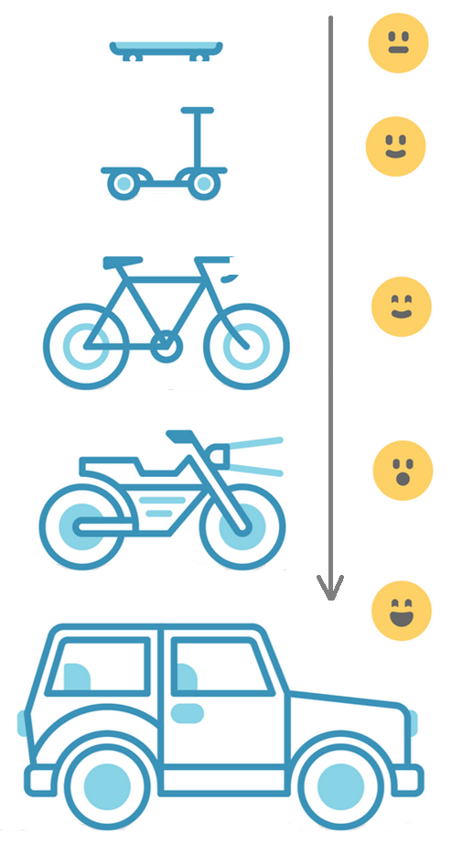
Address YANG Specification and Integration Gaps Aiming for an automated data processing pipeline
YANG Specifications Gaps:
Extensible YANG model for YANG-Push Notifications draft-netana-netconf-notif-envelope
YANG Notification Transport Capabilities draft-netana-netconf-yp-transport-capabilities
Validating anydata in YANG Library context draft-aelhassany-anydata-validation
YANG Integration Gaps:
Support of Network Observation Timestamping in YANG Notifications draft-tgraf-netconf-yang-push-observation-time
Support of Versioning in YANG Notifications Subscription draft-ietf-netconf-yang-notifications-versioning
Augmented-by Addition into the IETF-YANG-Library draft-ietf-netconf-yang-library-augmentation
YANG Simplification:
YANG-Push Operational Data Observability Enhancements draft-wilton-netconf-yp-observability

Slide 3
IETF YANG-Push Implementations and Next Steps What we discussed…
Development on first major vendor implementations started at IETF 118. Throughout IETF 119 and 120, vendor implementation and network operator testing scope and interest from other vendors and operators steadily grew. In this process questions on various feature specifications were brought forward. To channelize these discussions, 4 workshops have been organized throughout the last 3 months. In the workshops we clarified:
What do you like about IETF YANG-Push?
What in IETF YANG-Push could have been defined differently and why?
What prevents IETF YANG-Push for being integrated/used efficiently?
What in IETF YANG-Push is missing and for which purpose?
What xpaths do you subscribe to for which Network Analytics use case?
Which features should be available in which MVP release?
How to make IETF YANG-Push available to a wider audience?

Slide 4
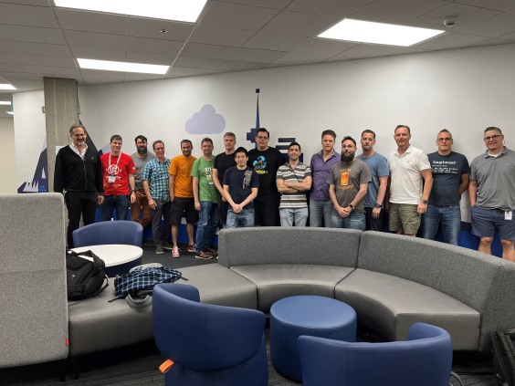
IETF YANG-Push Implementations and Next Steps Who we are and what we like…
The group consisting of: 34 colleagues from Bell Canada, Deutsche Telekom, NTT International, Swisscom, Huawei, Cisco, 6Wind, Ciena Blueplanet, Juniper, Nokia, and INSA Lyon.
The group decided to make the outcome of these workshops available to the IETF community at NMOP and NEMOPS and continue there these discussions.
What do you like about IETF YANG-Push?
Interoperable
Unified with Netconf and Restconf
Transport independent
Push based
What will you never implement nor use in IETF YANG-Push?
Replay
Message Bundling
Dampening

Slide 5
IETF YANG-Push Implementations and Next Steps Challenges and how to solve…
What in IETF YANG-Push could have been defined differently and why?
What prevents IETF YANG-Push for being integrated/used efficiently?
What in IETF YANG-Push is missing and for which purpose?
On-change notification schema different then periodical
Patch-id in On-Change complex to implement.
Reduce YANG complexity (example: augmentations, deviations, xpath, lists)
Each subscribed xpath needs normalization. High effort with many vendor specific YANG modules
Missing end to end open-source implementations
Extensible YANG-Push header combing notification and subscription. Separation of header and subscribed content is needed to allow partial parsing of message in binary encoding for data processing chain.
On-change and periodical notification schema should have identical schema and contain the entire schema tree below subscription and represent current state.
Common alignment on what should be supported in xpath and what not.
Agile incremental driven development. Deployment guide describing implementers and operators what is/should be supported at which MVP stage.

Slide 6
IETF YANG-Push Subscriptions What Deutsche Telekom subscribes to…
Cisco
Cisco-IOS-XR-fib-common-oper:mpls-forwarding/nodes/node[node-name=0/RP0/CPU0]/label-fib/forwarding-details/forwarding-detail
Cisco-IOS-XR-sysadmin-asr9k-envmon-ui:environment/oper/power/location/pem_attributes
Cisco-IOS-XR-envmon-oper:power-management/rack/producers
Cisco-IOS-XR-nto-misc-oper:memory-summary/nodes/node/summary
Cisco-IOS-XR-qos-ma-oper:qos/interface-table/interface/output
openconfig-interfaces:interfaces/interface/state
Cisco-IOS-XR-wdsysmon-fd-oper:system-monitoring/cpu-utilization/total-cpu-one-minute
Cisco-IOS-XR-wdsysmon-fd-oper:system-monitoring/cpu-utilization/total-cpu-five-minute
Cisco-IOS-XR-wdsysmon-fd-oper:system-monitoring/cpu-utilization/total-cpu-fifteen-minute
Cisco-IOS-XR-qos-ma-oper:qos/interface-table/interface/
Juniper
/components/component[name=Routing Engine0]/properties/property
/components/component[name=Routing Engine1]/properties/property
/interfaces/interface/state
/junos/services/segment-routing/sid/usage

Slide 7
IETF YANG-Push Subscriptions What Bell Canada subscribes to…
Cisco
openconfig-interfaces:interfaces
Cisco-IOS-XR-envmon-oper:power-management
Cisco-IOS-XR-envmon-oper:environmental-monitoring
Cisco-IOS-XR-nto-misc-oper:memory-summary/nodes/node/summary
Cisco-IOS-XR-procmem-oper:processes-memory/nodes/node/process-ids/process-id
Cisco-IOS-XR-wdsysmon-fd-oper:system-monitoring/cpu-utilization/total-cpu-one-minute
Cisco-IOS-XR-qos-ma-oper:qos/interface-table/interface/input/service-policy-names/service-policy-instance/statistics
Cisco-IOS-XR-qos-ma-oper:qos/interface-table/interface/output/service-policy-names/service-policy-instance/statistics
Cisco-IOS-XR-platforms-ofa-oper:ofa/stats/nodes/node/Cisco-IOS-XR-8000-platforms-npu-resources-oper:hw-resources-datas/hw-resources-data
Cisco-IOS-XR-mpls-lsd-oper:mpls-lsd-nodes/mpls-lsd-node/label-summary
Cisco-IOS-XR-controller-optics-oper:optics-oper/optics-ports/optics-port/optics-info
Cisco-IOS-XR-controller-optics-oper:optics-oper/optics-ports/optics-port/optics-lanes
Cisco-IOS-XR-invmgr-oper:inventory/entities/entity/attributes/inv-basic-bag
Cisco-IOS-XR-mediasvr-linux-oper:media-svr/nodes/node/partition

Slide 8
IETF YANG-Push Subscriptions What Swisscom subscribes to…
Cisco
openconfig-interfaces:interfaces
Cisco-IOS-XR-nto-misc-oper:memory-summary/nodes/node/summary
Cisco-IOS-XR-procmem-oper:processes-memory/nodes/node/process-ids/process-id
Cisco-IOS-XR-qos-ma-oper:qos/interface-table/interface/input/service-policy-names/service-policy-instance/statistics
Cisco-IOS-XR-qos-ma-oper:qos/interface-table/interface/output/service-policy-names/service-policy-instance/statistics
Cisco-IOS-XR-wdsysmon-fd-oper:system-monitoring/cpu-utilization
Cisco-IOS-XR-sysadmin-fretta-envmon-ui:environment/oper
Cisco-IOS-XR-envmon-oper:environmental-monitoring
Cisco-IOS-XR-sysadmin-asr9k-envmon-ui:environment/oper
Cisco-IOS-XR-asr9k-lpts-oper:platform-lptsp-ifib-static/node-statics
Cisco-IOS-XR-asr9k-np-oper:hardware-module-np/nodes/node/nps/np/counters/np-counter
Cisco-IOS-XR-platforms-ofa-oper:ofa/stats/nodes/node/Cisco-IOS-XR-NCS-BDplatforms-npu-resources-oper:hw-resources-datas
Cisco-IOS-XR-platforms-ofa-oper:ofa/stats/nodes/node/Cisco-IOS-XR-8000-platforms-npu-resources-oper:hw-resources-datas/hw-resources-data

Slide 9
IETF YANG-Push Subscriptions What Swisscom subscribes to…
Huawei
/huawei-ifm:ifm/interfaces/interface
/huawei-ifm:ifm/interfaces/interface/dynamic
/huawei-ifm:ifm/interfaces/interface/mib-statistics
/huawei-ifm:ifm/interfaces/interface/mib-statistics/huawei-pic:eth-port-err-sts
/huawei-bras-user-manage:bras-user-manage/access-tables/access-table
/huawei-bras-user-manage:bras-user-manage/access-tables/access-table/access-user-aaa-info
/huawei-bras-user-manage:bras-user-manage/access-tables/access-table/access-user-basic-info
/huawei-bras-user-manage:bras-user-manage/access-tables/access-table/access-user-edsg-infos/access-user-edsg-info
/huawei-bras-user-manage:bras-user-manage/online-fail-or-offline-records/online-fail-or-offline-record
/huawei-bras-dhcp-access:bras-dhcp-access/dhcp-access-statistics
/huawei-bras-dhcp-server:bras-dhcp-server/dhcp-servers/dhcp-server/statistics
/huawei-bras-dhcpv6-access:bras-dhcpv6-access/dhcpv6-packets-statistics
/huawei-bras-l2tp-access:bras-l2tp-access/lac-tunnels/lac-tunnel
/huawei-bras-l2tp-access:bras-l2tp-access/lac-tunnels/lac-tunnel/redundant
/huawei-bras-l2tp-access:bras-l2tp-access/lac-tunnels/lac-tunnel/statistics
/huawei-bras-user-manage:bras-user-manage/domain-statistics/domain-statistic
/huawei-bras-user-statistic:bras-user-statistic/access-user/summary/by-user-types/by-user-type
/huawei-bras-user-statistic:bras-user-statistic/access-user/summary/by-vpn-instances/by-vpn-instance
/huawei-ifm:ifm/interfaces/interface/huawei-bras-basic-access:bas/bas-interface/information
/huawei-radius:radius/account-packet-statistics/account-packet-statistic
/huawei-radius:radius/authentication-packet-statistics/authentication-packet-statistic
/huawei-radius:radius/author-packet-statistics/author-packet-statistic

Slide 10
IETF YANG-Push Use Cases Operator consolidated…
66% Common among 3 Operators
Environment Metrics (Power, Fan Speed, Temperature) -> RFC 8348 ietf-hardware
Memory Usage (summary and per process) ->
CPU Usage (summary and per process) -> RFC 8348 ietf-hardware
Network Processor Usage (per type) -> RFC 8348 ietf-hardware
MPLS label (summary) -> RFC 8960 ietf-mpls
SRv6 SID usage (summary) -> draft-ietf-spring-srv6-yang ietf-srv6-base
QOS Interface Statistics (ingress and egress) -> draft-ietf-rtgwg-qos-model ietf-traffic-policy
Interface Statistics (ingress and egress) -> RFC 8343 ietf-interfaces
33% Specific to 1 Operator
RIB/FIB entries for Traffic Engineering -> RFC 8349 ietf-routing, RFC 9403 ietf-rib-extension
Optical interface statistics ->
Link Layer Discovery -> RFC 8449 ietf-l2-topology
Hardware Inventory -> RFC 8348 ietf-hardware

Slide 11
IETF YANG-Push Use Cases high level and how frequent…
66% Common among 3 Operators
Capacity Management Frequency: Between 1 min and 1 hour periodical for metrics. Use Case: Learn from the past, trend the future and alert x weeks before reaching limit.
Interface Statistics Frequency: On-change sync on start for state and between 1- and 5-minutes periodical for metrics. Use Case: Monitor and verify current state.
33% Specific to 1 Operator
Traffic Engineering Frequency: On-change sync on start for state and 15 minutes periodical for metrics. Use Case: Monitor and Verify current state.
Visualize L1 Topology and Hardware Inventory Frequency: On-Change sync on start for state. Use Case: Visualize Dependencies.

Slide 12
IETF YANG-Push Implementations and Next Steps Incremental development…
MVP 1 - Works
draft-ietf-netconf-udp-notif transport (with segmentation option) and notifications encoded in RFC 7951 IETF-JSON.
RFC 8641 periodic subscription with anchor-time configurable in ietf-subscribed-notifications.
YANG notifications as defined in draft-ahuang-netconf-notif-yang supporting hostname and sequence number as in draft-tgraf-netconf-notif-sequencing, observation time as in draft-tgraf-netconf-yang-push-observation-time, YANG module name and version as in draft-ietf-netconf-yang-notifications-versioning and notification capabilities (RFC 9196) discoverable as defined in their documents.
YANG-Library as defined in RFC 8525 and draft-ietf-netconf-yang-library-augmentedby.
MVP 2 – Scales and Secures
Distributed notifications as defined in draft-ietf-netconf-distributed-notif.
YANG notifications encoded in CBOR (named identifiers) as defined in RFC 9254.
YANG notifications DTLS (1.2 MUST RFC 6347, 1.3 SHOULD RFC 9147) encrypted as defined in draft-ietf-netconf-udp-notif.
MVP 3 - Optimizes
RFC 8641 on-change subscription configurable in ietf-subscribed-notifications.
RFC 8641 on-change and periodical subscription in RFC 9196 defined capabilities discoverable.
draft-ietf-netconf-udp-notif transport, encoding and encryption capabilities (RFC 9196) discoverable with draft-netana-netconf-yp-transport-capabilities.

Slide 13

YANG-Push Implementation Status IETF 121 – MVP 1
 | 6WIND VSR | Huawei VRP | Cisco IOS XR | Open-Source
RFC 8639 YANG-Push Subscription | ✓ | P | P
RFC 8641 YANG-Push Notification | ✓ | P | ✓
draft-ietf-netconf-udp-notif | ✓ | ✓ | ✓ | ✓
draft-ietf-netconf-yang-notifications-versioning | ✓ | ✓ | ✓
draft-tgraf-netconf-notif-sequencing | ✓ | ✓ | ✓
draft-tgraf-netconf-yang-push-observation-time | ✓ | ✓ | ✓
RFC 7895 YANG Library |  | ✓
RFC 8525 YANG Library (NMDA) | ✓ |  | ✓
draft-ietf-netconf-yang-library-augmentation |  | P |  | ✓
RFC 9196 System and Notification Capabilities
draft-netana-netconf-notif-envelope
Green marked describes new capability at IETF 121. "P" to partially implemented.

Slide 14
YANG-Push Implementation Status IETF 121 – MVP 2
 | 6WIND VSR | Huawei VRP | Cisco IOS XR | Open-Source
draft-ietf-netconf-distributed-notif | ✓ | ✓
RFC 9254 CBOR
RFC 6347/RFC 9147 DTLS
Green marked describes new capability at IETF 121. P to partially implemented

Slide 15
YANG-Push Implementation Status IETF 121 – MVP 3
 | 6WIND VSR | Huawei VRP | Cisco IOS XR | Open-Source
RFC 8641 on-change subscriptions | ✓ | ✓ | P
draft-netana-netconf-yp-transport-capabilities
Green marked describes new capability at IETF 121. P to partially implemented

Slide 16
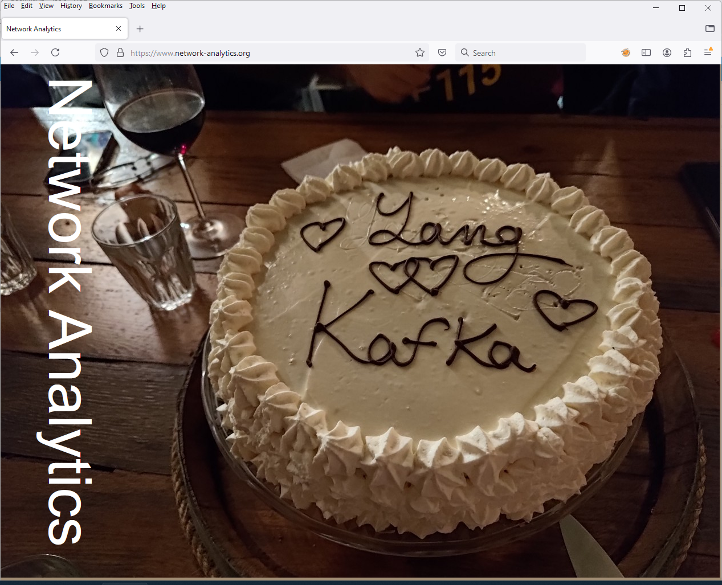
IETF YANG-Push Website How do we want to advertise…
Introduction
Overview, what does it address and solve. Example: https://cbor.io/
How to Implement
Describes which features are in which MVP feature set and references to IETF documents an open-source reference implementations.
How to Deploy and Use
List implementations and describe which MVP feature sets are available in which implementation.
Demonstrate in video implementation examples to how to query and dashboard the collected metrics.
Quick deployment guide on how to setup the YANG data processing chain (data collection, message broker, normalization, timeseries data base, OLAP UI). Example: https://imply.io/blog/an-end-to-end-streaming-analytics-stack-for-network-telemetry-data/
Stay Up to Date
IETF, development and collaboration news
https://www.network-analytics.org/

