Slide 1
YANG Groupings for UDP Clients and UDP Servers draft-ietf-netconf-udp-client-server-06
Two YANG 1.1 modules
to support the configuration of UDP clients and UDP servers
A. Huang Feng, INSA-Lyon
P. Francois, INSA-Lyon
K. Watsen, Watsen Networks
March 18th 2025

Slide 2
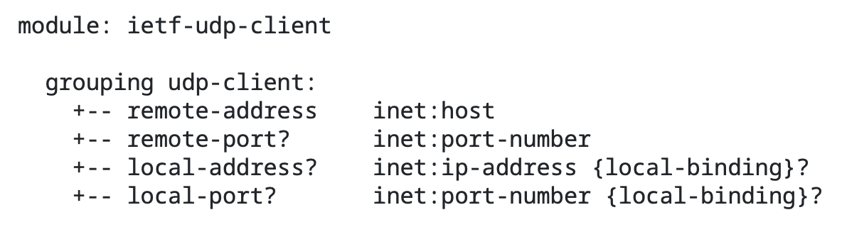
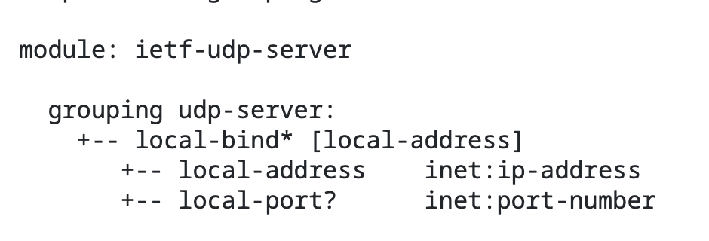
YANG Groupings for UDP Clients and UDP Servers Groupings (No changes since -05)
Client
Server
To be used
configuring a UDP client and UDP server
standalone or with other protocols
Note:
we removed “-grouping” and “-supported” suffixes (as requested by the WG)
Notes:
Comment that there was a consistency request from the WG

Slide 3
YANG Groupings for UDP Clients and UDP Servers Status
WGLC ended 20th February (closed already)
Thanks to Thomas, Benoit, Med, Andy, Mahesh and Rob for the review and comments during the WGLC
Changes:
Editorial changes (+ add consistency with RFC 9643 [TCP groupings])
Server grouping: explicit that the remote-address and local-address must be part of the same address family
New section with “Adherence to NMDA”
Security Considerations updated with latest I-D.ietf-netmod-rfc8407bis template
Ready for next steps :)

Slide 4
BACKUP

Slide 5
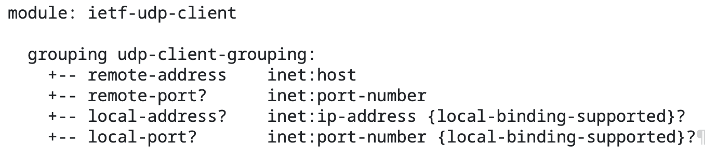
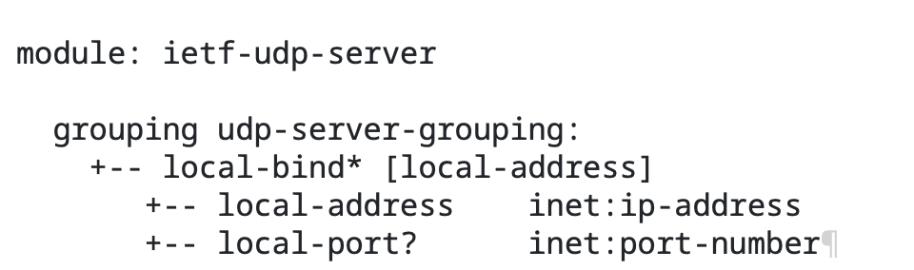
YANG Groupings for UDP Clients and UDP Servers Changes on -03 and -04
OLD
NEW

