Slide 1

Semantic Metadata Annotation for Network Anomaly Detection OPSAWG/NMRG WG
IETF 118
November 4-5th, 2023
Hackathon
draft-netana-opsawg-nmrg-network-anomaly-semantics

Slide 2
Hackathon - Plan
Finalize metadata semantics and ontology.
Create ietf-symptom-semantic-metadata.yang and ietf-incident-semantic-metadata.yang modules and update draft document accordingly.
Develop example application to annotate operational Network Telemetry (RFC 9232) data.
Support the following two use cases:
Network operator does the initial annotation based on network incident
Network operator adjusts the initial annotation from network anomaly detection system

Slide 3
Hackathon – Software
Software
Grafana
InfluxDB
…

Slide 4

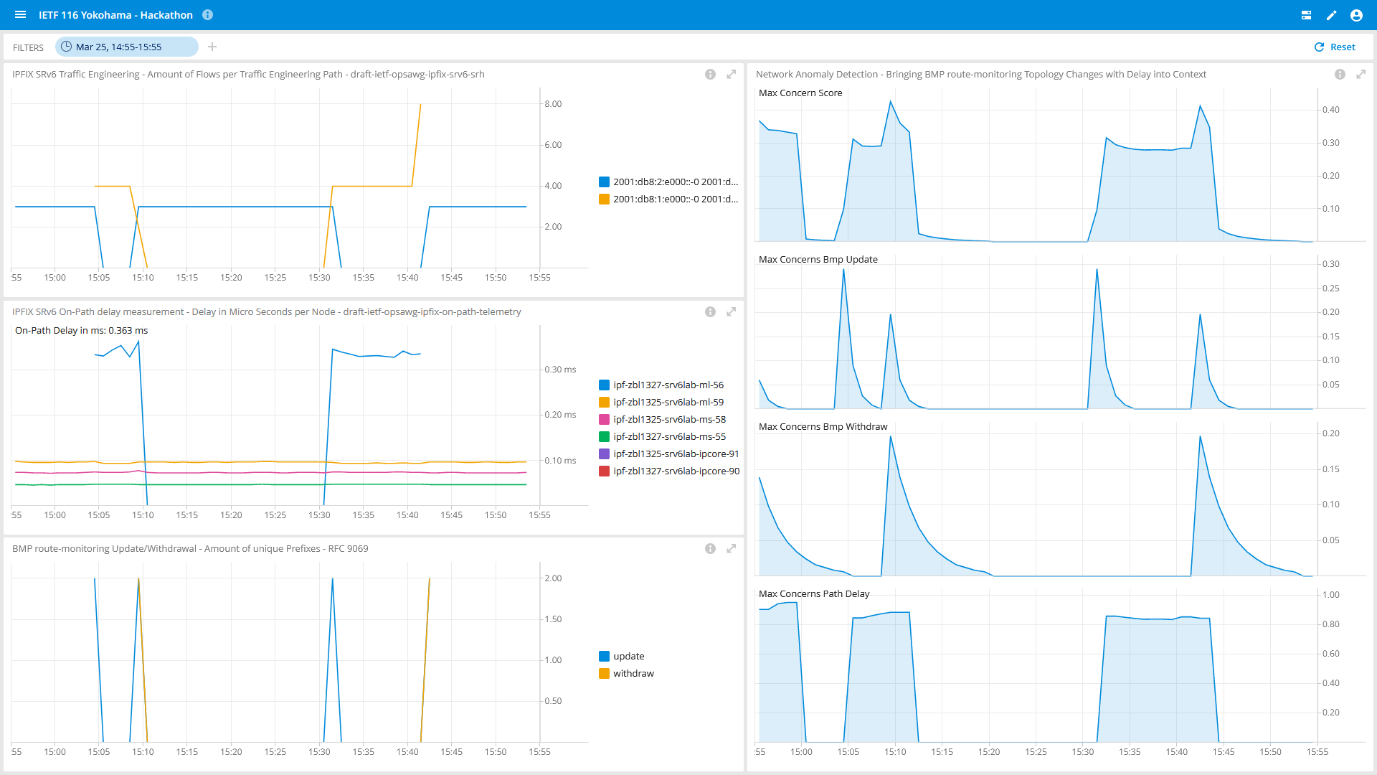
Visualization & Conclusion
Shows SRv6 SID list change of the traffic engineered paths.
Shows on which node how much on-path delay was being measured.
Shows the BGP update/withdrawals from the topology change.
Shows that Network Anomaly Detection detects the topology and delay change and the Max Concern Score calculation.
1
4
2
3

Slide 5
What we learned (again)
module: ietf-symptom-semantic-metadata
+--rw symptom
+--rw id yang:uuid
+--rw event-id yang:uuid
+--rw description string
+--rw start-timeyang:date-and-time
+--rw end-time yang:date-and-time
+--rw confidence-score float
+--rw concern-score? float
+--rw tags* [key]
| +--rw key string
| +--rw value string
+--rw (pattern)?
| +--:(drop)
| | +--rw dropempty
| +--:(spike)
| | +--rw spike empty
| +--:(mean-shift)
| | +--rw mean-shift empty
| +--:(seasonality-shift)
| | +--rw seasonality-shift empty
| +--:(trend)
| | +--rw trend empty
| +--:(other)
| +--rw other string
+--rw source
+--rw (source-type)
| +--:(human)
| | +--rw human empty
| +--:(algorithm)
| +--rw algorithm empty
+--rw name? string
Good
Preparation and good team setup is gold.
As always… the beers were most welcome!
Surprise
Finding the right simple ontology semantics which makes sense is easier said then done.

Slide 6

Thanks to…
Vincenzo Riccobene – Huawei
Wanting Du - Swisscom
Thomas Graf - Swisscom

