Slide 1
YANG Groupings for UDP Clients and UDP Servers draft-ietf-netconf-udp-client-server-06
Two YANG 1.1 modules
to support the configuration of UDP clients and UDP servers
A. Huang Feng, INSA-Lyon
P. Francois, INSA-Lyon
K. Watsen, Watsen Networks
March 18th 2025

Slide 2
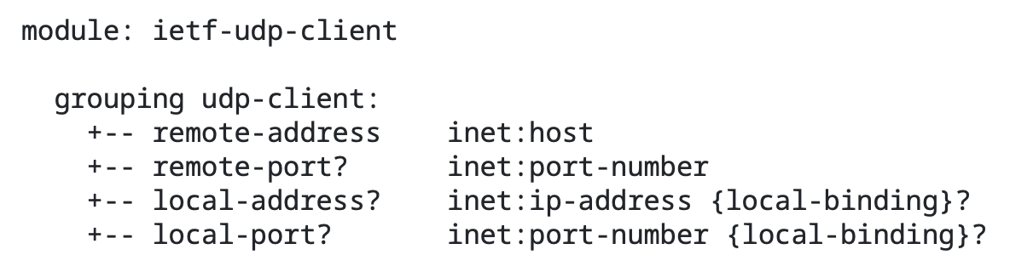
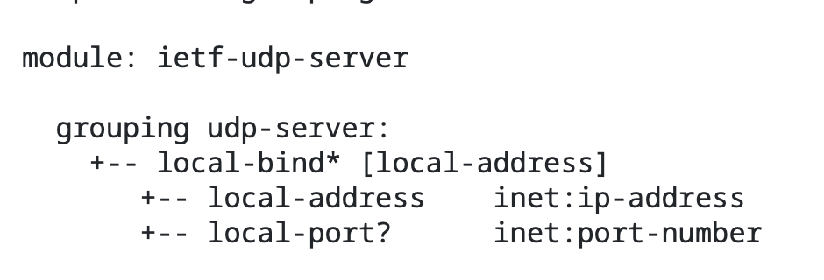
YANG Groupings for UDP Clients and UDP Servers Groupings (No changes since -05)
Client
Server
To be used
configuring a UDP client and UDP server
standalone or with other protocols
Note:
we removed “-grouping” and “-supported” suffixes (as requested by the WG)
Notes:
Comment that there was a consistency request from the WG

Slide 3
YANG Groupings for UDP Clients and UDP Servers Status
WGLC ended 20th February (closed already)
Thanks to Thomas, Benoit, Med, Andy, Mahesh and Rob for the review and comments during the WGLC
Changes:
Editorial changes (+ add consistency with RFC 9643 [TCP groupings])
Server grouping: explicit that the remote-address and local-address must be part of the same address family
New section with “Adherence to NMDA”
Security Considerations updated with latest I-D.ietf-netmod-rfc8407bis template
Ready for next steps (but got a last-minute discussion :) )

Slide 4
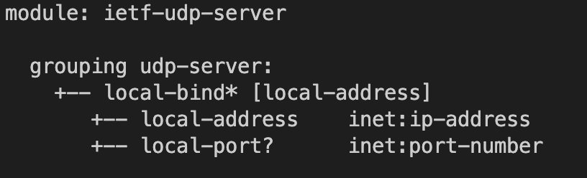
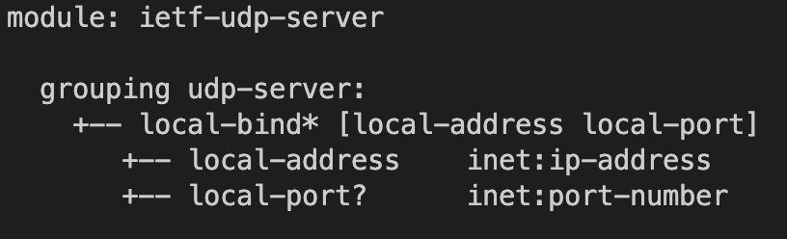
YANG Groupings for UDP Clients and UDP Servers One last discussion with Rob
Current iteration
With the current implementation, the server cannot have a ‘local-address’ bound to multiple ‘local-port’s
Reason: only ‘local-address’ is present on the ‘local-bind’ key
Note this is implemented similarly in TCP server grouping
Was discussed on the ML [1]
Question to the WG:
Is this a valid use case?
Discussed on the ML
[1] https://mailarchive.ietf.org/arch/msg/netconf/yGrkdcOZFIvLTBl0Fu6w__xxUNA/

Slide 5

YANG Groupings for UDP Clients and UDP Servers One last discussion with Rob
Current iteration
A way to fix this is changing local-port to a ‘leaf-list’ instead of a ‘leaf’
We should decide and move on (poll?):
Option A: without changes
Option B: ‘local-port’ as a leaf-list
Proposal

Slide 6
BACKUP

Slide 7
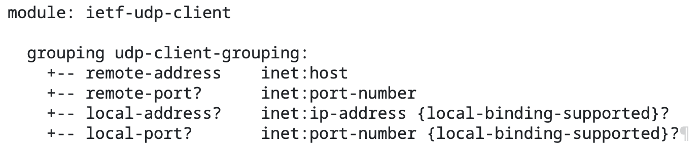
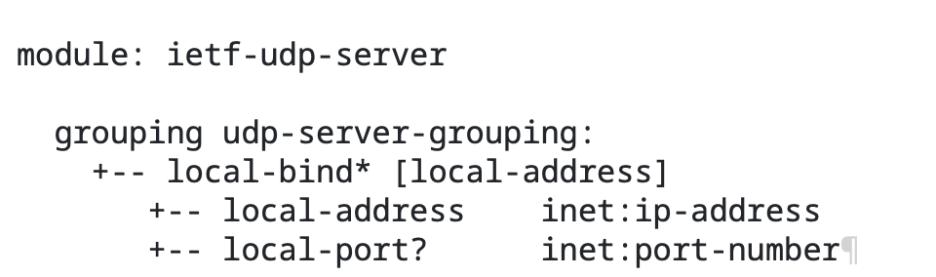
YANG Groupings for UDP Clients and UDP Servers Changes on -03 and -04
OLD
NEW

