Slide 1
BMP YANG Model for Network Telemetry Messages draft-netana-nmop-message-broker-bmp-telemetry-msg-03
A BGP Monitoring Protocol (BMP) message schema extension in YANG to be used at data collection to transform Network Telemetry messages into external systems such as Message Brokers
thomas.graf@swisscom.com paolo@ntt.net leonardo.rodoni@swisscom.com
maxence.younsi@insa-lyon.fr
16. July 2026

Slide 2
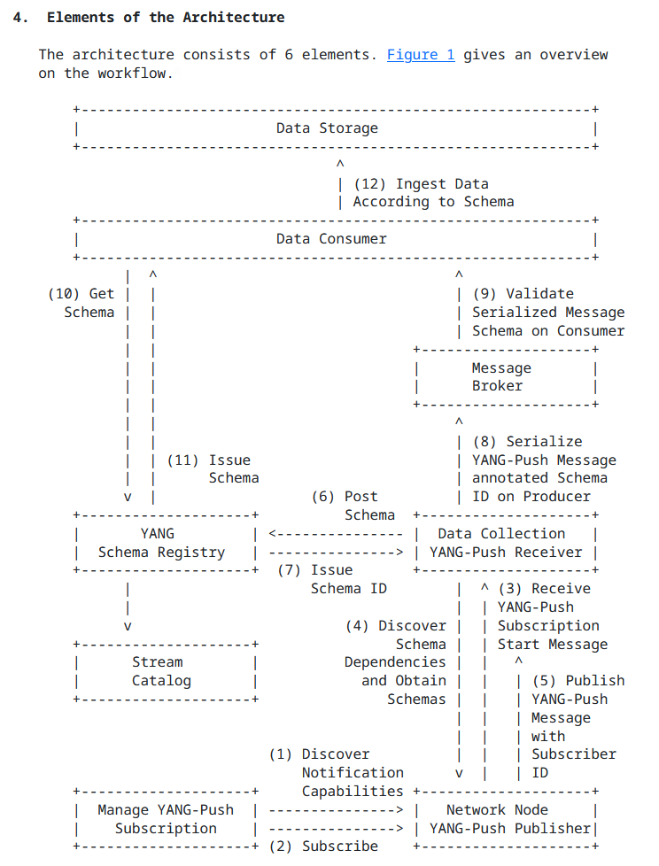
An Architecture for YANG-Push to Message Broker Integration From YANG-Push, BMP and IPFIX to Network
A network operator aims for:
An automated data processing pipeline which starts with YANG-Push, BMP and IPFIX, consolidates at Data Mesh with YANG and ends at Network Analytics.
Operational metrics where IETF defines the semantics.
Analytical metrics where network operators gain actionable insights.
These are the documents relate to the Message Broker integration:
draft-ietf-nmop-yang-message-broker-integration defines the YANG-Push to message broker integration architecture.
draft-ietf-nmop-message-broker-telemetry-message defines the message schema being used between YANG data producer and consumer.
Updated: draft-ietf-nmop-yang-message-broker-message-key defines how YANG-Push metrics can be indexed and addressed efficiently and therefore reduce the number of consumed messages and reduce the number of stored metrics with topic compaction.
Updated: draft-netana-nmop-message-broker-bmp-telemetry-msg defines the message schema extensions for BMP transformation and how message keys and topic names are derived.

Slide 3
YANG Converged Network Telemetry Data Processing Pipeline From network nodes to message broker nodes
At the YANG data producer, thanks to the YANG awareness to the YANG data producer and the YANG schema registry, for each unique YANG schema tree a message broker topic and subject is being created, and messages are being indexed and hashed according to the message key.
At the message broker, thanks to the dedicated topic per BMP message type and its YANG message key, BMP YANG state metrics such as BGP peer, BGP RIB and BMP session state can be compacted to the latest state; reducing the number of stored messages.
At the YANG data consumer, thanks to the YANG awareness of the stream catalog and consumer, a specific topic, partition and subject can be consumed for the interested BMP YANG metrics; reducing the number of messages to be consumed.

Slide 4
BMP YANG Telemetry Message Relationship with `ietf-bgp` module (IDR)
Replaced the previously redefined BGP submodules with standalone modules (ietf-bgp-rib-entry, ietf-bgp-open) that import groupings and typedefs from draft-ietf-idr-bgp-model).
Avoid duplicating BGP semantics already standardized at IDR working group.
draft-ietf-idr-bgp-model authors restructured ietf-bgp from submodules to standalone reusable modules (since submodules cannot be imported independently of the main module) and we are looking forward that these changes are being mirrored to the draft-ietf-idr-bgp-model document.
YANG modules in this document could then be simplified to import only the specific modules needed and not importing BGP configuration and policy related schema content which is not needed for telemetry use cases.
module ietf-bgp-rib-entry {
yang-version 1.1;
namespace "urn:ietf:params:xml:ns:yang:ietf-bgp-rib-entry";
prefix bre;
import ietf-inet-types { prefix inet; }
import ietf-yang-types { prefix yang; }
import iana-bgp-types { prefix bt; }
// from draft-ietf-idr-bgp-model
import ietf-bgp { prefix bgp; }
}

Slide 5
BMP YANG Telemetry Message New `ietf-bmp-tlv` module
Dedicated module modeling the decoded value of BMP TLVs, consolidates TLV groupings from multiple specs in one place:
RFC 7854 (BMP): Info, Term, RM TLVs
RFC 9069 (Loc-Rib): VRF/Table Name TLV
draft-ietf-grow-bmp-tlv (BMP v4)
Message-type specific groupings are provided, to determine which TLVs are applicable. All message-types have a common set of TLVs represented by sequence-number, timestamps, and extended-flags.
module: ietf-bmp-telemetry-message
structure message:
+-- (message-type)?
+--:(route-monitoring)
| +-- route-monitoring
| +-- peer-type peer-type
| +-- peer-flags
| | +-- ipv6-peer? boolean
| | +-- post-policy? boolean
| | +-- legacy-as-path? boolean
| | +-- adj-rib-out? boolean
| | +-- filtered? boolean
| +-- peer-distinguisher rt-types:route-distinguisher
| +-- peer-address inet:ip-address
| +-- peer-as uint32
| +-- peer-bgp-id inet:ipv4-address
| +-- timestamp? yang:date-and-time
| +-- afi-safi-type identityref
| +-- rib-entry
| +-- vrf-table-name? string
| +-- sequence-number? uint64
| +-- timestamps* [timestamp-type]
| | +-- timestamp-type timestamp-type
| | +-- timestamp yang:date-and-time
| +-- extended-flags!
| +-- ipv6-peer? boolean
| +-- post-policy? boolean
| +-- legacy-as-path? boolean
| +-- adj-rib-out? boolean
| +-- filtered? boolean

Slide 6
BMP YANG Telemetry Message New `ietf-bmp-tlv` module – BGP best path decision metadata
Route-monitoring messages might also contain path-status and relative path-status-reason-code information leaves from:
draft-ietf-grow-bmp-path-marking-tlv
Presence container with boolean leaves to represent non-mutually exclusive flags; only instantiated when router sends the Path Status TLV for the relevant route.
Optional reason-code explaining why BGP best path decision produced this path-status.
Mailing list feedback: address duplication between path-status.best and adj-rib-in-post.best-path.
module: ietf-bmp-telemetry-message
structure message:
+-- (message-type)?
+--:(route-monitoring)
| +-- route-monitoring
| +-- peer-type peer-type
| +-- peer-flags
| | +-- ipv6-peer? boolean
| | +-- post-policy? boolean
| | +-- legacy-as-path? boolean
| | +-- adj-rib-out? boolean
| | +-- filtered? boolean
| +-- peer-distinguisher rt-types:route-distinguisher
| +-- peer-address inet:ip-address
| +-- peer-as uint32
| +-- peer-bgp-id inet:ipv4-address
| +-- timestamp? yang:date-and-time
| +-- afi-safi-type identityref
| +-- rib-entry
| +-- path-status!
| | +-- invalid? boolean
| | +-- best? boolean
| | +-- nonselected? boolean
| | +-- primary? boolean
| | +-- backup? boolean
| | +-- non-installed? boolean
| | +-- best-external? boolean
| | +-- add-path? boolean
| | +-- filtered-inbound-policy? boolean
| | +-- filtered-outbound-policy? boolean
| | +-- stale? boolean
| | +-- suppressed? boolean
| | +-- reason-code?
| | path-status-reason-code

Slide 7
BMP YANG Telemetry Message New `ietf-bgp-open` module
module: ietf-bmp-telemetry-message
structure message:
+-- (message-type)?
+--:(peer-up-notification)
| +-- peer-up-notification
| +-- peer-type peer-type
| +-- peer-flags
| | +-- ipv6-peer? boolean
| | +-- post-policy? boolean
| | +-- legacy-as-path? boolean
| | +-- adj-rib-out? boolean
| | +-- filtered? boolean
| +-- peer-distinguisher rt-types:route-distinguisher
| +-- peer-address inet:ip-address
| +-- peer-as uint32
| +-- peer-bgp-id inet:ipv4-address
| +-- timestamp? yang:date-and-time
| +-- local-address? inet:ip-address
| +-- local-port? inet:port-number
| +-- remote-port? inet:port-number
| +-- sent-open
| | +-- version uint8
| | +-- my-as uint32
| | +-- hold-time uint16
| | +-- bgp-identifier inet:ipv4-address
| | +-- capabilities* [code index]
| | +-- code uint8
| | +-- index uint8
| | +-- name? identityref
| | +-- value
| | +-- mpbgp
| | | +-- afi? iana-rt-types:address-family
| | | +-- safi? iana-rt-types:bgp-safi
| | | +-- name? identityref
| | +-- graceful-restart
| | | +-- flags?
| | | | bt:graceful-restart-flags
| | | +-- unknown-flags? bits
| | | +-- restart-time?
| | | | bt:graceful-restart-time-type
| | | +-- afi-safis*
| | | +-- afi?
| | | | iana-rt-types:address-family
| | | +-- safi?
| | | | iana-rt-types:bgp-safi
| | | +-- afi-safi-flags?
| | | | bt:graceful-restart-flags-for-afi
| | | +-- afi-safi-unknown-flags? bits
| | +-- asn32
| | | +-- as? inet:as-number
| | +-- add-paths
| | +-- afi-safis*
| | +-- afi? iana-rt-types:address-family
| | +-- safi? iana-rt-types:bgp-safi
| | +-- mode? enumeration
Standalone grouping `bgp-open` exposing the BGP OPEN message fields defined in RFC 4271 (BGP-4).
Complements ietf-bgp (IDR) by making OPEN message fields reusable outside full BGP config models.
Used in peer-up-notification, capturing both sides of the negotiation with sent-open and received-open.

Slide 8
BMP YANG Telemetry Message New `session-metadata` presence container
BMP Initiation message is sent once per session, subsequent per-peer messages carry no equivalent router-identity information.
An optional presence session-metadata container is introduced, reusing previously defined ietf-bmp-tvl:information grouping.
A collector implementation SHOULD cache the Init content per BMP session and populate session-metadata in every subsequent message.
module: ietf-bmp-telemetry-message
structure message:
+-- session-metadata!
| +-- string* string
| +-- sys-descr? string
| +-- sys-name? string
| +-- vrf-table-name? string
+-- version uint8
+-- (message-type)?

Slide 9
BMP YANG Telemetry Message Message Broker Topic Naming Concept
BMP data can be subscribed for BMP session and BGP peering session state-changes, BGP peering statistics or BGP RIB states. as defined in Section 3.1 of RFC 7854.
Two topics carry all BMP data:
state-changes-and-statistic: all BMP message types in real-time (including statistics)
current-state: all BMP message types except statistics, topic-compacted (i.e. the broker retains only the latest message per message-key, resulting in the current state per each router RiB)
Optional organizational prefix MAY be prepended with – separator (e.g. nmop-bmp-current-state).
A consumer MAY subscribe to either or both topics depending on the needs.

Slide 10
BMP YANG Telemetry Message Message Broker Keys and Indexes
Message Key is a 2-line byte string constructed with:
Node hostname
YANG instance-identifier path into the ietf-bmp-telemetry-message instance data
Used by the Message Broker for indexing and topic compaction.
For a route-monitoring message, adding prefix and path-id to the key means the message key uniquely identifies a single rib-entry, so topic compaction naturally keeps only the latest update per prefix from the same peer.
NOTE: '\' is used for line folding.
Key:
router-nyc-01
/ietf-bmp-telemetry-message:/
message/route-monitoring\
[peer-type='global-instance-peer']\
[peer-distinguisher='0:0:0']\
[peer-address='203.0.113.45']\
[peer-as='65002']\
[peer-bgp-id='203.0.113.1']\
/rib-entry/ipv4-unicast/adj-rib-in-post/route\
[prefix='192.0.2.0/24']\
[path-id='0']
Headers:
schema-id: 5
content-type: application/yang-data+json
partition-key: router-nyc-01

Slide 11
BMP YANG Telemetry Message Dedicated Partition Key for deterministic per-router partitioning
BMP requires message ordering, and Message Brokers only guarantee ordering within a partition.
Introduce a Partition Key (=hostname of the network node), distinct from the Message Key.
Partition Key is used by a custom partitioner implementation in the Message Broker producer to ensure that all BMP messages from a given router end up in the same partition.
NOTE: '\' is used for line folding.
Key:
router-nyc-01
/ietf-bmp-telemetry-message:/
message/route-monitoring\
[peer-type='global-instance-peer']\
[peer-distinguisher='0:0:0']\
[peer-address='203.0.113.45']\
[peer-as='65002']\
[peer-bgp-id='203.0.113.1']\
/rib-entry/ipv4-unicast/adj-rib-in-post/route\
[prefix='192.0.2.0/24']\
[path-id='0']
Headers:
schema-id: 5
content-type: application/yang-data+json
partition-key: router-nyc-01

Slide 12
Questions to… NMOP
Does the topic naming concept and the split between Message and Partition key makes sense?
Do you agree on the data modeling of the BMP related metadata. Any comments?
Do you still resonate of having BMP and IPFIX data being transformed to YANG and integrated uniformly to Message Broker to ease data consumption for network operation and next generation AI applications?

Slide 13
Next Steps Extend model, working group adoption and code contribution
Extend document to cover:
Support additional BGP address families (labeled-unicast, l3vpn-unicast, l2vpn,…)
Improve BMP Statistics modeling (identityref/enumeration of statistics-type)
Clarify authoritative timestamps (when BMP header timestamp and TLVs are present
Address mailing list feedback
Request NMOP working group feedback adoption.
Implement document in BMP data collection and YANG Message Broker Producer.

Slide 14
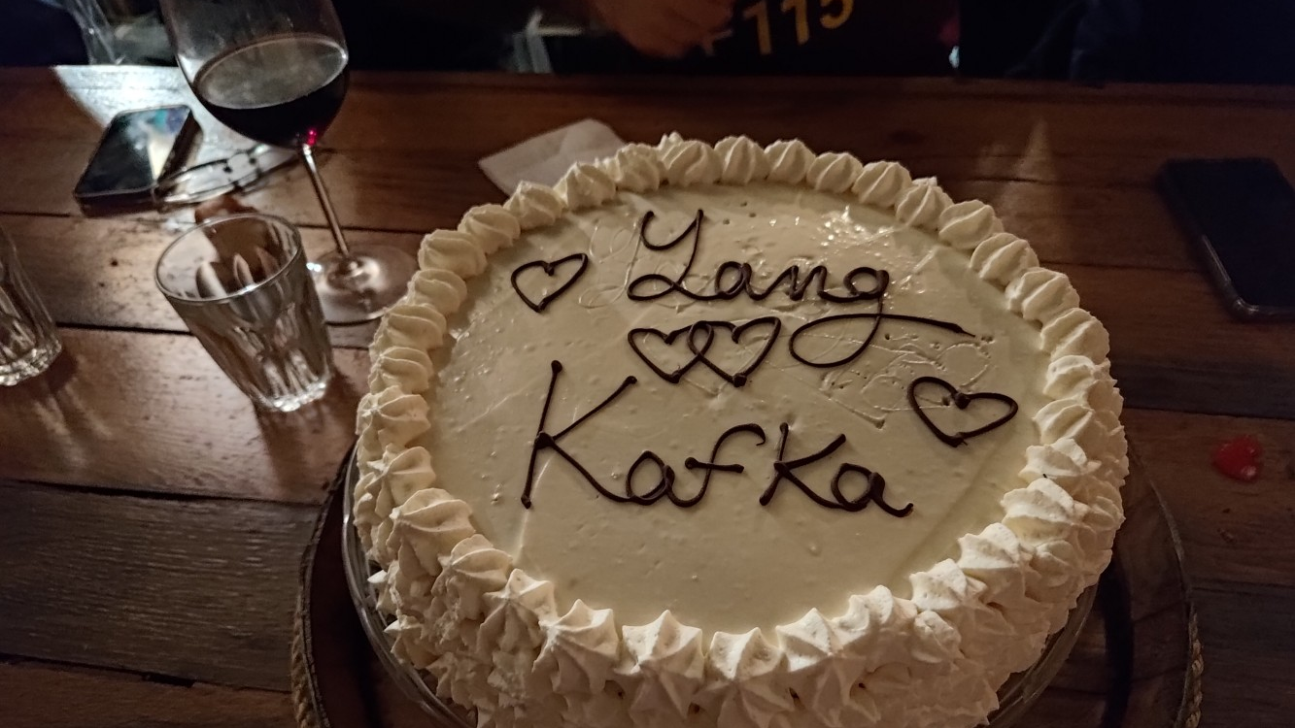
…and BMP and soon also IPFIX as well

