Slide 1
YANG model for NETCONF Event Notifications draft-ahuang-netconf-notif-yang-05
A. Huang Feng, INSA-Lyon
P. Francois, INSA-Lyon
T. Graf, Swisscom
B. Claise, Huawei
September 19th 2024

Slide 2
YANG model for NETCONF Event Notifications Problem statement - Netconf Notification
<notification xmlns="urn:ietf:params:xml:ns:netconf:notification:1.0">
<eventTime>2022-09-02T10:59:55.32Z</eventTime>
<push-update xmlns="urn:ietf:params:xml:ns:yang:ietf-yang-push">
<id>101</id>
<datastore-contents>
<interfaces xmlns="urn:ietf:params:xml:ns:yang:ietf-interfaces">
<interface>
<name>eth0</name>
<oper-status>up</oper-status>
</interface>
</interfaces>
</datastore-contents>
</push-update>
</notification>
{
"ietf-notification:notification": {
"eventTime": "2017-10-25T08:00:11.22Z",
"ietf-yang-push:push-update": {
"id": 1011,
"datastore-contents": {
"ietf-interfaces:interfaces": [
"interface": {
"name": "eth0",
"oper-status": "up"
}
]
}
}
}
}
RFC 5277 - Netconf Event Notifications
RFC 8641 - YANG Push
YANG encodings:
RFC 7950 - YANG XML
RFC 7951 - YANG JSON
RFC 9254 - YANG CBOR
Implementation Issues:
(1) YANG module not defined
(2) Non-existing Normative text defining this header

Slide 3
YANG-Push Specifications Dependencies
RFC8641 YANG-Push
Defines the “push-update” and “push-change-update” Notifications statements
Relies in Subscribed Notifications [RFC8639] for
RPCs for configuring the subscription
How the notification is encoded
RFC8639 Subscribed Notifications
Defines the RPCs for configuring subscriptions to Datastores
Relies in Netconf Event Notifications [RFC5277] for
How the notification is encoded [XML]
RFC5277 Netconf Event Notifications
Defines XML-based mechanism for sending notifications
Model of the notification structure implemented in XML

Slide 4
YANG-Push Specifications Dependencies
What happens if we look for the Notification definitions from a YANG perspective?
RFC7950 YANG 1.1 XML
RFC7951 JSON encoding for YANG 1.1
RFC9254 CBOR encoding for YANG 1.1

Slide 5
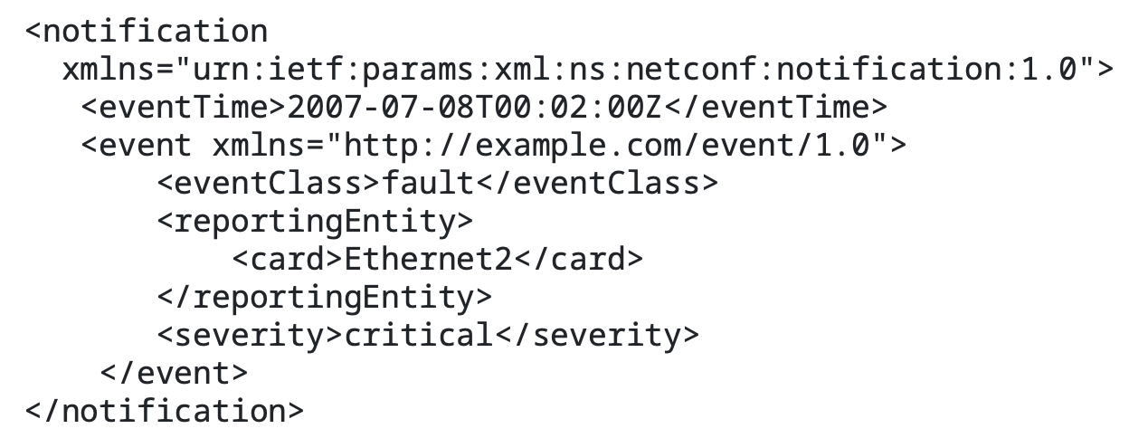
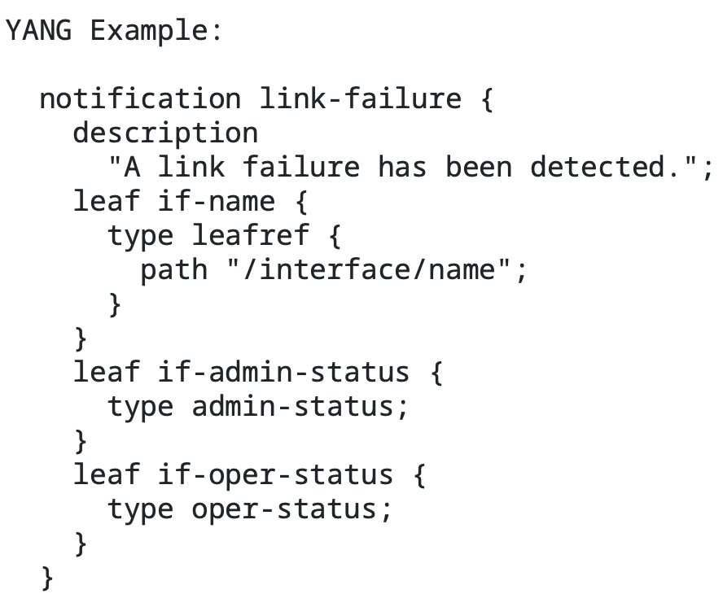
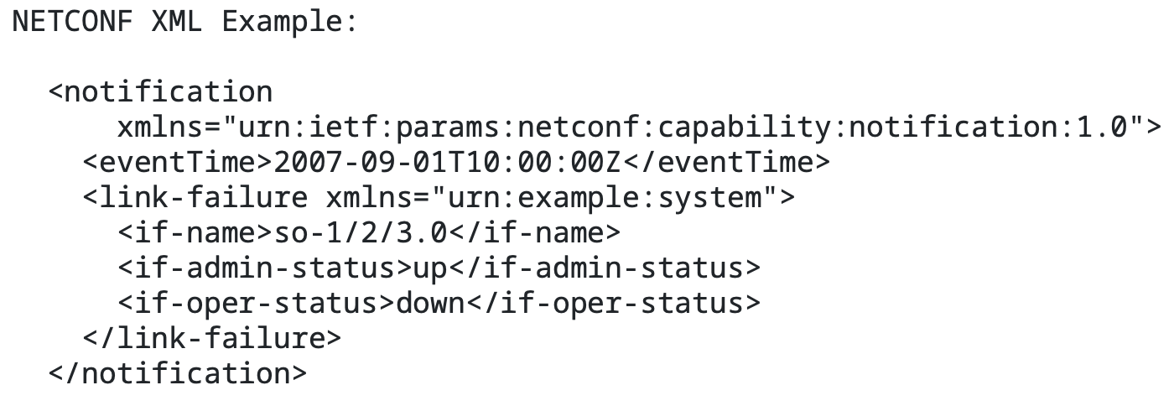
Notifications encoded in XML/YANG-JSON/YANG-CBOR
RFC5277 (NETCONF Event Notifications) Defines the structure of the Notification and XML examples:
RFC7950 (YANG 1.1) Section 4.2.10, defines how Notifications should be encoded when modeled in YANG:
Notes:
Regarding the SID range request for this YANG module, I would like to ask the Netconf WG for guidelines. Should all new YANG modules defining notifications request for a SID / SID range?

Slide 6
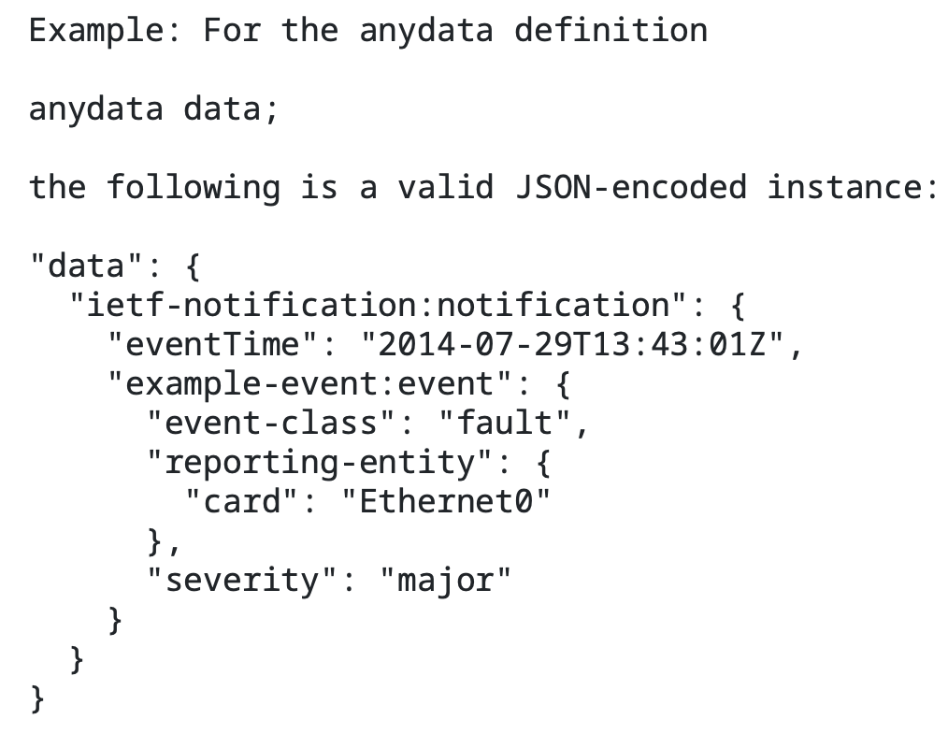
Notifications encoded in XML/YANG-JSON/YANG-CBOR
RFC7951 (YANG-JSON):
Notifications are not explicitly covered
Example in Section 5.5 covering how “anydata” statements should be encoded:
eventTime as defined in RFC5277 present
Notes:
Regarding the SID range request for this YANG module, I would like to ask the Netconf WG for guidelines. Should all new YANG modules defining notifications request for a SID / SID range?

Slide 7
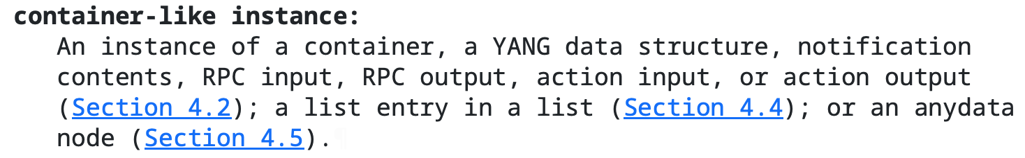
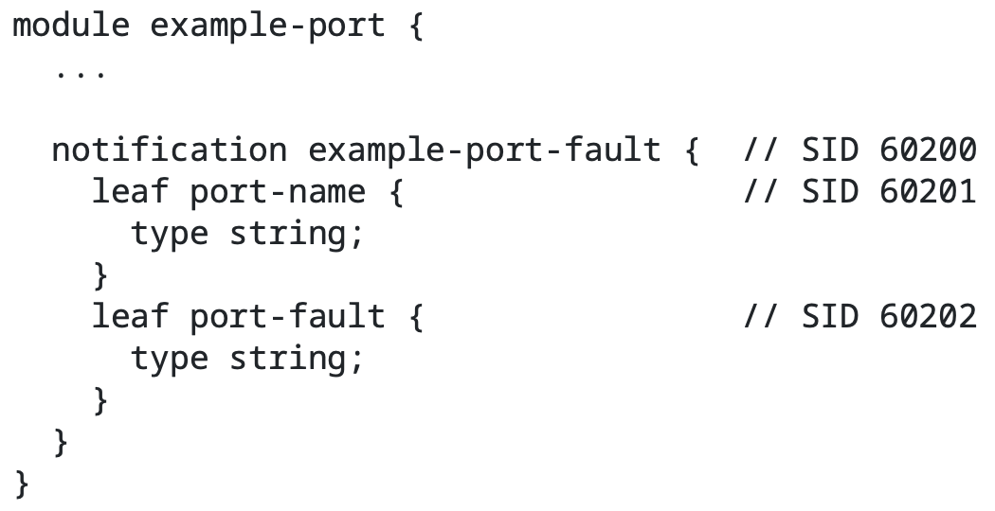
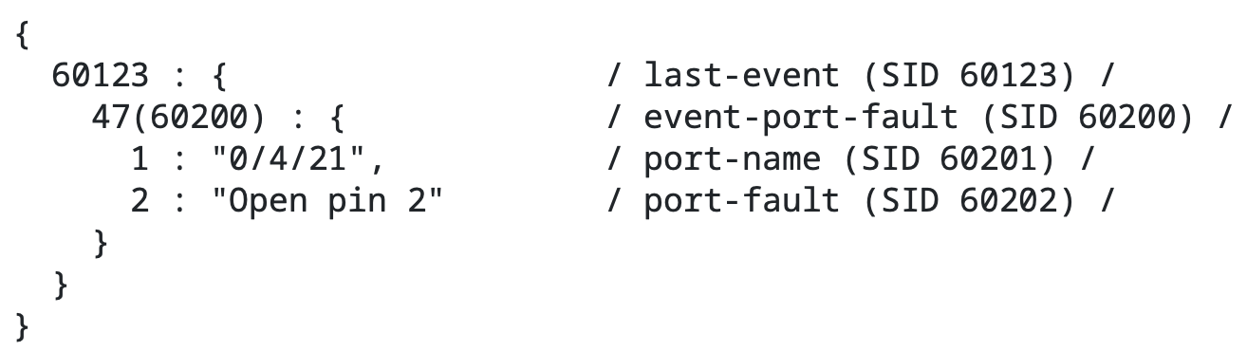
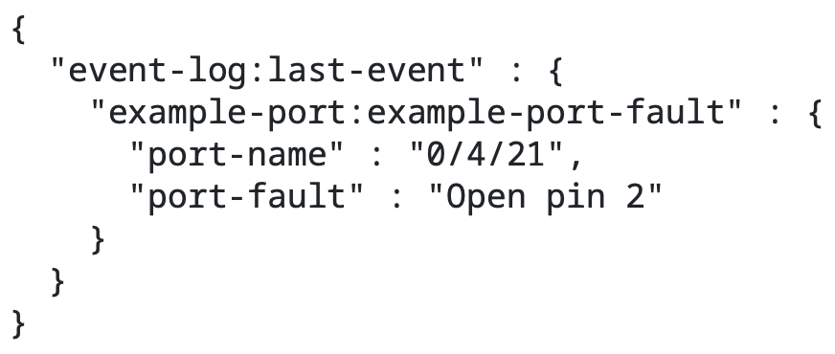
Notifications encoded in XML/YANG-JSON/YANG-CBOR
RFC9254 (YANG-CBOR):
Notifications are not explicitly covered
Defines a Notification as a “container-like” structure:
An example of a “notification” statement is in Section 4.5 covering “anydata” statements
Using YANG-SID
ietf-notification:notification container missing
eventTime leaf missing
Using names in keys
Notes:
Regarding the SID range request for this YANG module, I would like to ask the Netconf WG for guidelines. Should all new YANG modules defining notifications request for a SID / SID range?

Slide 8
YANG model for NETCONF Event Notifications Proposal Summary
(1) Use Normative text to explicit how message need to be encoded [mimick RFC8040 RESTCONF]
(2) Definition of the notification structure in a YANG
(3) RESTCONF out of the scope of the document
Updates multiple RFCs:
RFC5277 (NETCONF Notifications) → The Notification is defined in this RFC, using XML
RFC8639 (Subscribed Notifications) → The Notification uses the definition of RFC5277
RFC7951 (YANG JSON) → Notifications are not explicitly defined
RFC9254 (YANG CBOR) → Notifications are “container-like” instances

Slide 9
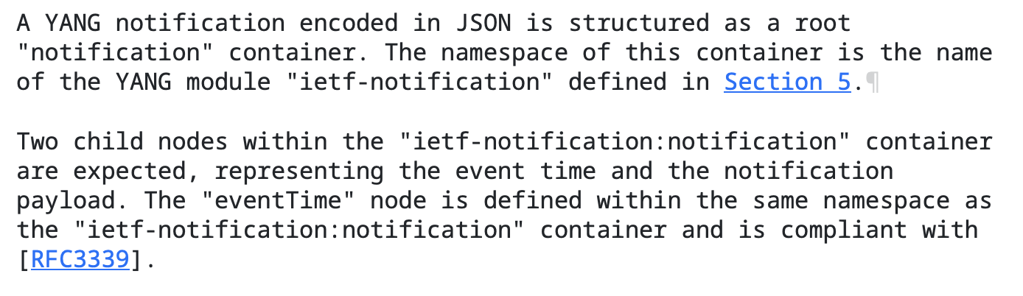
YANG model for NETCONF Event Notifications Proposal (1) – Use Normative Text
(1) Use Normative text to explicit how message need to be encoded [mimick RFC8040]
Normative text for each encoding and including an example: XML, JSON, CBOR
Section 4.2. JSON encoding

Slide 10
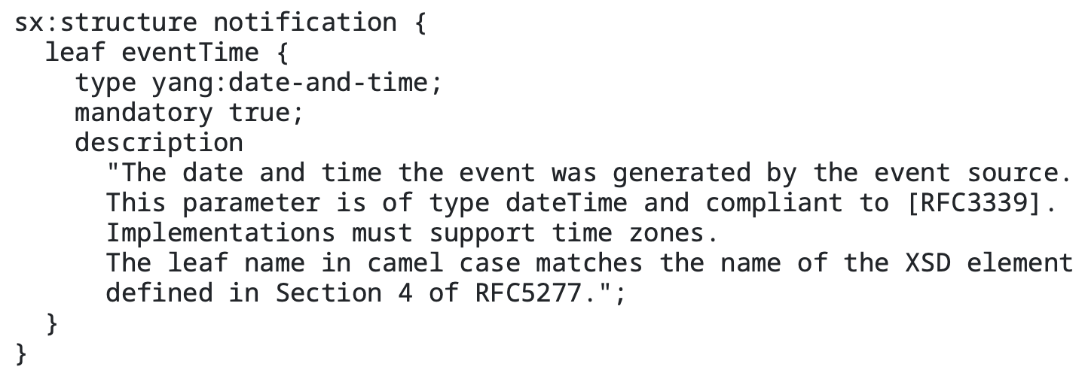
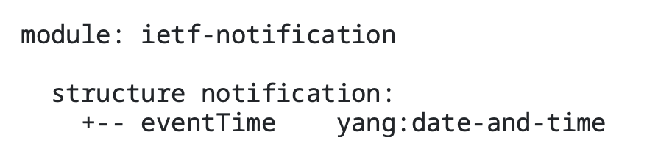
YANG model for NETCONF Event Notifications Proposal (2) – Define a YANG module
(2) Definition of the notification structure in a YANG
Definition of the notification structure in a YANG
Uses the same XML URI as RFC5277
“eventTime” in CamelCase following model defined in RFC5277
*Structure definition based on the feedback on the list [Oct 17, 2022]: https://mailarchive.ietf.org/arch/msg/netconf/q2nf9Da05R3YIusPhbt6TwMo4Q8/

Slide 11
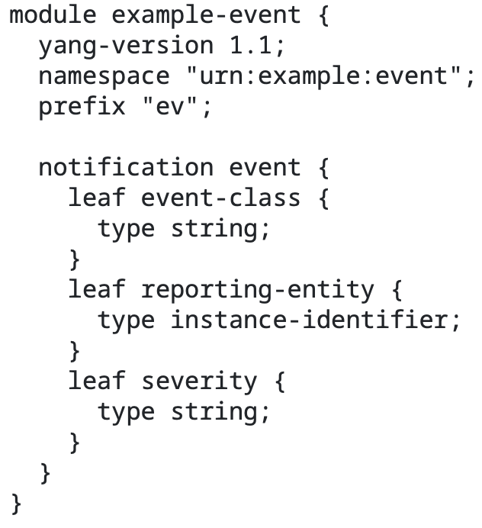
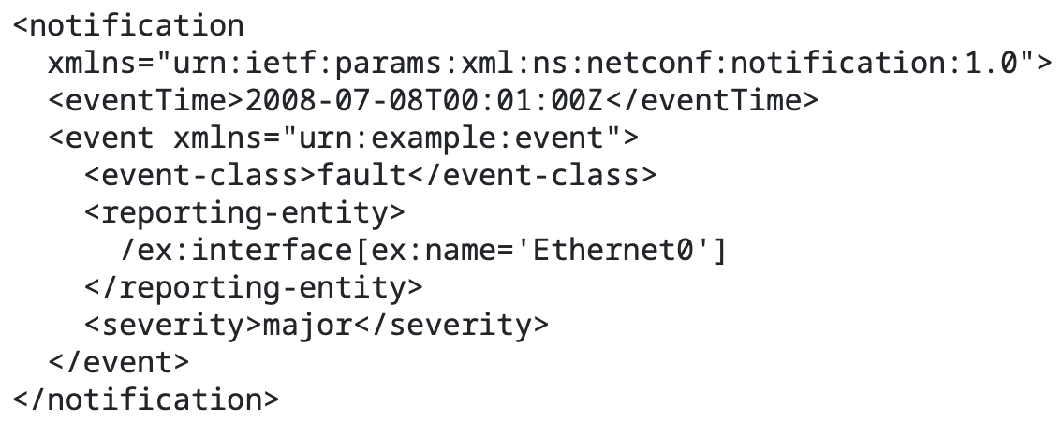
Why the YANG module defines a “structure” rather than a “container”?
Section 7.16.3 of RFC7950 defines:

Slide 12
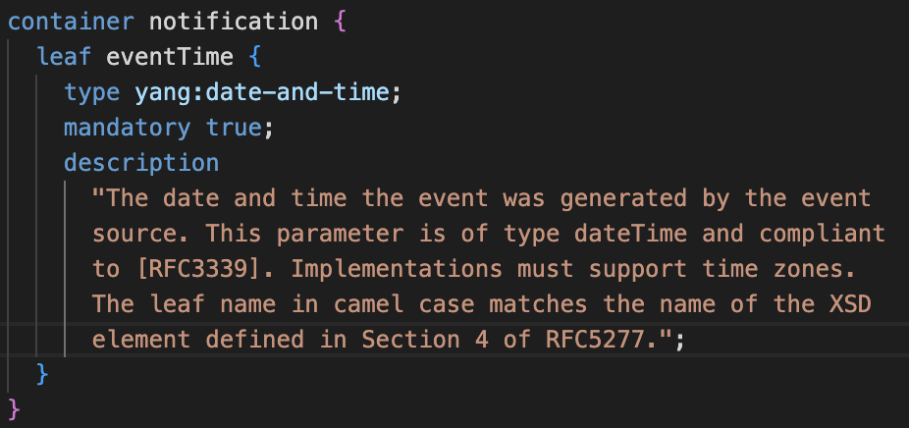
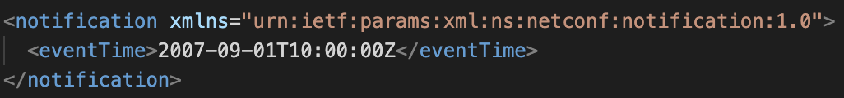
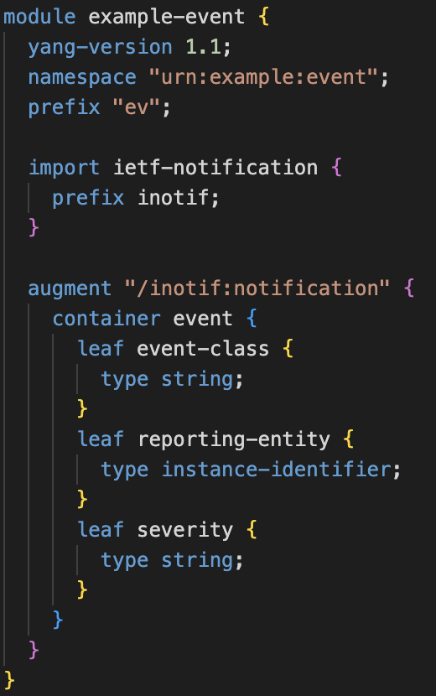
Why the YANG module defines a “structure” rather than a “container”?
If we define the notification as a container:
The notification defined in Section 7.16.3 of RFC7950 needs to be defined as augmentation rather than using the “notification” statement. Otherwise, the relationship is between “example-event” and “ietf-notification” is non-existant.

Slide 13
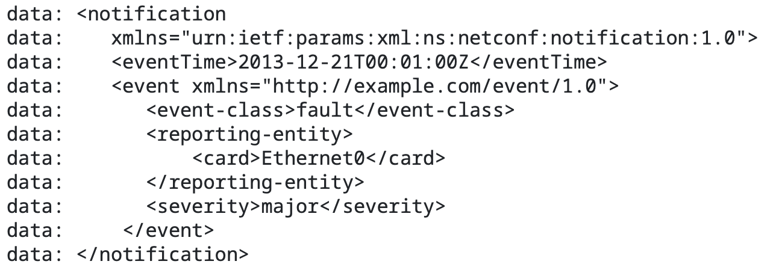
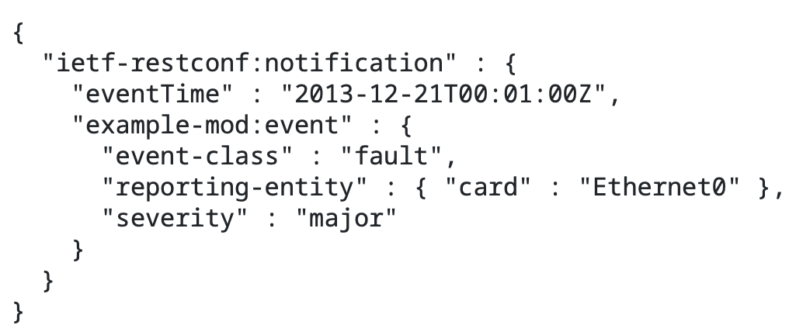
YANG model for NETCONF Event Notifications Proposal (3) – RESTCONF out of scope
(3) RESTCONF out of the scope of the document
Namespace of a notification for RESTCONF remains “ietf-restconf” as defined in RFC8040 (Sec. 6)
XML notification from RFC8040
JSON notification from RFC8040

Slide 14
YANG model for NETCONF Event Notifications Status (last IETF meeting)
Clear interest from the WG
Plenty of support during the WG adoption call
Addressed Mohamed Boucadair’s comments on -05 iteration
Triggered other discussions related to YANG-Push

Slide 15
YANG model for NETCONF Event Notifications Questions to the WG
(1) Is updating the RFCs the way to fix this issue?
(2a) Is normative text the way to solve this gap?
(2b) Is providing a YANG module definition the way to solve this gap?
Do we have a rough consensus on using a struct in the YANG definition?
(3) Do we have a rough consensus that this header should be extensible?
Next steps:
➢ Find consensus
➢ WG Adoption
Notes:
Regarding the SID range request for this YANG module, I would like to ask the Netconf WG for guidelines. Should all new YANG modules defining notifications request for a SID / SID range?

Slide 16
Notification Header Extensions

Slide 17
Extend Netconf Notifications with Hostname and Sequence Number Extends ietf-notification and ietf-system-capabilities
module: ietf-notification-sequencing
augment /sysc:system-capabilities/notc:subscription-capabilities:
+--ro sysname-sequence-supported? notification-support {sysname-sequence}?
augment-structure /inotif:notification:
+-- sysName inet:host
+-- sequenceNumber yang:counter32
YANG-Push [RFC8641] uses the same structure defined in [RFC5277]. [RFC5277] defines the structure using XML encoding. For other YANG encodings, [I-D.ahuang-netconf-notif-yang] describes how notifications should be encoded in JSON and CBOR.
An implementation supporting this document extends the notification defined in Section 4 of [I-D.ahuang-netconf-notif-yang] adding a sysName and a sequenceNumber. Two more child nodes within the "notification" root container are expected, representing the sysName and the sequenceNumber.
YANG-related system capabilities can be discovered by subscribing to the datastore defined in [RFC9196]. This document augments the "ietf-notification-capabilities" defined in Section 5 of [RFC9196] so that the YANG-Push receiver can learn the capabilities defined in this documents through the datastore.
{
"ietf-notification:notification": {
"eventTime": "2023-03-25T08:30:11.22Z",
"ietf-notification-sequencing:sysName": "example-router",
"ietf-notification-sequencing:sequenceNumber": 1,
"ietf-yang-push:push-update": {
"id": 6666,
"ietf-yp-observation-time:observation-time": "2023-02-04T16:30:09.44Z",
"ietf-yp-observation-time:point-in-time": "current-accounting",
"datastore-contents": {
"ietf-interfaces:interfaces": [
{
"interface": {
"name": "eth0",
"type": "iana-if-type:ethernetCsmacd",
"oper-status": "up",
"mtu": 1500
}
}
]
}
}
}
}

Slide 18
Extend Netconf Notifications with Hostname and Sequence Number And adds a new Netconf Capability
<hello xmlns="urn:ietf:params:xml:ns:netconf:base:1.0">
<capabilities>
<capability>
urn:ietf:params:xml:ns:netconf:base:1.0
</capability>
<capability>
urn:ietf:params:netconf:capability:startup:1.0
</capability>
<capability>
urn:ietf:params:netconf:capability:notification:1.0
</capability>
<capability>
urn:ietf:params:netconf:capability:notification-sysname-sequence:1.0
</capability>
</capabilities>
<session-id>4</session-id>
</hello>
Adds a new capability to NETCONF so that the NETCONF server can notify the support of the sysName and sequenceNumber to the NETCONF client.
In the capability exchange between the NETCONF client and server, the server will announce this capability along with the supported capabilities by the server as shown in the example.

Slide 19
BACKUP

Slide 20
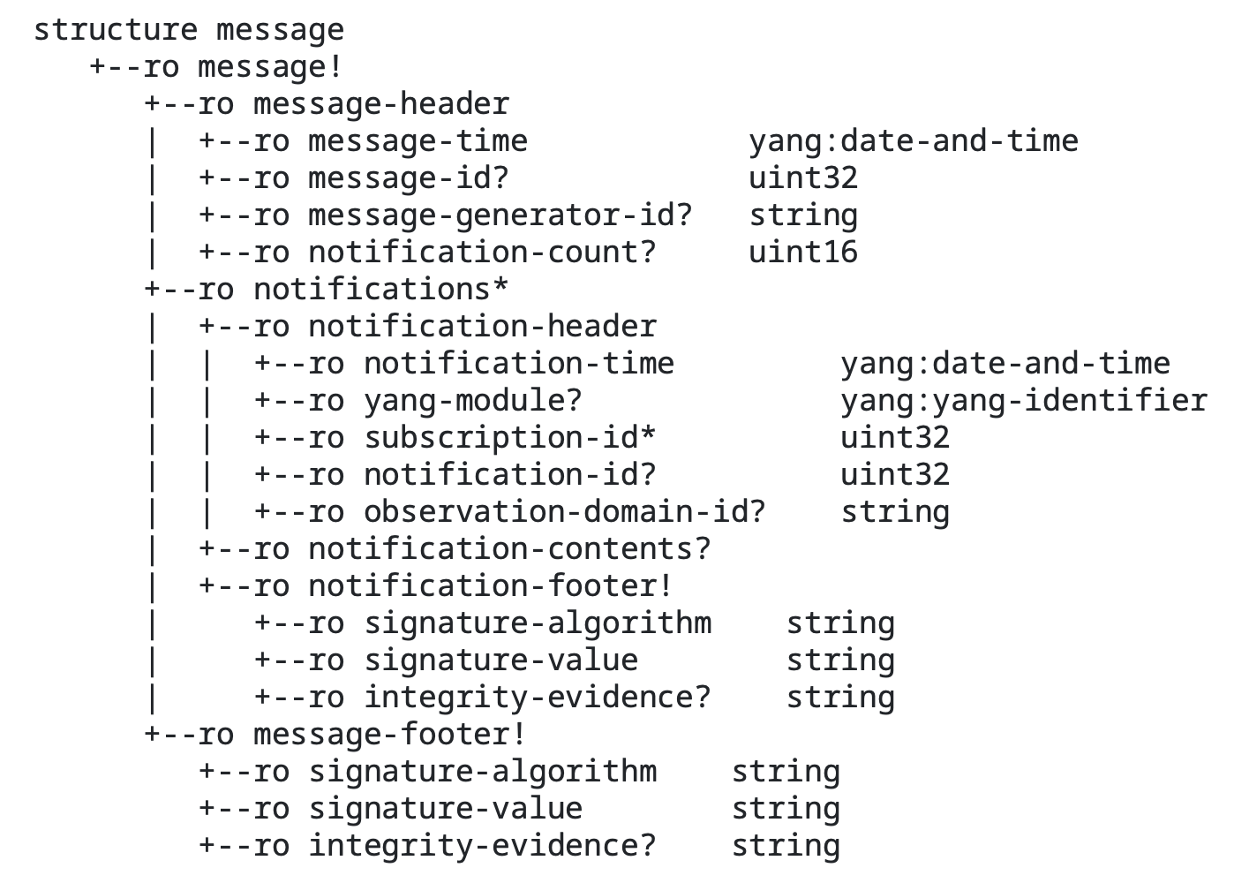
BACK UP: Difference with draft-ietf-netconf-notification-messages
draft-ietf-netconf-notification-messages
draft-ahuang-netconf-notif-yang
Notes:
Regarding the SID range request for this YANG module, I would like to ask the Netconf WG for guidelines. Should all new YANG modules defining notifications request for a SID / SID range?

