Slide 1

Validate YANG-Push to Message Broker End-To-End Data Processing Chain IETF 125 Hackathon, March 14-15th 2026
NMOP & NETCONF WG

Slide 2
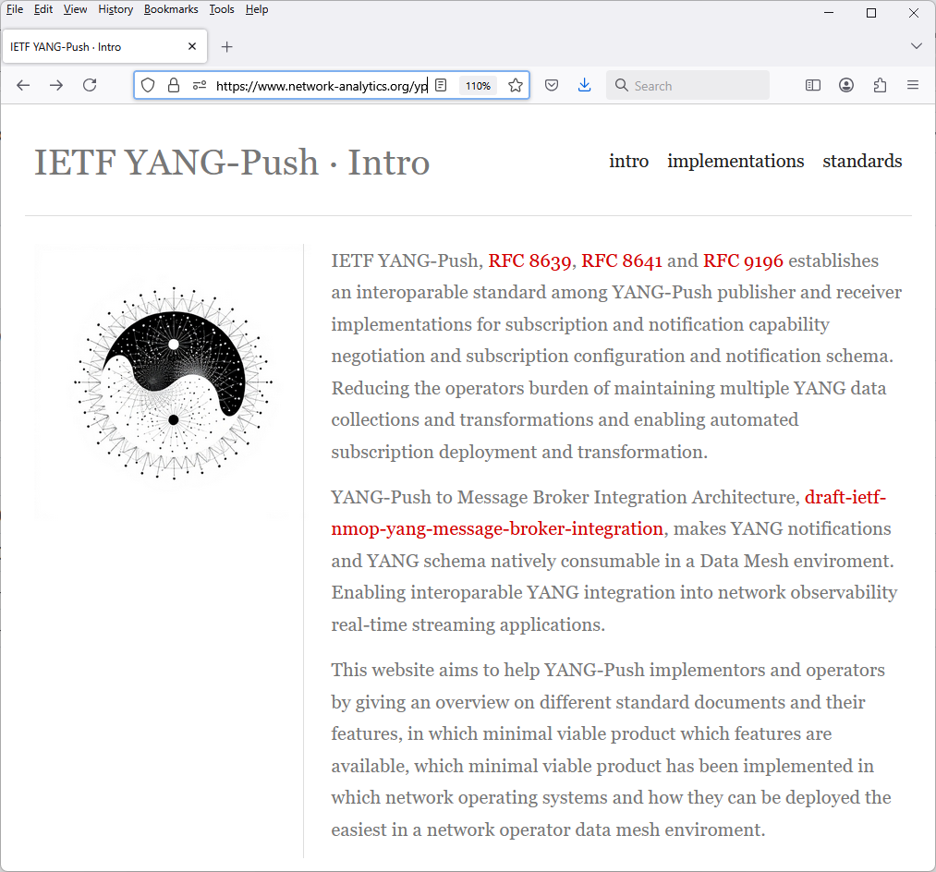
Hackathon Plan, Software and Website
Test Plan
Validate and verify
5 YANG-Push Publishers
2 YANG-Push Receivers
2 YANG-Push Network Telemetry Message
1 YANG Message Broker Producer and Schema Registry
3 YANG Message Broker Consumers
implementation in YANG data integration automation. Subscribe to YANG data on YANG-Publisher, obtain and register all YANG modules necessary to build YANG schema tree, register YANG schemas to Schema Registry and verify YANG notifications against scheme trees and produce and consume from Message Broker.
Software
YANG-Push Publisher - Cisco IOS XR, 6WIND VSR, Huawei NE (Router) and MA (OLT) and Arrcus Arcos
YANG-Push Receiver – Netgauze and Pmacct
YANG Message Broker Producer – Netgauze
YANG Message Broker Consumer – Netgauze, Ciena Blueplanet UAA Workflow Engine, Cisco Crosswork Ingestion Service
YANG Schema Registry – Apache Kafka YANG Plugin
Libyang - https://github.com/CESNET/libyang/compare/master...devel
Yangkit - https://github.com/yang-central/yangkit/pull/41
Wireshark - udp-notif dissector
NMOP & NETCONF WG
https://www.network-analytics.org/yp/how-to-deploy.html

Slide 3
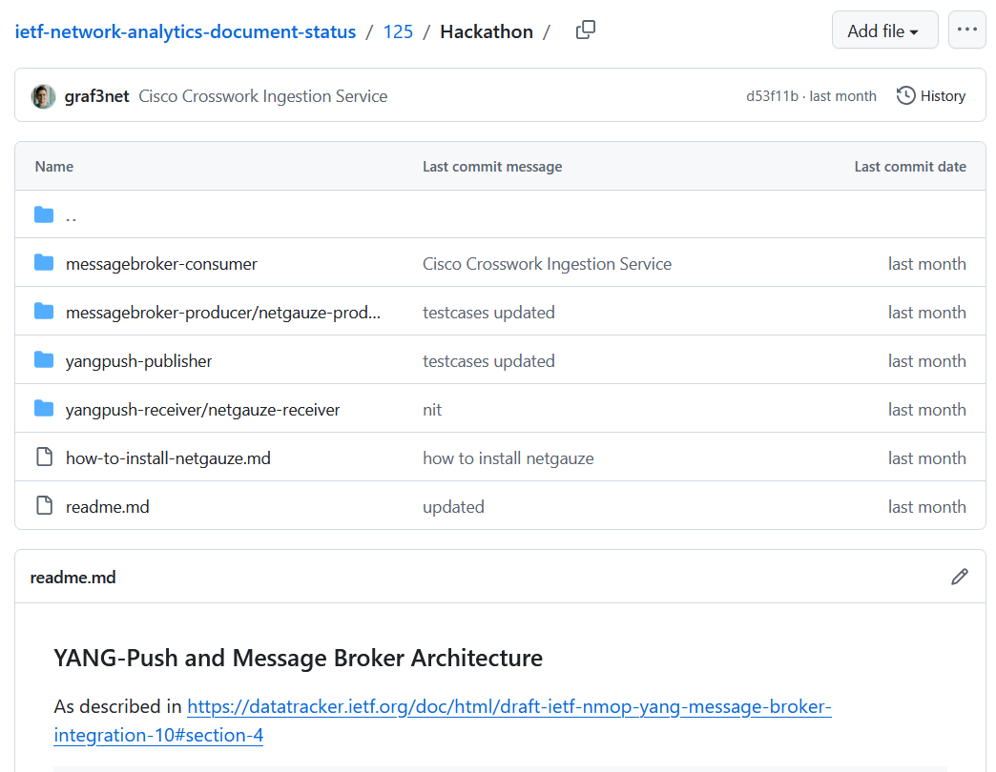
Hackathon – Repositories
Test Results on End to End Tests
Netconf RPCs and YANG-Push JSON encoded notifications with wire captures from receiver
YANG-Push Receiver cache content generation with YANG library context, YANG modules, metadata and notification schema validation logs
YANG Message Broker Producer serialization logs
YANG Schema Registry schema examples
YANG Message Broker Consumer, serialization logs, YANG library context, YANG modules and message schema validation
NMOP & NETCONF WG
https://github.com/network-analytics/ietf-network-analytics-document-status/tree/main/125/Hackathon/

Slide 4
An Architecture for YANG-Push to Message Broker Integration draft-ietf-nmop-yang-message-broker-integration draft-ietf-nmop-message-broker-telemetry-message draft-ietf-nmop-yang-message-broker-message-key draft-netana-nmop-message-broker-bmp-telemetry-message
+------------------------------------------------------------+
| Data Storage |
+------------------------------------------------------------+
^
| (12) Ingest Data
| According to Schema
+------------------------------------------------------------+
| Data Consumer |
+------------------------------------------------------------+
| ^ ^
(10) Get | | | (9) Validate
Schema | | | Serialized Message
| | | Schema on Consumer
| | +--------------------+
| | | Message |
| | | Broker |
| | +--------------------+
| | ^
| | | (8) Serialize
| | (11) Issue | YANG-Push Message
| | Schema | annotated Schema
v | (6) Post | ID on Producer
+--------------------+ Schema +--------------------+
| YANG | <--------------- | Data Collection |
| Schema Registry | ---------------> | YANG-Push Receiver |
+--------------------+ (7) Issue +--------------------+
| Schema ID | ^ (3) Receive
| | | YANG-Push
v (4) Discover | | Subscription
+--------------------+ Schema | | Start Message
| Stream | Dependencies | | ^
| Catalog | and Obtain | | | (5) Publish
+--------------------+ Schemas | | | YANG-Push
| | | Message
| | | with
(1) Discover | | | Subscriber
Notification v | | ID
+--------------------+ Capabilities +--------------------+
| Manage YANG-Push | ---------------> | Network Node |
| Subscription | ---------------> | YANG-Push Publisher|
+--------------------+ (2) Subscribe +--------------------+
Subscription to YANG Notifications RFC 8639
Subscription to YANG Notifications for Datastore Updates RFC 8641
UDP-based Transport for Configured Subscriptions draft-ietf-netconf-udp-notif
Subscription to Distributed Notifications draft-ietf-netconf-distributed-notif
Extensible YANG Model for YANG-Push Notifications draft-ietf-netconf-notif-envelope
Support of Versioning in YANG Notifications Subscription draft-ietf-netconf-yang-notifications-versioning
YANG Modules Describing Capabilities for Systems and Datastore Update Notifications RFC 9196
YANG Notification Transport Capabilities draft-ietf-netconf-yp-transport-capabilities
YANG Library RFC 8525
Augmented-by Addition into the IETF-YANG-Library draft-ietf-netconf-yang-library-augmentation
Validating anydata in YANG Library context draft-ietf-netmod-yang-anydata-validation
Encoding of Data Modeled with YANG in the CBOR RFC 9254
NMOP & NETCONF WG

Slide 5

YANG-Push IETF 125 Publisher Implementation Status
 | 6WIND VSR | Huawei NE | Huawei MA | Cisco IOS XR | Arrcus Arcos | Open-Source
RFC 8639 YANG-Push Subscription | ✔ | ✔ | ✔ | ✔ | ✔
RFC 8641 YANG-Push Notification | ✔ | ✔ | ✔ | ✔ | ✔
draft-ietf-netconf-udp-notif | ✔ | ✔ | ✔ | ✔ | ✔ | ✔
draft-ietf-netconf-distributed-notif | ✔ | ✔ | ✔ |  | na
draft-ietf-netconf-notif-envelope | ✔ | ✔ | ✔ | ✔ | ✔
draft-ietf-netconf-yang-notifications-versioning | ✔ | ✔ | ✔ | ✔ | ✔
RFC 8525 YANG Library | ✔ | ✔ | ✔ | ✔ | ✔
draft-ietf-netconf-yang-library-augmentation | ✔ | ✔ | ✔ | ✔ |  | ✔
RFC 9196 System and Notification Capabilities |  |  | ✔ | P | ✔
draft-netana-netconf-yp-transport-capabilities |  |  | ✔ | ✔ | ✔
RFC 9254 CBOR Named Identifiers | ✔
NMOP & NETCONF WG
NetGauze
Pmacct
udp-notif-c-collector
yang-library-augmentedby
Green marked describes new capability at IETF 125. "P" to partially implemented.

Slide 6
Operational IETF/IEEE YANG IETF 125 Module Implementation Status
 | 6WIND VSR | Huawei NE | Huawei MA | Cisco IOS XR | Arrcus Arcos
ietf-interfaces.yang (inventory, state and statistic) | ✔ | P | ✔
ietf-hardware.yang (inventory, state and statistic) | (✔) |  | ✔
ietf-alarms.yang (state) | ✔ |  | ✔
ieee802-dot1ab-lldp.yang (inventory and state) | (✔)
ieee802-dot1ax.yang (inventory, state and statistic)
ietf-bfd-ip-sh.yang (state)
ietf-bfd-ip-mh.yang (state)
ietf-bfd-lag.yang (state)
ietf-isis.yang (state)
NMOP & NETCONF WG
Green marked describes new capability at IETF 125. "P" to partially implemented.

Slide 7
YANG Message Broker IETF 125 Implementation Status
 | NetGauze | Pmacct | Apache Kafka | Ciena Blueplanet | Cisco Crosswork
draft-ietf-nmop-message-broker-telemetry-message | ✔ | ✔
YANG-Push Receiver | ✔ | ✔
YANG Schema Retrieval | ✔
YANG Message Broker Producer | ✔
YANG Schema Registry | na | na | ✔ | na | na
YANG Message Broker Consumer | ✔ |  |  | (✔) | ✔
Validate Telemetry Message against YANG Schema | ✔ |  |  | (✔) | ✔
draft-ietf-netmod-yang-anydata-validation | ✔
YANG Schema Comparison | na | na | ✔ | na | na
NMOP & NETCONF WG
NetGauze
Pmacct
Green marked describes new capability at IETF 125. "P" to partially implemented.

Slide 8

Next Steps from IETF 124 Hackathon…
Yanglint, misses anydata validation support within YANG structures
Pmacct corrects collection-timestamp to be typedef date-and-time compliant.
Pmacct corrects encoding value to include ietf-subscribed-notifications namespace in JSON encoding.
Pmacct corrects network-operator-metadata/labels/anydata-values anydata statement to be valid I-JSON.
YANG schema registry supporting YANG features
NetGauze supporting
netconf <get> to obtain YANG library content,
YANG validation for YANG-Push notifications,
YANG schema registration.
NMOP & NETCONF WG

Slide 9

Next Steps for IETF 126 and 127 Hackathon…
Re-do YANG Message Broker Consumer tests on updated testbed with Ciena Blue Planet UAA Workflow Engine
Complete IETF YANG module subscription tests with 6Wind VSR
Compare YANG feature coverage between libyang, yangkit and yangtools
Support draft-ietf-netmod-yang-anydata-validation in yangkit
Revert import only modules for augmented-by workaround
Preserve cached YANG-Push subscription state across receiver reload
Obtain YANG-Push subscription state from publisher if missing
Support Netconf session queuing for schema retrieval
Support YANG-Push Message Broker Topic Naming with dynamic Apache Kafka topic creation API
NMOP & NETCONF WG

Slide 10
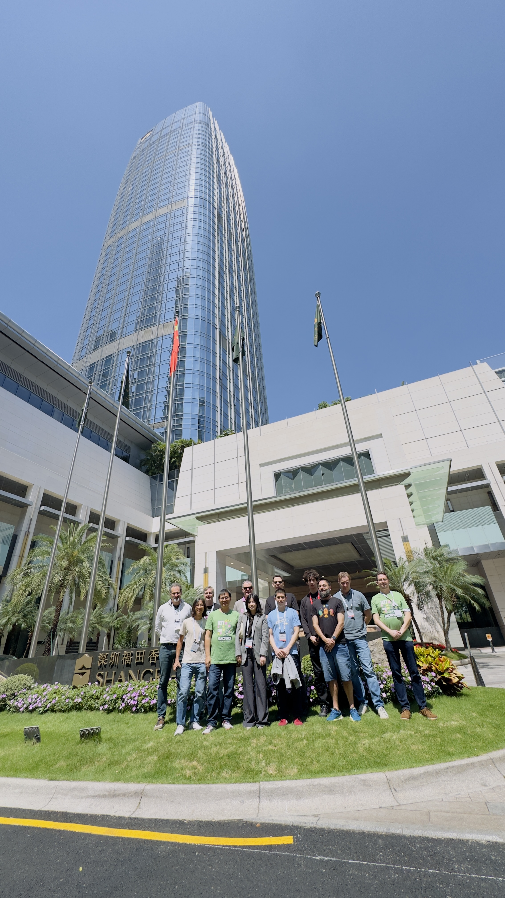
Thanks to…
Paolo Lucente – Pmacct
Qin Wu – Huawei
Michael Mackey – Huawei
Scott Huang - Cisco
Rob Wilton – Cisco
Dan Voyer – Cisco
Sivakumar Sundaravadivel – Ciena
IJsbrand Wijnands – Arrcus
Irfan Mohammad – Arrcus
Benoit Claise - Everything OPS
Wanting Du – Swisscom
Rafael Julio – Swisscom
Leonardo Rodoni - Swisscom
Ahmed Elhassany – Swisscom
Thomas Graf – Swisscom
NMOP & NETCONF WG
Want to know more than join us at…
NMOP on Friday 09:00 – 11:00 at the Grand Ballroom 1 for Message Broker, Telemetry Message and Message Key document updates and hackathon related details.

