Slide 1
Export of Gigabit Passive Optical Network Encapsulation Mode in IPFIX draft-netana-opsawg-ipfix-gpon-gem
Enabling data plane visibility in passive optical transport
of the optical distribution network in broadband access
thomas.graf@swisscom.com
zhenghaomian@huawei.com
8. April 2025

Slide 2
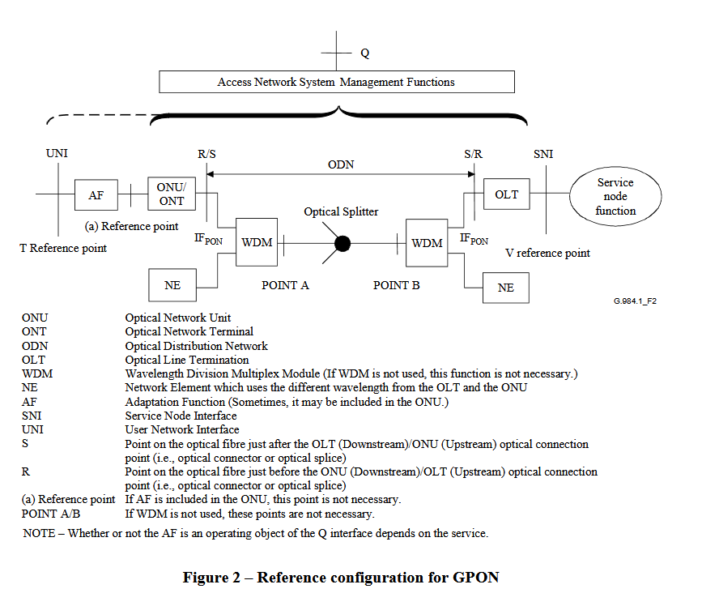
Export of GPON Encapsulation Mode in IPFIX ITU-T G.984.1 defines the General characteristics
ITU-T G.984.1 defines the General characteristics of GPON.
Figure 2 in Section 5.2 shows the Reference Configuration.
Red marked highlights the Optical Distribution Network (ODN) where GPON Encapsulation Mode (GEM) is used between ONU/ONT and OLT.

Slide 3
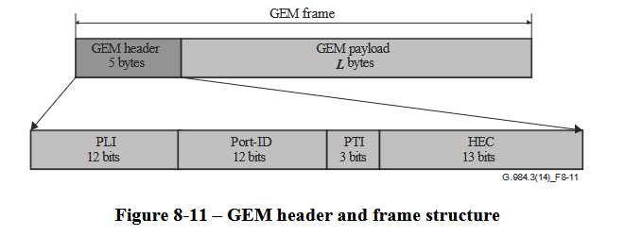
Export of GPON Encapsulation Mode in IPFIX ITU-T G.984.3 defines the transmission convergence layer
ITU-T G.984.3 defines the transmission convergence layer.
Figure 8-11 in Section 8.3.1 shows the GEM header.
The GEM header contains the payload length indicator (PLI), Port-ID, payload type indicator (PTI) and a 13-bit header error control (HEC) field.
Red marked highlights the GEM Port-ID and PTI which is of interest to account frames and bytes in IPFIX [RFC 7011], [RFC 7012] and [RFC 7015].
Payload length indicator (PLI) and header error control (HEC) are for tracing and debugging purposes interesting but not relevant for accounting. Therefore, excluded from IPFIX.

Slide 4
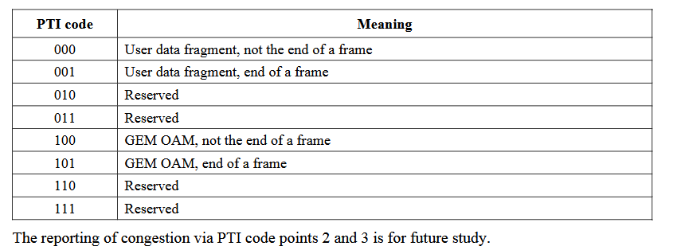
Export of GPON Encapsulation Mode in IPFIX ITU-T G.984.3 defines the PTI registry
ITU-T G.984.3 defines in Section 8.3.1 the PTI registry with below code points. Differentiate between user and OAM resp. not the end and end of the frame.

Slide 5
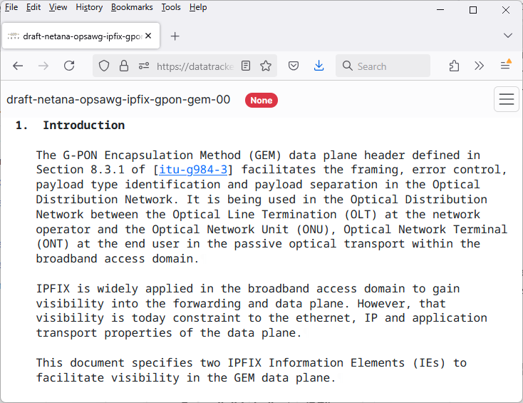
Export of GPON Encapsulation Mode in IPFIX draft-netana-opsawg-ipfix-gpon-gem defines IPFIX entities
5.1.1. gponGemPti
Name: gponGemPti
ElementID: TBD1
Description: The 3-bit GEM PTI content type field defined in Section 8.3.1 of [itu-g984-3].
Abstract Data Type: unsigned8
Data Type Semantics: flags
Additional Information: See Section 8.3.1 of [itu-g984-3] for the content type list.
Reference: [RFC-to-be]
5.1.2. gponGemPortId
Name: gponGemPortId
ElementID: TBD2
Description: The 12-bit GEM Port-ID field defined in Section 8.3.1 of [itu-g984-3].
Abstract Data Type: unsigned16
Data Type Semantics: identifier
Additional Information: See Section 8.3.1 of [itu-g984-3] for the content type list.
Reference: [RFC-to-be]

Slide 6
Export of GPON Encapsulation Mode in IPFIX Sample Use Case
GEM Port-ID is usually mapped to IEEE 802.1Q into VLAN identifier (VID) and Priority code point (PCP, IEEE 802.1p class of service) which is used for Network Slicing related use cases. Differentiate between different application and their Quality-of-Service properties.
The IPFIX IEs gponGemPti (TBD1) or gponGemPortId (TBD2), sourceMacAddress (56), destinationMacAddress (80), ingressInterface (10), egressInterface (14) and forwardingStatus (89)[RFC5102] [RFC7270] [IANA-IPFIX], and some existing counter information's [IANA-IPFIX] providing answers to the following questions (amongst others):
How many user or OAM frames are forwarded or dropped to which ONU on which egress interface and GEM Port-ID?
If dropped, for which reasons?
The received ONU frames on an OLT are mapped and forwarded depending on GEM Port-ID to a dot1qVlanId (243) and dot1qPriority (244) upstream to the provider network.
ONU ONT
GEM-Port ID 1001
GEM-Port ID 1011
GEM-Port ID 2005
ONU ONT
GEM-Port ID 1001
Optical Splitter
OLT
VLAN 100, CS 1
GEM-Port ID 1011
VLAN 101, CS 1
GEM-Port ID 2005
VLAN 200, CS 5
ONU ONT
GEM-Port ID 1001
GEM-Port ID 1011
GEM-Port ID 2005

Slide 7
Export of GPON Encapsulation Mode in IPFIX Document Status and Next Steps
First document revision published on April 7th 2025.
Implementation planned on Huawei MA5800T-X17 with IETF hackathon verification.
Request feedback and review from CCAMP.
Considering to establish ITU-T Liaison and adoption at OPSAWG.
thomas.graf@swisscom.com
zhenghaomian@huawei.com
8. April 2025

