Slide 1
An Architecture for a Network Anomaly Detection Framework draft-netana-nmop-network-anomaly-architecture-00
Motivation and architecture of a Network Anomaly Detection Framework
and the relationships to other documents describing
network symptom semantics and network incident lifecycle
wanting.du@swisscom.com pierre.francois@insa-lyon.fr
thomas.graf@swisscom.com vincenzo.riccobene@huawei-partners.com alex.huang-feng@insa-lyon.fr
25. July 2024

Slide 2
Why This I-D? A Reminder
This document describes motivation and a generic and extensible architecture of a Network Anomaly Detection Framework.
Anchors draft-netana-nmop-network-anomaly-semantics and draft-netana-nmop-network-anomaly-lifecycle documents.
Different applications will be described and exampled with open-source running code.

Slide 3






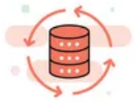

Structuring Anomaly Detection NMOP Effort Integrates into Data Mesh
Alert
Postmortem
RFC 8632
draft-netana-nmop-network-anomaly-semantics draft-netana-nmop-network-anomaly-lifecycle
Analytical Data
Network Device Trend Detection
Verify, Troubleshoot and Notify
Network Anomaly Detection
Network Visualization
Network SLI and SLO
Closed Loop Operation
draft-netana-nmop-network-anomaly-architecture
Operational Data
Network Data Collection
Network Telemetry
RFC 9232

Slide 4
What to monitor Which metrics are collected
« Network operators connect customers in routing tables called Connectivity Services »
« Network Telemetry (RFC 9232) describes how to collect data from all 3 network planes efficiently »

Slide 5



What does Network Anomaly Detection mean Monitor changes, called outliers, in networks
Answers
What changed and when, on which connectivity service, and how does it impact the customers?
Focuses
Provides meaningful connectivity service impact information before customer is aware of and support in root-cause analysis.
Data Mesh
Consumes operational real-time Forwarding Plane, Control Plane and Management Plane metrics and produces analytical alerts.
Direction
From connectivity service to network platform.
Network Anomaly Detection
For Connectivity Services, Network Anomaly Detection constantly monitors and detects any network or device topology change, along with their associated forwarding consequences for customers as outliers. Notifications are sent to the Network Operation Center before the customer is aware of service disruptions. It offers operational metrics for in-depth analysis, allowing to understand in which platform the problem originates and facilitates problem resolution.

Slide 6
What our motivation is Automate learn and improve
From network incidents postmortems we network operators learn and improve so does network anomaly detection and supervised and semi-supervised machine learning.
The more network incidents are observed, the more we can improve. With more incidents the postmortem process needs be automated, let's get organized first by defining human and machine-readable metadata semantics and annotate operational and analytical data.
Let's get further organized by exchanging standardized labeled network incident data among network operators, vendors and academia to collaborate on academic research.
« The community working on Network Anomaly Detection is probably the only group wishing for more network incidents »

Slide 7
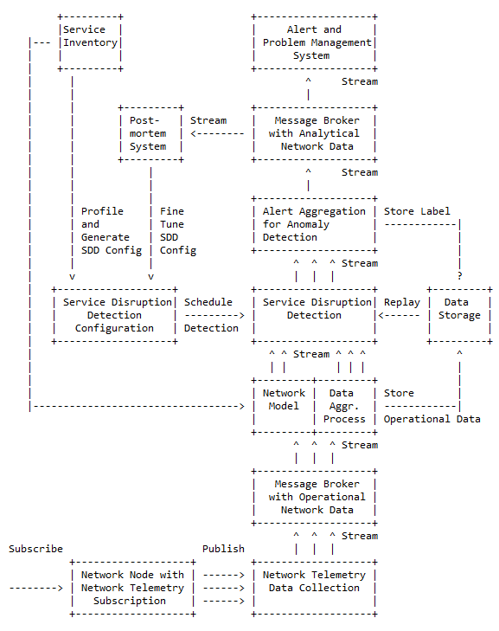
Elements of the Architecture
Service Inventory contains list of the connectivity services.
Service Disruption Detection processes aggregated network data to decide whether a service is degraded or not.
Service Disruption Detection Configuration defines the set of approaches that need to be applied to perform SDD.
Operational Data Collection manages network telemetry subscriptions and transforms data into message broker.
Operational Data Aggregation produces data upon which detection of a service disruption can be performed.
Network Modeling establishes knowledge of network relationships.
Data Profiling categorizes nondeterministic customer related data.
Detection Strategies for a profile a detection strategy is defined.
Machine Learning is commonly used to detect outliers or anomalies.
Storage some algorithms may relay on historical (aggregated) operational data to detect anomalies.
Alerting consolidates analytical insights and notifies.
Postmortem refines and stores the network anomaly and symptom labels into the Label Store.
Replaying to validate refined anomaly and symptom labels, historical operational data is replayed.

Slide 8
Semantic Metadata Annotation for Network Anomaly Detection draft-netana-nmop-network-anomaly-semantics
Goal: Enable the exchange of labelled dataset for network anomaly detection between operators, vendors and academia
module: ietf-symptom-semantic-metadata
+--rw symptom
+--rw id? yang:uuid
+--rw event-id? yang:uuid
+--rw description? string
+--rw start-time? yang:date-and-time
+--rw end-time? yang:date-and-time
+--rw confidence-score? score
+--rw concern-score? score
+--rw tags* [key]
| +--rw key string
| +--rw value string
+--rw (pattern)?
| +--:(drop)
| | +--rw drop empty
| +--:(spike)
| | +--rw spike empty
| +--:(mean-shift)
| | +--rw mean-shift empty
| +--:(seasonality-shift)
| | +--rw seasonality-shift empty
| +--:(trend)
| | +--rw trend empty
| +--:(other)
| +--rw other string
+--rw annotator
+--rw (annotator-type)
| +--:(human)
| | +--rw human empty
| +--:(algorithm)
| +--rw algorithm empty
+--rw name? string
Symptom ID and description uniquely identifies the detected symptom with its start and end time, how confident the system identified the anomaly and how concerned an operator should be.
Tags describe the semantic metadata of the symptom).
Pattern describes the identified pattern of the anomaly.
Annotator Name, Type, describes wherever the anomaly was detected by a human or algorithm and uniquely identifies the entity who/which detected.

Slide 9
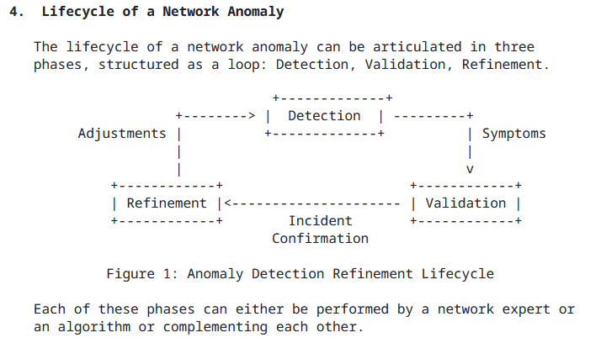
Experiment: Network Anomaly Lifecycle draft-netana-nmop-network-anomaly-lifecycle
Detection: The Network Anomaly Detection stage is about the continuous monitoring of the network through Network Telemetry [RFC9232] and the identification of symptoms.
Validation: Decides if the detected symptoms are signaling a real incident or if they are to be treated as false positives.
Refinement: Network operator performs detailed postmortem analysis of the network incident, collected Network Telemetry data and detected anomaly with the objective to identify useful adjustments in the Network Telemetry data collection and Anomaly Detection system.
« Network Anomaly Detection is an iterative process that requires continuous improvement »

Slide 10
Experiment: Network Anomaly Lifecycle draft-netana-nmop-network-anomaly-lifecycle
This draft defines:
A State machine for network anomalies spanning across the whole lifecycle
A YANG data model describing the network anomaly as a collection of symptoms
ID and Description uniquely identifies the detected network anomaly (as a container of symptoms).
Description and State provide general information regarding the anomaly and its current state in the lifecycle.
Annotator describes the entity that observed the network anomaly: this can be a human or an algorithm (anomaly detection system).
Symptoms provides a list of symptoms that are part of this network anomaly.
module: ietf-network-anomaly-metadata
+--rw network-anomalies
+--rw network-anomaly* [id version]
+--rw id yang:uuid
+--rw version uint32
+--rw description? string
+--rw state identityref
+--rw annotator
| +--rw (annotator-type)
| | +--:(human)
| | | +--rw human empty
| | +--:(algorithm)
| | +--rw algorithm empty
| +--rw name? empty
+--rw symptoms* [symptom_id]
+--rw symptom_id yang:uuid

Slide 11
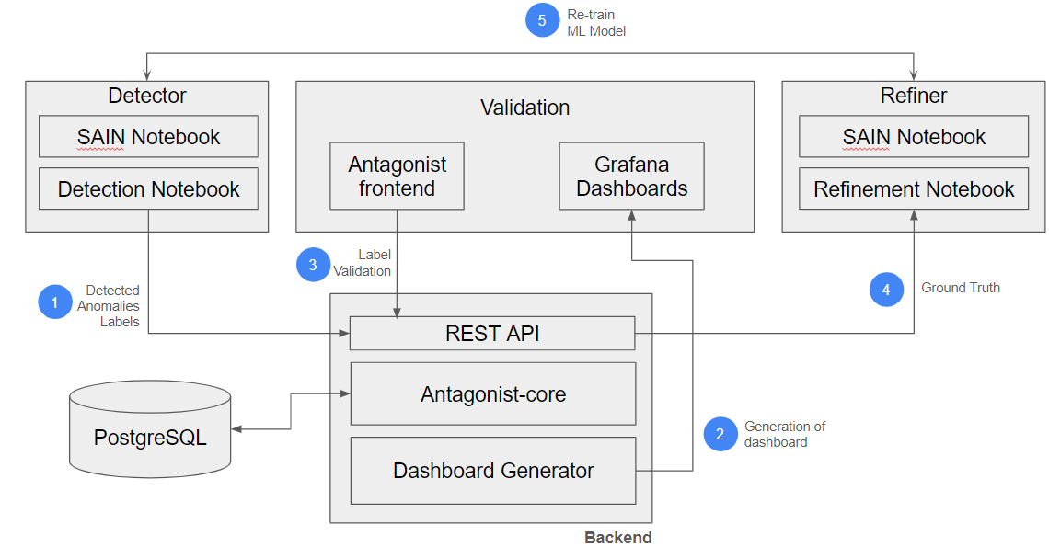
Experiment: Antagonist anomaly tagging on historical data
Goals:
Prove that YANG models contain all the necessary information
Validate models across a wide range of use-cases
Show interoperability between stages
Done so far:
Validation with real operational data (Cloud monitoring)
Validating with rule-based Network Anomaly Detector (SAIN RFC9417/RFC9418)
Validation with a ML-based Network Anomaly Detector (Autoencoder)
Add support for Re-training of ML-based models
Add partial support for Metadata Filtering and search
YANG model refinements to reflect the results of the coding
Automatic dashboard generation
Label Store
Next Steps:
Improve scalability
Refine YANG Models
Integrate and Validate with Swisscom Data

Slide 12
Swisscom - Cosmos Bright Lights PoC Summary After 20 Incidents and 18 Months Time
Key Facts in V0 (2023-2024)
16 L3 VPNs proactively monitored.
Individual Service Disruption Detection rule accuracy is beyond 90%. Summed accuracy is beyond 95%.
Max Concern score ranged between 0.06 and 0.85. In average 0.46.
In 4 cases additional YANG, in 13 cases additional BMP, in 2 cases Netconf Transaction-ID and 1 case additional L2 IPFIX metrics would have helped to gain more visibility.
Key observability feature missing: BMP Local RIB with Path Marking.
5
In Replay Incident Detected
72 Alert Notifications
15
In Near Real-Time Incident Detected
46
Falls Positive due to Apache Druid delayed ingestion
6
Falls Positive due to previous week data not comparable

Slide 13
Swisscom – PoC Detail and Outlook Multiple Perspectives increases Accuracy
Key Improvements in V1 (2024)
>12000 L3 VPNs proactively monitored since June 2024.
Realtime Streaming eliminates delayed ingestion falls positives and scaling.
Improved profiling. Compares to multiple previous weeks and discard largest deviation eliminates falls positives. -> Work In progress
Key Improvements in V2 (2025)
Annotate operational and analytical Network Incident data for reproduction.
Enabling automated workflow. From PowerPoint slide decks to data driven actionable insights.
3
One out of Six checks
2
Four out of Six checks
20 Network Incidents
6
Three out of Six checks
8
Two out of Six checks

Slide 14
An Architecture for a Network Anomaly Detection Framework Status, Summary and Next steps
Status of draft-netana-nmop-network-anomaly-architecture
Reference document to anchor anomaly detection work items.
Status of draft-netana-nmop-network-anomaly-semantics and draft-netana-nmop-network-anomaly-lifecycle
Referenced draft-netana-nmop-network-anomaly-architecture as the architecture document.
Change the term source to annotator and updated the YANG modules accordingly.
Added/updated terminology section with references to draft-ietf-nmop-terminology and draft-netana-nmop-network-anomaly-architecture.
Moved data mesh and outlier detection section to draft-netana-nmop-network-anomaly-architecture.
Next Steps
Request adoption for all 3 anomaly detection documents starting with draft-netana-nmop-network-anomaly-architecture.
NMOP interim meeting on September 11th proposal
Network incident postmortem examples from Swisscom and Bell Canada
Detailing documents, updates and hackathon experiment results
Invite other operators to contribute on experiments

Slide 15
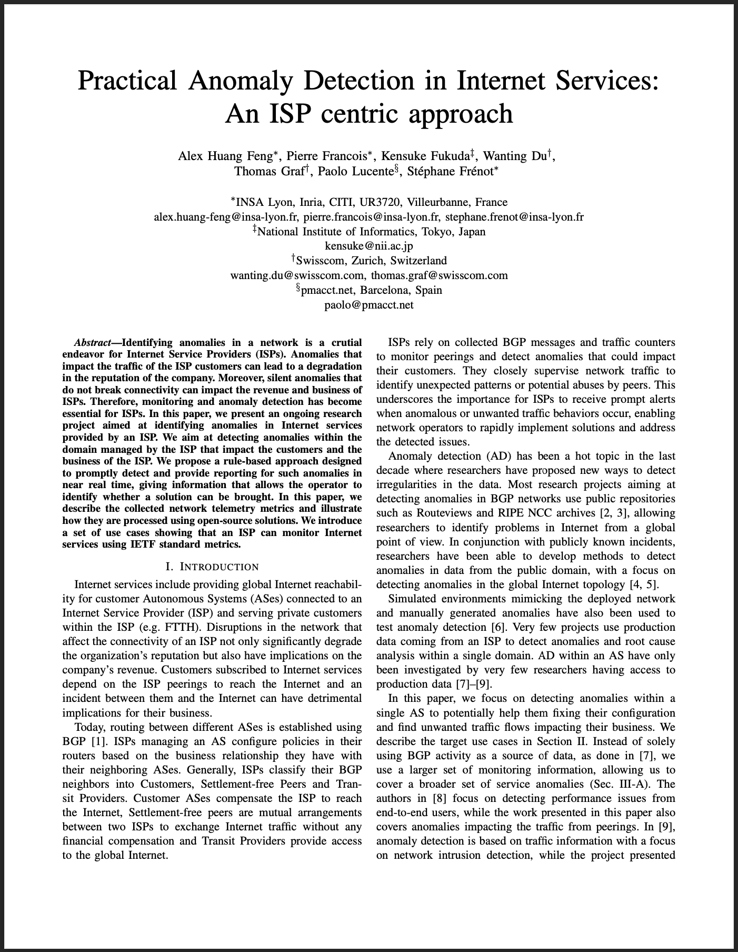
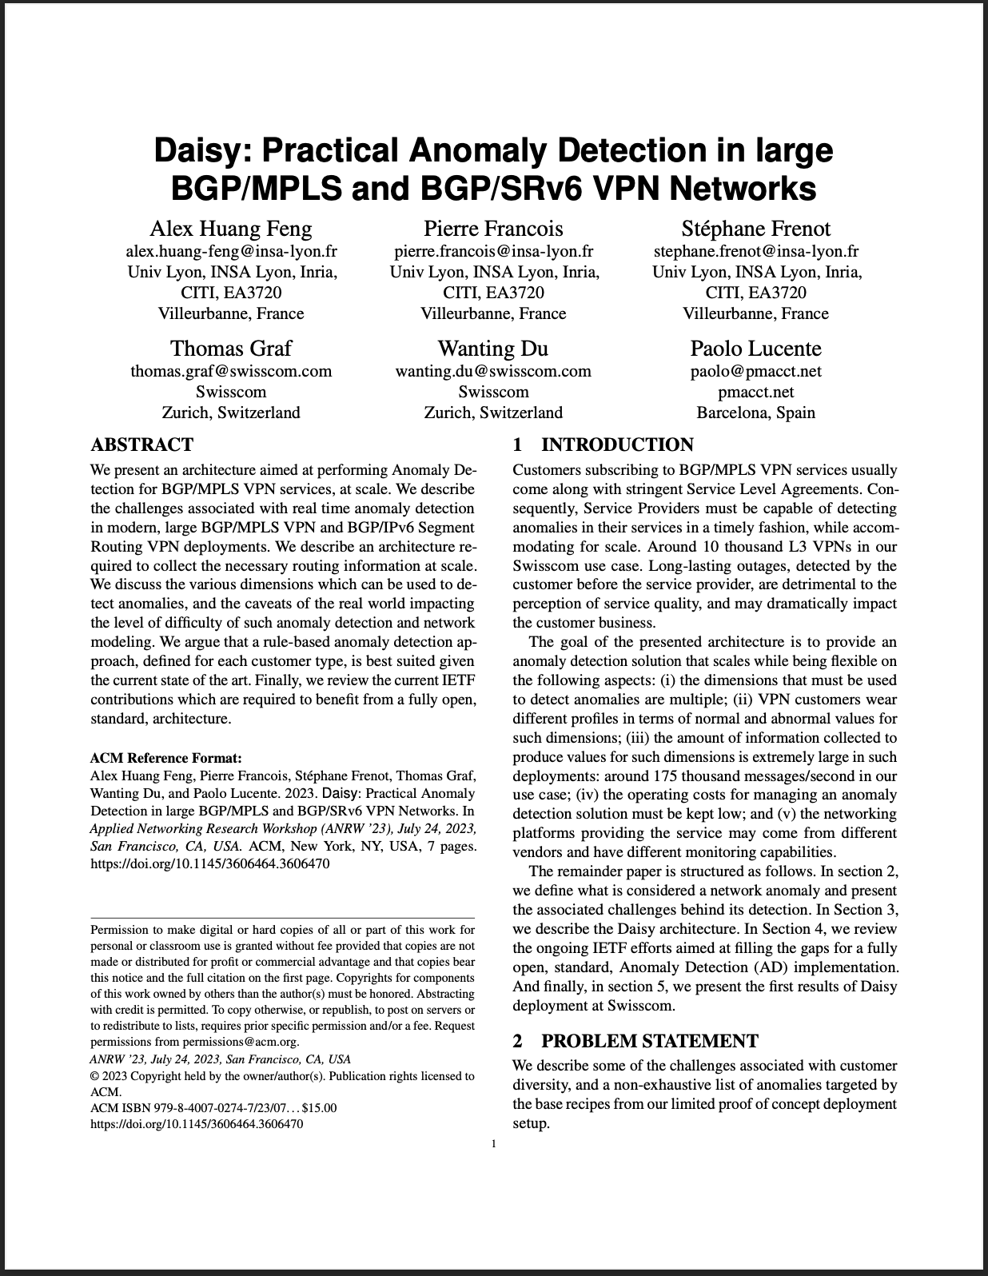
Relevant Papers for more Details
Paper “Practical Anomaly Detection in Internet Services: An ISP centric approach”
Published at AnNet Workshop (In conjunction with IEEE NOMS)
Seoul, South Korea (6–10 May 2024)
Open access: https://hal.science/hal-04655324
Paper “Daisy: Practical Anomaly Detection in large BGP/MPLS and BGP/SRv6 VPN Networks” published at ACM/IRTF ANRW’23
San Francisco, USA (24 July 2023)
Open access: http://hal.science/hal-04307611

