Slide 1
YANG push Integration
into Apache Kafka
Zhuoyao Lin
IETF 118 - NETCONF

Slide 2
TABLE OF CONTENT
YANG push Integration into Apache Kafka
I. Introduction
II. Problems
III. Proposal
Motivation
Overview
Problems and proposed solution
Chosen solution
Augmenting the ietf-yang-library

Slide 3
I. INTRODUCTION: Motivation
YANG push Integration into Apache Kafka
Challenge of Network Management
Networks are growing and being more and more complex to manage.
A costly task for network operators is to identify and correct network issues.
This involves three steps:
Detect that there is an issue,
Identify the cause of issue,
Correct the issue
Today, it is often the customer that notifies the operator about an issue. Then the cause detection and correction of an issue is done by expert engineers.
The challenge of the network management industry today, is to automate the detection, identification and correction of the problem, which is the frame we are trying to achieved.
The project will be deployed into production at the end.
Notes:
Global thing
Big network Intorduce new device in the network
Expert: expensive costly->customer identifies issue->pay service fee
In order to do this we need a system to detect issue->need reliable network telemetry

Slide 4
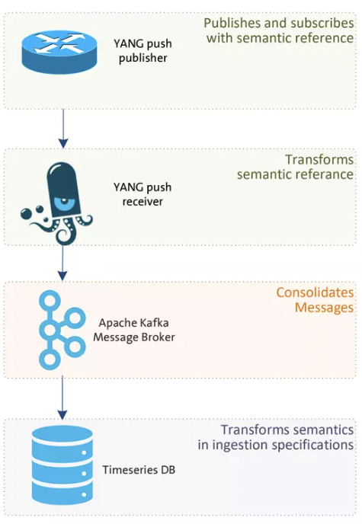
I. INTRODUCTION: Motivation
YANG push Integration into Apache Kafka
Network Analytics
Missing Semantics
Nowadays Network Analytics requires to correlate metrics from various sources to make accurate detection/prediction.
There are different sources and protocols to collect metrics. Here we focus on the YANG push protocol.
The metrics are the foundation to network analytics. We must have reliable and meaningful data collection.
In the TSDB, YANG model semantics might be lost. It is not clear how to interpret the data.
An example: Temperature
Data Mesh
The principle of Data Mesh is to present the data as a product. The quality of the data is guarantee by the team preparing the data.
In our case, the collected data comes with the YANG model.
Notes:
Job of network analytics: follow the previous slide: Data collection; reliability; There are different
Data mesh: not only the data but also the info of where data comes from etc
Need Reliable Data collection platform : kafka is a huge part
We need to avoid losing message
Keep semantics
Data mesh: data comes with a schema
For the data pipelein: We have all data in the TSDB but what have no infor about what this data mean
Tosolve: use data mesh in Colum 3
In the TSDB, we lost the context from the device.

Slide 5
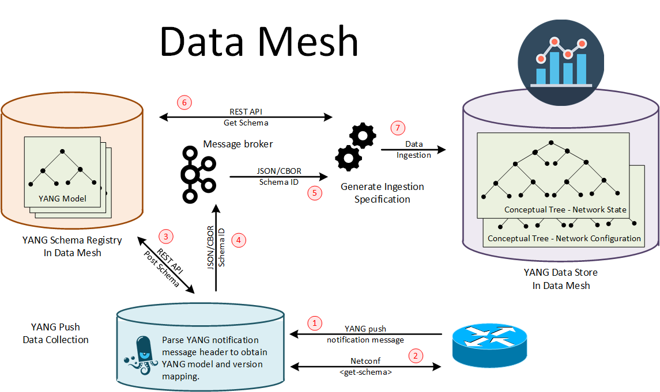
I. INTRODUCTION: Overview
YANG push Integration into Apache Kafka
YANG Schema Registry
A solution to keep the semantics is to have a schema registry. Each message in Kafka contains a schema id pointing to the original YANG model.
Schema will be used during serialization and deseralization.
YANG push Receiver
Apart from collecting YANG data, the receiver needs to be extended to register schema for YANG subscription.
This is the goal of libyangpush.
Notes:
Explain data mesh:
explain what’s schema registry;
in data mesh each message has a schema
Solution:
schema registry
YANG push receiver: encode decode validate
Explain the diagram at the beginning.

Slide 6
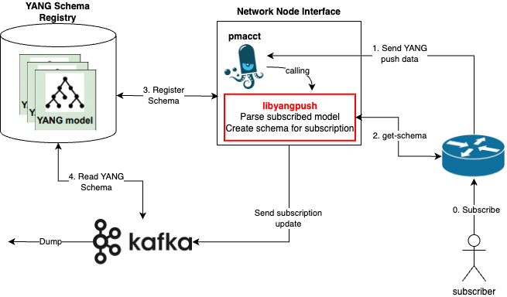
I. INTRODUCTION: Overview and Current State
YANG push Integration into Apache Kafka
pmacct: A multi-purpose Network Monitoring tool(https://github.com/pmacct/pmacct)
Schema registry: Confluent pluggable schema registry has been extended to natively support YANG.
YANG push:
1. Subscription to YANG Notifications for Datastore Updates - RFC 8641 2. draft-ietf-netconf-udp-notif-11 It is partially being supported in the device
Notes:
With more generic descript for each step
Message has sub_id->from the sub_id,
1. find out the schema
2. then get the full schema=> in YANG schema compose of multiple files; explain the dependency
3. register schema to obtain schema ;
Schema id<->sub_id
1.Find out what’s the schema for sub
2.
All methods->one slide
What is YANG->

Slide 7
TABLE OF CONTENT
YANG push Integration into Apache Kafka
II. Problems
II. Problems
III. Proposal
Motivation
Overview
Problems and proposed solution
Chosen solution
Augmenting the ietf-yang-library

Slide 8
II. PROBLEMS
YANG push Integration into Apache Kafka
Problem 1:
How to store YANG model in schema registry?
Problem 2:
How to know the subscribed model? (On the basis that the YANG push subscription is providing telemetry data)
Problem 3:
How to obtain the YANG model and its dependencies?
Notes:
Yang is a schema language
Pic+yang tree: explain the augment(ietf-ip), import(iana-if-type)
Change to text: minimize the tree
Receive this, don’t know how to interprete this message, we know only the original module, but we need more information.
Cannot interpret everthing with a signle model.
1.Import with external type
2. Augment with ietf-ip
3. Include and deviate has similar principle

Slide 9
II. PROBLEM 1: How to store YANG model in schema registry?
YANG push Integration into Apache Kafka
Simulate YANG data structure:
Schema Content <-> YANG model code
Schema Reference <-> YANG model dependency
Functionality of schema registry:
Validate YANG model and its dependencies relationship
Notes:
Yang is a schema language
Pic+yang tree: explain the augment(ietf-ip), import(iana-if-type)
Change to text: minimize the tree
Receive this, don’t know how to interprete this message, we know only the original module, but we need more information.
Cannot interpret everthing with a signle model.
1.Import with external type
2. Augment with ietf-ip
3. Include and deviate has similar principle

Slide 10
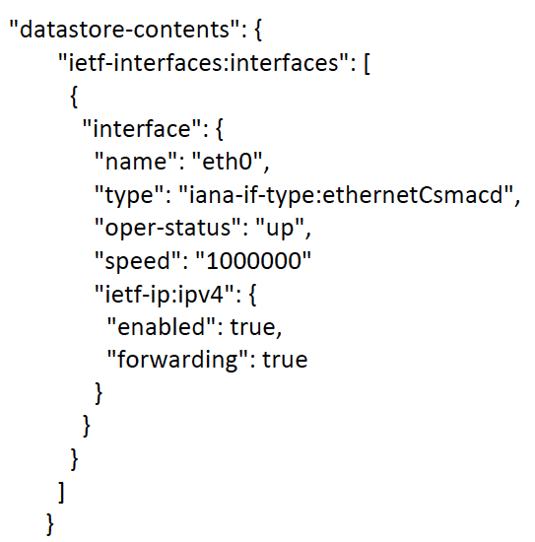
II. PROBLEM 2: How to know the subscribed model?
YANG push Integration into Apache Kafka
Solution 1:
Parse namespaces in the first YANG push message
It is possible to find the reverse dependency in this way.
Solution 2:
Use YANG to get subscription information:
<subscriptions>
<subscription>
<id>6666</id>
<datastore>ds:operational</datastore>
<datastore-xpath-filter>
/a-module:a
</datastore-xpath-filter>
<encoding>encode-xml</encoding>
<periodic>
<period>30000</period>
</periodic>
</subscription>
</subscriptions>
Subscribed YANG models can be known by parsing fields: datastore-xpath-filter or datastore-subtree-filter. The subscription is identified by a sub-id.
This information is exposed as YANG model. It can be obtain:
As a subscription. Subscription will be synced through the first push-update, and updated through the push-change-update(new added, edit, remove etc.)
Via NETCONF <get> operation. Send a <get> to obtain the same information.
Notes:
Introduce a bit
Summarize the challenge
Three solution in a sslide/just present this one/ a table
Pic name: there is YANG model to model subscription, subscribe the YANG model to get the subsription

Slide 11
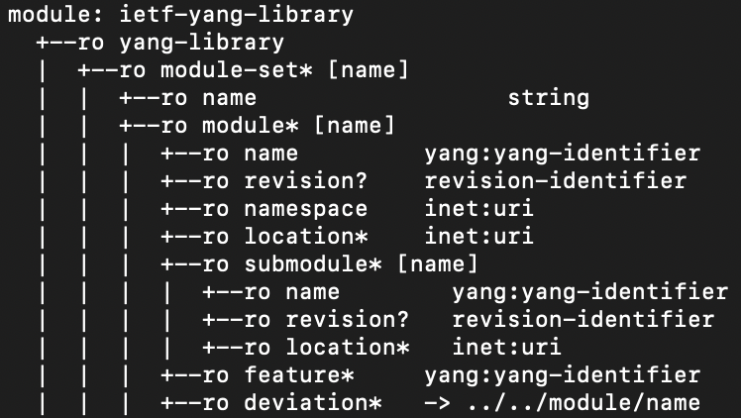
II. PROBLEM 3: How to obtain the YANG model and its dependencies?
YANG push Integration into Apache Kafka
There are two possible implementation solutions, each with pros and cons
Solution 1:
On-demand Downloading
The idea of on-demand downloading is to send get-schema request to get the YANG models based on the model name we obtain. For the main model in the subscription, we can obtain its name using method in “identify model”.
Import and include can parsed from the YANG code. Deviate can be known by subscribing to /ietf-yang-library:modules-state.
Pros: schema is update-to-date
Cons: Cannot handle augment
Solution 2:
Get-all-schema
The main idea of get-all-schemas is to get all models, store them in the disk, and analyse their full dependencies (import, include, deviate and augment) at the beginning of connection.
Pros: Can handle all dependencies
Cons: Downloading all schemas takes a lot of time

Slide 12
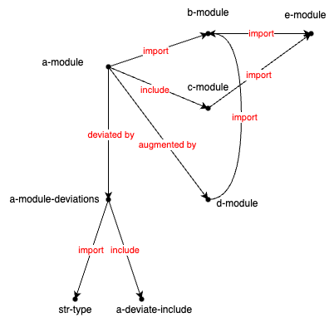
II. PROBLEM 3: How to obtain the YANG model and its dependencies?
YANG push Integration into Apache Kafka
The YANG source can be obtained via NETCONF <get-schema>.
Now we need to obtain the full schema and dependencies.
Algorithm for finding dependency
Expend on DFS to traverse the YANG model dependency tree, for the main model: sequentially search for its import, include, augment and deviate. For its dependency model, we only search for their import and include.
The model with the greatest depth will be put into register list first, then the top level module, in order to ensure that each register model has the dependency to refers to in the schema registry.
A hash map is used throughout the traverse with the index being djb2 hash of the model name to make sure that the model will not be put into register list twice.
Notes:
Second part
Import include augment deviate introduction in slide 8
Explain the registration order: for schema registry

Slide 13
II. PROBLEMS: An example for the chosen solution
YANG push Integration into Apache Kafka
module: a-module
+--rw a
+--rw a-instance* [name]
| +--rw name string
| +--rw state? string
+--rw d:y
+--rw d:y-leaf? e:e-enum
a-module
e-module
augment
import
d-module
<subscriptions>
<subscription>
<id>6666</id>
<datastore>ds:operational</datastore>
<datastore-xpath-filter>
/a-module:a
</datastore-xpath-filter>
<encoding>encode-xml</encoding>
<periodic>
<period>30000</period>
</periodic>
</subscription>
</subscriptions>
The schema for a-module require to register a-modules, e-module and d-module.
Schema registration Order:
a-module, reference{}
e-module, reference{}
d-module, reference{e-module, a-module}
a-module, reference{d-module, e-module}
Notes:
Second part
Import include augment deviate introduction in slide 8
Explain the registration order: for schema registry
Explain how we get the order.

Slide 14
TABLE OF CONTENT
YANG push Integration into Apache Kafka
I. Introduction
II. Problems
III. Proposal
Motivation
Overview
Problems and proposed solution
Chosen solution
Augmenting the ietf-yang-library

Slide 15
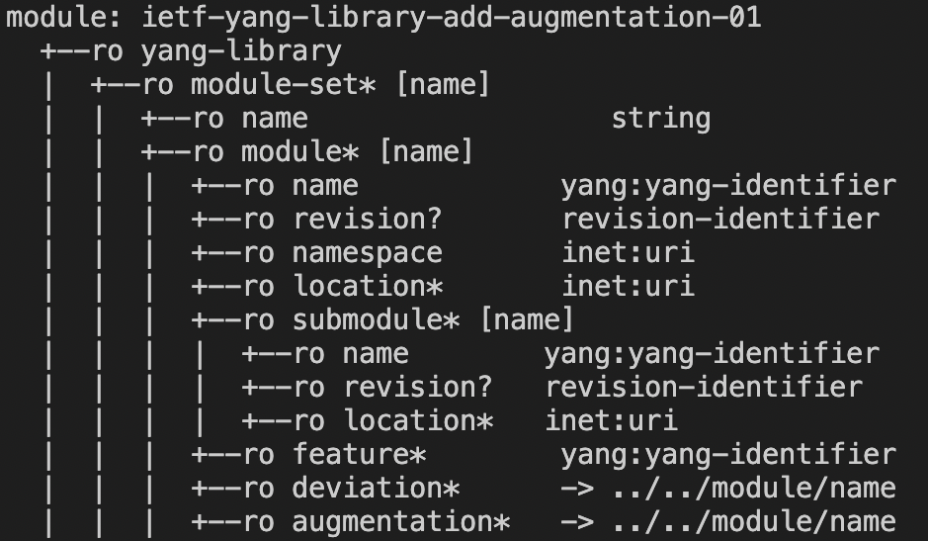
III. Proposal: Augmenting YANG model
ietf-yang-library
YANG push Integration into Apache Kafka
Problem 3:
How to obtain the YANG model and its dependencies?
Explanation:
As for the current chosen solution, we cannot invalidate the model stored in disk when they have been updated in the device. As a way to get the most up-to-date reverse dependency model, the on-demand downloading only support checking for deviations currently. However, it is reasonable to augment to make the ietf-yang-library to also support storing the augmentations.
In this way, we can get rid of having to use the get-all-schemas solution, while we can also handle the reverse dependencies easily.

Slide 16
IV. Conclusion & Future Work
YANG push Integration into Apache Kafka
Outcomes
Gaps to fill
Demo is presented during IETF117 Hackathon: https://wiki.ietf.org/en/meeting/117/hackathon#network-telemetry-yang-push-integration-into-apache-kafka
Demonstrate the interaction with a working YANG schema registry during the demo
Github repository for libyangpush:
https://github.com/network-analytics/libyangpush.git
Integration with pmacct
Test with device as YANG push becomes better supported
Augment YANG model ietf-yang-library to support the record of augmentations(to support the on-demand downloading)
Future Work
Industry Post:
https://github.com/graf3net/draft-daisy-kafka-yang-integration/blob/main/draft-daisy-kafka-yang-integration-05.md https://www.linkedin.com/pulse/network-analytics-ietf-115-london-thomas-graf/ https://www.linkedin.com/pulse/network-analytics-ietf-116-yokohama-thomas-graf/ https://www.linkedin.com/pulse/network-analytics-ietf-117-san-francisco-thomas-graf/
Deploy the functionalities into Swisscom lab.

