Slide 1
UDP-based Transport for Configured Subscriptions draft-ietf-netconf-udp-notif-11
UDP-based protocol for YANG notifications
to collect data from networking devices
G. Zheng, Huawei T. Zhou, Huawei
T. Graf, Swisscom
P. Francois, INSA-Lyon
A. Huang Feng, INSA-Lyon
E. Voit, Cisco Systems
26. October 2023

Slide 2
UDP-based Transport for Configured Subscriptions Status and Next Steps
Updates introduced in -11
Clarified version number and message length definition.
Message Publisher ID terminology aligned with latest update in terminology section of draft-ietf-netconf-distributed-notif-08.
Addressed UDP transport potential loss concerns in main applicability section. -> Requesting feedback from the working group and suggest that the netconf chairs reach out to the Transport Area Directorate (https://datatracker.ietf.org/group/tsvdir/email/) next and request an early review before the document is moving forward to working group last call.
Open points to be addressed next
Externalize generic YANG module for UDP clients. draft-ahuang-netconf-udp-client-server has been published.
G. Zheng, Huawei T. Zhou, Huawei
T. Graf, Swisscom
P. Francois, INSA-Lyon
A. Huang Feng, INSA-Lyon
E. Voit, Cisco Systems
26. October 2023

Slide 3
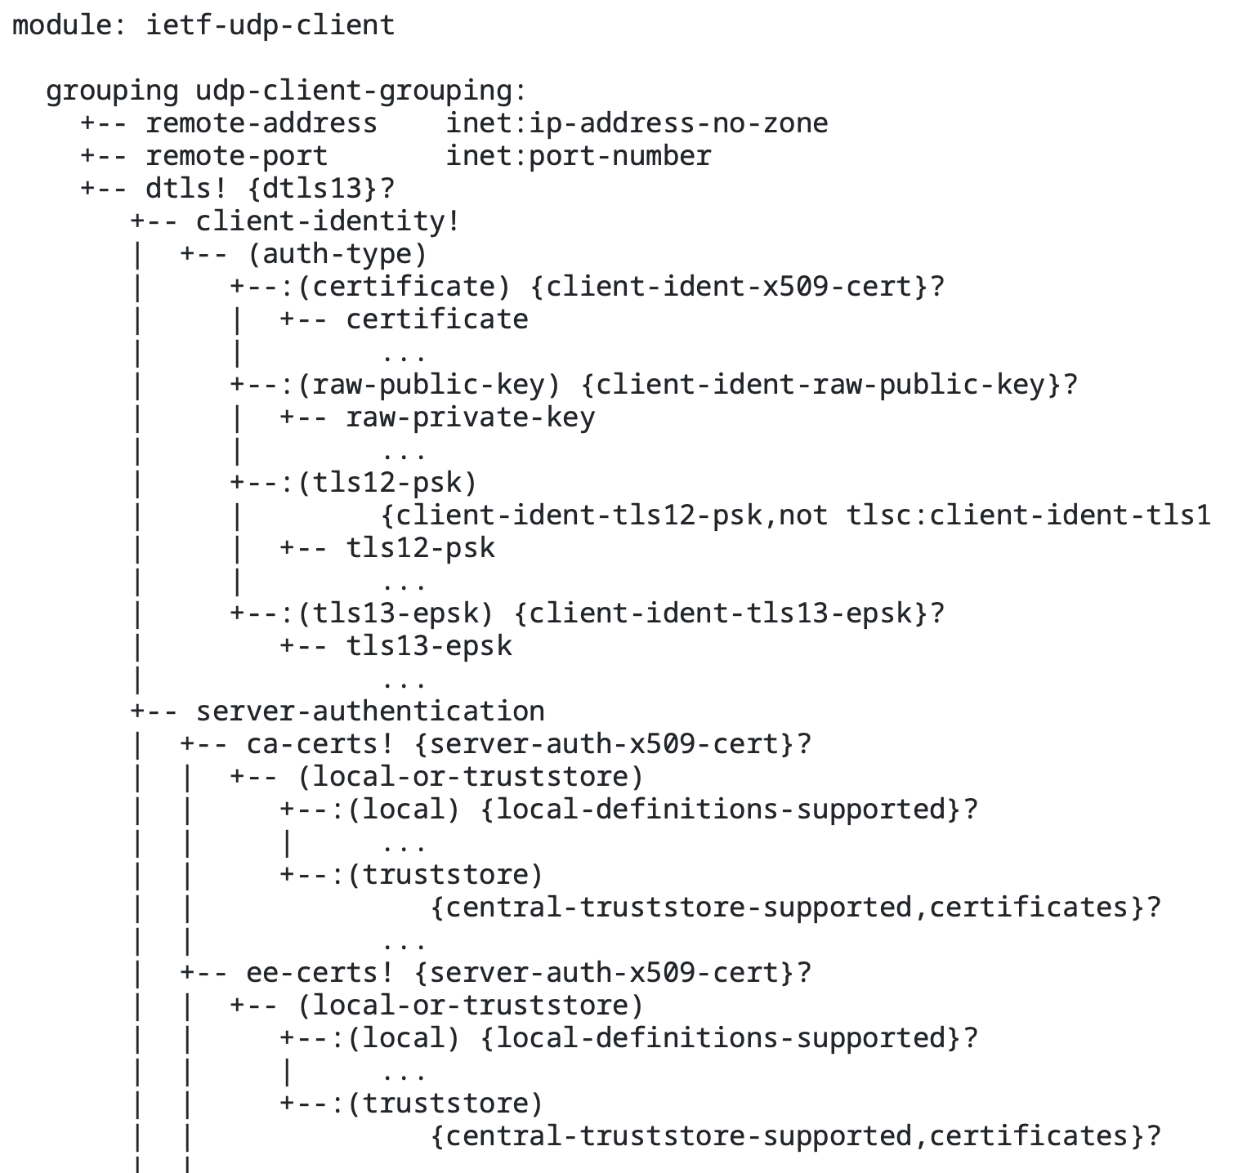
UDP-based Transport for Configured Subscriptions Current ML discussions
Current generic “ietf-udp-client” grouping
“ietf-udp-server” grouping?
Separate “dtls” container into another grouping?
G. Zheng, Huawei T. Zhou, Huawei
T. Graf, Swisscom
P. Francois, INSA-Lyon
A. Huang Feng, INSA-Lyon
P. Lucente, NTT
26. October 2023

