Slide 1
An Architecture for a Network Anomaly Detection Framework draft-netana-nmop-network-anomaly-architecture-00
Motivation and architecture of a Network Anomaly Detection Framework
and the relationship to other documents describing
network symptom semantics and network incident lifecycle
wanting.du@swisscom.com pierre.francois@insa-lyon.fr
thomas.graf@swisscom.com vincenzo.riccobene@huawei-partners.com
12. July 2024

Slide 2






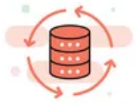

Data Mesh organizes Data in Organizations Enables Network Analytics use cases
Alert
Postmortem
RFC 8632
draft-netana-nmop-network-anomaly-semantics draft-netana-nmop-network-anomaly-lifecycle
Analytical Data
Network Device Trend Detection
Verify, Troubleshoot and Notify
Network Anomaly Detection
Network Visualization
Network SLI and SLO
Closed Loop Operation
draft-netana-nmop-network-anomaly-architecture
Operational Data
Network Data Collection
Network Telemetry
RFC 9232

Slide 3
What to monitor Which operational metrics are collected
« Network operators connect customers in routing tables called Connectivity Services »
« Network Telemetry (RFC 9232) describes how to collect data from all 3 network planes efficiently »

Slide 4



What does Network Anomaly Detection mean Monitor changes, called outliers, in networks
Answers
What changed and when, on which connectivity service, and how does it impact the customers?
Focuses
Provides meaningful connectivity service impact information before customer is aware of and support in root-cause analysis.
Data Mesh
Consumes operational real-time Forwarding Plane, Control Plane and Management Plane metrics and produces analytical alerts.
Direction
From connectivity service to network platform.
Network Anomaly Detection
For Connectivity Services, Network Anomaly Detection constantly monitors and detects any network or device topology change, along with their associated forwarding consequences for customers as outliers. Notifications are sent to the Network Operation Center before the customer is aware of service disruptions. It offers operational metrics for in-depth analysis, allowing to understand in which platform the problem originates and facilitates problem resolution.

Slide 5
What our motivation is Automate learn and improve
From network incidents postmortems we network operators learn and improve so does network anomaly detection and supervised and semi-supervised machine learning.
The more network incidents are observed, the more we can improve. With more incidents the postmortem process needs be automated, let's get organized first by defining human and machine-readable metadata semantics and annotate operational and analytical data.
Let's get further organized by exchanging standardized labeled network incident data among network operators, vendors and academia to collaborate on academic research.
« The community working on Network Anomaly Detection is probably the only group wishing for more network incidents »

Slide 6
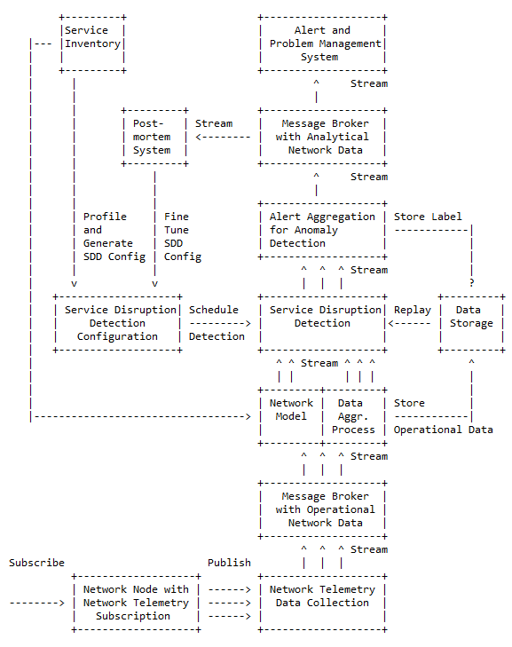
Elements of the Architecture
Service Inventory contains list of the connectivity services.
Service Disruption Detection processes aggregated network data to decide whether a service is degraded or not.
Service Disruption Detection Configuration defines the set of approaches that need to be applied to perform SDD.
Operational Data Collection manages network telemetry subscriptions and transforms data into message broker.
Operational Data Aggregation produces data upon which detection of a service disruption can be performed.
Network Modeling establishes knowledge of network relationships.
Data Profiling categorizes nondeterministic customer related data.
Detection Strategies for a profile a detection strategy is defined.
Machine Learning is commonly used to detect outliers or anomalies.
Storage some algorithms may relay on historical (aggregated) operational data to detect anomalies.
Alerting consolidates analytical insights and notifies.
Postmortem refines and stores the network anomaly and symptom labels into the Label Store.
Replaying to validate refined anomaly and symptom labels, historical operational data is replayed.

Slide 7
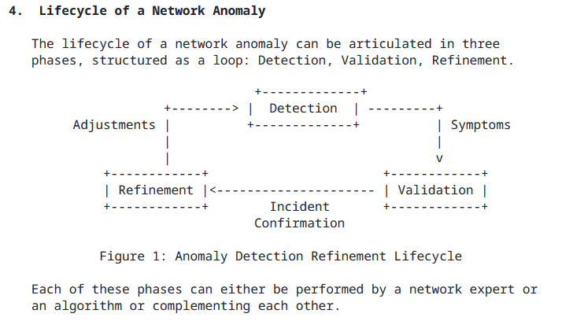
Experiment: Network Anomaly Lifecycle draft-netana-nmop-network-anomaly-lifecycle
Detection: The Network Anomaly Detection stage is about the continuous monitoring of the network through Network Telemetry RFC 9232 and the identification of symptoms.
Validation: Decides if the detected symptoms are signaling a real incident or if they are to be treated as false positives.
Refinement: Network operator performs detailed postmortem analysis of the network incident, collected Network Telemetry data and detected anomaly with the objective to identify useful adjustments in the Network Telemetry data collection and Anomaly Detection system.

Slide 8
Semantic Metadata Annotation for Network Anomaly Detection draft-netana-nmop-network-anomaly-semantics
module: ietf-symptom-semantic-metadata
+--rw symptom
+--rw id? yang:uuid
+--rw event-id? yang:uuid
+--rw description? string
+--rw start-time? yang:date-and-time
+--rw end-time? yang:date-and-time
+--rw confidence-score? score
+--rw concern-score? score
+--rw tags* [key]
| +--rw key string
| +--rw value string
+--rw (pattern)?
| +--:(drop)
| | +--rw drop empty
| +--:(spike)
| | +--rw spike empty
| +--:(mean-shift)
| | +--rw mean-shift empty
| +--:(seasonality-shift)
| | +--rw seasonality-shift empty
| +--:(trend)
| | +--rw trend empty
| +--:(other)
| +--rw other string
+--rw annotator
+--rw (annotator-type)
| +--:(human)
| | +--rw human empty
| +--:(algorithm)
| +--rw algorithm empty
+--rw name? string
Symptom ID and description uniquely identifies the detected anomaly. Event ID, start/end-time and confidence/concern-score uniquely identifies the network event with its start and end time, how confident the system identified the anomaly and how concerned an operator should be.
Tags allows to add customer information.
Pattern describes the identified pattern of the anomaly.
Annotator Name, Type, describes wherever the anomaly was detected by a human or algorithm and uniquely identifies the system who/which detected.

Slide 9
An Architecture for a Network Anomaly Detection Framework Status, Summary and Next steps
Status of draft-netana-nmop-network-anomaly-architecture-00
Initial document published. Requesting feedback from the working group.
Status of draft-netana-nmop-network-anomaly-semantics-02 and draft-netana-nmop-network-anomaly-lifecycle-03
Referred to draft-netana-nmop-network-anomaly-architecture as the main document for the architecture
Change the term source to annotator and updated the YANG modules accordingly
Added/updated terminology section with references to draft-ietf-nmop-terminology and draft-netana-nmop-network-anomaly-architecture
Moved data mesh and outlier detection section to draft-netana-nmop-network-anomaly-architecture
Next Steps
Request adoption for all 3 documents starting with draft-netana-nmop-network-anomaly-architecture-00.
In-depth coverage at NMOP interim meeting on September 11th.

Slide 10
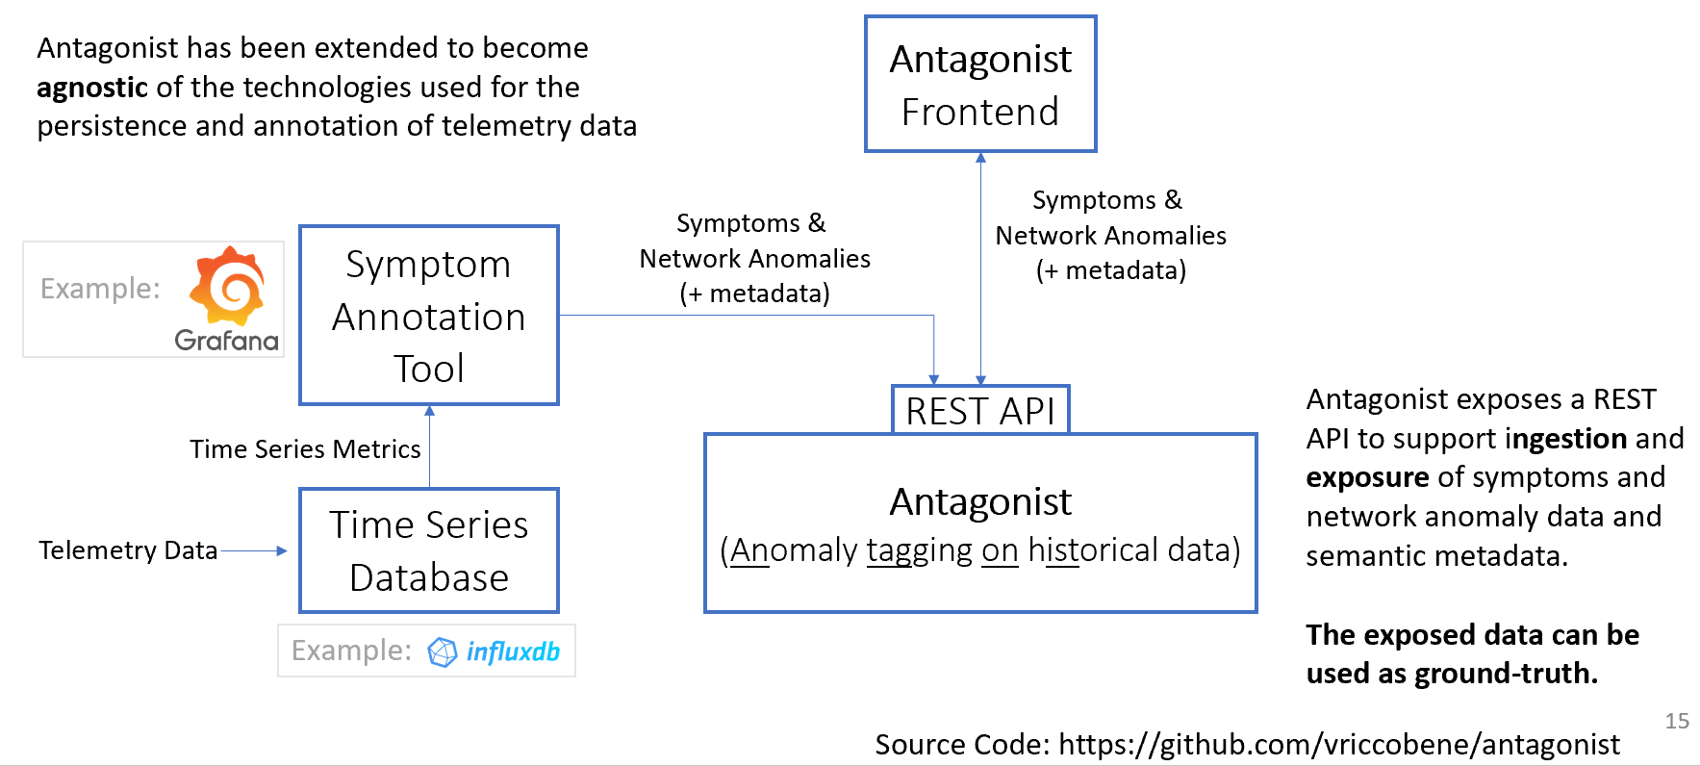
Hackathon – Software

Slide 11
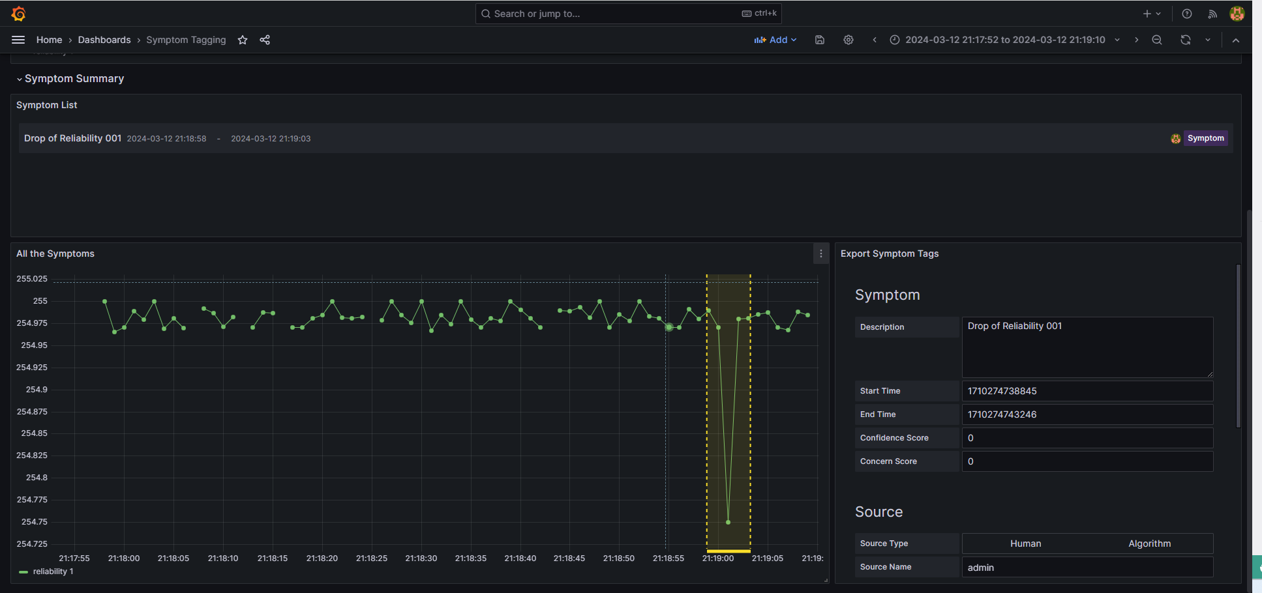
Antagonist – Labelling a Symptom

Slide 12
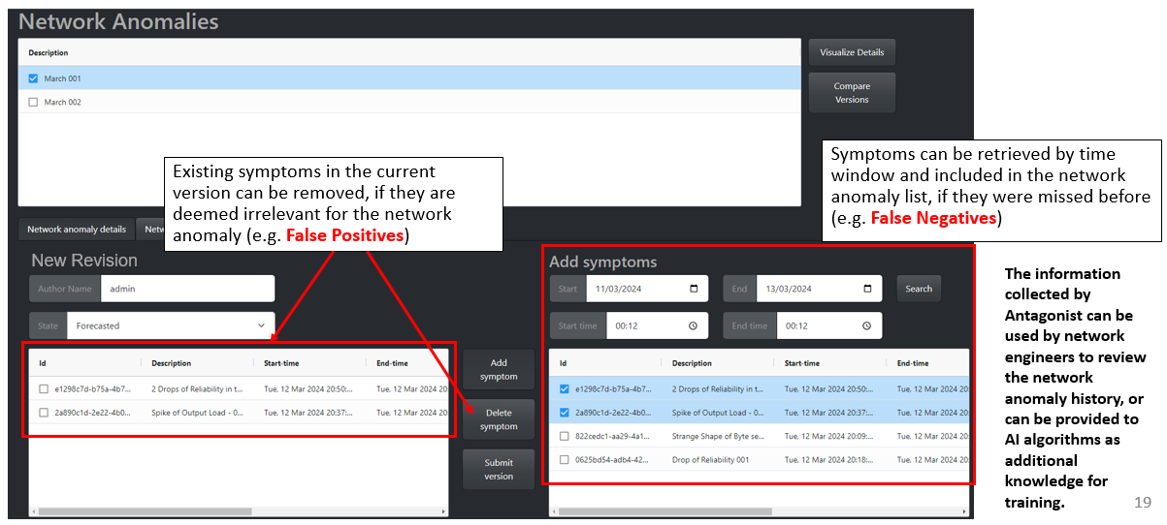
Antagonist – Exposure of the Network Anomalies

Slide 13
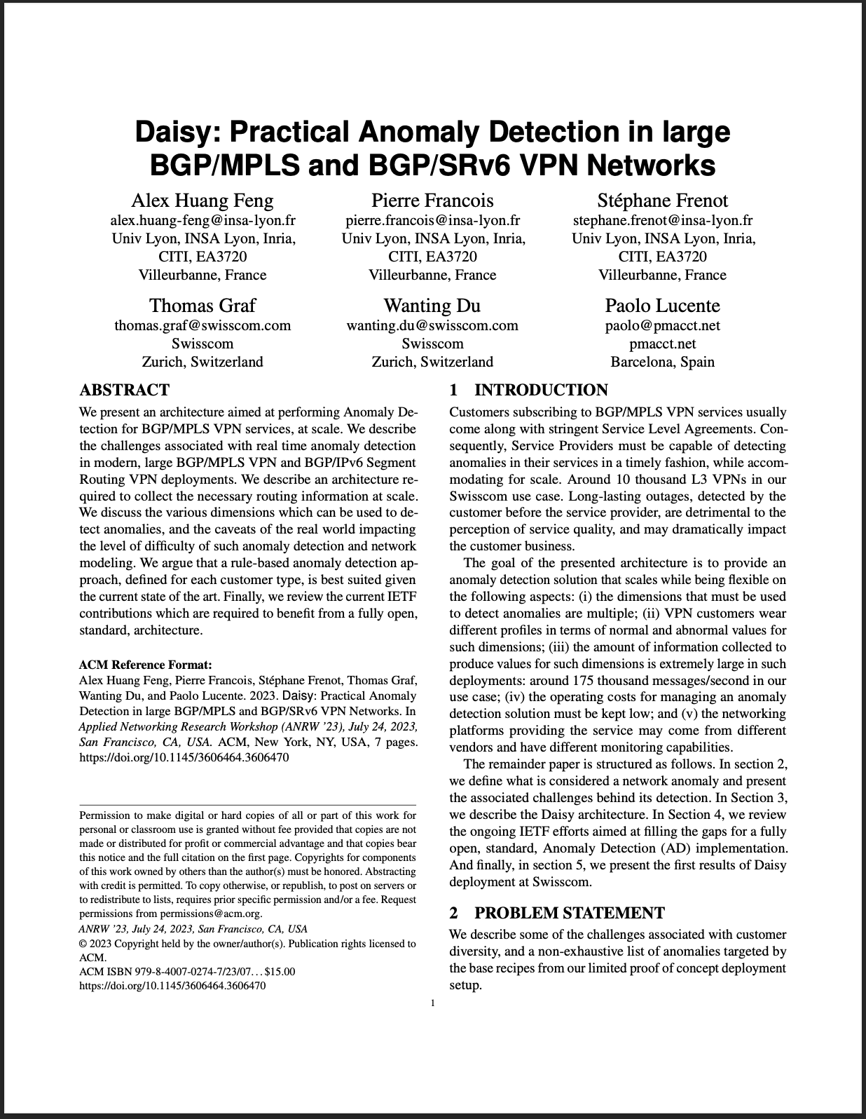
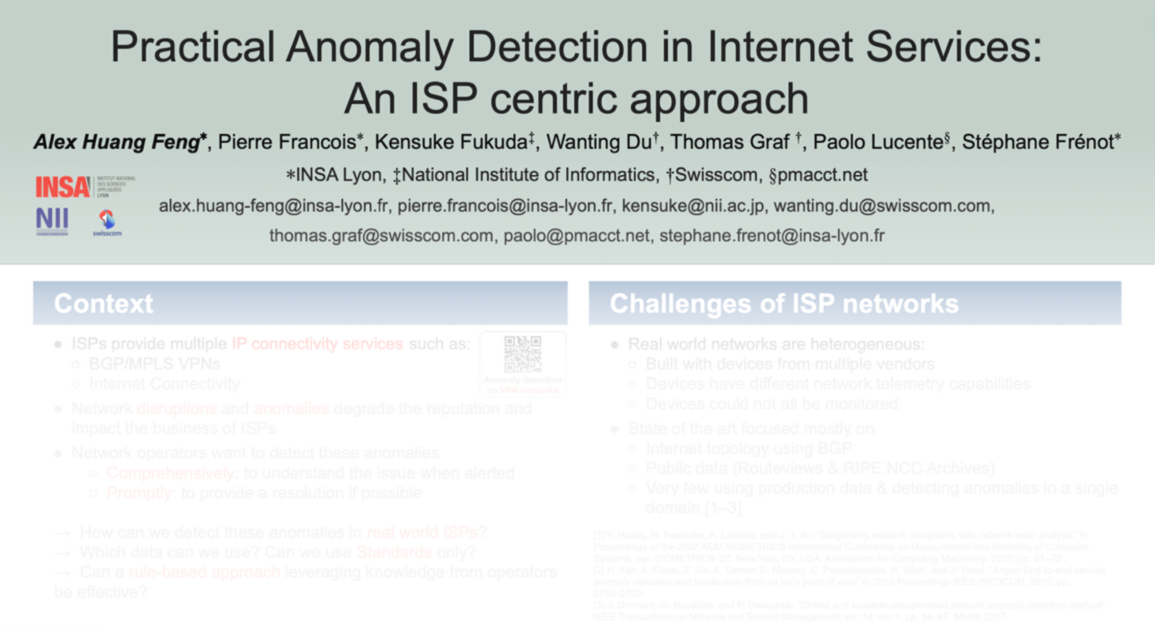
Relevant Papers for more Details
Paper “Practical Anomaly Detection in Internet Services: An ISP centric approach”
accepted at AnNet’24
(in conjunction with IEEE NOMS’24)
Seoul, Korea (6–10 May 2024)
[Will be presented as a poster the May 6th 2024]
Paper “Daisy: Practical Anomaly Detection in large BGP/MPLS and BGP/SRv6 VPN Networks” published at ACM/IRTF ANRW’23
San Francisco, USA (24 July 2023)
Open access: http://hal.science/hal-04307611

